Slide 1
Comprehensive Study of Education and Related Services on the White Earth Indian Reservation: Part II
April 23, 2013
Mahnomen, MN
Ximena Suarez-Sousa, Ph.D.
Boyd Bradbury, Ph.D.

Slide 2
Basics of the Study
2,800 students
140 parents
400 teachers
7 schools
Grades 3-12
Mixed-Methods
Early childhood, social services, health services

Slide 3
Quantitative Findings
Appraisal of Academic Influences Inventory
Outcome Variables (MCA II and MAP)
Predictor Variables (e.g. absenteeism, tardy, free and reduced lunch)
Predictive Models
Differences and similarities between the American Indian and White populations

Slide 4
1. Appraisal of Academic Influences Inventory (AAII) (Bradbury, 2006)
Constructs (9)
Structure
Computer-base
3-5 grades: Dichotomous items (Yes/No) (quantitative data)
6 – 12 grades: Scale items (1-5) (quantitative data)
All grades: Open ended questions (qualitative data)
Technical integrity
Validity
Reliability
CSV data from schools to MSUM (SPSS).

Slide 5
2. Outcome Variables
MCA Math
MCA Reading
MAP Math
MAP Reading
Cumulative GPA
3-5 and 6-12
2010-2011

Slide 6
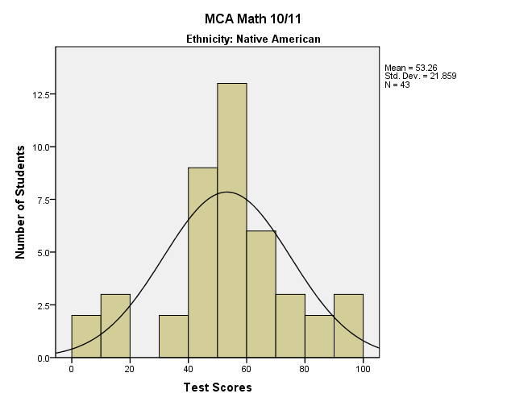
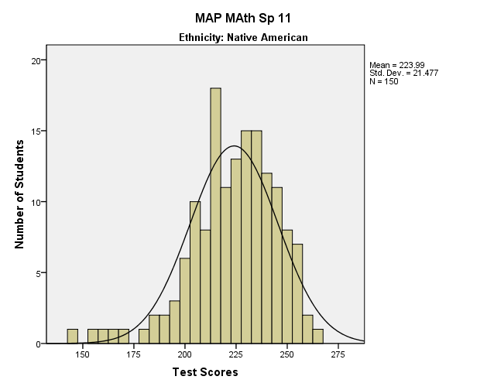
MCA – Math (3-5) MAP – Math (3 – 5)

Slide 7
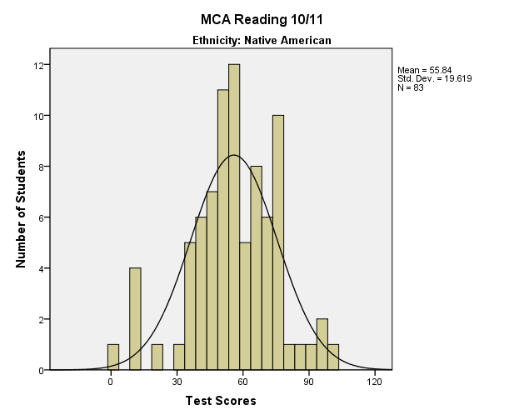
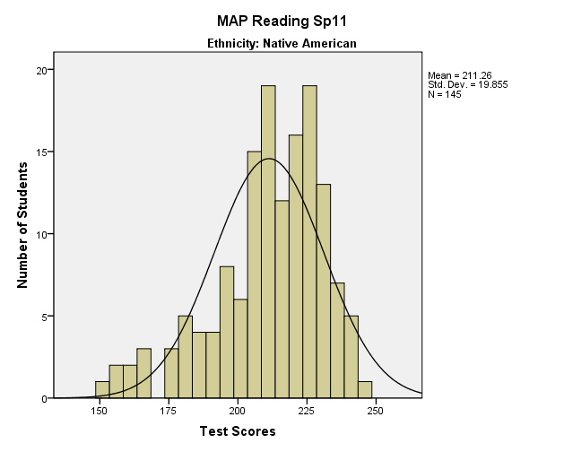
MCA – Reading (3-5) MAP – Reading (3-5)

Slide 8
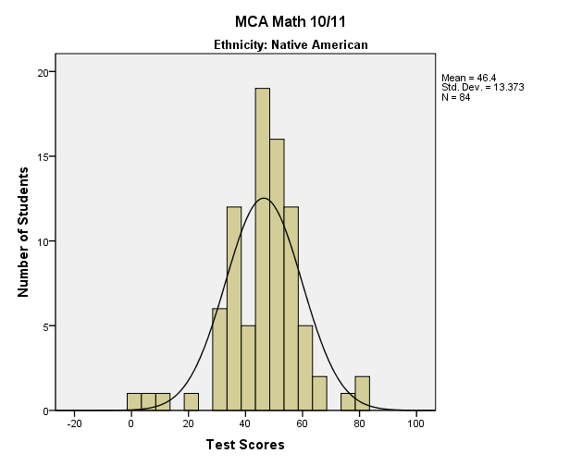
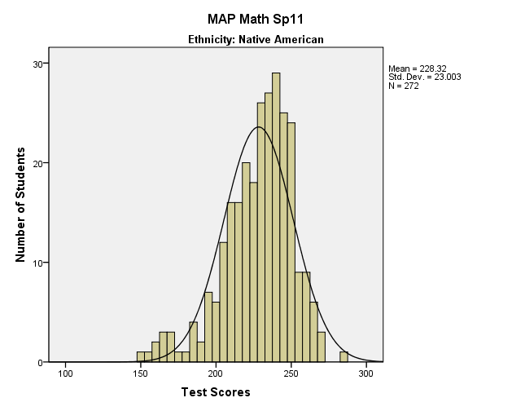
MCA – Math (6-12) MAP – Math (6-12)

Slide 9
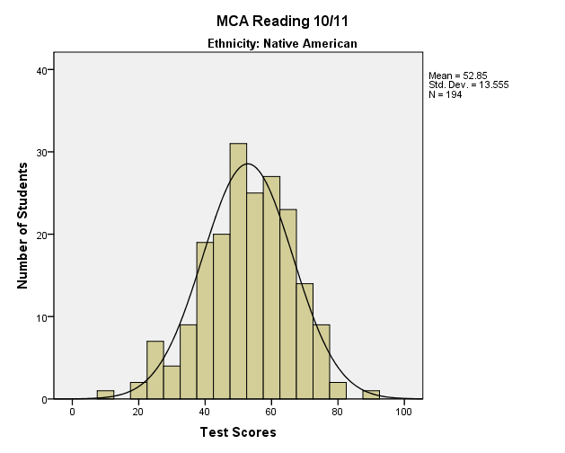
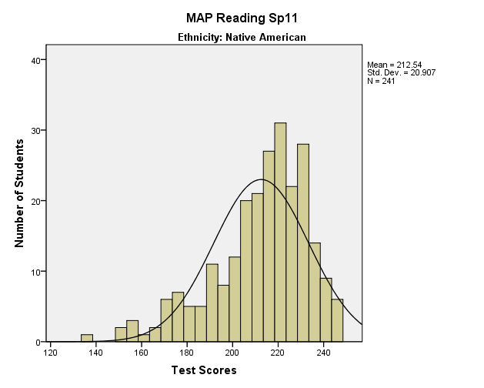
MCA – Reading (6-12) MAP – Reading (6-12)

Slide 10
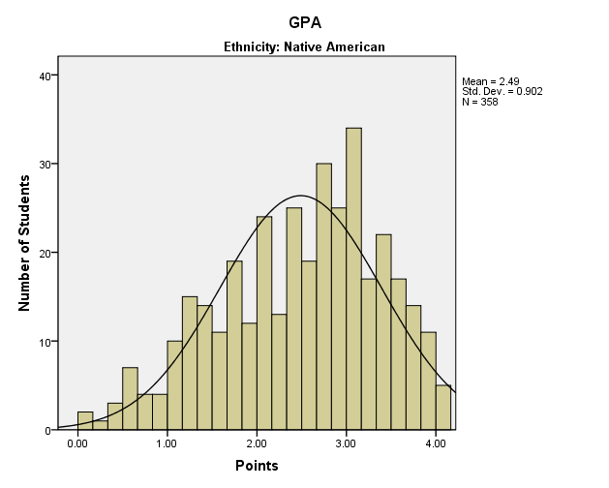
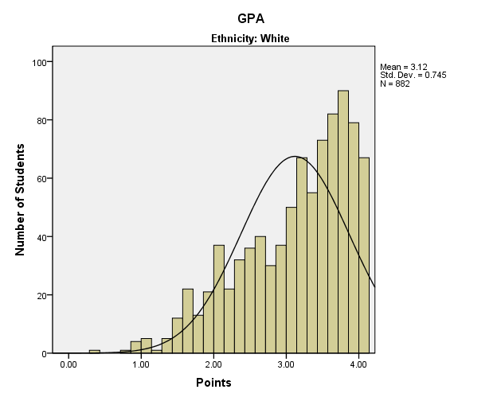
Cumulative GPA (6-12)

Slide 11
3. Predictor Variables
Demographic data
Lunch code
Absenteeism
Household configuration
Gender
among others
Appraisal Data (AAII)
Self (e.g., “I feel that I do my best in school”)
Parents and Home Environment (e.g., “I feel safe at home”
Own Behavior (e.g., “I get in trouble in school”)
Teacher (e.g., “My teacher makes sure that I know how to do something before moving onto something else”)
Relationships (e.g., “My classmates influence my behavior and performance in school more than any other thing”)
School Environment (e.g., “I feel safe at school”)

Slide 12
MCA – Math (3-5) MAP – Math (3 – 5)
MAP Math
Native
American
Tardiness
(.19*)
MAP Reading (.85**)
MCA Math
Native
American
MCA Reading (.84**)
Notes:
Discipline:
Absenteeism (.32**)
Relationships (-.30*)
Explain correlation
Effect size, again
+ = one increases, the other increases; one decreases, the other decreases
- = one increases, the other decreases
Differences by correlation size
Correlation is no causation, but significantly strong influence. These are areas for intervention

Slide 13
MCA – Reading (3-5) MAP – Reading (3-5)
MCA Reading
Native
American
Discipline
(.53**)
MCA Math (.84**)
MAP Reading
Native
American
Percept. of Teacher
(-.22*)
Tardiness
(.28**)
MAP Math (.85**)
Notes:
Tardiness:
Absenteeism (.54**)
Perception of Parents (-.24*)
Teacher:
Perception of Parents (.17*)
Perception of Own Behavior (.35**)
Perception of School Environment (.47**)
Perception of Relationships (.39**)

Slide 14
MCA – Math (6-12) MAP – Math (6-12)
MCA Math
NA
Percept
Parents
(.36**)
MCA Reading
(.73**)
MAP Math
NA
Percept. of Behavior
(.37**)
MAP Reading
(.85**)
MCA Reading
(.26**)

Slide 15
MCA – Reading (6-12) MAP – Reading (6-12)
MCA Reading
NA
MCA Math
(.78**)
MAP Math
(.26**)
MAP Reading
(.34**)
GPA
(.46**)
Discipline
(-.23*)
Absence
(-.28**)
Percep. of Parents
(.25**)
Percept. of School
(.32**)
Percept. of Behavior
(.40*)
MAP Reading
NA
MAP Math
(.85**)
MCA Reading
(.34**)
Percept. of Parents
.23**
Percept. of Behavior
(.47**)

Slide 16
Cumulative GPA (6-12)
Cum.
GPA
NA
MCA Reading
(.46**)
Discipline
(-.40**)
Percept. of Self
(.27**)
Percept. of Teacher
(.20*)
Absence
(-.52*)
Tardiness
-.42**
Percept. of School (.20**)
Percept. of Relats. (.19*)

Slide 17
4. Predictive Models
Multiple regression analysis
Cause effect relationships
Effect size

Slide 18
MCA – Math (3-5)
MCA Reading score (an increase increases MCA Math scores)
Perception of Own Behavior (an increase increases MCA Math scores)
Model fit R² = .43
The MCA Reading score and the student’s perception of own behavior can predict 43% of the changes on students’ MCA Math scores.
MCA – Reading (3-5)
MCA Math score (an increase increases MCA Reading scores)
Model fit R² = .48
The MCA Math score can predict 48% of the changes on students’ MCA Reading scores.

Slide 19
MAP – Math (3-5)
MAP Reading score (an increase increases MAP Math score)
Model fit R² = .80
The MAP Reading score can predict 80% of the changes on students’ MAP Math Reading scores.
MAP – Reading (3-5)
MAP Math score (an increase increases MAP Reading score)
Model fit R² = .80
The MAP Math score can predict 80% of the changes on students’ MAP Reading scores.

Slide 20
MCA – Math (6-12)
MCA Reading score (an increase increases MCA Math score)
Model fit R² = .53 (53%)
The MCA Reading score can predict 53% of the changes on students’ MCA Math scores.
MCA – Reading (6-12)
MCA Math score (an increase increases MCA Reading score)
Model fit R² = .34 (34%)
The MCA Math score can predict 34% of the changes on students’ MCA Reading scores.

Slide 21
MAP – Math (6-12)
MAP Reading score (an increase increases MAP Math score)
Model fit R² = .72 (72%)
The MAP Reading score can predict 72% of the changes on students’ MAP Math scores.
MAP – Reading (6-12)
MAP Math score (an increase increases MAP Reading score)
Model fit R² = .72 (72%)
The MAP Math score can predict 72% of the changes on students’ MAP Reading scores.

Slide 22
Cumulative GPA (6-12)
Number of absences (an increase reduces GPA)
Number of tardy days (an increase reduces GPA)
Perception of student’s own behavior (an increase increases GPA)
Model fit R² = .48 (48%)
These three variables have the power to predict 48% of the change on students’ cumulative GPA.

Slide 23
5. Differences and Similarities between Native American and White Students
Grades 3-5
Grades 6-12

Slide 24
3-5
Native American students:
Total: 278 (58% boys).
SES: 65% received free lunch
Family Structure: Approximately 25% lived with both biological parents.
White students:
Total: 608 (53% boys).
SES: 22% received free lunch
Family Structure: Approximately 66% lived with both biological parents.

Slide 25
3-5
White students:
Disciplinary data were significantly unavailable for this group and we cannot determine whether it was an omission in the data collection process or whether there were no data to report, in which case each student could have received a “zero” score on this variable; however, that was not the case. Approximately 18% of students were absent from school between 10 and 26 times.
Native American students:
While approximately half of this group had never been involved in disciplinary problems (46%), 13% had received a minimum of 6 and up to 36 disciplinary sanctions. Absenteeism or tardiness were not prevalent in this group, about 25% of students were absent from school between 10 and 41 times and 18% of them arrived late at school between 10 and 89 times.

Slide 26
3-5
Ethnicity Variable | Native American M | White M | t value and Level of Statistical Significance
MCA Math | 53.26 | 64.73 | t(315) = -3.307, p < .05
MCA Reading | 55.84 | 64.97 | t(625) = -3.844, p < .001
MAP Math | 223.99 | 212.04 | t(635) = -3.307, p < .05
MAP Reading | 211.26 | 202.52 | t(625) = 4.562, p < .001
Discipline | 3.75 | 1.33 | t(89) = 2.046, p < .05
Absenteeism | 7.03 | 5.73 | t(709) = 2.523, p < .05
Tardiness | 7.54 | 1.15 | t(615) = 5.168, p < .001
Perception of Self | 29.93 | 29.91 | Groups are equivalent
Perception of Teacher | 18.87 | 19.76 | t(569) = -4.605, p < .001
Perception of Parents | 11.89 | 12.73 | t(616) = -4.121, p < .001
Perception of Own Behavior | 7.14 | 7.64 | t(526) = 22.877, p < .05
Perception of School Environment | 7.58 | 7.67 | Groups are equivalent
Perception of Relationships | 12.76 | 13.16 | t(510) = -2.190, p < .05

Slide 27
6-12
Native American students:
Total: 485 (44% boys).
SES: 50% received free lunch
Family Structure: Approximately 33% lived with both biological parents.
White students:
Total: 1358 (51% boys).
SES: 23% received free lunch
Family Structure: Approximately 65% lived with both biological parents.

Slide 28
6-12
Native American students:
While approximately one third had never been involved in disciplinary problems (29.1%), 40% received a minimum of 6 and up to 39 disciplinary sanctions. Absenteeism and tardiness were prevalent in this group, about 50% of students were absent from school between 10 and 69 times and 46% of them arrived late at school between 10 and 251 times.
White students:
While approximately one third had never been involved in disciplinary problems (34.6%), 15% received a minimum of 6 and up to 16 disciplinary sanctions. Absenteeism and tardiness were prevalent in this group, about 54% of students were absent from school between 10 and 120 times and 27% of them arrived late at school between 10 and 223 times.

Slide 29
6-12
Ethnicity Variable | Native American M | White M | t value and Level of Statistical Significance
MCA Math | 46.40 | 51.77 | t(627) = -3.391, p < .001
MCA Reading | 52.85 | 59.98 | t(873) = -6.551, p < .001
MAP Math | 228.32 | 227.49 | Groups are equivalent
MAP Reading | 212.54 | 213.96 | Groups are equivalent
Discipline | 4.78 | 2.56 | t(248) = 3.319, p < .001
Absenteeism | 12.32 | 9.10 | t(1279) = 4.890, p < .001
Tardiness | 15.32 | 11.20 | t(1097) = 2.262, p < .05
Perception of Self | 16.35 | 16.58 | Groups are equivalent
Perception of Teacher | 58.23 | 60.17 | t(1523) = -3.629, p < .001
Perception of Parents | 73.86 | 83.49 | t(1293) = -10.214, p < .001
Perception of Own Behavior | 64.56 | 71.98 | t(369) = -6.967, p < .001
Perception of School Environment | 29.83 | 30.31 | Groups are equivalent
Perception of Relationships | 55.22 | 56.49 | t(1338) = -2.322, p < .05

Slide 30
Descriptive and Qualitative Findings
Parents, Teachers, and Students
Process of analysis
Narrative data
Generalized and specific themes to school districts

Slide 31
Descriptive and Qualitative Findings: Bagley (Self-Perception Construct)
Nearly ½ of children in grades 3-5 do not like reading.
3 times the dislike level of the overall White and AI populations
Pre-assessment
Leveling
Children find math to be very hard and don’t like it.
10% (1/3) higher dislike than the overall White and AI populations in grades 3-5
½ of students in grades 6-12 identify math as the hardest subject and 7 in 10 teachers agree.

Slide 32
Descriptive and Qualitative Findings: Bagley (Teacher Construct)
Utilize more technology in the classroom.
Only 46% of Bagley teachers agree that Bagley teachers use technology regularly in the classroom versus 68% of the overall teacher population.
A majority of students would agree to greater engagement when technology is used.
Professional development (technology integration) should occur.

Slide 33
Descriptive and Qualitative Findings: Bagley (School Environment Construct)
Fear of safety is a concern
14% of Bagley students in grades 6-12 feel unsafe (twice the rate of the overall student population)
Only 48% of Bagley students in grades 3-5 feel safe on school buses (10% lower than overall population and 20% lower than overall AI populations)
17% of Bagley students in grades 6-12 do not feel safe on the school bus (nearly double the overall and AI student populations)

Slide 34
Descriptive and Qualitative Findings: Bagley (Relationships Construct)
32% of students do not think that their classmates like them (a rate 6 times higher than the overall student population and 3.5 times higher than the overall AI student population)
The overall rates of students not liking their principals and principals not liking students based on student and teacher responses is 4 times the rate of the overall population responses.

Slide 35
Descriptive and Qualitative Findings: Bagley (Relationships Construct--Continued)
21% of students feel bullied in grades 3-5 and 20% of children in grades 6-12 either feel bullied or aren’t sure if they are bullied.
Only 55% of children in grades 3-5 report a responsible adult with whom they can visit if they have problems. This is far lower than the overall and AI populations, 85% and 76%, respectively.

Slide 36
Descriptive and Qualitative Findings: COL (Self-Perception Construct)
COL students in grades 3-12 identify reading as their least favorite subject (twice the rate of the overall AI population in grades 6-12).
43% of COL students in grades 6-12 view math as their hardest subject. About 1 in 4 students finds math easy, which is similar to overall student population statistics.

Slide 37
Descriptive and Qualitative Findings: COL (Teacher Construct)
COL students don’t believe teachers are concerned about their academic achievement at rates witnessed in other school districts
Only 58% of COL students in grades 3-5 their teachers care about them versus 97% of the overall AI student population.
27% of COL students in grades 6-12 versus 54% of the overall AI student population agree that teachers care about them.
22% of COL students in grades 6-12 disagree that teachers care about them versus 6% of the overall AI student population.

Slide 38
Descriptive and Qualitative Findings: COL (Teacher Construct--Continued)
COL teachers use technology at a much lower rate than the overall teacher population
26% of students in grades 3-5 agree that teachers used technology versus 91% of the overall grade 3-5 AI student population.
This figure increases to 44% in grades 6-12 versus 78% of the overall grade 6-12 AI student population.
46% of teachers at COL agree that they use technology versus 68% of the overall teacher population.
Professional development for technology usage and integration should be considered.

Slide 39
Descriptive and Qualitative Findings: COL (Parent/Home Life Construct)
Lower engagement of parents reported (e.g. checking on homework completion, watches TV rather than spending time with child).
Higher rates of physical aggression and yelling in home.
High percentage of children uncertain as to where they are staying at night (double the overall AI student population).

Slide 40
Descriptive and Qualitative Findings: COL (Student Behaviors Construct)
Only 17% of COL students participate in extracurricular activities, compared with 48% of the overall AI and 64% of the Caucasian populations.
Drug and alcohol usage is elevated—16% of students in grades 3-5 (4-8 times higher) and 27% in grades 6-12 (twice the rate of the overall AI student population and more than 5 times the overall rate of the Caucasian student population.

Slide 41
Descriptive and Qualitative Findings: COL (Student Behaviors Construct--Continued)
1 in 10 students skip school due to alcohol and drug usage.
Are more counselors needed?

Slide 42
Descriptive and Qualitative Findings: COL (School Environment Construct)
COL students do not like their school schedule as much as the overall student populations. Only 46% of COL students like their schedules as compared with 71% of the overall student population.

Slide 43
Descriptive and Qualitative Findings: COL (Relationships Construct)
Over 50% of the COL student population are don’t believe or uncertain if teachers like them.
37% of COL children in grades 3-5 feel bullied as compared with 25% of the overall AI and 20% of the Caucasian populations.

Slide 44
Descriptive and Qualitative Findings: DL (Student Behaviors Construct)
Up to 20% of children do not participate in extracurricular activities due to cost and transportation issues.
DL should consider reducing/eliminating participation fees and increasing extracurricular transportation to rural areas, especially for the AI student population.

Slide 45
Descriptive and Qualitative Findings: DL (Parents/Home Life Construct)
2/3 of teachers disagree that parents help their children regularly with homework. Students report diminished help in higher grades.
Homework should be used sparingly, and if used, students must be able to complete the work independently.
AI absence rates are twice that of Caucasian students. DL needs to establish a plan to increase AI student attendance and evaluate the effectiveness of that plan.

Slide 46
Descriptive and Qualitative Findings: DL (Mahnomen Self-Perception Construct)
Social studies as identified as a difficult, less favorite subject than we find in other schools.
Not one Mahnomen teacher identified himself/herself as the most important reason that kids do not succeed. However, 12% of Mahnomen parents identified teachers as the critical factor.

Slide 47
Descriptive and Qualitative Findings: DL (Mahnomen Teachers Construct)
An elevated percentage of Mahnomen students and parents do not believe that teachers set high expectations for students.
There is a sense of tension between some parents and teachers in regard to teacher effectiveness.
Mahnomen teachers underutilize technology in the classroom.

Slide 48
Descriptive and Qualitative Findings: DL (Mahnomen Student Behaviors Construct)
The percentage of Mahnomen students who complete homework on a regular basis is much lower (1 in 3) than is found in other schools. This figure increases to 1 in 2 when those who are “uncertain” are figured into the mix. Homework holds a lower value by students at Mahnomen.
Extracurricular activities are more valued by Mahnomen students than is found in other school districts.
Concern for student safety is elevated on school buses.

Slide 49
Descriptive and Qualitative Findings: DL (Relationships Construct)
Classmates appear to have a much greater influence on students than is found in other school districts.

Slide 50
Descriptive and Qualitative Findings: Naytahwaush (Self-Perception Construct)
Social studies is viewed as a difficult, less favorite subject than is found in most school districts.
Reading is popular in grades 3-5, but declines in grades 6-8.

Slide 51
Descriptive and Qualitative Findings: Naytahwaush (Teachers Construct)
Naytahwaush teachers enjoy a much better relationship with students and parents than is found in other school districts.
Naytahwaush teachers appear to do a better job with authentic education than is found in other school districts.

Slide 52
Descriptive and Qualitative Findings: Naytahwaush (Parents/Home Life Construct)
Between 8% and 14% of Naytahwaush students do not get help with homework.
The rate of parents preferring TV over time with their children is several times higher in Naytahwaush than is found in other school districts.
Naytahwaush children in grades 6-12 are left at home at a much higher rate than is found in other school districts.

Slide 53
Descriptive and Qualitative Findings: Naytahwaush (Parents/Home Life Construct--Continued)
Naytahwaush students have even less access to books than the overall AI student population, which has less access to books in the home than the Caucasian population.
There is an elevated concern for the home life in Naytahwaush.

Slide 54
Descriptive and Qualitative Findings: Naytahwaush (Student Behaviors Construct)
The percentage of students not completing homework is higher (1 in 3) in Naytahwaush than is found in most other districts.
Very few Naytahwaush students participate in extracurricular activities.
Free time usage is a concern. No students in grades 6-8 prefer reading over TV.

Slide 55
Descriptive and Qualitative Findings: Naytahwaush (School Environment Construct)
Naytahwaush students like school lunch more than students in most school districts.
Elevated concern for safety is present in school and on buses.

Slide 56
Descriptive and Qualitative Findings: Naytahwaush (Relationships Construct)
Naytahwaush students in grades 3-5 reported not liking their classmates or not being liked by classmates at a higher rate than the overall AI and Caucasian student populations.
Naytahwaush children report being bullied or not sure if they are bullied at a rate of more than 3 times that of the overall AI and Caucasian student populations. Two-thirds of parents report that students feel bullied at Naytahwaush.

Slide 57
Descriptive and Qualitative Findings: Naytahwaush (Relationships Construct--Continued)
Classmates influence other students at a rate higher than the overall student population.
Adults at Naytahwaush influence students at a rate twice that of the overall AI and Caucasian student populations.

Slide 58
Descriptive and Qualitative Findings: Pine Point (Self-Perception Construct)
Students, teachers, and parents believe that PP students are good at math.
Social studies and science are not viewed as easy for PP students.

Slide 59
Descriptive and Qualitative Findings: Pine Point (Teachers Construct)
PP teachers, students, and parents seem to enjoy an overall good relationship
Teachers at PP seem to do a better job with authentic education than most school districts.

Slide 60
Descriptive and Qualitative Findings: Pine Point (Parents/Home Life Construct)
Students at PP like homework as a means to learn at a much higher rate than the overall AI and Caucasian student populations.
PP children report violent behavior at a much higher rate than children in other school districts.
PP children report parental lack of interest in spending time with them at night at a much higher rate than the other school districts.
PP children have far less access to books than is found in most other school districts.

Slide 61
Descriptive and Qualitative Findings: Pine Point (Student Behaviors Construct)
A majority of PP children do not participate in extracurricular activities.
PP children spend far more free time watching TV and playing violent video games than do other student populations in this study.

Slide 62
Descriptive and Qualitative Findings: Pine Point (School Environment Construct)
A larger percentage of students are dissatisfied with their schedules than is found in other school districts.
Concern for safety at school and on buses is reported at a higher rate for PP students than found in most other school districts.

Slide 63
Descriptive and Qualitative Findings: Pine Point (Relationships Construct)
PP students in all grades report not liking their classmates or classmates not liking them at a higher rate than the overall Caucasian and AI student populations. School officials should work to formalize what would be known as hidden curriculum.
PP students report feeling bullied and/or not sure if they are bullied at a rate of approximately 3 times that of the overall Caucasian and AI student populations

Slide 64
Descriptive and Qualitative Findings: Pine Point (Relationships Construct--Continued)
Classmates influence PP students at a rate higher than the overall Caucasian and AI student populations.
Adults in school at PP influence student behavior at a rate much higher than the overall Caucasian and AI student populations.

Slide 65
Descriptive and Qualitative Findings: WOWE (Self-Perception Construct)
Although math is a concern for the overall Caucasian and AI populations, many students at W like math and/or feel that they are good at it. However, about 1/3 of the W student population find math to be hard.
Social studies and science are not viewed as easy for children at W.

Slide 66
Descriptive and Qualitative Findings: WOWE (Parents/Home Life Construct)
Although most students report that their parents help them with homework, up to 1 in 4 students at W would disagree.
Far fewer AI children have access to books than do White children. In addition, the overall W student population would appear to have less access to books in the home than do students populations associated with other schools in this study.

Slide 67
Descriptive and Qualitative Findings: WOWE (Student Behaviors Construct)
The percentage of W students who do not complete homework on a regular basis is much higher than the overall AI and Caucasian populations.
The lack of participation in extracurricular activities appears to be tied to limited opportunities, a lack of transportation, and a lack of money.
W children prefer spending more time on the subject during the school day than doing homework.

Slide 68
Descriptive and Qualitative Findings: WOWE (School Environment Construct)
Although a fear for safety is of concern to a limited percentage of the student population, W students report this concern at a higher rate (up to 1/3 do not feel safe or are uncertain) both in school and on buses.
A far larger percentage of W children do not like their schedules during the day, as compared with the overall Caucasian and AI student populations

Slide 69
Descriptive and Qualitative Findings: WOWE (Relationships Construct)
W students do not like their teachers or are uncertain as to whether they like their teachers at the grades 6-12 levels at a rate (40%) much higher than the overall Caucasian and AI student populations. In addition, around 15% of children report that they do not like paraprofessionals or are not liked by paraprofessionals.

Slide 70
Recommendations: Quantitative Data
Administrators:
Explore differences between the MCA and MAP tests (e.g., structure, content, surrounding events at the time of testing)
Be aware that MAP scores do not predict MCA scores
Improve academic performance data collection system
Ensure immediate access of test results data to teachers and parents
Consider developing self-enhancement interventions for students, young students in particular
Evaluate the current interventions for absenteeism and tardiness

Slide 71
Teachers Elementary Grades:
Students in the 3rd grade need reinforcement in math (MCA, partially meeting standards)
Students in 3rd and 5th grade need reinforcement in reading (MCA, partially meeting standards)
Analyze level of academic challenge (differentiated instruction) as higher levels of disciplinary problems are observed among students with higher reading performances. Adjust expectations.
Likewise, higher academic progress in math is observed among students with higher rates of tardiness. Adjust expectations
Be aware that disciplinary problems are found among students who are absent more frequently and have a negative perception of relationships in school

Slide 72
Be aware that higher academic achieving young students have a negative appraisal of their teachers
Reinforce academic performance in the early grades, support transition to middle and secondary grades
Develop activities that support the improvement of young student’s perception of own behavior
Do not use MAP test as predictor of MCA performance
Curriculum-Based Measurements

Slide 73
Teachers Middle and Secondary Grades
Develop an intervention that impacts on students perception of:
Own behavior
School environment
Relationships (i.e., students with peers, students with teachers, students with administrators)
Parents
as these are associated with academic performance
Place special attention to students in 7th and 12th grades as 2/3 of these students are failing the MCA test in math
Be aware that students’ positive perceptions of parents and home environment is associated to better academic performance
Be aware that absenteeism and disciplinary problems are more prevalent among students showing lower reading performance

Slide 74
Develop awareness of the association that a positive perception of own behavior has with academic performance. To great extent students’ perception of self is influenced by what students hear teachers say about their students.

Slide 75
Parents of Young Students:
Be aware that even though absenteeism and tardiness at this young age is positively associated with academic achievement, absenteeism and tardiness have a negative association to appraisal of parents and home life

Slide 76
Parents of Older Students:
Develop awareness of the strong association that a positive parental perception has with academic performance
Develop awareness of the association that a positive perception of school has on academic performance. To great extent school perception is influenced by what students hear parents say about school.
Be aware that absenteeism, tardiness, and disciplinary problems are observed among students who are in need of significant academic improvement

Slide 77
Recommendations: Descriptive and Qualitative Data

Slide 78
Recommendations: Qualitative (Self-perception Construct: General)
Reading: Pre-assessment is critical at all levels.
Leveling
Differentiation
Math is found to be difficult by many students, and it is the least-liked subject overall.
Alternative approaches to teaching math
Authentic education and assessment
Allow re-takes of summative assessments (applicable to all subjects)
AI parents do not view attendance as critical to academic success as do White parents.
Work with AI parents to get their children to school on time.

Slide 79
Recommendations: Qualitative (Teacher Construct: General)
Teacher capacity to explain things was identified as critical.
Uniform methodological approach across all grades and subjects.
Madeline Hunter’s direct instruction is recommended.
Standards (outcomes)
Anticipatory Set (Hook)
Teaching (input, modeling, checking for understanding)
Guided Practice/Monitoring
Closure
Independent Practice

Slide 80
Recommendations: Qualitative (Teacher Construct: General)
There must be a cultural shift in thinking among teachers.
Teachers do not see themselves as a critical factor in student underachievement.
School administrators must stand accountable for teacher implementation of recommendations.
Evaluations
Professional Development

Slide 81
Recommendations: Qualitative (Parents/Home Life Construct: General)
All children should have access to breakfast, regardless of free/reduced lunch status.
Get books into the homes of American Indian children.
Increase teacher/parent communication, especially with American Indian population.

Slide 82
Recommendations: Qualitative (Student Behavior Construct: General)
Homework should be assigned sparingly
Up to 1/3 of students do not complete homework when it is assigned.
A majority of teachers would disagree that most parents help their children with homework or check for completion.
Extracurricular fees should be reduced or eliminated.
Up to 1 in 5 children do not participate due to cost and transportation.

Slide 83
Recommendations: Qualitative (School Environment Construct: General)
Spend more time on core subjects in school.
Children are tired in school.
Work with parents to encourage consistent sleep schedules.
Students should complete more work in class, under the guidance of a licensed teacher.
Many children do not or cannot do homework that is assigned due to various reasons, including poor pedagogy.
A majority of students both prefer and feel that they would learn more if they could complete work under the guidance of a teacher as opposed to homework.

Slide 84
Final Thoughts

Slide 85
Contact Information
Ximena Suarez-Sousa, Ph.D., 1104 7th Avenue South Moorhead, MN 56563, 218-477-2095, suarez@mnstate.edu
Boyd Bradbury, Ph.D., 1104 7th Avenue South Moorhead, MN 56563, 218-477-2095, bradbury@mnstate.edu

