Slide 1
Effects of Attractiveness on Guilt Perception
First M. Last
Minnesota State University Moorhead

Slide 2
Problems
How do people determine “who looks guilty”
How are first impressions influenced by attractiveness
How does attraction and its associated positive traits influence guilt perception
How does determination of guilt change when faced with a choice between attractive and unattractive

Slide 3
Background - Theories
“What is Beautiful is Good”
Dion, Berscheid & Walster, 1971
Attractiveness Bias
Stereotype that attractive individuals are also good people
Present in other countries and is similar between cultures (Olson & Marshuetz, 2005)
Has a direct relationship to social ideals
Exists between both male and females (Talamas, Mavor & Perret, 2016)
Reliant on first impressions and resulting judgements
Reverse Attribution Bias

Slide 4
Background – First Impressions
Physical attractiveness serves as a cue to the health, level of genetic fitness, and fertility of potential partners
Agthe, Strobel, Sporrle, Pfundmair & Maner, 2016
Attractiveness is the most accessible characteristic when forming first impressions
Dion, Berschied & Walster, 1971
Attractiveness and other survival like traits (Dominance, warmth, threat) are determined in as little as 39ms
Bar, Neta & Linz, 2006

Slide 5
Background – Guilt Perception
Attractive people are assigned other positive traits such as trustworthiness and honesty while unattractice individuals are not
Sigall & Ostrove (1975) study found that attractive people are liked significantly more than unattractive people
Leventhal & Krate (1977) study found attractive defendants were found guilty less often than unattractive defendants
Gap in research – no side by side comparisons have been done

Slide 6
Hypotheses
Unattractive suspects will be chosen as guilty significantly more often than attractive suspects when compared side by side
Participant gender compared to suspect gender will influence how strong the attractiveness bias is, with same-sex participants and suspects showing weaker bias effects than opposite-sex participants and suspects

Slide 7
Participants
50 or more MSUM undergraduate psychology students
(18-56 years old)
Volunteer based recruitment
Sign up sheet on
Blue slip and extra credit incentive
All participants will be treated according to the American Psychological Association (APA) standards

Slide 8
Design
A 2(gender of the suspect) by 2 (attractiveness condition) within subjects factorial design
Each independent variable has 2 levels
Gender of suspect: Male or Female
Attractiveness condition: Attractive or Unattractive
Dependent measure is the participants choice between the attractive and unattractive suspect as guilty

Slide 9
Materials
A pair of colored images of either 2 Caucasian males or 2 Caucasian females
Each pair will consist of 1 attractive suspect and 1 unattractive suspect
A Crime report summarizing an armed robbery
All materials will be exactly the same for each participant
Each conditions material will be presented in a manila file folder

Slide 10
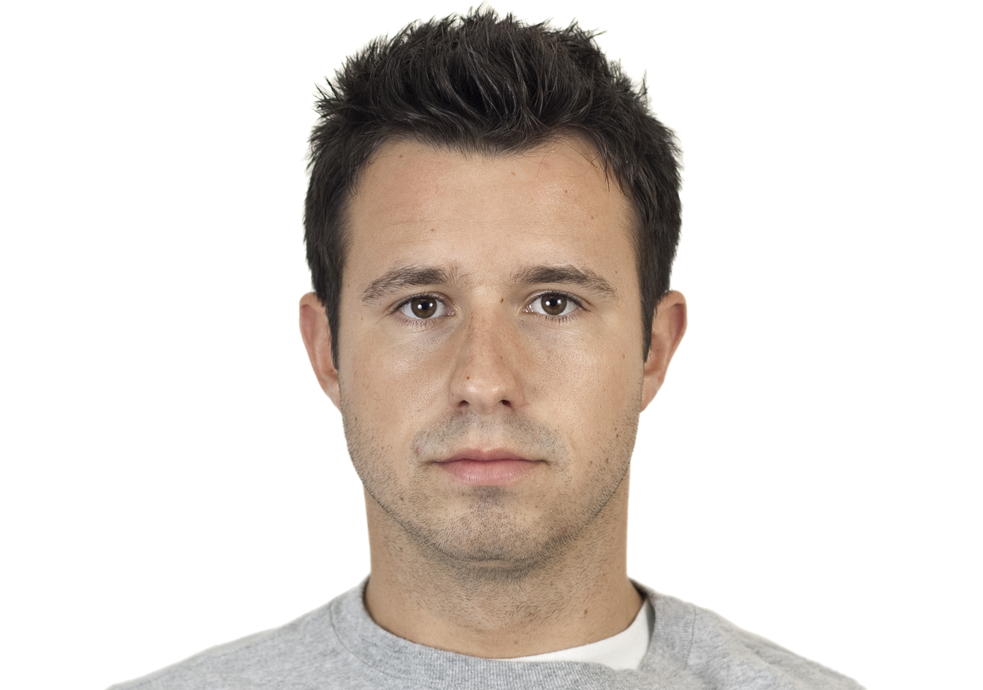
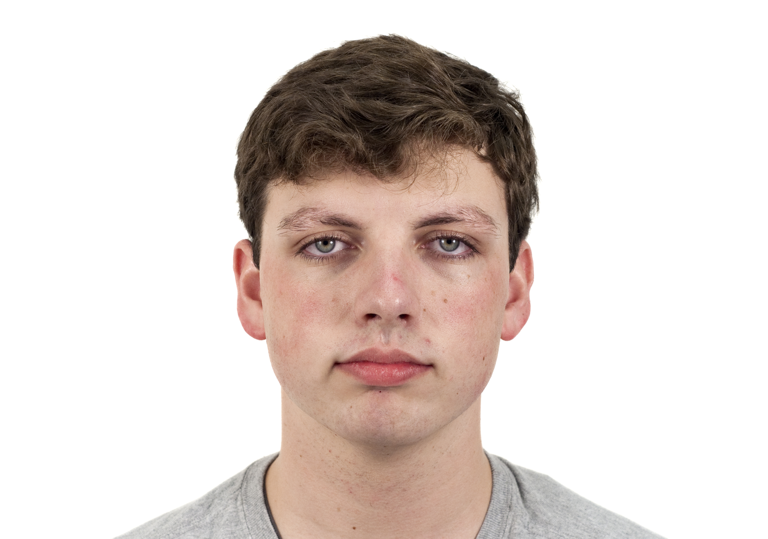
Male Suspects

Slide 11
Crime Report
“On March 13th, 2018, at approximately 21:38, one unidentified male entered a Tesoro convenience store and stole $368 from the register at gunpoint...witness described the suspect as white, wearing a black hoodie, jeans and a black ski-mask”

Slide 12
Procedure
Told instructions and asked to fill out a brief demographic survey
Testing will take place on 3rd floor Bridges Hall
Participants will be tested one at a time in a private room with the researcher absent
Participants will be randomly assigned to each of the two suspect gender conditions to complete first before given the other condition next
Participants will be instructed to Read crime report first, then view faces and assign a guilty title to one of the two faces
Debriefed, answer any questions, give blue slip, and thank them

Slide 13
Proposed Results
Descriptive Statistics
Guilty = a value of 1 assigned to the image
Not guilty = a value of 0 assigned to the image
The mean and sum of results for each condition and level of the independent variables will be obtained
Inferential Statistics
Two-way within subjects ANOVA
Chi-square test for independence

Slide 14
Questions?

