Slide 1
10
The Nonexperimental and Quasi-Experimental Strategies

Slide 2
10.1 Nonexperimental and Quasi-Experimental Research Strategies
The structure of nonexperimental and quasi-experimental designs
The distinction between the two types of designs is the degree to which the research strategy limits confounding variables and controls threats to internal validity
A nonexperimental design makes little or no attempt to minimize threats
A quasi-experimental design makes some attempt to minimize threats to internal validity—is almost, but not quite, a true experiment

Slide 3
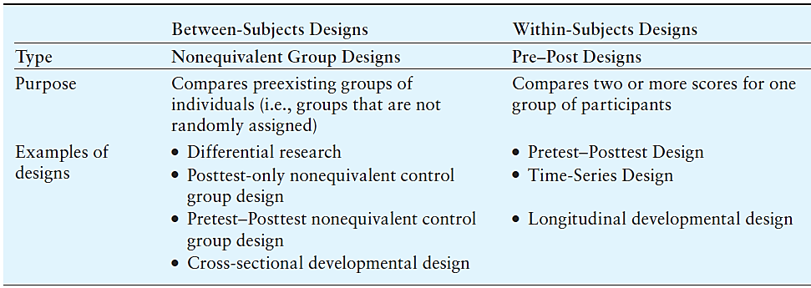
An Overview of Research Designs
Notes:
Figure 10.1 An Overview of Research Designs for the Nonexperimental and Quasi-Experimental Research Strategies

Slide 4
10.2 Between-Subjects Nonexperimental and Quasi-Experimental Designs
Nonequivalent group design
Different groups of participants are formed under circumstances that do not permit the researcher to control the assignment of individuals to groups
The researcher cannot use random assignment to create groups of participants

Slide 5
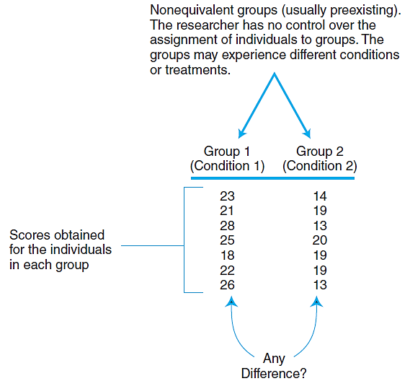
The General Structure of a Nonequivalent Group Study
Notes:
Figure 10.3 The General Structure of a Nonequivalent Group Study

Slide 6
Threats to Internal Validity for Nonequivalent Group Designs
Note: the groups are differentiated by one specific factor that identifies the groups
Assignment bias precludes a clear cause-and-effect explanation
Groups have different participant characteristics
There is no random assignment to groups ► no assurance of equivalent groups

Slide 7
Nonexperimental Designs with Nonequivalent Groups
The differential research design: a research study that compares preexisting groups
Goal: to establish differences between the preexisting groups
Also called an ex post facto design—looks at differences “after the fact”

Slide 8
Nonexperimental Designs with Nonequivalent Groups
The posttest-only nonequivalent control group design uses preexisting groups
One group serves in the treatment condition
A second group of similar but nonequivalent participants is used for the control condition
There is no random assignment to groups

Slide 9
A Quasi-Experimental Design with Nonequivalent Groups
A pretest–posttest nonequivalent control group design compares two non- equivalent groups
One group is measured twice ►once before a treatment is administered and once after
A second group is measured at the same two times but does not receive any treatment
This design attempts to limit threats to internal validity—thus classified as quasi-experimental

Slide 10
10.3 Within-Subjects Nonexperimental and Quasi-Experimental Designs
Pre-post designs
Threats to internal validity
History
Instrumentation
Testing effects
Maturation
Statistical regression

Slide 11
A Nonexperimental Pre-Post Design
The pretest-posttest design: a research study in which a series of observations is made over time for one group of participants
There is no attempt to control the many threats that exist

Slide 12
A Quasi-Experimental Pre-Post Design
A time-series design has a series of observations for each participant before a treatment or event and a series of observations after the treatment or event
Treatment: a manipulation administered by the researcher
Event: an outside occurrence that is not controlled or manipulated by the researcher
The researcher can minimize most threats to internal validity

Slide 13
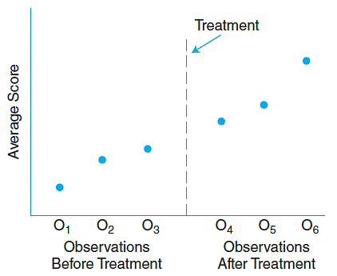
Single-Case Applications of Time-Series Designs
Possible to see the trend in the data that existed before the treatment was administered and that continues after the treatment
Notes:
Figure 10.6 A Time Series Study with Multiple Observations Before and After Treatment

Slide 14
10.4 Developmental Research Designs
Nonexperimental developmental research designs
The cross-sectional developmental research design uses different groups of individuals
Each group represents a different age
The different groups are measured at one point in time and then compared
This design is an example of a between-subjects nonexperimental design (a nonequivalent group design)

Slide 15
Strengths and Weaknesses of the Cross-Sectional Developmental Design
Strengths:
Data can be collected in a short period of time
Researcher can observe how behavior changes as people age without waiting for subjects to grow older
Weaknesses:
Factors other than age may differentiate groups
Cohort effects
Generation effects

Slide 16
The Longitudinal Developmental Research Design
Involves measuring a variable in the same group of individuals over a period of time
An example of a within-subjects nonexperimental design (a one-group pretest-posttest design)
A set of observations is followed by a period of development or aging, then another set of observations
Differences between observations define the effects of development

Slide 17
Cross-Sectional Longitudinal Designs
Compares the results obtained from separate samples (like a cross-sectional design) that were obtained at different times (like a longitudinal design)
Examines the development of phenomena other than individual aging

Slide 18
Strengths and Weaknesses of Longitudinal Research Designs
Longitudinal
Strengths
No cohort or generation effects
Assesses individual behavioral changes
Weaknesses
Time-consuming
Participant dropout may create bias
Potential for practice effects

Slide 19
Strengths and Weaknesses of Cross-Sectional Research Designs
Cross-sectional
Strengths
Time-efficient
No long-term cooperation required
Weaknesses
Individual changes are not assessed
Cohort or generation effects may be responsible for observed differences

Slide 20
10.5 Applications, Statistical Analysis, and Terminology
Nonexperimental and quasi-experimental research
Between-subjects designs: refer to chapter 8
Within-subjects designs: refer to chapter 9
Two-group designs
Compare numerical scores with a t test for two means or a single-factor analysis of variance for multiple means
Use chi-square test for non-numerical data

Slide 21
The Pretest–Posttest Nonequivalent Control Group Design
Statistical analysis of numerical scores
A two-factor, mixed design analysis of variance
Refer to a statistical software program, e.g., SPSS

Slide 22
Review of Research Design Terminology
Within the context of nonexperimental and quasi-experimental research
Quasi-independent variable (IV): the variable that is used to differentiate the groups of participants or the groups of scores being compared
Dependent variable (DV): the variable that is measured to obtain the scores within each group

