Slide 1
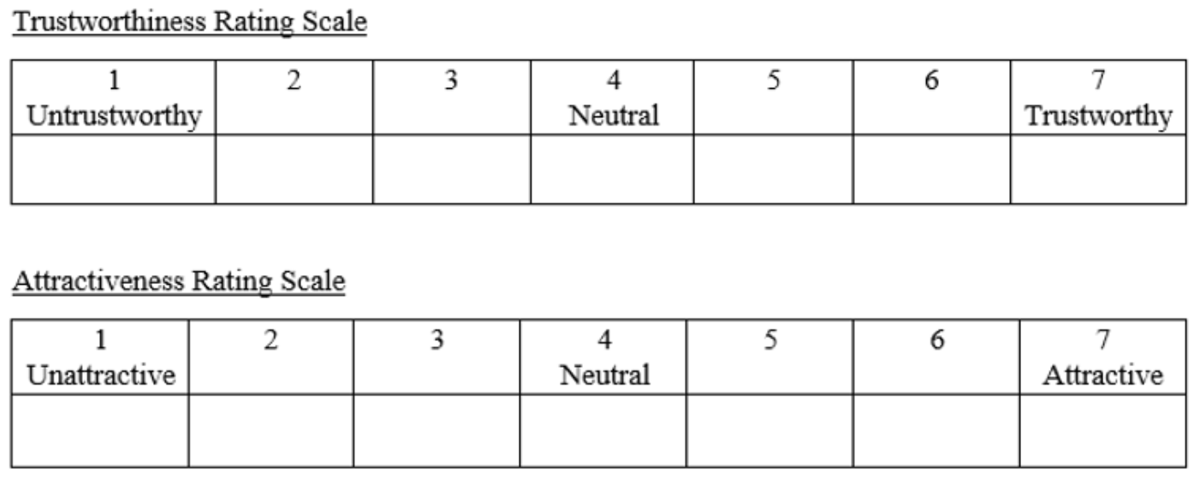
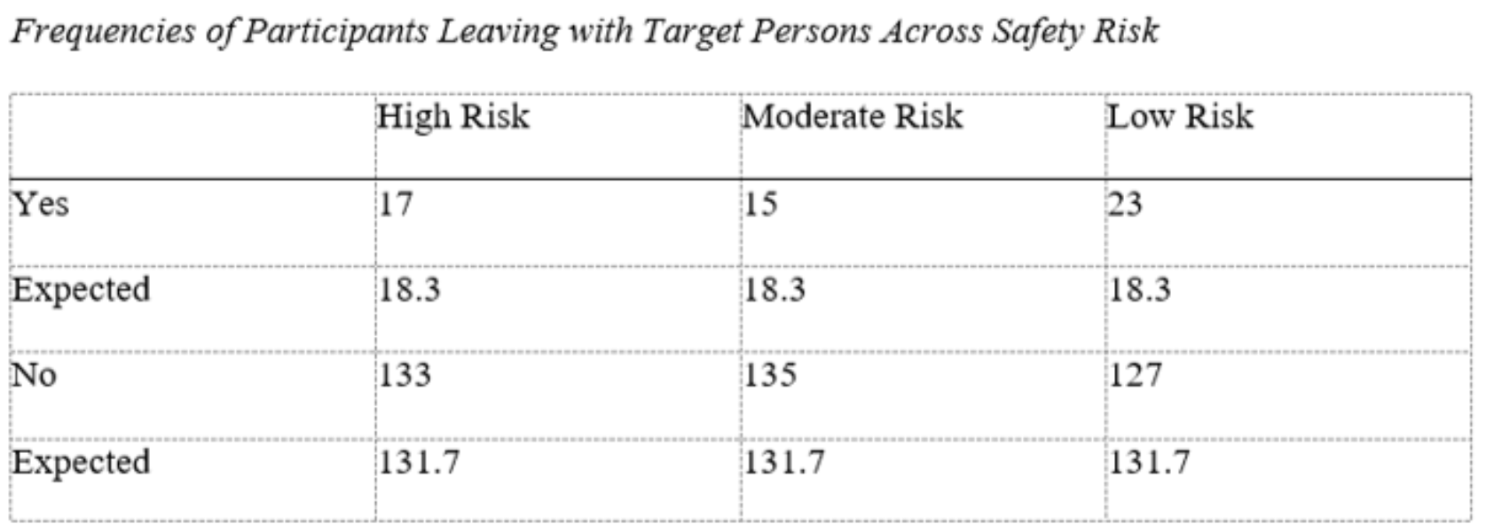
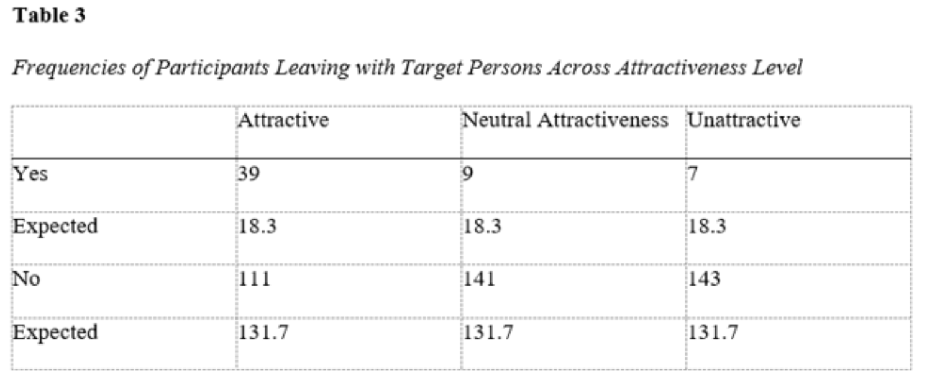
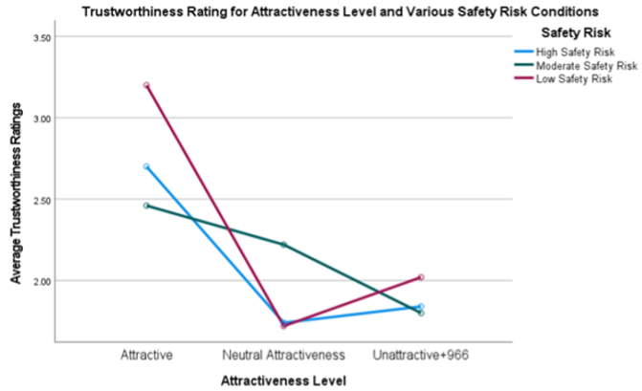
The Effects of Attractiveness on the Judgement of Trust in Safety Risk Situations Katlyn Watson ( Dr. Christine Malone, faculty advisor)
Department, Minnesota State University Moorhead, 1104 7th Avenue South, Moorhead, MN 56563
Background:
Various research has shown a connection between attractiveness and trust
One study found that when asked to give money to another person in the study, the participants gave more money to those who were rated as more attractive; and believed that if the roles were reversed, they would expect to receive more money from that person as well (Zhao et al., 2015)
Researchers showed pictures to participants without a description of the person, found that participants trusted the attractive photos more than the unattractive ones (Putz et al., 2018)
Past research has not investigated situational context where safety could be at risk.
The current study investigated whether various levels of safety risk situations influence the effect of attractiveness on trust.
Hypothesis
Part 1: We predicted to see that participants would be overall less likely to leave with the target person as the risk level increased
Part 2: We predicted to see an interaction between attractiveness and safety risk, where participants would be less cautious when presented with attractive targets.
Procedure:
Informed consent was obtained​
Demographic questionnaire​
Shown image of target person with a scenario​
Asked whether they would leave with the person​ (Trustworthiness decision)
Asked to rate the person on trust and attractiveness​ using the likert scales
Repeated for 9 scenario/image combinations​
Debriefed​ and directed to another site for extra credit
Results:
The two-factor analysis of variance on the attractiveness ratings showed a significant main effect for safety risk F(2,196) = 14.597, p < .001, η² = 0.23; a significant main effect for attractiveness level F(2,196) = 151.921, p < .001, η² = 0.756; and a significant interaction between attractiveness and safety risk F(4,196) = 12.165, p < .001, η² = 0.199. (It showed the validity of the attractiveness independent variable)
The two-factor analysis of variance on the trustworthiness rating showed a significant main effect for attractiveness level F(2,196) = 38.031, p < .001, η² = 0.437 and a significant interaction between attractiveness and safety risk F(4,196) = 5.411, p < .001, η² = 0.099. However, there was no significant main effect for safety risk F(2,196) = 2.074, p =.131, η² = 0.41.
Frequencies of leaving with the target person differed across various attractiveness levels x²(2, n=450) = 39.936, p < .001, ϕ = .298. The attractive target persons were close to double the expected value (x = 39) for participants to state they would leave with them. This value is higher than either the neutral attractive target persons (x = 9) or the unattractive target persons (x = 7).
Frequencies of leaving with the target person did not differ across various safety risks (high risk, moderate risk, and low risk, x²(2, n=450) = 2.154, p = .341, ϕ = .069.
Discussion:
Participants were more likely to trust the target person if they were viewed as more attractive. This was shown in the trustworthiness ratings.
Safety risk situations did not impact trust, whether it was the trustworthy decision or trustworthiness rating.
There was a significant interaction between safety risk and attractiveness on trustworthiness ratings which was shown in the two-factor analysis of variance on the trustworthiness rating. This is supportive of part two of the hypothesis.
Limitations include the lack of similar risk levels among the risk factors and does not look at the influence of race and sex.
Future studies should look at closely evaluating the risk factors within the study. Future studies can also change the race or gender of the participants and/or target persons.
References
Adewumi Israel Badiora, & Bashir O Odufuwa. (2019). Fear dynamics in public places: a case study of urban shopping centers. Journal of Place Management and Development, 12(2), 248–270. https://doi.org/10.1108/JPMD-11-2018-0084
Ceccato, V., & Tcacencu, S. (2018). Perceived Safety in a Shopping Centre: A Swedish Case Study. In Retail Crime (pp. 215–242). Springer International Publishing. https://doi.org/10.1007/978-3-319-73065-3_9
Ma, D. S., Correll, J., & Wittenbrink, B. (2020, November). Chicago Face Database. CFD.
Retrieved February 22, 2021, from https://chicagofaces.org/default/
Putz, Ádám, Ferenc Kocsor, and Tamás Bereczkei. “Beauty Stereotypes Affect the Generalization of Behavioral Traits Associated with Previously Seen Faces.” Personality and individual differences 131 (2018): 7–14. Web.
Zhao, N., Zhou, M., Shi, Y., & Zhang, J. (2015). Face attractiveness in building trust: Evidence from measurement of implicit and explicit responses. Social Behavior and Personality, 43(5), 855-866. doi:10.2224/sbp.2015.43.5.855
Method:
Participants:
50 female undergraduate students participated in the study
The study was presented online, using Qualtrics
Compensation was given in the form of extra credit in participating psychology courses
Design:
3x3 factor within-subjects design
Independent Variables
Attractiveness (attractive, neutral, and unattractive)
Various risk of safety scenarios (high risk, moderate risk, low risk)
Adewumi and Odufuwa (2019), showed that people felt less safe in settings with bad lighting. Another study found that if the place was secluded, lack of surveillance, unclean/dirty, too noisy, crowded with clutter/garbage, homeless people around, poor maintenance and if there are drug addicts around the area, people perceive that place as less safe (Ceccato & Tcacencu, 2018). These factors were used to differentiate the different levels of safety risk.
Four factors in the high risk condition, two factors in the moderate risk condition, and zero factors in the low risk condition
Dependent Variables
Trustworthiness decision
Trustworthiness rating
Attractiveness rating (analyzed to check validity)
Materials:
Demographic Questionnaire
9 photos of white male faces from the Chicago Face Database was used (Ma, Correll, & Wittenbrink, 2020).
9 scenarios varying in levels of safety, presented with each photo
Two likert-type scales were used in determining a trustworthiness and attractiveness rating. Both scales ranged from 1 to 7.
Evaluate this poster
Presentation ID: 6076
Scan the QR Code or go to:
https://bit.ly/sac2022-eval

