Slide 1
The effect of Framing on ratings of attractiveness
First Last
Minnesota State University Moorhead

Slide 2
Background Information
Framing occurs when objects of equal value are presented in either a positive or negative style which may alter how individuals perceive the object (Dunegan, 2010).
Attribute framing describes an object by its positive features for a positive frame or negative features for a negative frame.
-(e.g. Levin and Gaeth’s 1988 Meat Study)
-Attribute-framing bias: positive frames are favored over negative frames because of the association’s individuals
make with the object (Shafir, 1993).
Individuals can be easily persuaded. (Gamliel, & Kreiner, 2017; Perfecto, Galak, Simmons, & Nelson, 2017).

Slide 3
Task Frames and Academic Success
Task Frames:
Positive frames: anticipate potential gains and focus on positive attributes (Levin & Gaeth, 1988 Park et al., 2000; Perfecto et al., 2017; Sokolova & Krishna, 2016).
Negatives frames: anticipate potential losses and focus on negative attributes.
Academic Success:
Research has discovered that students with higher academic success were less susceptible to framing than students with lower academic success (Smith & Levin, 1996).
GPA is correlated with numeracy, critical thinking skills, motivation, cognitive abilities, and general mental abilities (Dunegan, 2010).

Slide 4
Rationale for Study
Previous studies have found that the choice of frame (i.e. positive and negative) and academic success (i.e. higher or lower) can influence perceptions of individuals.
Positive frames (i.e. choices) have been shown to influence individuals’ attractiveness ratings over negative frames (i.e. rejections).
Previous studies largely focus on framing of products and there is a lack of research on how framing affects interpersonal attraction.
Aim of this current study was to examine if framing effects could alter perceptions of attractiveness towards individuals and if academic success, which was measured by participants’ GPA, could alter the extent of bias towards attribute frames.

Slide 5
Hypothesis
It was predicted that attribute framing would bias all participants’ responses; such that higher ratings of attractiveness would occur in the positive task frame than the negative task frame.
Moreover, attribute framing would bias the responses of participants with lower grade point averages more than participants with higher grade point averages.

Slide 6
Method
Participants
One hundred twenty lower level male and female students enrolled at MSUM.
Design
2x2 between-subjects factorial design
Two independent variables each with two levels
Task Frame: positive (choice), negative (rejection)
Grade Point Average: lower and higher GPA
GPA levels were created by a median split
(Lower: 2.00-2.99; higher: 3.00-3.99)
Dependent variable: participants’ ratings of attractiveness based on a ten-point scale

Slide 7
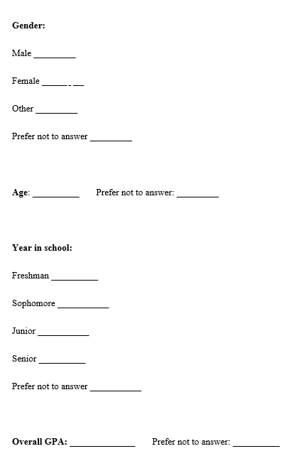
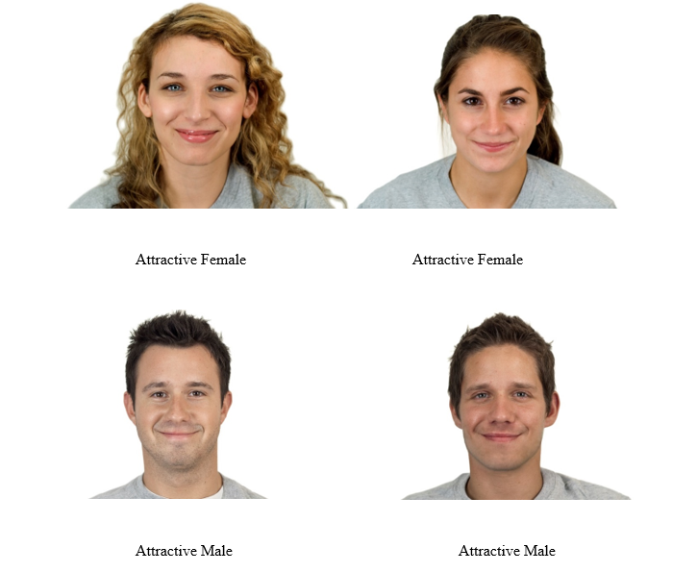
Materials
GPA and demographic questionnaire form
Four image examples of attractive female and male model candidates
Attractiveness rating scale

Slide 8
Procedure
Informed consent was obtained
Participants completed the GPA and demographics questionnaire form
Positive task frame required participants to make a choice
Rated attractiveness of individual in image
Negative task frame required participants to make a rejection
Rated attractiveness of individual in remaining image
Debriefed and awarded extra credit
Total amount of time sessions took were approximately 15 minutes

Slide 9
Results
The two-factor analysis of variance showed a significant main effect for the different task frame groups, positive (choice) or negative (rejection), F(1, 116) = 159.36, p < 0.001, η2 = 0.579
A significant main effect for higher vs. lower GPA, F(1, 116) = 63.30, p < 0.001, η2 = 0.353
And a significant interaction between task frame and GPA, F(1, 116) = 7.03, p = 0.009, η2 = 0.057.

Slide 10
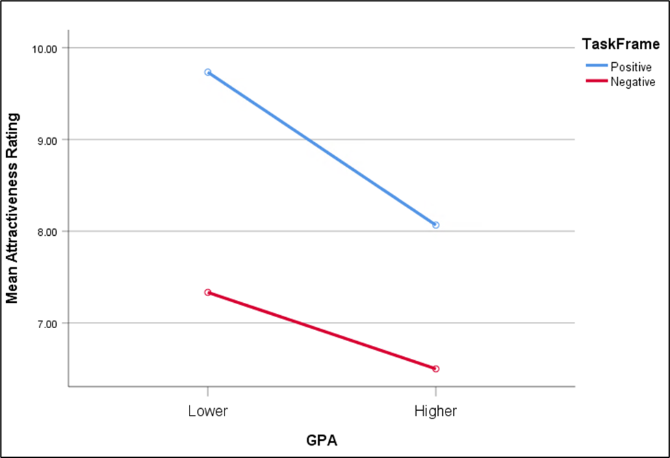
Figure 1
Mean attractiveness rating scores across conditions

Slide 12
Conclusions
Choice of frame (i.e. positive and negative) and academic success (i.e. higher or lower) can influence perceptions of individuals and their extent of bias towards attribute frames.
positive framed condition showed significant results over the negative framed condition
lower GPA level participants reported higher ratings than higher GPA level participants
lower GPA level participants that were randomly assigned to the positive framed condition reported the highest ratings overall
Understanding that the way things are framed can result in different perceptions of equivalent objects may eventually help individuals decrease susceptibility to superficial cues.

Slide 13
References
Dunegan, K. (2010). GPA and attribute framing effects: Are better students more sensitive or more susceptible? Journal of Education for Business, 85(4), 239–247. https://doi
-org.trmproxy.mnpals.net/10.1080/08832320903449444
Gamliel, E., & Kreiner, H. (2017). Outcome proportions, numeracy, and attribute‐framing bias. Australian Journal of Psychology, 69(4), 283–292. https://doi
org.trmproxy.mnpals.net/10.1111/ajpy.12151
Gamliel, E., Zohar, A. H., & Kreiner, H. (2014). Personality traits moderate attribute framing effects. Social Psychological and Personality Science, 5(5), 584–592. https://doi
-org.trmproxy.mnpals.net/10.1177/1948550613516874
Kim, J., Kim, J.-E., & Marshall, R. (2014). Search for the underlying mechanism of framing effects in multi-alternative and multi-attribute decision situations. Journal of Business Research, 67(3), 378–385.
https://doi org.trmproxy.mnpals.net/10.1016/j.jbusres.2012.12.024
Levin, I. P., & Gaeth, G. J. (1988). How consumers are affected by the framing of attribute information before and after consuming the product. Journal of Consumer Research, 15(3), 374–378. https://doi
-org.trmproxy.mnpals.net/10.1086/209174
Levin, I. P., Gaeth, G. J., Schreiber, J., & Lauriola, M. (2002). A new look at framing effects: Distribution of effect sizes, individual differences, and independence of types of effects. Organizational Behavior and
Human Decision Processes, 88(1), 411–429. https://doi-org.trmproxy.mnpals.net/10.1006/obhd.2001.2983
Ma, D. S., Correll, J., & Wittenbrink, B. (2015). The Chicago Face Database: A free stimulus set of faces and norming data. Behavior Research Methods, 47(4), 1122–1135.
http://search.ebscohost.com.trmproxy.mnpals.net/login.aspx?direct=true&db=psyh&AN=2016 04121-001&site=ehost-live
Park, C. W., Jun, S. Y., & Macinnis, D. J. (2000). Choosing what I want versus rejecting what I do not want: An application of decision framing to product option choice decisions. Journal of Marketing Research, 37(2), 187–202.
https://doi org.trmproxy.mnpals.net/10.1509/jmkr.37.2.187.18731
Perfecto, H., Galak, J., Simmons, J. P., & Nelson, L. D. (2017). Rejecting a bad option feels like choosing a good one. Journal of Personality and Social Psychology, 113(5), 659–670. https://doi
-org.trmproxy.mnpals.net/10.1037/pspa0000092.supp (Supplemental)
Shafir, E. (1993). Choosing versus rejecting: Why some options are both better and worse than others. Memory & Cognition, 21(4), 546–556. https://doi-org.trmproxy.mnpals.net/10.3758/BF03197186
Smith, S. M., & Levin, I. P. (1996). Need for cognition and choice framing effects. Journal of Behavioral Decision Making, 9(4), 283–290. https://doi-org.trmproxy.mnpals.net/10.1002/(SICI)1099-0771(199612)9:4<283::AID-BDM241>3.0.CO;2-7
Sokolova, T., & Krishna, A. (2016). Take it or leave it: How choosing versus rejecting alternatives affects information processing. Journal of Consumer Research, 43(4), 614–635. https://doi-org.trmproxy.mnpals.net/10.1093/jcr/ucw049

Slide 14
Questions?

