Slide 1
competition of plant species

Slide 2
Competition between species
The struggle for food, space, and pollinators in order to survive
Can occur between individuals of different species
interspecific competition.
or between individuals of the same species
intraspecific competition.
Competition is considered to be a major driving force in evolution.
Better-adapted species surviving and less well-adapted species becoming extinct

Slide 3
May be Positive, negative, or neutral
Interspecific interactions (between individuals of different species)
Affect population densities, species distributions, and ultimately lead to evolutionary changes.
The interactions can be beneficial or detrimental to either of the species
They can lead to extinction.

Slide 4
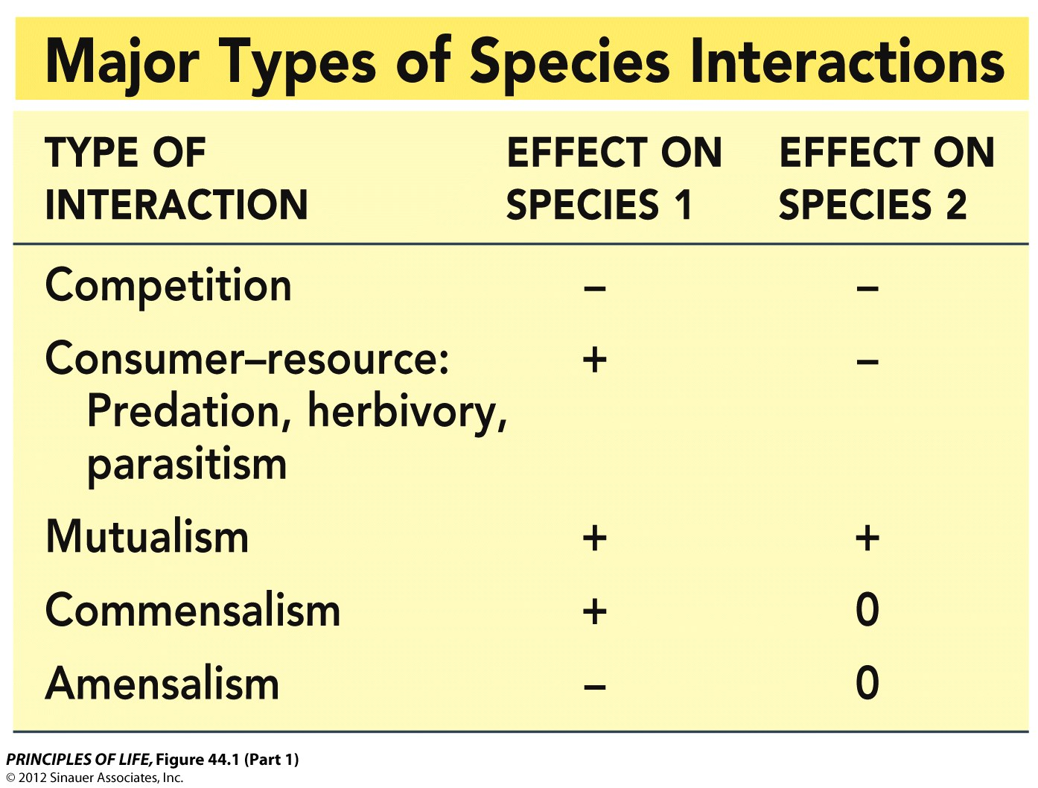
May be Positive, negative, or neutral
Interspecific competition refers to –/– interactions
Members of two or more species use the same resource.
At any one time there is often one limiting resource in the shortest supply relative to demand.

Slide 5
May be Positive, negative, or neutral
Consumer–resource interactions
organisms get their nutrition by eating other living organisms.
+/– interactions—the consumer benefits while the consumed organism loses
Includes predation, herbivory (previous talk), and parasitism

Slide 6
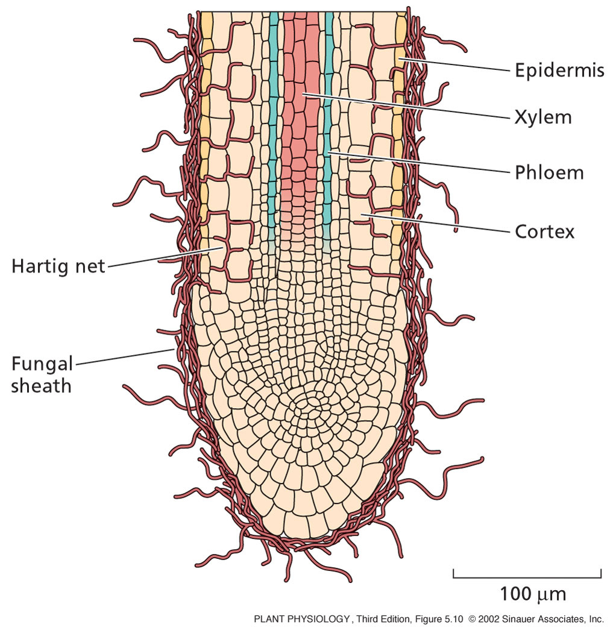
May be Positive, negative, or neutral
Mutualism benefits both species: +/+ interaction
Ectotrophic Mycorrhizal fungi
Form a thick sheath around root. Some mycelium penetrates the cortex cells of the root
Root cortex cells are not penetrated, surrounded by a zone of hyphae called Hartig net
The capacity of the root system to absorb nutrients improved by this association – the fungal hyphae are finer than root hairs and can reach beyond nutrient-depleted zones in the soil near the root

Slide 7
May be Positive, negative, or neutral
Mutualism benefits both species: +/+ interaction
All mutualisms involve the exchange of resources and services.
The fitness effect of the mutualism can vary depending on environmental conditions.
Mycorrhizae benefit plants in nutrient-poor soils, but can be a liability in nutrient-rich soils, where the cost of feeding the mycorrhizae outweighs their value in nutrient uptake.

Slide 8
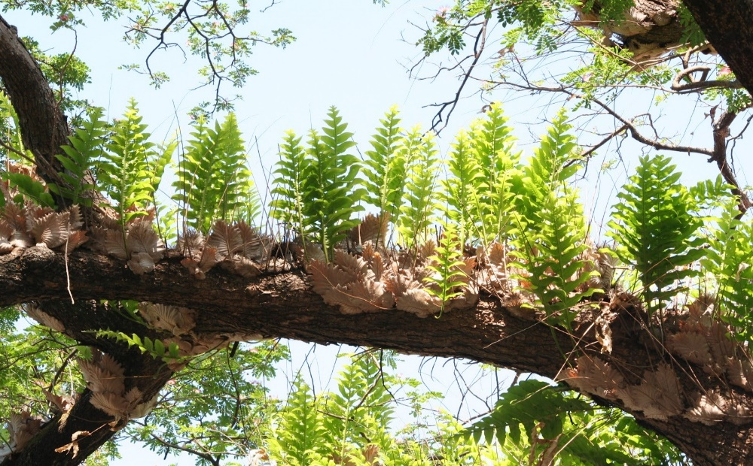
May be Positive, negative, or neutral
Commensalism—one species benefits while the other is unaffected (+/0 interaction).
Epiphytes are small plants that live on the branches of other trees. This allows the epiphyte to get more light, and neither helps nor harms the tree
Usually found in the temperate zone or in the tropics.
Sometimes called "air plants" because they do not root in soil. However, there are many aquatic species of algae that are epiphytes on other aquatic plants.
From the wikimedia free licensed media file repository

Slide 9
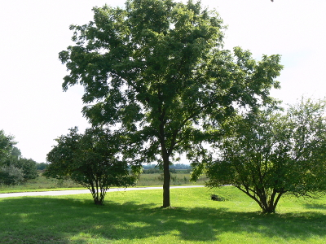
May be Positive, negative, or neutral
Amensalism—one species is harmed while the other is unaffected (–/0 interactions).
Tend to be more accidental than other relationships. (Example – Allelopathy)
Black walnut is a prime example of this.
In addition to its leaves, store allelopathic properties within their buds, nut hulls, and roots.
The chemical responsible for its toxicity, remains in the soil around the tree -Juglone.
Plants most susceptible to the black walnut’s toxicity include nightshade plants (tomatoes, peppers, eggplants, potatoes), pines, and birch trees.
From the wikimedia free licensed media file repository

Slide 10
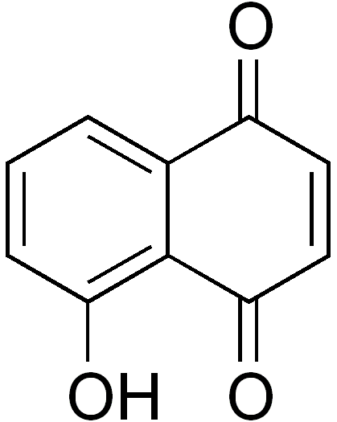
Juglone
Also named 5-hydroxy-1,4-naphthalenedione (IUPAC) is an organic compound with the molecular formula C₁₀H₆O₃.
It is sometimes used as an herbicide, as a dye for cloth and inks, and as a coloring agent for foods and cosmetics.
At low concentrations - inhibits respiration activity of mitochondria and inhibits photosynthesis output of common crops such as maize and soy.
In addition to these inhibitions, juglone has been shown to alter the relationship between plants and water because of its effect on inhibiting stomatal functionality.
Einhelling F.A. (1986) Mechanisms and modes of action of allelochemicals. In The Science of Allelopathy. Eds. A R Putnam and C S Tang. pp 171–188
From the wikimedia free licensed media file repository

Slide 11
Characteristics of intra-specific Competition
The ultimate effect is a decrease in either reproduction or survival (decrease in the contribution to the next generation).
The resource for which individuals are competing must be in short supply.
Competing individuals are inherently equivalent (circumstances, more than individual differences, determines who “wins”).
The effects of intra-specific competition are density dependent.
The greater the number of individuals, the greater the probability any given individual will be adversely affected.

Slide 12
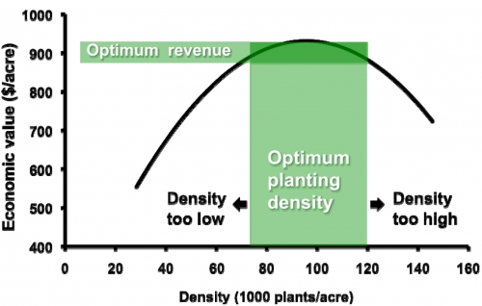
Characteristics of intra-specific Competition
Not all density dependent effects are a result of intra-specific competition.
They can arise from other processes such as inter-specific competition.
Density dependence tends to regulate population size.
Mathieu Ngouajiob (2011). Since both low and high crop densities reduce yield and total revenue, it is important to calibrate the planter for optimum density. Michigan State University Extension, Department of Horticulture.

Slide 13
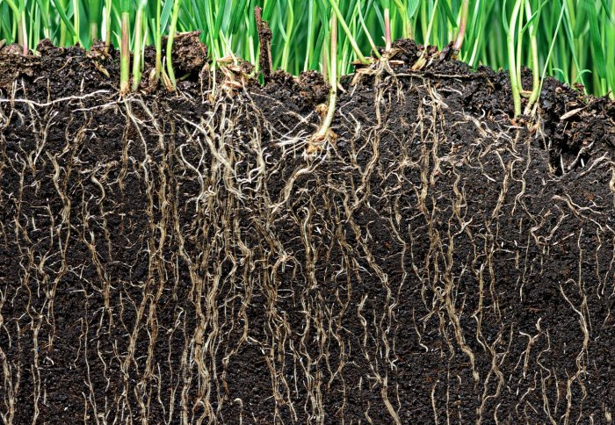
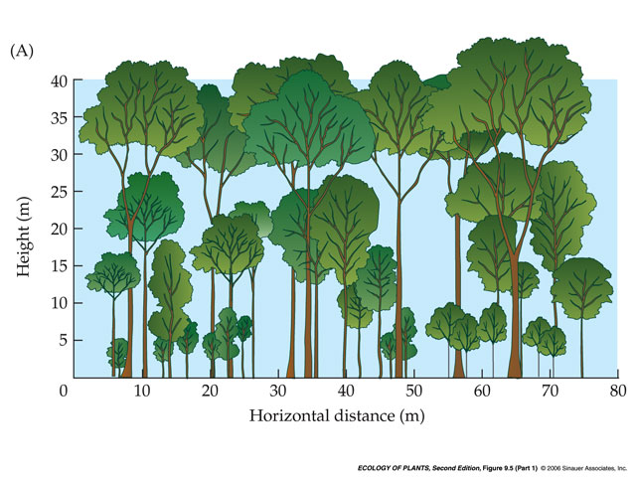
Scramble and Contest Competition
These are the theoretical extremes originally proposed by the ecologist A.J. Nicholson in 1954.
Scramble (size symmetric): All individuals get an equal share of resources.
soil nutrients are usually taken up in a size-symmetric manner
Contest (size asymmetric): A few “winners” get all the resources, the remaining individuals get nothing.
light is often taken up in a size-asymmetric manner: the bigger plant gets most or all, smaller plant dies

Slide 14
Intra-specific Competition in Plants
Law of constant final yield
This is a form of intraspecific competition.
Survival is not decreased, but plant size, and reproductive output, are affected.
This relationship compares plots of different densities at a single instant of time; it is not a dynamic process

Slide 15
Self-thinning in plants
As plants grow in size, density-dependent mortality may start to occur.
This is a dynamic process known as self-thinning

Slide 16
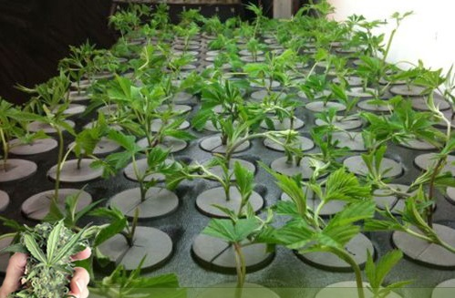
Size Hierarchies Under Crowded Conditions
In plants, dense populations tend to lead to many small individuals but only a few large ones.
This is a result of intra-specific competition and can occur even if all organisms start out the same size initially.
From the wikimedia free licensed media file repository

Slide 17
Habitat productivity can influence competition between plant species
Two hypotheses:
(1) Plants compete more intensively when mineral nutrients are less abundant in the soil
Plants compete more intensively when nutrients are less plentiful.
High nutrients are less likely to limit plant population; thus the intraspecific competition is weak.
Reprinted by permission from Wiley from Drew, M.C. (1975). Comparison of the effects of a localised supply of phosphate, nitrate and ammonium and potassium on the growth of the seminal root system, and the shoot, in barley. New Phytol. 75: Reprinted from Bouguyon, E., Gojon, A. and Nacry, P. (2012). Nitrate sensing and signaling in plants. Sem. Cell Devel. Biol. 23: , with permission from Elsevier. See also Gersani, M. and Sachs, T. (1992). Development correlations between roots in heterogeneous environments. Plant Cell Environ. 15:
Notes:
The difference between the Grubb– Tilman and Grime– Keddy hypothe­ses lies in the relative importance placed on belowground and aboveground competition for resources— that is, for nutrients and light, respectively.
Middle hypothesis:
Is there a way to consolidate these two hypothesis?

Slide 18
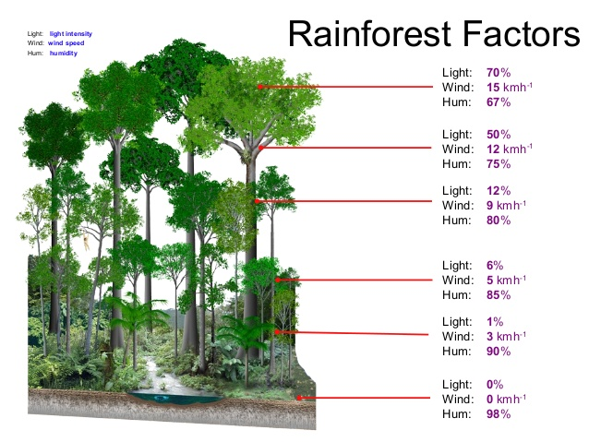
Habitat productivity can influence competition between plant species
Two hypotheses:
(2) Competition is less intense when water and nutrients are less abundant
Competition for light is more important than competition for nutrients; limit in water and nutrients would limit the population growth to a certain point that individual plants are widely spread and do not compete for light.
Difference between these hypotheses lies in the relative importance placed on belowground and aboveground competition for resources --Light or nutrient.
From the wikimedia free licensed media file repository
Notes:
The difference between the Grubb– Tilman and Grime– Keddy hypothe­ses lies in the relative importance placed on belowground and aboveground competition for resources— that is, for nutrients and light, respectively.
Middle hypothesis:
Is there a way to consolidate these two hypothesis?

Slide 19
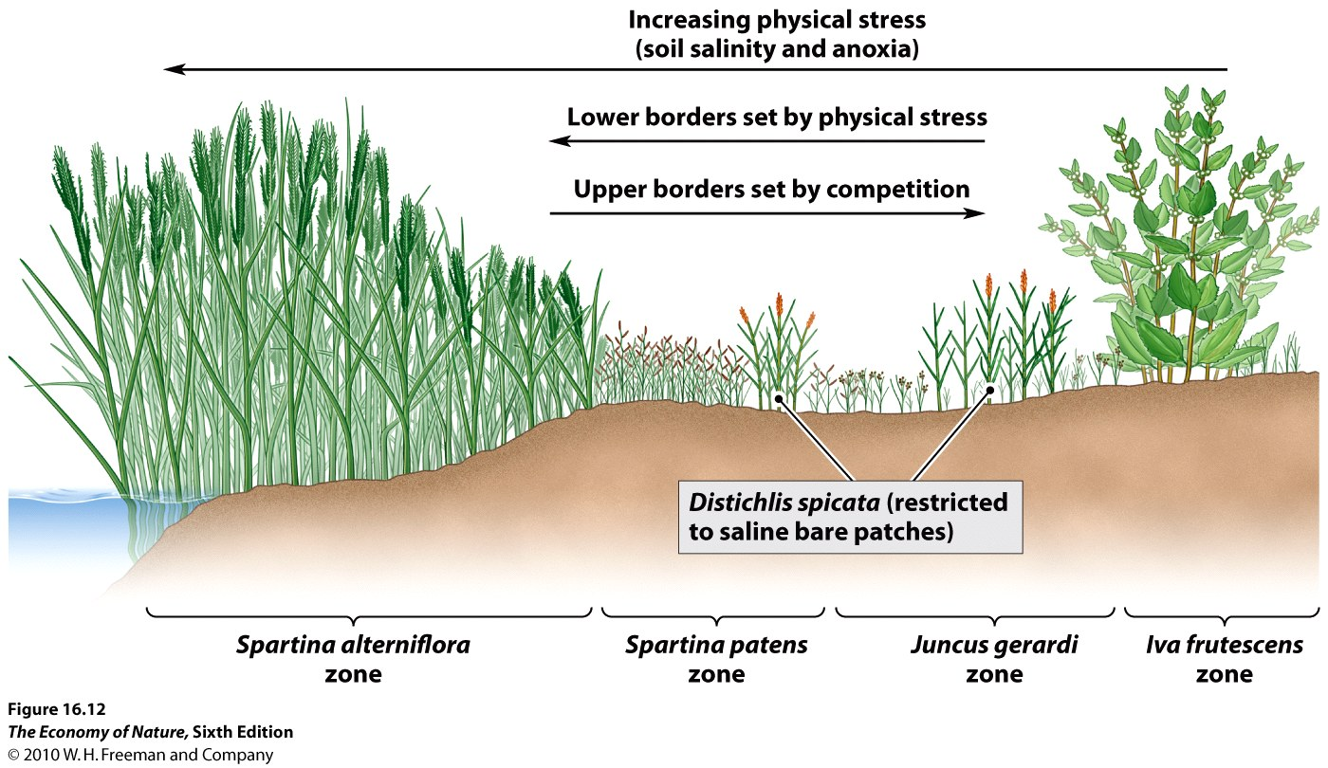
Habitat productivity can influence competition between plant species
Saltmarsh community
Upper border set by competition
Lower borders set by tolerate the physical:
Salinity
Waterlogging
Low O₂
Smooth cordgrass salt meadow cordgrass black grass alder
Notes:
New England saltmarsh community
Upper border set by competitino, lower borders set by tolerate the physical: salinity, waterlogging, and low O2
Spartina: cord-grass (s. altermifora: smooth cordgrass; s. patens: saltmeadow cordgrass)
Juncus: black grass
Iva: mesh alder, shrub

Slide 20
Summary
Intra-specific competition is characterized by four conditions:
Decrease in demographic rates with increasing density
A critical resource must be in limiting supply
Individuals are inherently equivalent
The effects of intra-specific competition are density dependent.

Slide 21
The End.
Any Questions?
Notes:
21

