Slide 1
Plant Chemistry and
Higher Plant Cells

Slide 2
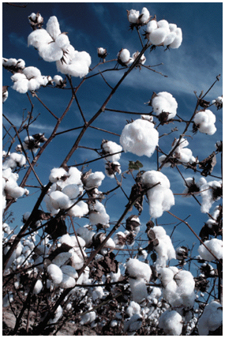
Carbohydrates
Of the macromolecules that we will cover in this class, those involving carbohydrates are the most abundant in nature.
Via photosynthesis, over 100 billion metric tons of CO₂ and H₂O are converted into cellulose and other plant products.
The term carbohydrate is a generic one that refers primarily to carbon-containing compounds that contain hydroxyl, keto, or aldehydic functionalities.
Carbohydrates can range in sizes, from simple monosaccharides (sugars) to oligosaccharides, to polysaccharides.

Slide 3
Carbohydrates
Carbohydrates constitute more than 1/2 of organic molecules
Main role of carbos in nature
  Storage of energy
  Structural support
  Lipid and protein modification:
    membranes asymmetry, recognition by IgG/fertilization/virus recognition/cell cell communication
Definition: Carbohydrates, Sugars and Saccharides- are all polyhydroxy
    (at least 2 OH) C_{n}(H₂0) _{n} = hydrate of carbon
Notice that there are two distinct types of monosaccharides, ketoses and aldoses.
The number of carbons is important in general nomenclature (triose = 3, pentose = 5, hexose =6,

Slide 4
Basic facts
Monosaccharides - Simple sugars
    Single polyhydroxyl
        Can’t be hydrolyzed to simpler form
Trioses - Smallest monosaccharides have three carbon atoms
Tetroses (4C) Pentose (5C) Hexoses (6C) Heptoses (7C) etc…
Disaccharide - two sugars linked together. Can be the same molecule or two different sugars. Attached together via a glycosidic linkage
Oligosaccharide - 2 to 6 monosaccharides
Polysaccharides - straight or branched long chain monosaccharides. Bonded together by glycosidic linkages

Slide 5

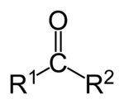
The functional groups
Aldehyde: Consists of a carbon atom bonded to a hydrogen atom and double-bonded to an oxygen atom.
  Polar. Oxygen, more electronegative than carbon, pulls the electrons in the carbon-oxygen bond towards itself, creating an electron deficiency at the carbon atom.
Ketone: Characterized by a carbonyl group (O=C) linked to two other carbon atoms or a chemical compound that contains a carbonyl group
  A carbonyl carbon bonded to two carbon atoms distinguishes ketones from carboxylic acids, aldehydes, esters, amides, and other oxygen-containing compounds

Slide 6
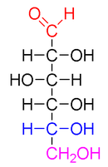
Classification of monosaccharides
Monosaccharides are classified according to three different characteristics:
  the placement of its carbonyl group,
  the number of carbon atoms it contains
  its chiral handedness.
If the carbonyl group is an aldehyde, the monosaccharide is an aldose
if the carbonyl group is a ketone, the monosaccharide is a ketose.
Monosaccharides with three carbon atoms are called trioses, those with four are called tetroses, five are called pentoses, six are hexoses, and so on.
These two systems of classification are often combined.
  For example, glucose is an aldohexose (a six-carbon aldehyde)

Slide 7
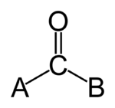
carbonyl group
A functional group composed of a carbon atom double-bonded to an oxygen atom: C=O.
The term carbonyl can also refer to carbon monoxide as a ligand in an inorganic or organometallic complex.

Slide 8
Classification of monosaccharides
D-glucose
is an aldohexose with the formula (C·H2O)6.
The red atoms highlight the aldehyde group
the blue atoms highlight the asymmetric center furthest from the aldehyde; because this -OH is on the right of the Fischer projection, this is a D sugar.

Slide 9
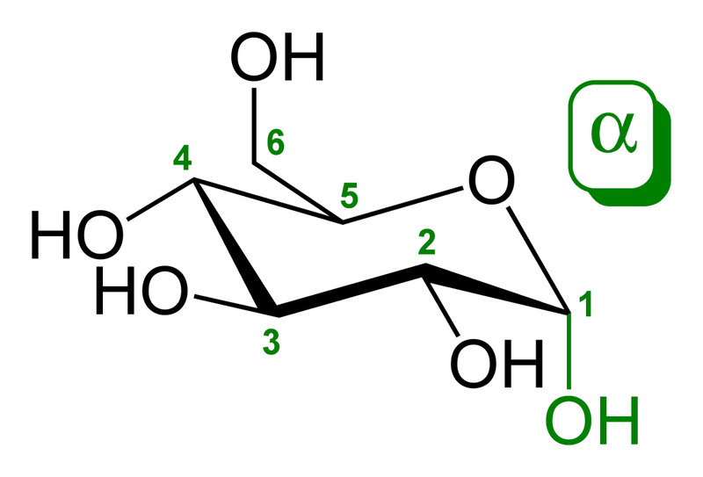
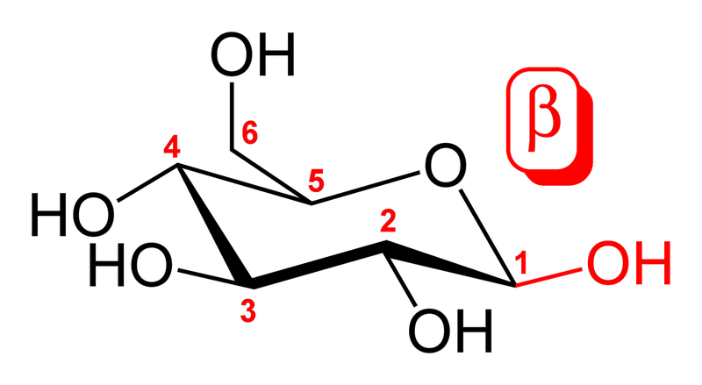
Classification of monosaccharides
The α and β anomers of glucose.
Note the position of the hydroxyl group (red or green) on the anomeric carbon relative to the CH2OH group bound to carbon 5:
Either on the opposite sides (α)
Or the same side (β).

Slide 10
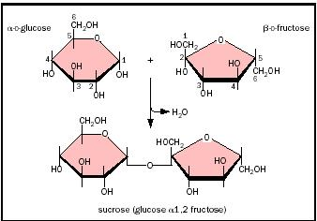
Important disaccharides
Sucrose
The osmotic effect of a substance is tied to the number of particles in solution, so a millilitre of sucrose solution with the same osmolarity as glucose will be have twice the number carbon atoms and therefore about twice the energy.
  Thus, for the same osmolarity, twice the energy can be transported per ml.
As a non-reducing sugar, sucrose is less reactive and more likely to survive the journey in the phloem.
Invertase (sucrase) is the only enzyme that will touch it and this is unlikely to be present in the phloem sieve tubes.

Slide 11
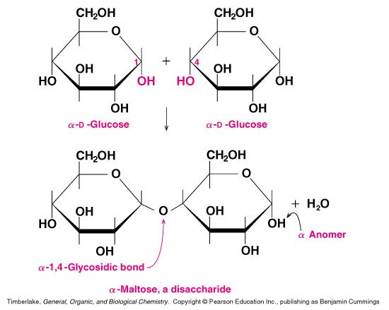
Important disaccharides
Maltose
Malt sugar or corn sugar consists of two glucose molecules linked by an α-1,4-glycosidic bond
It comes from partial hydrolysis of starch by the enzyme amylase, which is in saliva and also in grains (like barley)
Maltose is an important intermediate in the digestion of starch. Starch is used by plants as a way to store glucose. After cellulose, starch is the most abundant polysaccharide in plant cells.

Slide 12
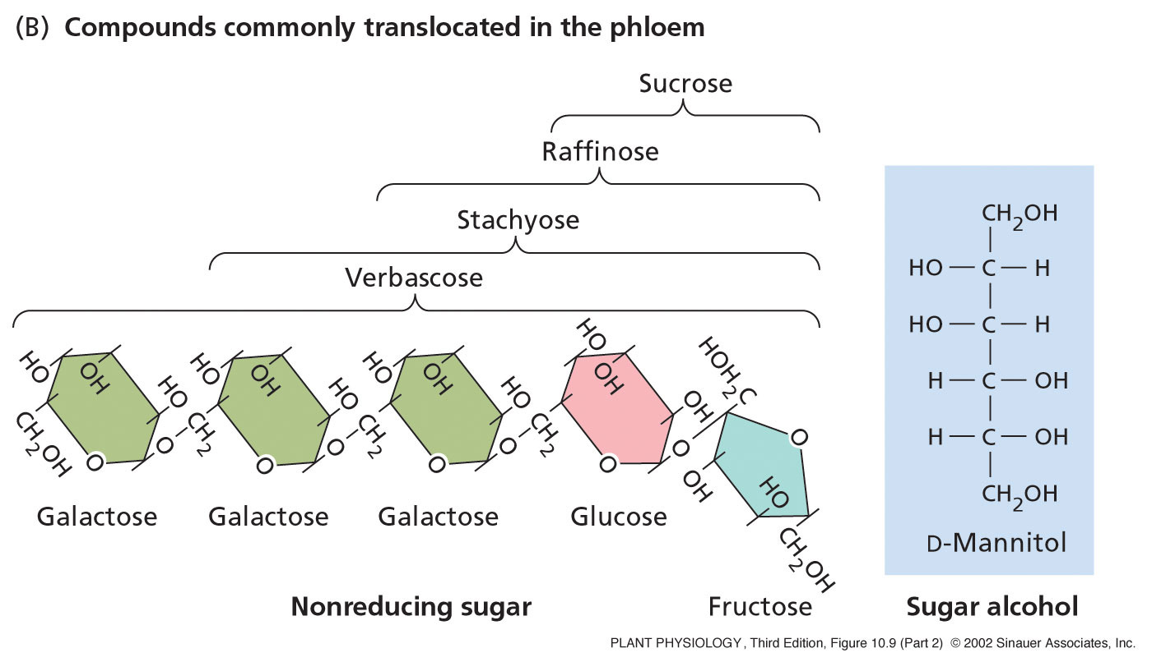
Important plant saccharides
Raffinose is a trisaccharide composed of galactose, fructose, and glucose.
Raffinose can be hydrolyzed to D-galactose and sucrose by the enzyme α-galactosidase (α-GAL), an enzyme not found in the human digestive tract. α-GAL also hydrolyzes other α-galactosides such asstachyose, verbascose, and galactinol, if present. The enzyme does not cleave β-linked galactose, as in lactose.
The raffinose family of oligosaccharides (RFOs) are alpha-galactosyl derivatives of sucrose, and the most common are raffinose, stachyose, verbascose.
RFOs are almost ubiquitous in the plant kingdom, being found in a large variety of seeds from many different families, and they rank second only to sucrose in abundance as soluble carbohydrates.

Slide 13
Carbohydrates-make up 16-25% of sap.
The major organic transport materials are sucrose, stachyose (sucrose-gal), raffinose (stachyose-gal).
These are excellent choices for transport materials for two reasons:
(a) they are non-reducing sugars (the hydroxyl group on the anomeric carbon, the number one carbon, is tied up) which means that they are less reactive and more chemically stable.
(b) the linkage between sucrose and fructose is a "high-energy" linkage similar to that of ATP. Thus, sucrose is a good transport form that provides a high energy, yet stable packet of energy;

Slide 14
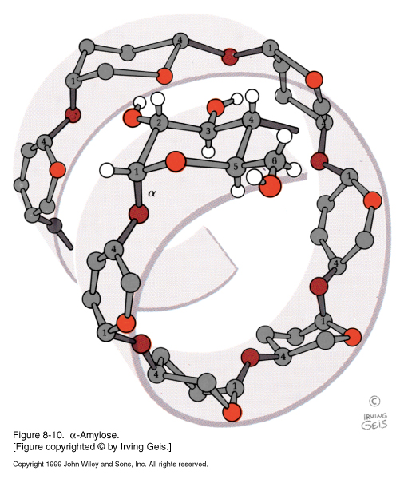
Important Polysaccharides:
Starch - energy reservoir in plants - made of two polysaccharides
Amylose -long unbranched glucose α (1,4) with open reducing end large tight helical forms. Test by iodination..

Slide 15
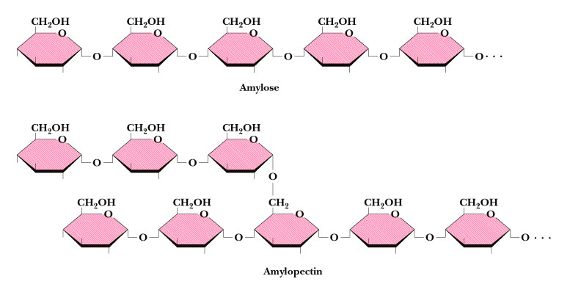
Important Polysaccharides:
Starch - energy reservoir in plants - made of two polysaccharides
  Amylose -long unbranched glucose α (1,4) with open reducing end large tight helical forms. Test by iodination.
  Amylopectin - polymer of α(1,4) and α (1,6) branches. Not helical.

Slide 16
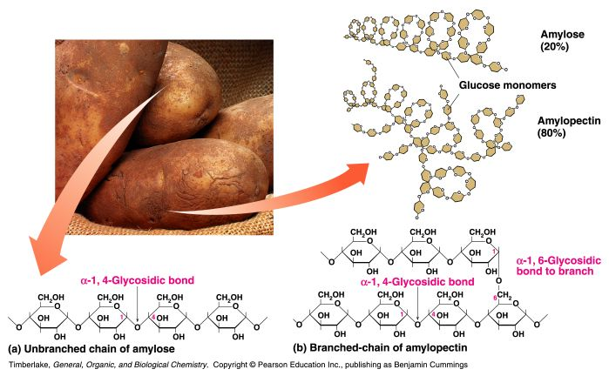
Plant Starch (Amylose and Amylopectin)
Starch contains a mixture of amylose and amylopectin
Amylose is an unbranched polymer (forms α-helix) of D-glucose molecules linked by α-1,4-glycosidic bonds
Amylopectin is like amylose, but has extensive branching, with the branches using α-1,6-glycosidic bonds

Slide 17
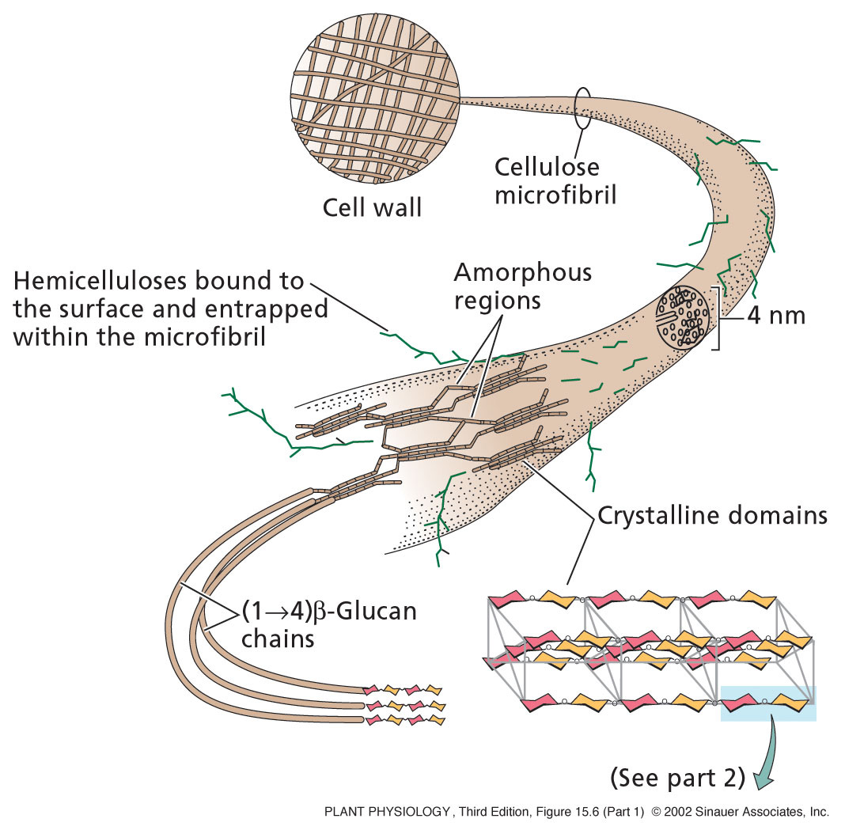
Cellulose
Linear glucan chains of unbranched (1-4)-β-linked-D-glucose in which every other glucose residue is rotated 180° with respect to its two neighbors and contrasts with other glucan polymers such as:
starch (1-4-α-glucan)
callose (1-3-β-glucan).

Slide 18
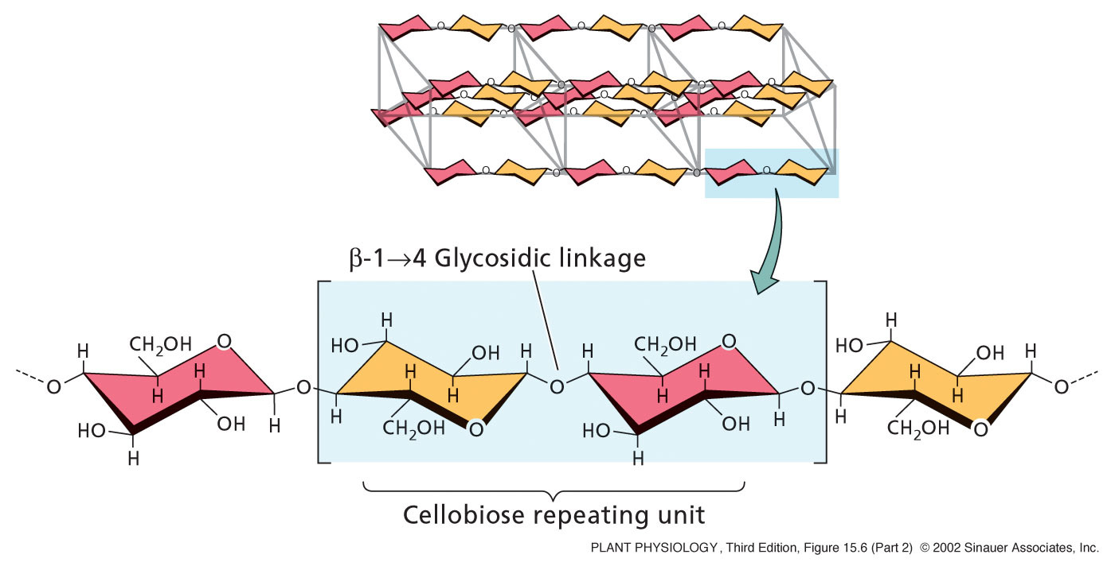
Cellulose
This means that cellobiose, and not glucose, is the basic repeating unit of the cellulose molecule. Groups of 30 to 40 of these chains laterally hydrogen-bond to form crystalline or para-crystalline microfibrils.

Slide 19
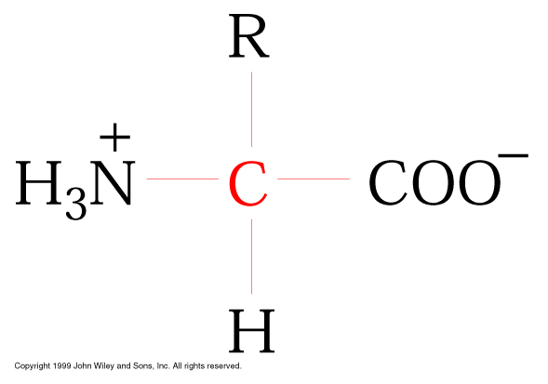
Amino acids
-20 common amino acids there are others found naturally but much less frequently
Common structure for amino acid
COOH, -NH₂, H and R functional groups all attached to the alpha carbon

Slide 20
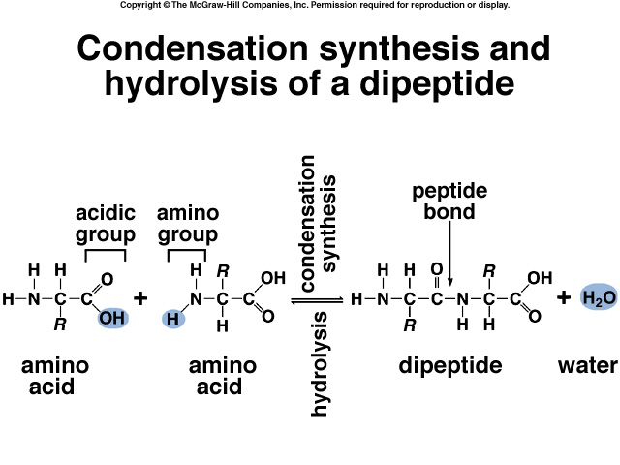

Slide 21
Proteins: Three-dimensional structure
Background on protein composition:
Two general classes of proteins
  Fibrous - long rod-shaped, insoluble proteins. These proteins are strong (high tensile strength).
  Globular - compact spherical shaped proteins usually water-soluble. Most hydrophobic amino acids found in the interior away from the water. Nearly all enzymes are globular…
  Proteins can be simple - no added groups or modifications, just amino acids
Or proteins can be conjugated. Additional groups covalently bound to the amino acids. The naked protein is called the apoprotein and the added group is the prosthetic group. Together the protein and prosthetic group is called the holoprotein. Ex. chlorophyll

Slide 22
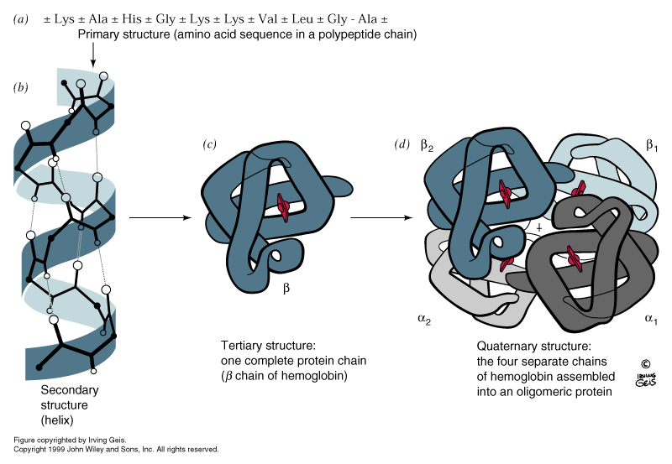
Four levels of protein structure
Primary structure: amino acid only. The actual amino acid sequence is specified by the DNA sequence. The primary structure is used to determine genetic relationships with other proteins - AKA homology. Amino acids that are not changed are considered invariant or conserved.
Primary sequence is also used to determine important regions and functions of proteins - domains.

Slide 23
Four levels of protein structure
Secondary structure: This level is only concerned with the local or close in structures on the protein - peptide backbone. The side chains are not considered here, even though they have an affect on the secondary structure.
Two common secondary structures - alpha helix and beta pleated sheet
Non- regular repeating structure is called a random coil.
- no specific repeatable pattern

Slide 24
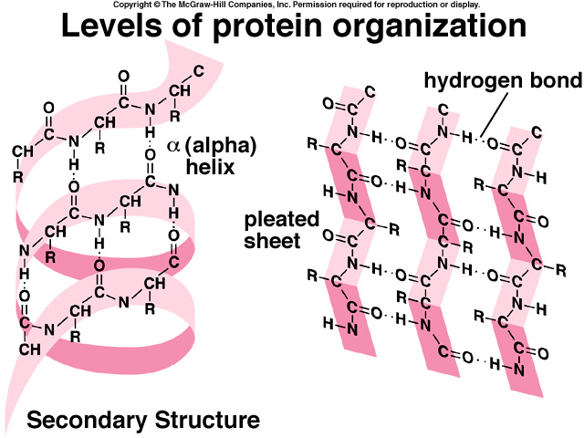

Slide 25
Four levels of protein structure
Tertiary structure - the overall three-dimensional shape that a protein assumes. This includes all of the secondary structures and the side groups as well as any prosthetic groups. This level is also where one looks for native vs. denatured state. The hydrophobic effect, salt bridges
And other molecular forces are responsible for maintaining the tertiary structure

Slide 26
Lipids
Lipids fats oils…. Greasy molecules, mmmmm donuts.
Several levels of complexity:
Simple lipids - a lipid that cannot be broken down to smaller constituents by hydrolysis.
  Fatty acids, waxes and cholesterol
Complex lipids - a lipid composed of different molecules held together mostly by ester linkages and susceptible to cleavage reactions.
  acylglycerols - mono, di and triacyl glycerols ( fatty acids and glycerol)
  phospholipids (also known as glycerophospholipids) - lipids which are made of fatty acids, glycerol, a phosphoryl group and an alcohol. Many also contain nitrogen
  glycolipids (also known as glycosphingolipids): Lipids which have a spingosine and different backbone than the phospholipids

Slide 27
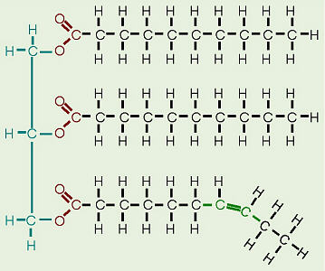
General Structure
glycerol (a type of alcohol with a hydroxyl group on each of its three carbons)
Three fatty acids joined by dehydration synthesis.
Since there are three fatty acids attached, these are known as triglycerides.

Slide 28
General Structure
The longer the fatty acids the higher the melting point.
Again the more hydrophobic interactions effects the more the energy it takes to break the order. Decreases in the packing efficiency decreases the mp
The van der Waals forces then come apart more easily at lower temperatures.
Animal alter the length and unsaturated level of the fatty acids in lipids (cholesterol too) to deal with the cold temps

Slide 29
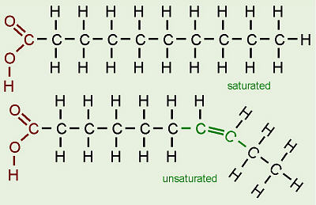
Saturated or not – the power of H
The terms saturated, mono-unsaturated, and poly-unsaturated refer to the number of hydrogens attached to the hydrocarbon tails of the fatty acids as compared to the number of double bonds between carbon atoms in the tail.
Oils, mostly from plant sources, have some double bonds between some of the carbons in the hydrocarbon tail, causing bends or “kinks” in the shape of the molecules.
Because some of the carbons share double bonds, they’re not bonded to as many hydrogens as they could if they weren’t double bonded to each other.

Slide 30
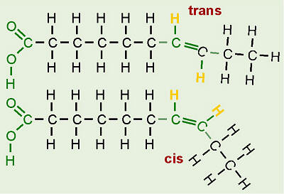
Trans and Cis
In unsaturated fatty acids, there are two ways the pieces of the hydrocarbon tail can be arranged around a C=C double bond.
TRANS
  The two pieces of the molecule are on opposite sides of the double bond, that is, one “up” and one “down” across from each other.
CIS
  the two pieces of the carbon chain on either side of the double bond are either both “up” or both “down,” such that both are on the same side of the molecule

Slide 31
Trans and Cis
Naturally-occurring unsaturated vegetable oils have almost all cis bonds
  but using oil for frying causes some of the cis bonds to convert to trans bonds.
If oil is used only once like when you fry an egg, only a few of the bonds do this so it’s not too bad.
However, if oil is constantly reused, like in fast food French fry machines, more and more of the cis bonds are changed to trans until significant numbers of fatty acids with trans bonds build up.
The reason this is of concern is that fatty acids with trans bonds are carcinogenic!

Slide 32
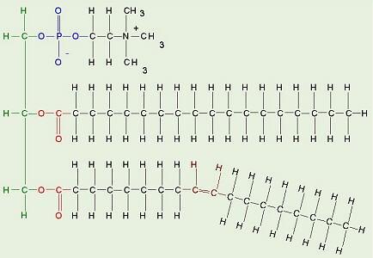
Phospholipids
Made from glycerol, two fatty acids, and (in place of the third fatty acid) a phosphate group with some other molecule attached to its other end.
The hydrocarbon tails of the fatty acids are still hydrophobic, but the phosphate group end of the molecule is hydrophilic because of the oxygens with all of their pairs of unshared electrons.
This means that phospholipids are soluble in both water and oil.

Slide 33
Overview of Plant Structure
Plants are Earth’s Primary Producers
  Harvest Energy from sunlight by converting light energy into chemical energy
They store this Chemical Energy in bonds formed when the synthesize Carbohydrates from Carbon Dioxide and Water.
Non- motile
  Have evolved to grow towards resources throughout their life span.

Slide 34
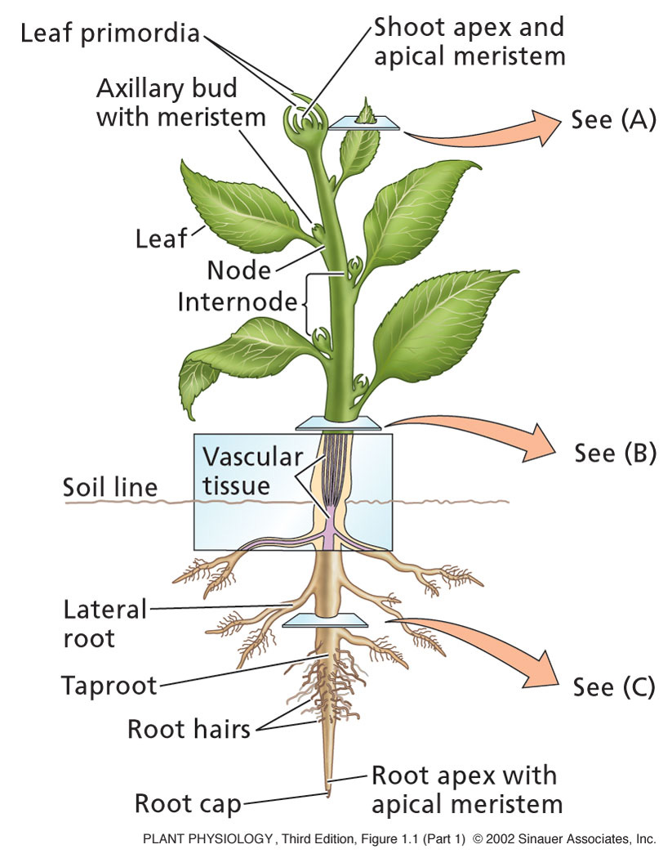
Overview of Plant Structure
The vegetative body consists of:
Leaf: Photosynthesis
Stem: Support
Roots: anchorage and absorption of water & minerals.
Nodes: leaf attached to stem.
Internode: Region of stem between two nodes

Slide 35
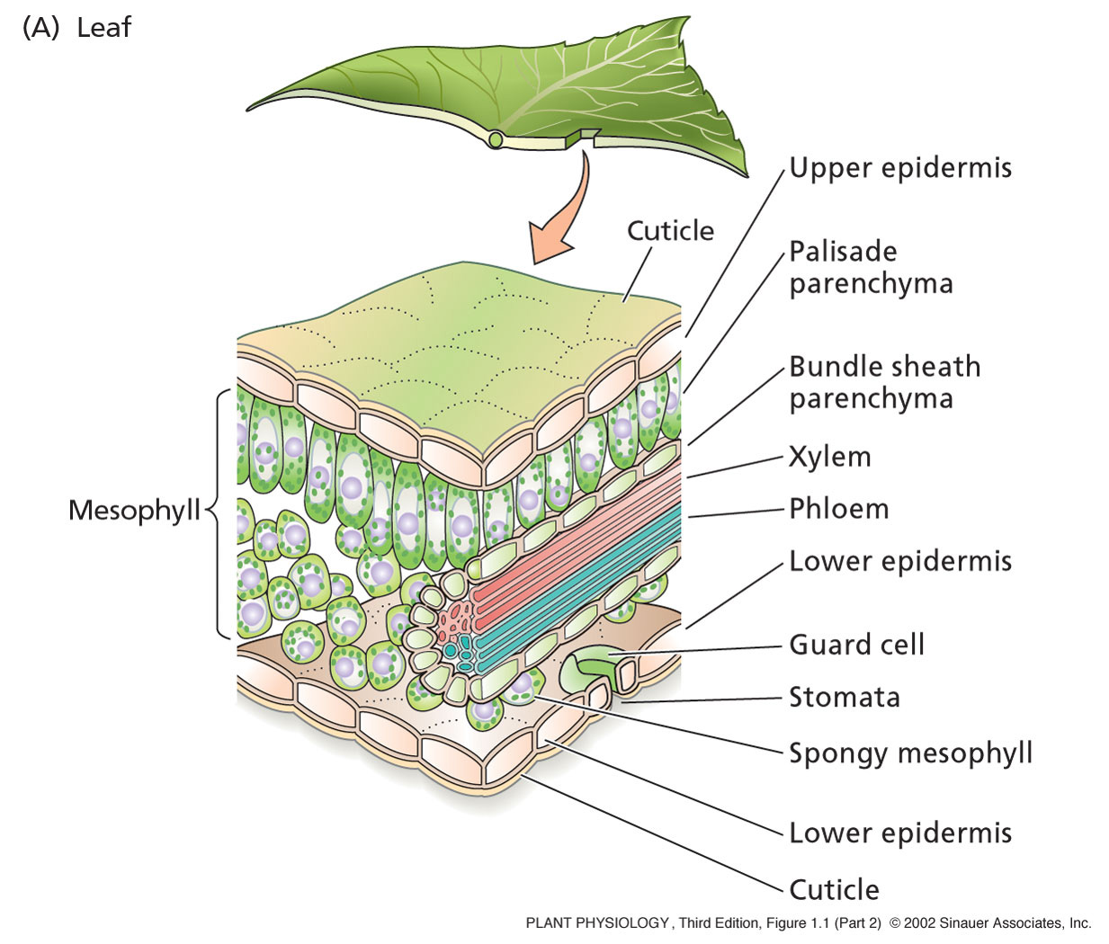
The leaf

Slide 36
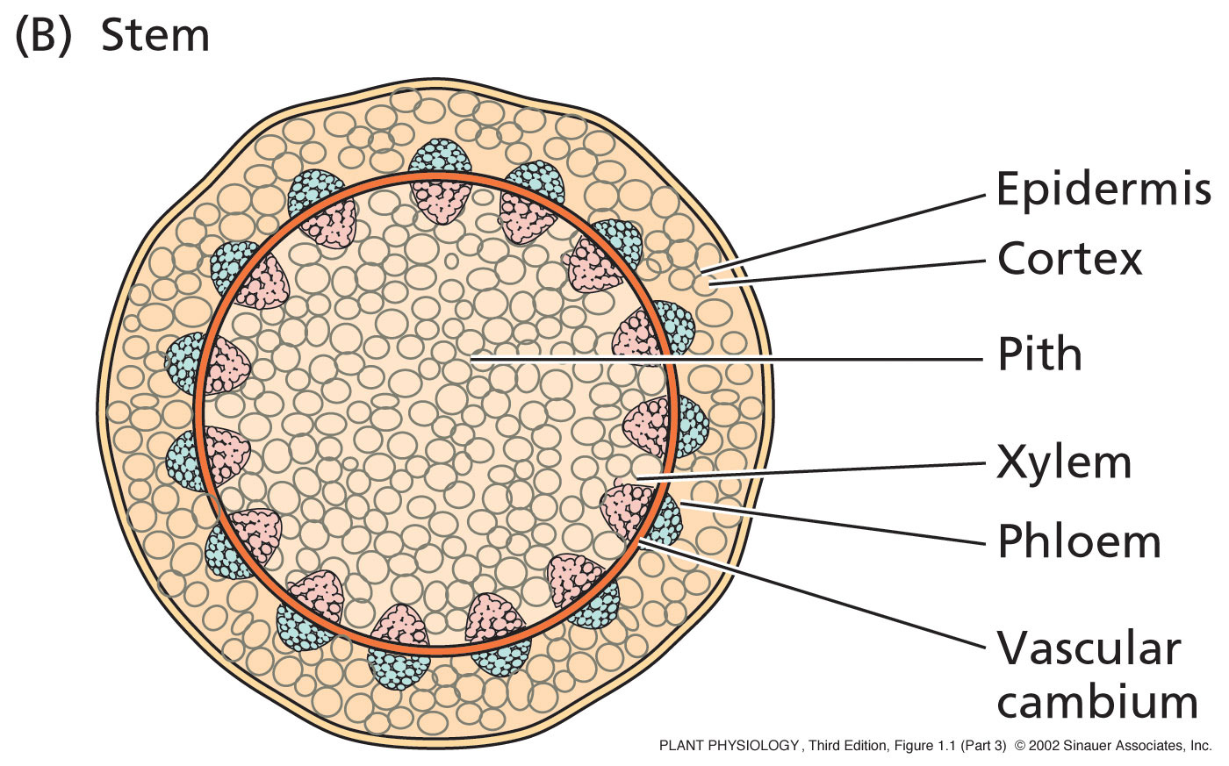
The stem

Slide 37
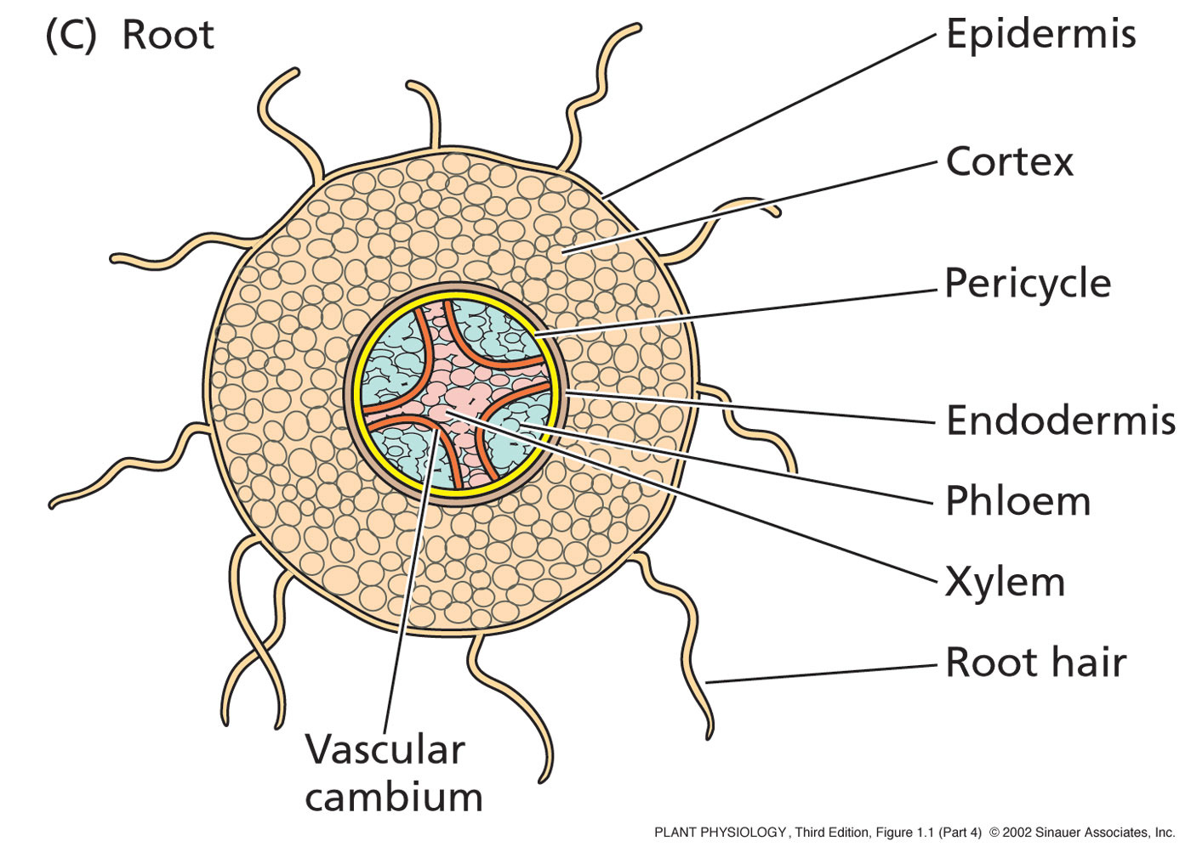
The Root

Slide 38
Overview of Plant Structure
Two general types of plants:
Angiosperms:
  More advanced type of plant
    About 250,000 species known
    Major innovation is the Flower
      So these are also known as flowing plants!
Gymnosperms:
  Less advanced than angiosperms
    About 700 species known
    Largest group is the conifer (cone bearer)
      ie, pine, fir, spruce, and redwood

Slide 39
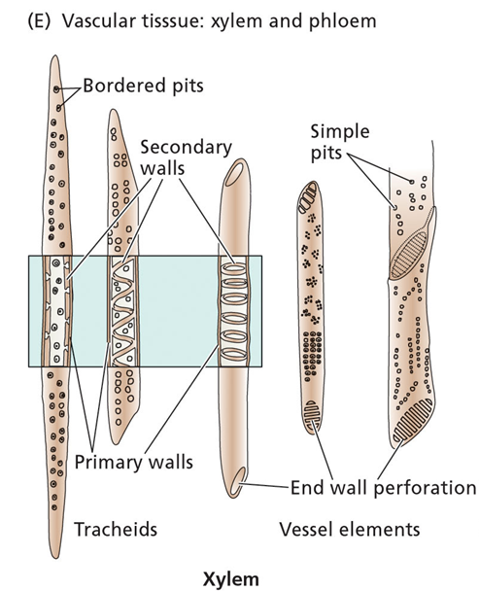
Overview of Plant Structure
Xylem:
  Main water-conducting tissue of vascular plants.
  arise from individual cylindrical cells oriented end to end.
  At maturity the end walls of these cells dissolve away and the cytoplasmic contents die.
  The result is the xylem vessel, a continuous nonliving duct.
  carry water and some dissolved solutes, such as inorganic ions, up the plant

Slide 40
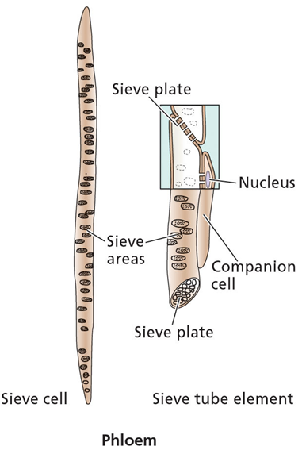
Overview of Plant Structure
Phloem:
  The main components of phloem are
    sieve elements
    companion cells.
  Sieve elements have no nucleus and only a sparse collection of other organelles . Companion cell provides energy
  so-named because end walls are perforated - allows cytoplasmic connections between vertically-stacked cells .
  conducts sugars and amino acids - from the leaves, to the rest of the plant

Slide 41
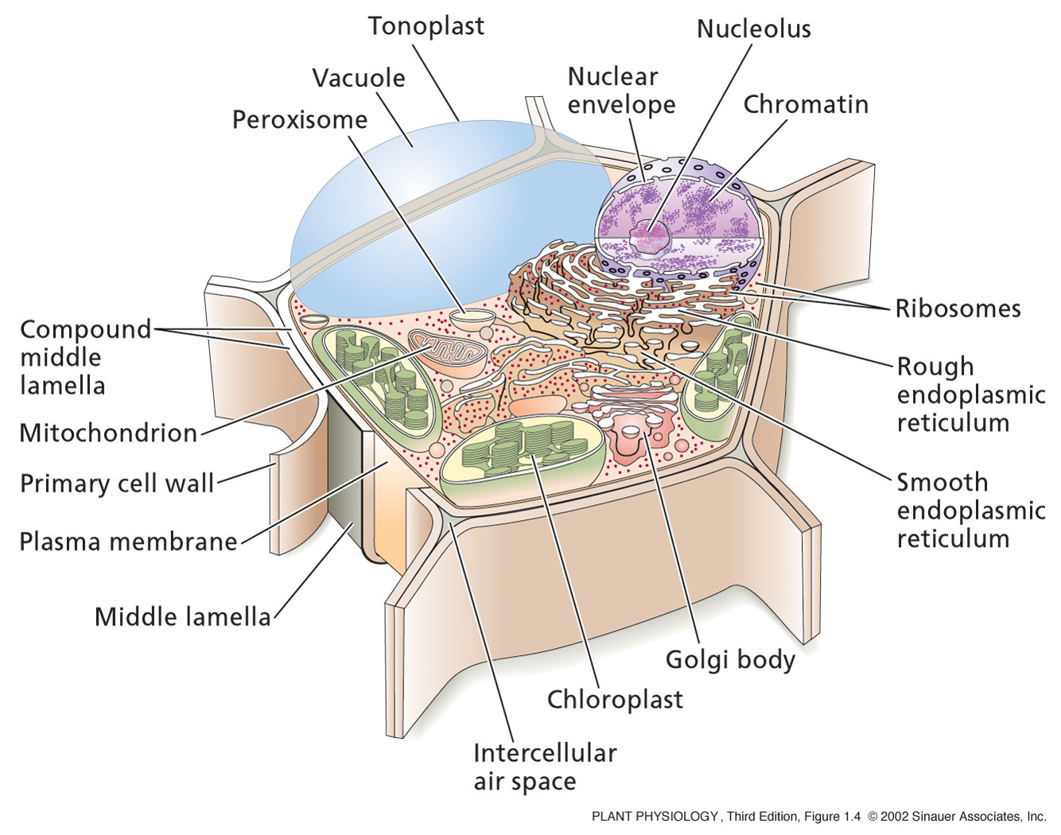
The Plant Cell

Slide 42
The Plant Cell
All plant cells have the same basic eukaryotic organization
  However, at maturity when they become specialized, plant cells may differ greatly from one another in their structures and functions
    Even those physically next to each other.
    Even the nucleus can be lost in some plant cells
Contains many organelles with specific functions
Enclosed by a membrane which defines their boundaries
Don’t Forget the Cell Wall!!!!!!!!!!

Slide 43
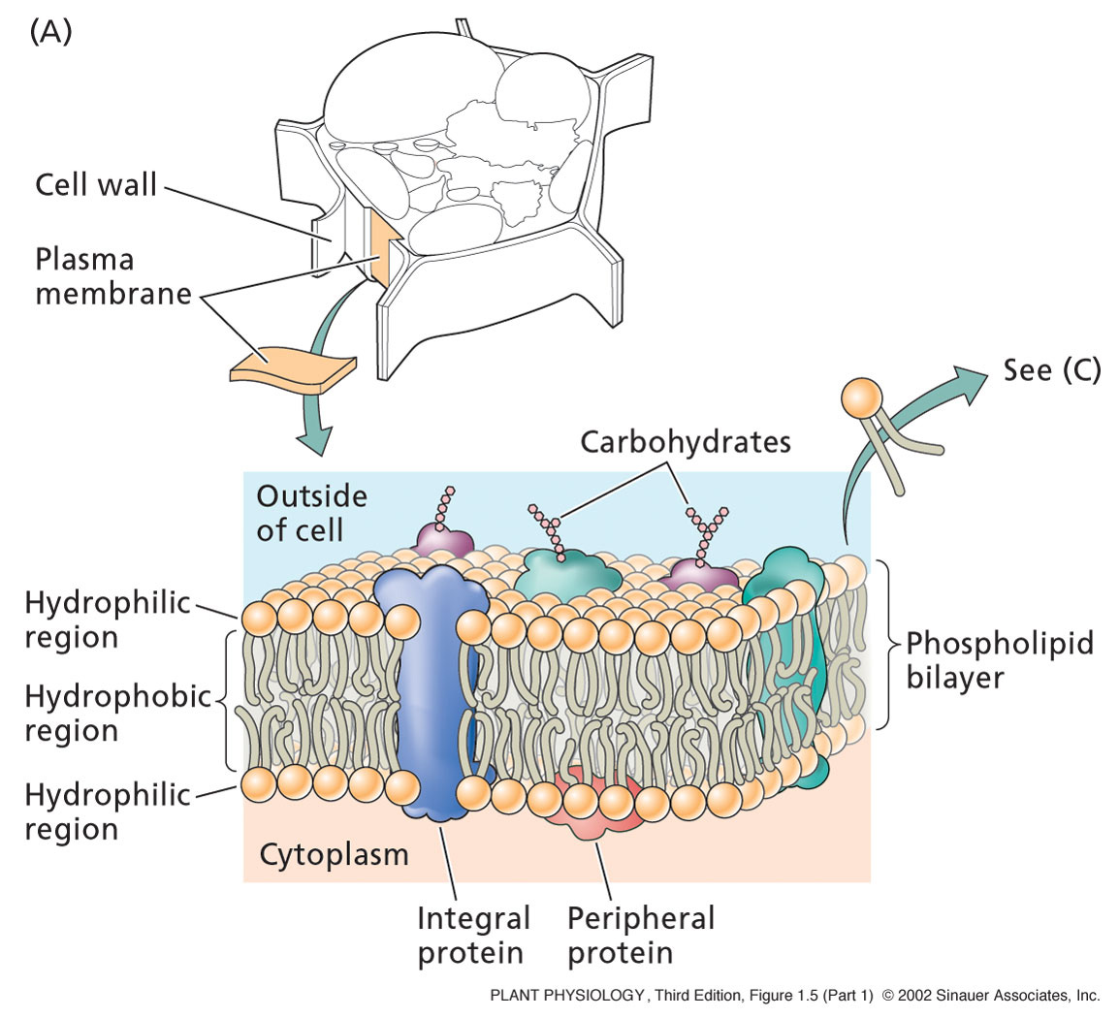
The Plasma Membrane
Composed of a phospholipid bilayer and proteins.
The phospholipid sets up the bilayer structure
Phospholipids have hydrophilic heads and fatty acid tails.
The plasma membrane is fluid--that is proteins move in a fluid lipid background

Slide 44
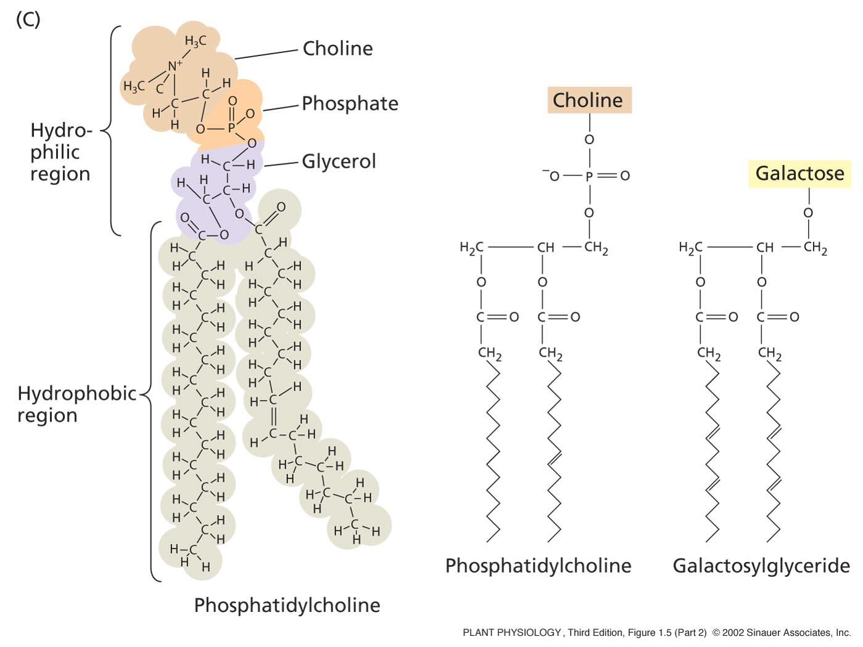
The Plasma Membrane
Phospholipids:
Two fatty acids covalently linked to a glycerol, which is linked to a phosphate.
All attached to a “head group”, such as choline, an amino acid.
Head group POLAR – so hydrophilic (loves water)
Tail is non-polar -hydrophobic
The tail varies in length from 14 to 28 carbons.

Slide 45
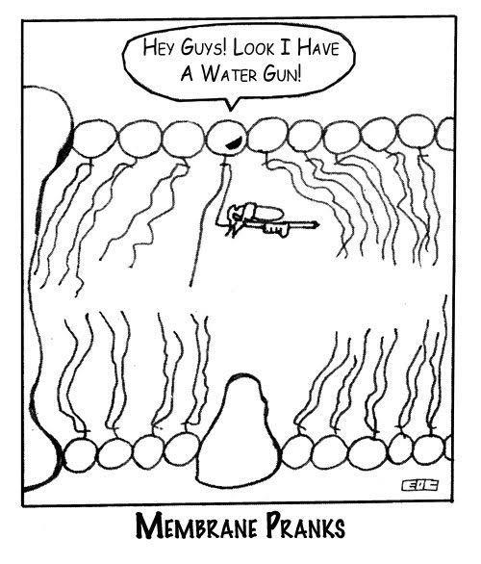
The Plasma Membrane

Slide 46
The Fluid Mosaic Model
Originally proposed by S. Jonathan Singer and Garth Nicolson in 1972.
Allows for dynamic nature of membrane
Little transition of lipids can take place without specific enzymes to mediate transfer - flippase.

Slide 47
Flippase
Enzymes located in the membrane responsible for aiding the movement of phospholipid molecules between the two leaflets that compose a cell's membrane
Two types:
  Transverse
  Lateral

Slide 48
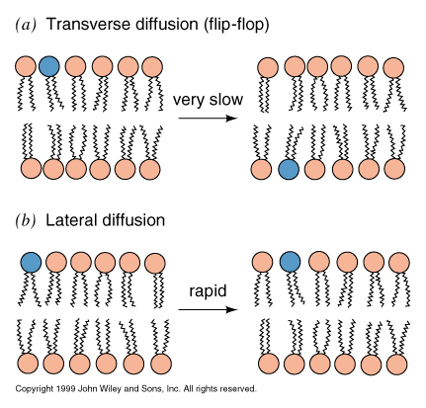
Transverse Diffusion
Or flip-flop involves the movement of a lipid or protein from one membrane surface to the other.
Is a fairly slow process due to the fact that a relatively significant amount of energy is required for flip-flopping to occur.
Notes:
48

Slide 49
Transverse Diffusion
Most large proteins do not flip-flop due to their extensive polar regions, which are unfavorable in the hydrophobic core of a membrane bilayer.
This allows the asymmetry of membranes to be retained for long periods, which is an important aspect of cell regulation.
Notes:
49

Slide 50
Lateral Diffusion
Refers to the lateral movement of lipids and proteins found in the membrane.
Membrane lipids and proteins are generally free to move laterally if they are not restricted by certain interactions.
Is a fairly quick and spontaneous process

Slide 51
Flippase
Potential role of ATP-dependent lipid flippases in vesicle formation.
ATP-dependent lipid translocation might help deform the membrane by moving lipid mass towards the cytoplasmic leaflet

Slide 52
Flippase
This area asymmetry will increase the spontaneous curvature of the bilayer, and may thus help deform the membrane during vesicle budding.
Lem3-Cdc50 proteins regulate the localization and activity of P4-ATPases.
P4-ATPases play a pivotal role in the biogenesis of intracellular transport vesicles, polarized protein transport and protein maturation.

Slide 53
Flippase
Interaction of P4-ATPases with peripheral guanine nucleotide-exchange factors (GEFs) might cause activation of small GTPases.
GTPases subsequently bind to the membrane and facilitate the assembly of coat proteins (if required)
And thus, the endo-membrane system allows gene expression, post-translational modification, and secretion to occur!

Slide 54
The Plasma Membrane
Proteins:
Integral proteins:
  Embedded in lipid bylayer – serve as “ion pumps”
  They pump ions across the membrane against their concentration gradient
Peripheral proteins:
  Bound to membrane surface by ionic bonds.
  Interact with components of the cytoskeleton
Anchored proteins:
  Bound to surface via lipid molecules

Slide 55
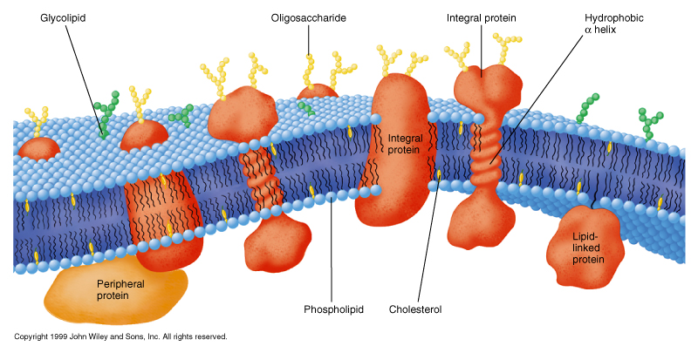
Proteins - Add function and structure to membrane
Extrinsic proteins (peripheral)
  Loosely attached to membrane
  ionic bonds with polar head groups and carbohydrates
  hydrophobic bonds with lipid
  proteins have lipids tails
Notes:
55

Slide 56
Integral proteins
tightly bound to membrane - span both sides
Protein has both polar and hydrophobic sections removed only through disrupting membrane with detergents
Notes:
56

Slide 57
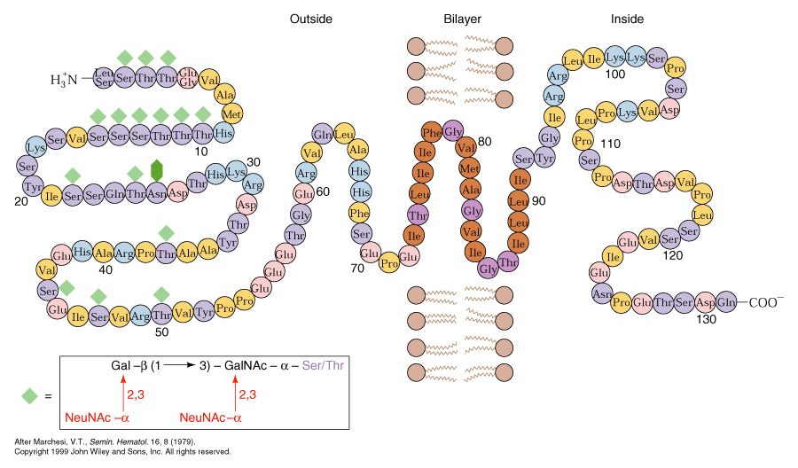
Transmembrane proteins
Has a total molecular weight of about 31,000 and is approximately 40% protein and 60% carbohydrate.
The primary structure consists of a segment of 19 hydrophobic amino acid residues with a short hydrophilic sequence on one end and a longer hydrophilic sequence on the other end.
The 19-residue sequence is just the right length to span the cell membrane if it is coiled in the shape of an α-helix.
The large hydrophilic sequence includes the amino terminal residue of the polypeptide chain.

Slide 58
Transmembrane proteins
General “Rules of thumb”
takes about 20 aa to cross membrane
  many proteins cross many times
  odd # of transmembrane regions,
      -COOH terminal usually cytosolic
      -NH₃⁺ terminal extracellular
  can be predicted by amino acid sequence
  high % of side chains will be hydrophobic

Slide 59
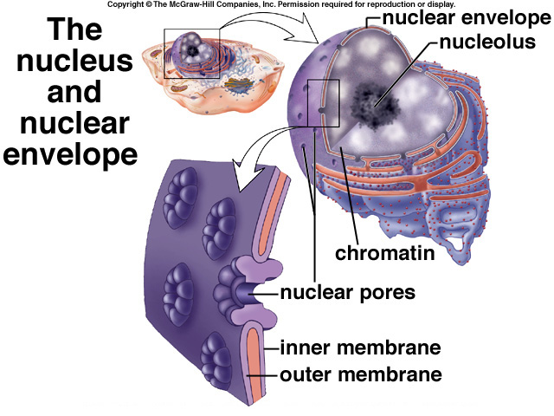
The nucleus
Contains almost all of the genetic material
What it contains is called the nuclear genome – this varies greatly between plant species.
Surrounded by nuclear envelope- double membrane - same as the plasma membrane.
The nuclear pores allow for the passage of macromolecules and ribosomal subunits in and out of the nucleus.

Slide 60
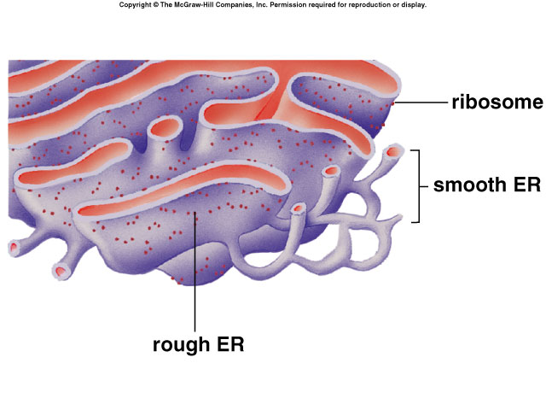
The Endoplasmic reticulum
Connected to the nuclear envelope
3D-network of continuous tubules that course through the cytoplasm.
Rough ER: Synthesize, process, and sort proteins targeted to membranes, vacuoles, or the secretory pathway.
Smooth ER: Synthesize lipids and oils.
Also:
  Acts as an anchor points for actin filaments
  Controls cytosolic concentrations of calcium ions

Slide 61
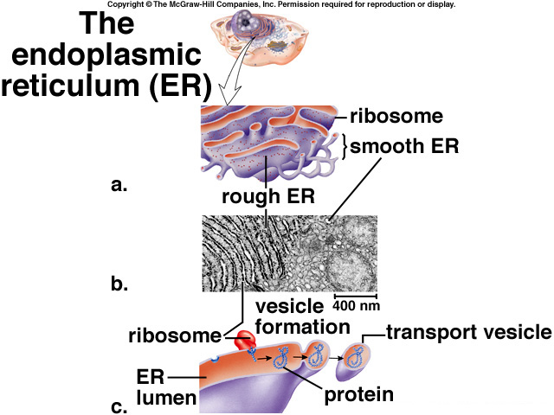
The Endoplasmic reticulum
Proteins are made in the Rough ER lumen by an attached ribosome.
Protein detaches from the ribosome
The ER folds in on itself to form a transport vesicle
This transport vesicle “buds off” and moves to the cytoplasm
Either:
  Fuses with plasma membrane
  Fuses with Golgi Apparatus

Slide 62
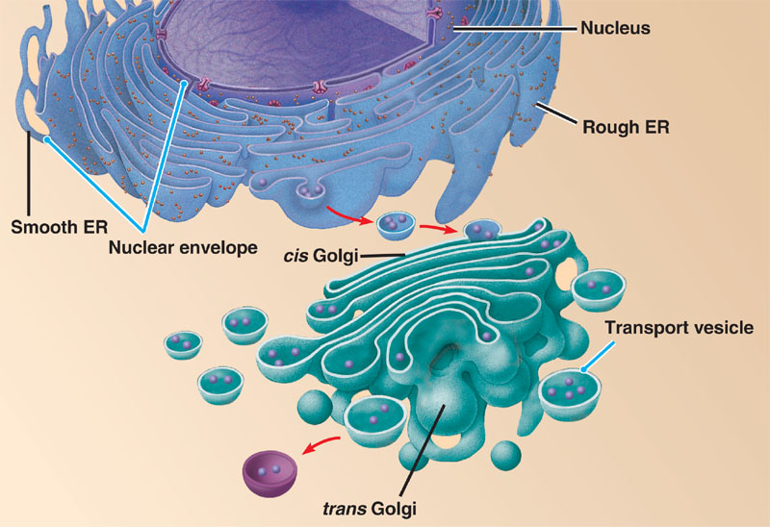
The Golgi Network
Proteins or lipids made in the ER contained in transport vesicles fuse with the Golgi.
The Golgi modifies proteins and lipids from the ER, sorts them and packages them into transport vesicles.
This transport vesicle “buds off” and moves to the cytoplasm.
Fuse with plasma membrane.

Slide 63
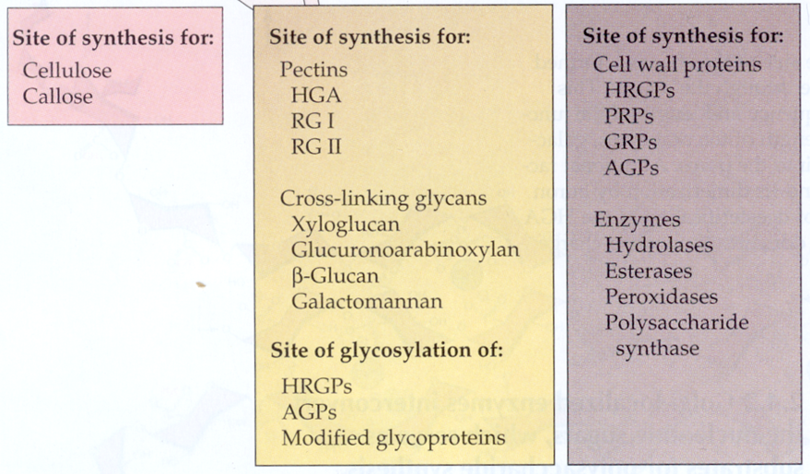
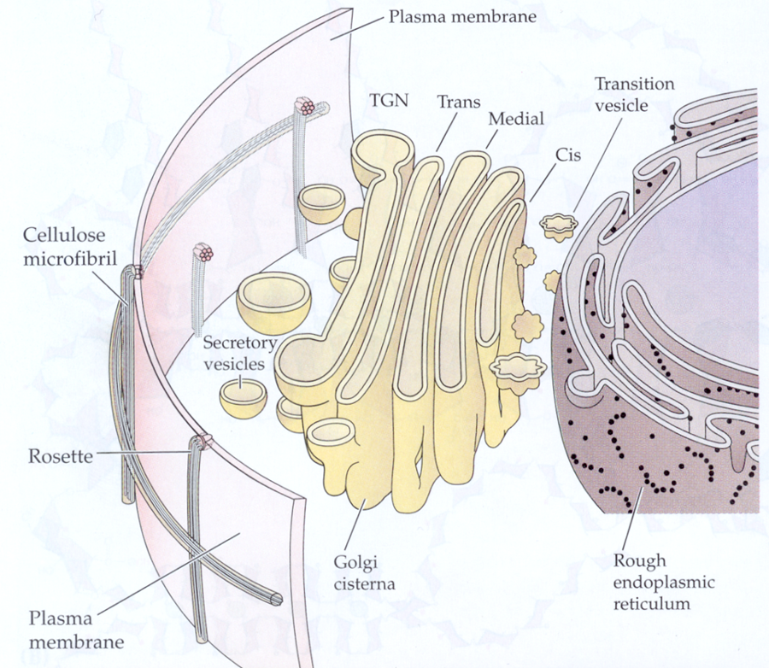
The Golgi Network

Slide 64
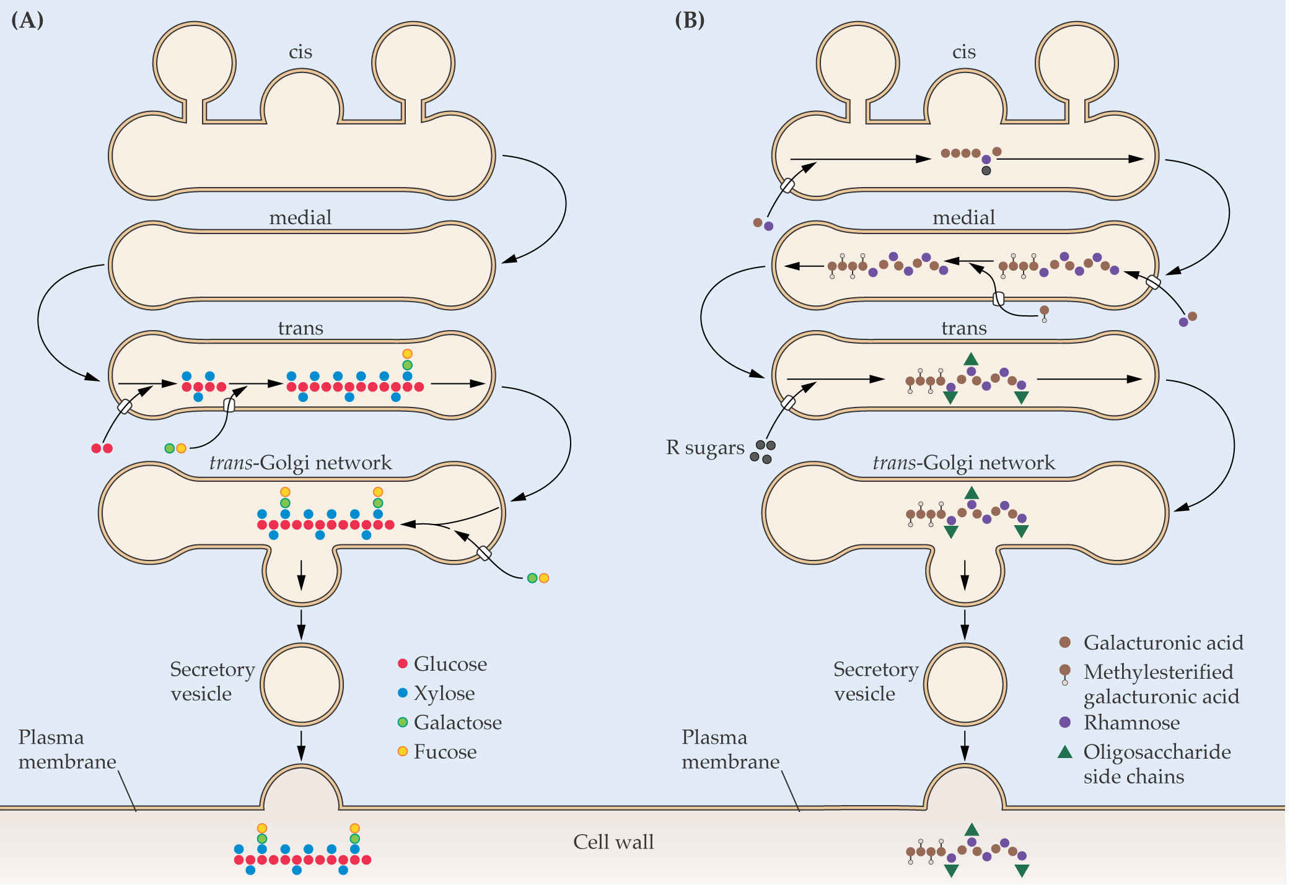
Golgi Trafficking
Xyloglucan Pectins

Slide 65
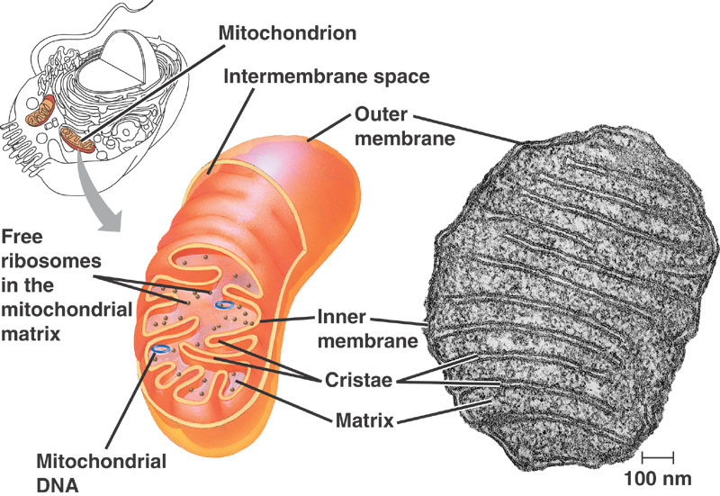
The Mitochondria
Contain their own DNA and protein-synthesizing machinery
  Ribosomes, transfer RNAs, nucleotides.
  Thought to have evolved from endosymbiotic bacteria.
  Divide by fusion
  The DNA is in the form of circular chromosomes, like bacteria
  DNA replication is independent from DNA replication in the nucleus

Slide 66
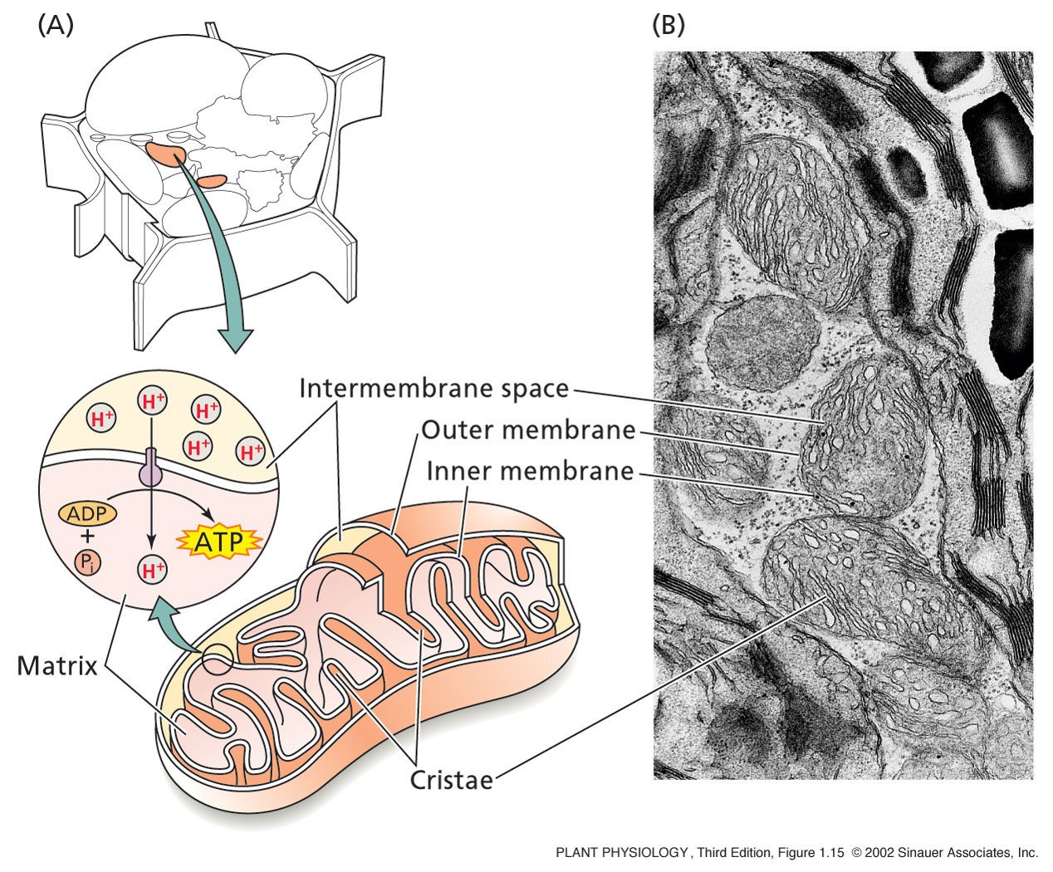
The Mitochondria
  Site of Cellular Respiration
This process requires oxygen.
Composed of three stages:
  Glycolysis--glucose splitting, occurs in the cell. Glucose is converted to Pyruvate.
  Krebs cycle--Electrons are removed--carriers are charged and CO2 is produced. This occurs in the mitochondrion.
  Electron transport--electrons are transferred to oxygen. This produces H2O and ATP. Occurs in the mito.

Slide 67
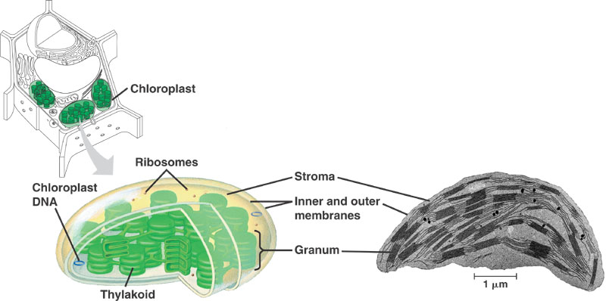
The Chloroplast
Contain their own DNA and protein-synthesizing machinery
  Ribosomes, transfer RNAs, nucleotides.
  Thought to have evolved from endosymbiotic bacteria.
  Divide by fusion
  The DNA is in the form of circular chromosomes, like bacteria
  DNA replication is independent from DNA replication in the nucleus

Slide 68
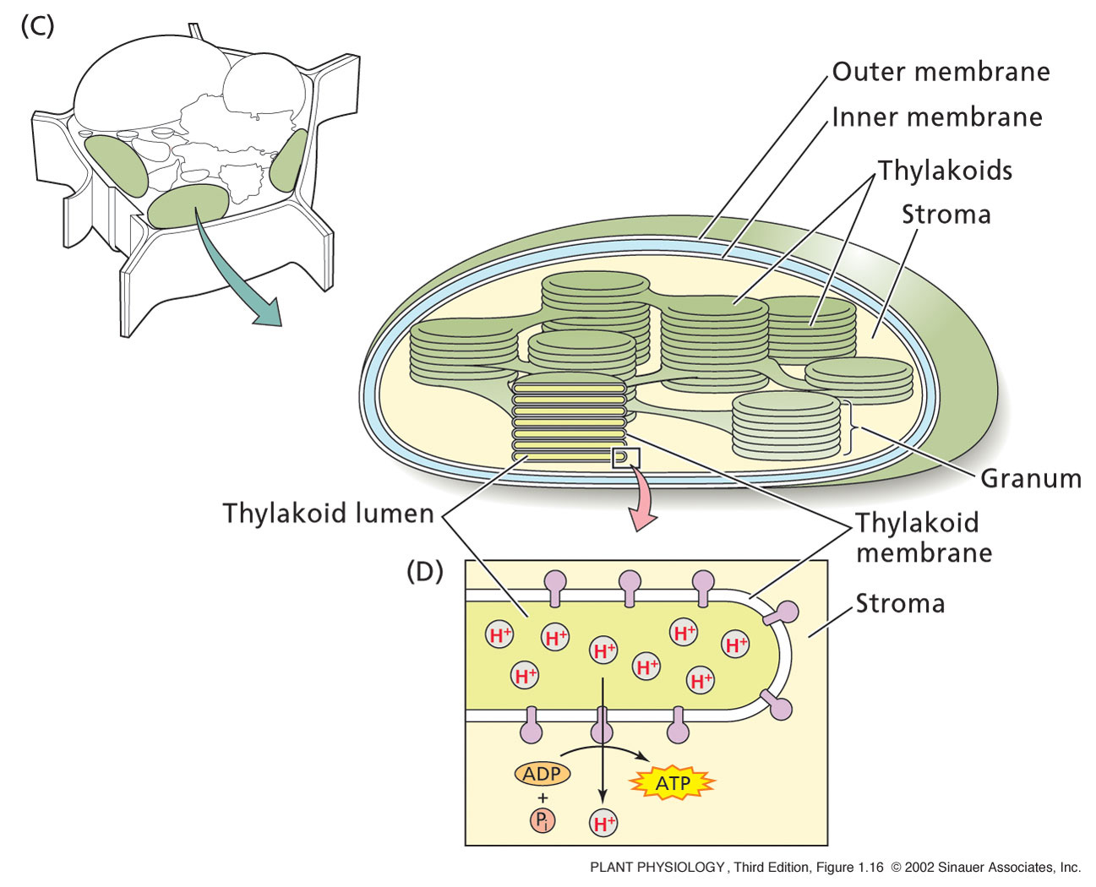
The Chloroplast
Membranes contain chlophyll and it’s associated proteins
  Site of photosynthesis
Have inner & outer membranes
3rd membrane system
  Thylakoids
Stack of Thylakoids = Granum
Surrounded by Stroma
  Works like mitochondria
During photosynthesis, ATP from stroma provide the energy for the production of sugar molecules

Slide 69
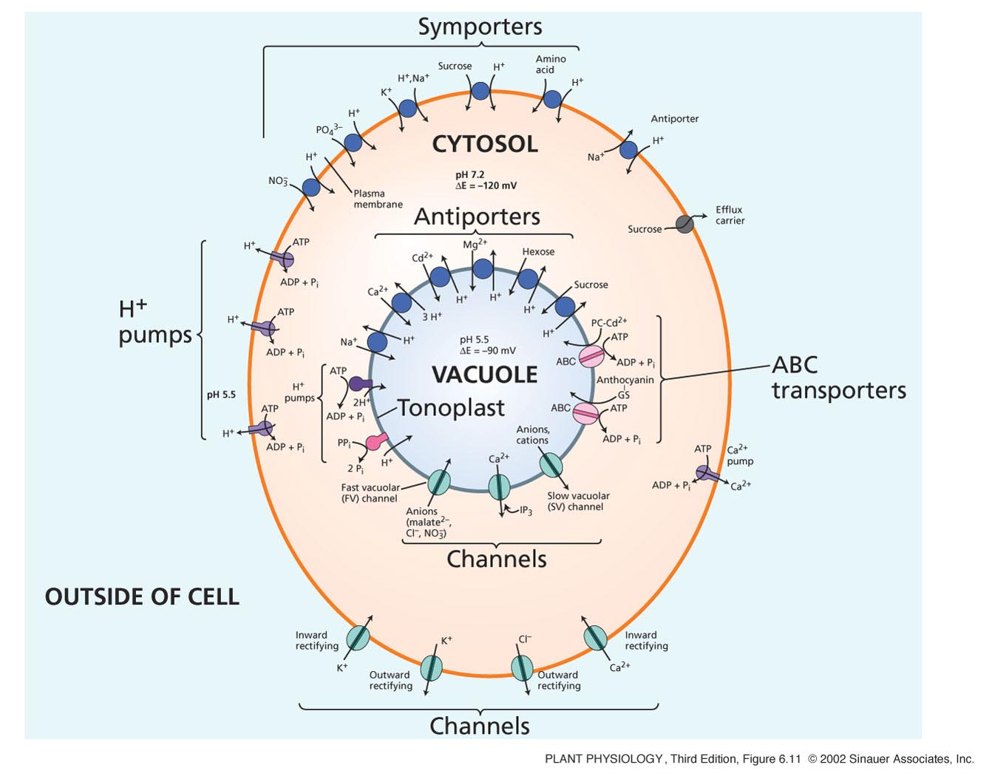
The Vacuole
Can be 80 – 90% of the plant cell
Contained within a vacuolar membrane (Tonoplast)
Contains:
  Water, inorganic ions, organic acids, sugars, enzymes, and secondary metabolites.
Required for plant cell enlargement
The turgor pressure generated by vacuoles provides the structural rigidity needed to keep herbaceous plants upright.

Slide 70
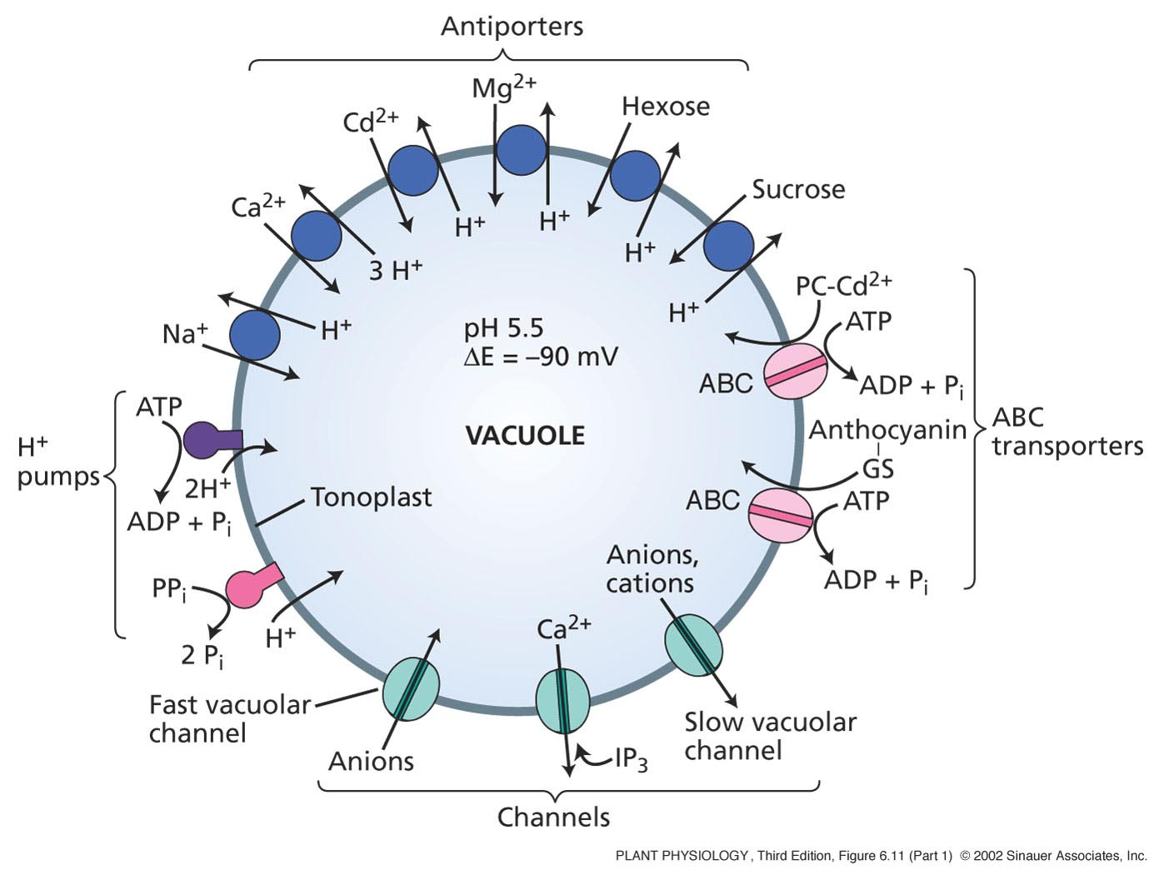
The Vacuole
In general, the functions of the vacuole include:
Isolating materials that might be harmful or a threat to the cell
Containing waste products
Containing water in plant cells
Maintaining internal hydrostatic pressure or turgor within the cell
Maintaining an acidic internal pH
Containing small molecules
Exporting unwanted substances from the cell
Allows plants to support structures such as leaves and flowers due to the pressure of the central vacuole
In seeds, stored proteins needed for germination are kept in 'protein bodies', which are modified vacuole

Slide 71
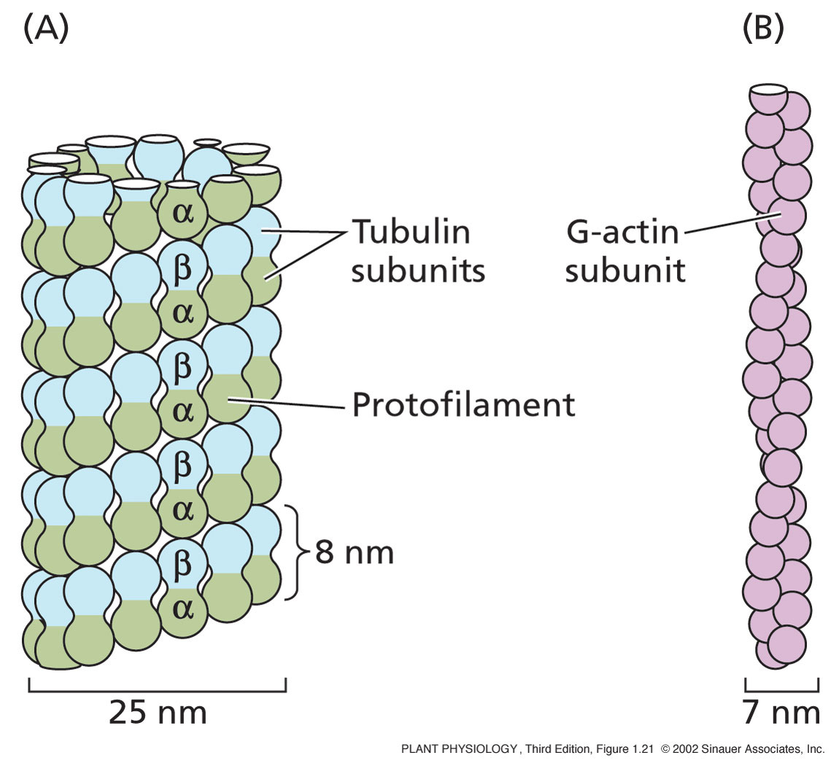
The cytoskeleton
Three main components:
Microtubules: are α and β proteins that create scaffolding in a cell. MTs are formed from the protein tubulin. 13 rows of tubulin =1 microtubule
Microfilaments: solid (7 nm) made from G-actin protein. Consists of 2 chains of actin subunits that intertwine in a helical fashion

Slide 72
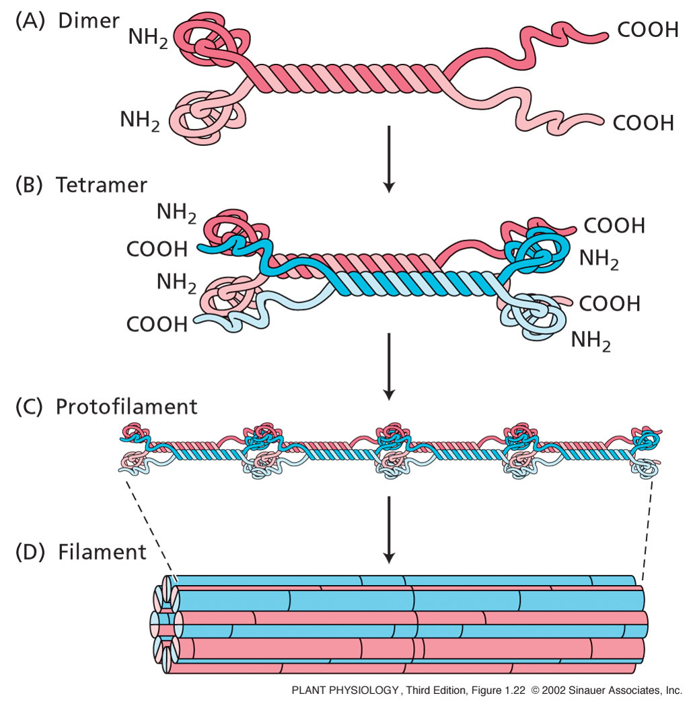
The cytoskeleton
Intermediate filaments: a diverse group of helically wound linear proteins.
Dimers line up parallel to each other
These form anti-parallel Tetramers
These join together to form a filament

Slide 73
The cytoskeleton
All these elements can assemble and disassemble
Involved in plant cell division
  During mitosis
    Process of division that produces two daughter cells with identical chromosomal content of parent cell

Slide 74

Plamodesmarta
Each contains a tube called a Desmotubule, which is part of the ER.
This is what connects adjacent cell and allow chemical communication and transport of material throughout the whole plant.
The restriction acts to control the size of the molecules which pass through.

Slide 75

The Plant Cell wall
The cell wall is the organelle that ultimately controls the shape of plant cells and consequently of organs and whole organisms.
It is sometimes naturally strengthened and made considerably more resistant to such abuses as pathogen infection by the release of specific oligosaccharides and enzymes and by overlaying or impregnation with cutin, suberin, waxes or silica

Slide 76

Major structural components of the primary cell wall and their likely arrangement

Slide 77
The Plant cell wall
    Critical to:
    plant cell growth
    plant growth and development
    differentiation
    response to biotic and abiotic stress
    Impact human activities in many ways:
    wood
    paper
    textile
    fuel
    food
    livestock feed
    brewing
    pharmaceuticals

Slide 78

The Plant Cell wall
Cell walls are held together by the middle Lamella.
Made up of:
Cellulose
Xyloglucan
Pectin
Proteins
Ca ions
Lignin
other ions
Water

Slide 79
ANY QUESTIONS?

