Slide 1
Evolution: Early Plants to Higher Plants

Slide 2
Biological classification
Used to group and categorize organisms into groups such as genus or species. These groups are known as taxa.
Think about classification that is used in everyday life
What would happen if grocery stores did not use a classification system?
What about libraries, movie stores, department stores, etc.?
About 1.8 million species have been given scientific names
nearly 2/3 of these are insects
Total number of living species is estimated to be between 13 and 14 million
with most being insects and microscopic life forms in tropical regions

Slide 3
Biological classification
Modern biological classification has its root in the work of Carl Linnaeus, who grouped species according to shared physical characteristics.
Linnaeus attempted to describe the entire known natural world and gave every species a two-part name.
Linnaeus is often known as “The Father of Taxonomy”
These groupings were later revised to improve consistency with the Darwinian principle of common descent.
He established that all species of life have descended over time from common ancestors, and proposed the scientific theory that this branching pattern of evolution resulted from a process that he called natural selection.
Carl Linnaeus
Charles Darwin
From the wikimedia free licensed media file repository

Slide 4
Ideal Classification Scheme
Ideally we would construct a classification scheme which progresses from primitive or ancestral traits to advanced or derived traits.
Ideally each taxon would be monophyletic - arisen by diversification from a single ancestor – the Plant Kingdom – whether the Embrophytes (land plants) or Viridiplantae (green algae plus land plants).
In contrast polyphyletic groups have arisen from more than one ancestor - the Protista
A paraphyletic group is one in which all members possess a single ancestor in common, but which does not constitute all descendants of that ancestor - the Dicots

Slide 5
Ancestral Green
Algae
Bryophytes
Ferns & allies
Gymnosperms
Angiosperms
Seed Plants
Vascular Plants
Flowers
Seeds
Overview of Plant Evolution
Vascular tissue
Embryos
Origin of land plants

Slide 6
Developing Classification Systems
In developing classification systems, we attempt to group plants which share derived characteristics - presumably these characters have only arisen once or at most a few times - it is not always easy to tell what is a derived character though
Derived characters may arise independently in different groups of plants through convergent evolution or parallel evolution
convergent - unrelated plants develop similar characteristics due to common environment
parallel - plants with common ancestor develop similar characteristics even though the ancestor did not have that characteristic

Slide 7
Usefulness of Characters
Different characteristics have differing degrees of utility in terms of classification - a uniform characteristic may be very good at demonstrating cohesion or relatedness at a higher level of classification such as the family
Conversely, some characters which have a great deal of variability may be of little value in differentiating higher orders of classification, such as family, but may be very valuable in differentiating lower taxonomic groups such as the genus or species

Slide 8
Systematics
Since fossil records are not complete, scientists rely on other types of evidence to establish the best hypothesis of evolutionary relationships
Systematics: the study of evolutionary relationships
Phylogeny: a hypothesis about patterns of relationship among species

Slide 9
Systematics classifies species based on similarity of traits and possible mechanisms of evolution, a change in the gene pool of a population over time.
Phylogenetic systematics is that field of biology that does deal with identifying and understanding the evolutionary relationships among the many different kinds of life on earth, both living and dead.
Evolutionary theory states that similarity among individuals or species is attributable to common descent, or inheritance from a common ancestor.
Evolution requires genetic variation which results from changes within a gene pool, the genetic make-up of a specific population.

Slide 10
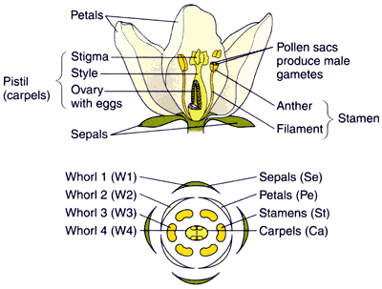
Morphology
Plants are highly plastic in their growth forms
- how tall they grow, their shape will vary depending upon environment and growing conditions
However, reproductive structures tend not to differ in form from plant to plant of the same species
-they may differ in number, but form is conservative - flowers, cones tend to be similar within all members of a species
- thus much plant classification and identification is based upon reproductive structures
Copyright © 2002 Pearson Education, Inc., publishing as Benjamin Cummings

Slide 11
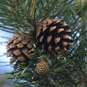
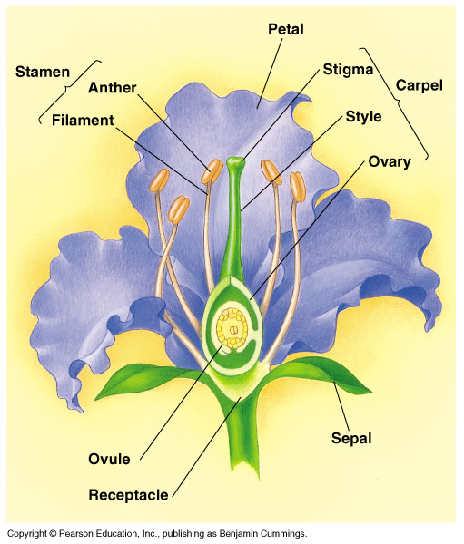
Morphology and Pollination
Very important and easily observed taxonomic differences in plants depend upon type of pollination
Wind pollinated plants typically have reduced, inconspicuous unisexual flowers - think of grasses, or the cones of pines
Insect and other animal pollinated plants tend to have large, colorful, conspicuous, nectar-secreting, bisexual flowers
If insect pollinated plants have small flowers, they are usually gathered together into a large inflorescence
From the wikimedia free licensed media file repository

Slide 12
Key Floral Characteristics
Among the most important floral characteristics for classification and identification are:
ovary position
floral symmetry
adhesion and cohesion of parts (are they fused together?)
carpel number
stamen number
number of petals and sepals
Copyright © 2002 Pearson Education, Inc., publishing as Benjamin Cummings

Slide 13
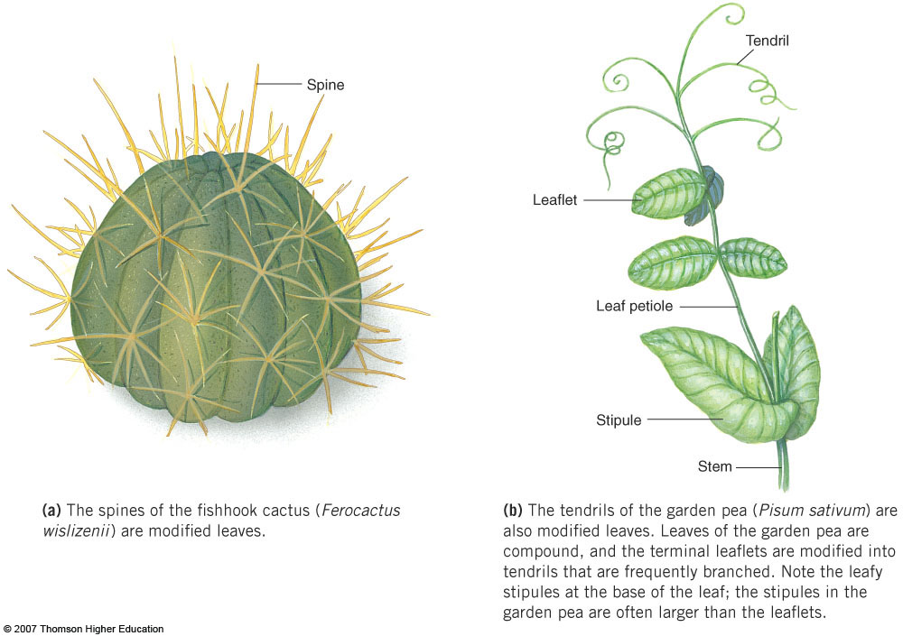
Homologous Features
Dissimilar structures with an underlying similarity of form and development that occur in different species with a common ancestry
Indicate evolutionary ties between the organisms possessing them

Slide 14
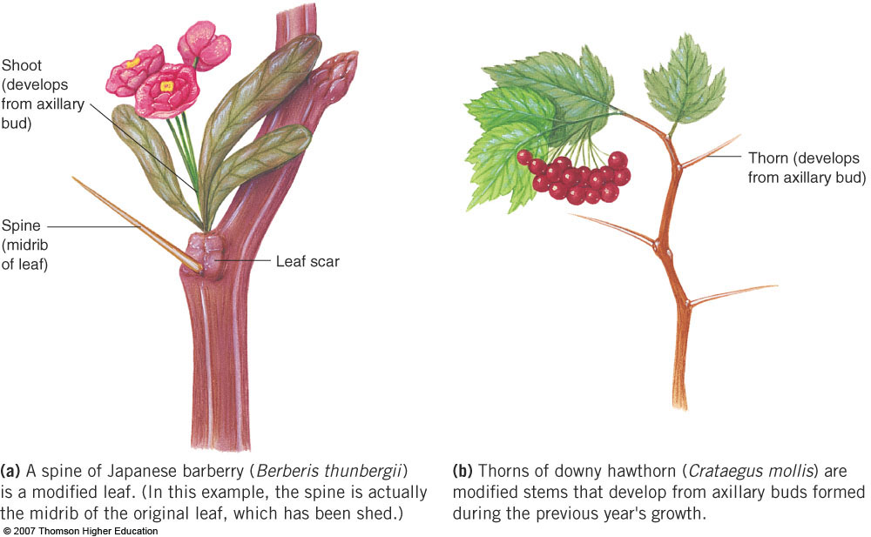
Homoplastic Features
Structures in unrelated species that are similar in function and appearance but not in evolutionary origin
Are the result of convergent evolution
Independent evolution of similar adaptations in unrelated species living in similar environments

Slide 15
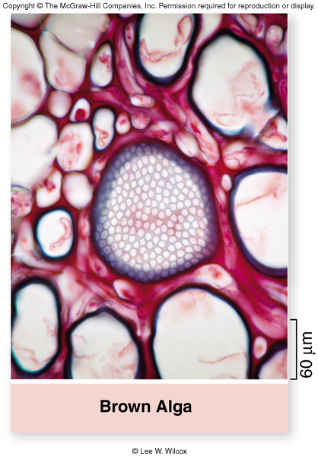
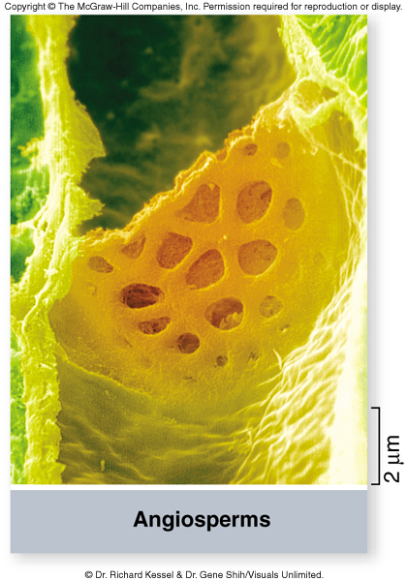
Comparative Biology
Homoplastic convergence: plant conducting tubes
Sieve tubes (in phloem) facilitate long-distance transport of food that is essential for the survival of tall plants
Brown algae also have sieve elements
Closest ancestor a single-celled organism
Convergent evolution of conducting tubes

Slide 16
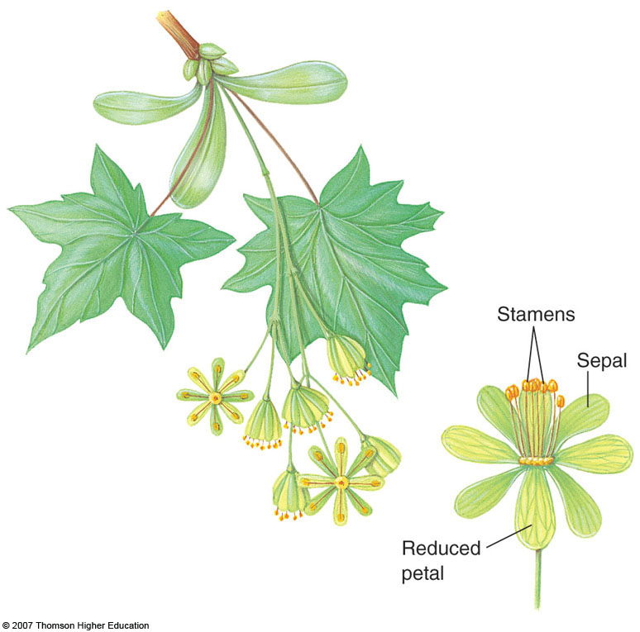
Vestigial Structure
An evolutionary remnant of a formerly functional structure
Occasionally present as an ancestral species adapts to a different mode of life

Slide 17
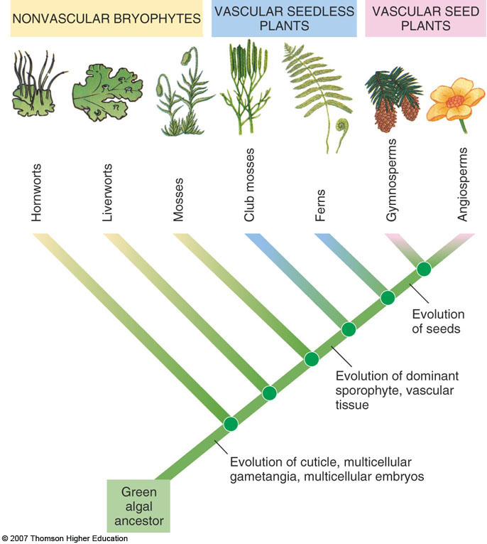
Plant Evolution

Slide 18
Plants from Sea
to the Land

Slide 19
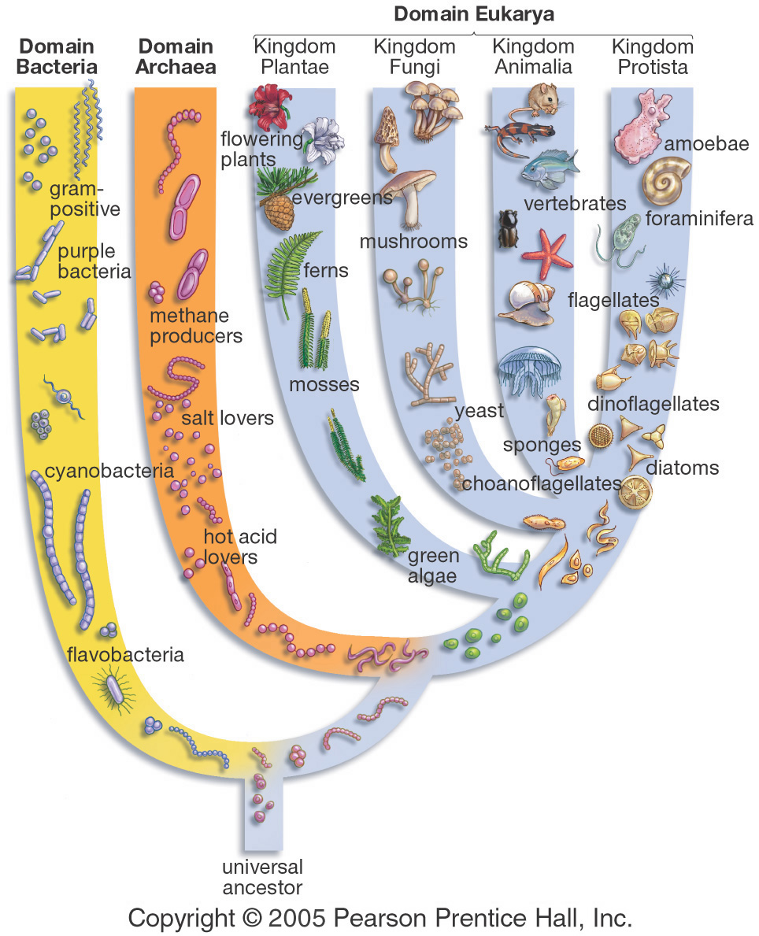
Algae - from the Kingdom Protista
Organisms in this Kingdom don’t fit clearly into what we call plant, animal, or fungi.
Most diverse eukaryotic Kingdom (>60,000 species).
We are interested in this Kingdom because of the Chlorophytes & Charophyceans - green algae.
From the wikimedia free licensed media file repository

Slide 20
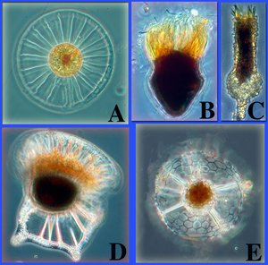
PROTISTS
• Protists are eukaryotes because they all have a nucleus.
• Most have mitochondria.
• Many have chloroplasts with which they carry on photosynthesis.
• Many are unicellular and all groups (with one exception) contain some unicellular members.
A better name for Protists would be "Eukaryotes that are neither Animals, Fungi, nor Plants".
From the wikimedia free licensed media file repository

Slide 21
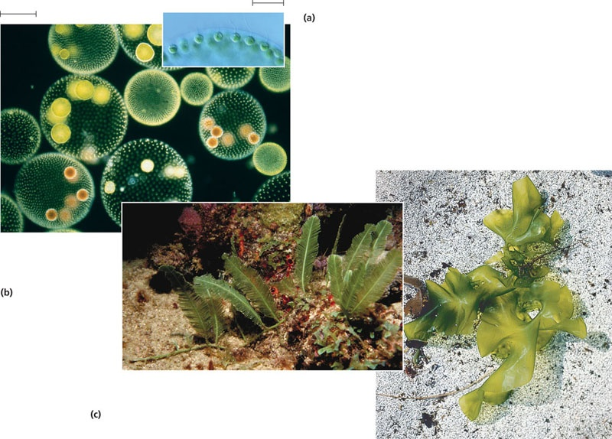
The start - Algae
Algae are the simplest multicellular plants. Some are unicellular eg. Chlamydomonas
Pant body: known as Thallus and they are avascular
Habitat: Algae are usually aquatic, either freshwater or marine and some are terresterial.
Algae are eukaryotic thallophytes.
Algae are photoautotrophs.
Storage form of food: Starch
Reproduction: Algae reproduce either by vegetative, asexual or sexual method

Slide 22
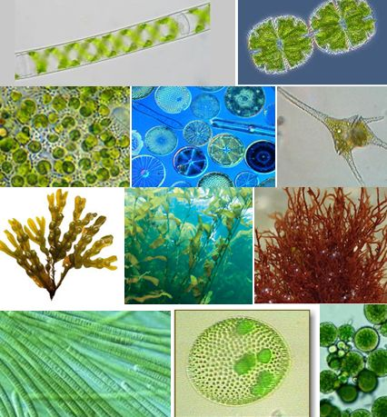
Classification
On the basis of photosynthetic pigments, algae are classified into three classes.
Chlorophyceae (green algae)
Phaeophyceae (brown algae)
Rhodophyceae (red algae).
Copyright © 2002 Pearson Education, Inc., publishing as Benjamin Cummings

Slide 23
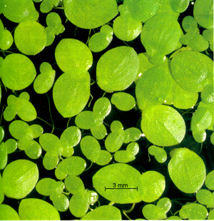
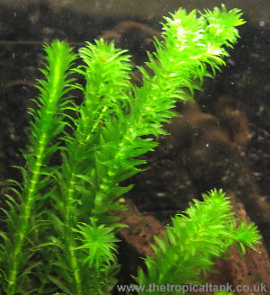
Green Algae
It is the largest class of algae
Photosynthetic pigments: chlorophyll a, chlorophyll b and small amount of β-carotenoids.
The body structure and chloroplasts vary in shape. Can be unicellular or colonial
Both freshwater and marine, some parasitic (They are unicellular as well as multicellular.
Each cell is eukaryotic
Reproduction: vegetative, asexual and sexual method
Copyright © 2002 Pearson Education, Inc., publishing as Benjamin Cummings

Slide 24
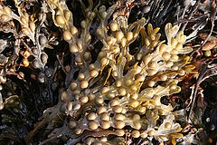
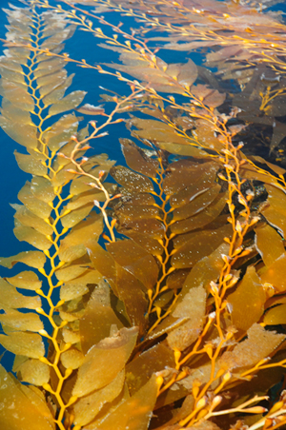
Brown Algae
Pheophyceae are called commonly known as brown algae
Photosynthetic pigments: They possesses brown colored photosynthetic pigments fucoxanthin and β-carotenoids in addition to chlorophyll a and c.
Mostly marine, very few are fresh water
They are multicellular. No unicellular and colonial (motile or non-motile) known.
Storage form of food: laminarin starch, manitol (alcohol) and some store iodine also.
Reproduction: vegetative, asexual and sexual methods
Copyright © 2002 Pearson Education, Inc., publishing as Benjamin Cummings

Slide 25
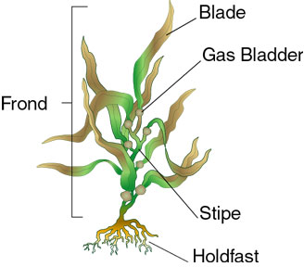
Structure of Brown Algae-kelp
Kelp anchors itself to the sea floor by use a massive holdfast.
Does not absorb nutrients from the water
Gases (both CO₂ and O₂), water ant nutrient exchanges occurs from water into the blade by permanently open stomata
Gas Bladder (Pneumatocysts) developed as a means to maximize energy production through photosynthesis by keeping the seaweedclose to the surface
From the wikimedia free licensed media file repository

Slide 26
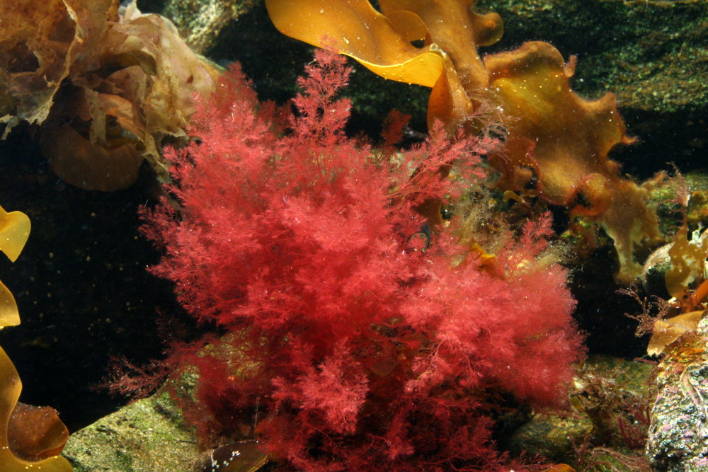
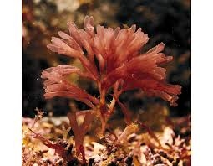
Red Algae
Rhodophyceae are commonly known as Red Algae
Photosynthetic pigments: They possesses Red colored photosynthetic pigments r-phycocyanin and r-phycoerythrin along with chlorophyll a, d, xanthophyll and β-carotenoid
They are aquatic, mostly marine. Some are freshwater. They show a variety of life forms.
Storage form of food is starch and 5-Carbon sugar (mostly Xylose).
Reproduction: vegetative, asexual and sexual mode
Some species shows Alternation of generations in their life cycle.
Copyright © 2002 Pearson Education, Inc., publishing as Benjamin Cummings

Slide 27
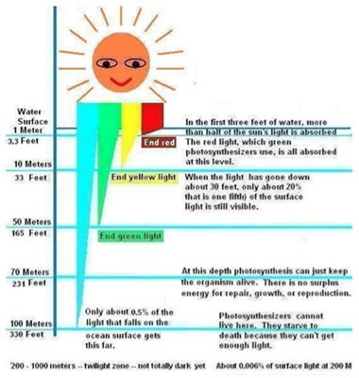
Photosynthesis underwater
Main advantage of Moving to a Terrestrial Environment
Increased Photosynthesis and Decreased Competition
Light energy available to organisms living beneath the water's surface is greatly reduced.
The blue and especially red wavelengths of light that are absorbed by photosynthetic pigments do not penetrate deep beyond the surface of the water
therefore, photosynthetic organisms living in an aquatic environment do not receive the full amount of light energy radiated from the sun.
Photosynthetic organisms growing on land do not face this problem
From the wikimedia free licensed media file repository

Slide 28
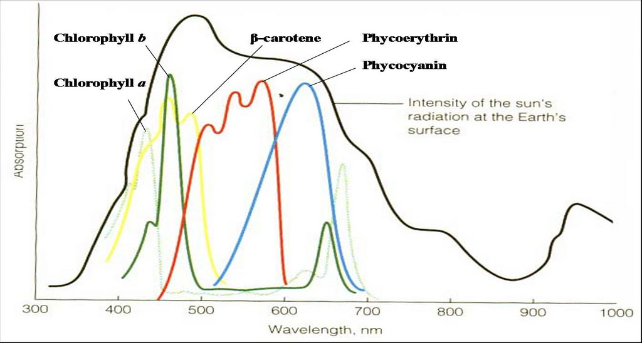
Absorbance spectra
Photons emitted from the sun can directly strike light-absorbing surfaces and the full range of the most useful wavelengths are available for photosynthesis
In the aquatic environment, many large algae compete for sunlight (similar to the competition for sunlight in modern forests).
For early plants first moving into terrestrial environments, there was no competition for access to light.
From the wikimedia free licensed media file repository

Slide 29
Getting carbon for Photosynthesis
Some plants can utilize bicarbonate ions.
Diffusion rates of dissolved carbon dioxide have been attributed to limiting photosynthesis, especially in still waters.
Utilization of HCO₃- under natural conditions has been reported for a number of aquatic species, while other species were found to utilize primarily CO₂
As CO₂ is taken up by plants, the equilibrium shifts so that more CO₂ is released. This is a diurnal process, at night more CO₂ is released than is taken up.
When CO₂ dissolves in seawater, carbonic acid is produced via the reaction:
This carbonic acid dissociates in the water, releasing hydrogen ions and bicarbonate:
to plant
One result of the release of hydrogen ions is that they combine with any carbonate ions in the water to form bicarbonate:
to plant

Slide 30
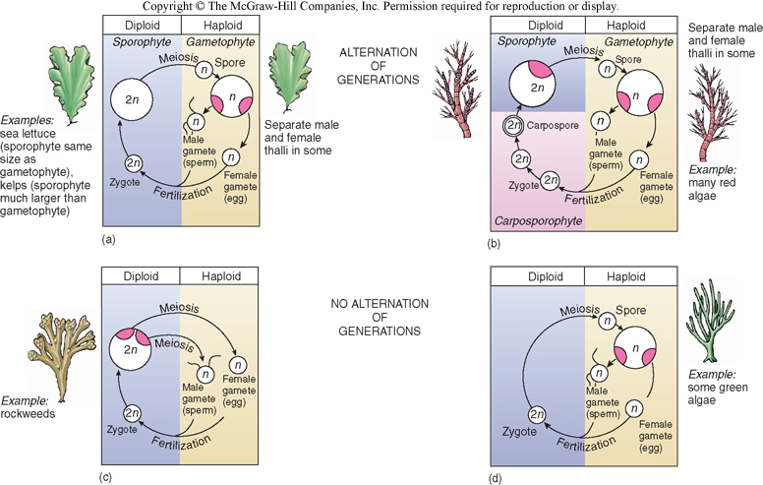
Sexual Reproduction - or not…
Sexual reproduction is expensive both energetically and physiologically.
Sometimes it’s better to reproduce by asexual means from fragments, spores, or buds.
Sometimes algae use both sexual and asexual reproduction depending on environmental conditions.

Slide 31
Ancestral Green
Algae
Bryophytes
Ferns & allies
Gymnosperms
Angiosperms
Seed Plants
Vascular Plants
Flowers
Seeds
Overview of Plant Evolution
Vascular tissue
Embryos
Origin of land plants

Slide 32
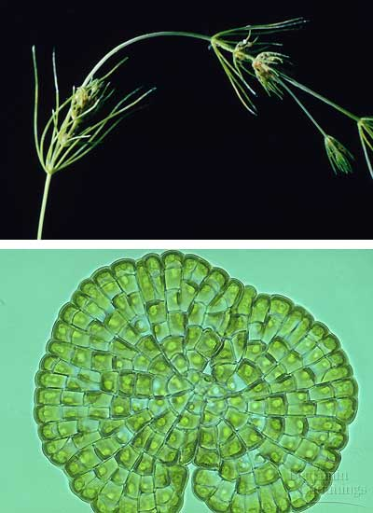
charophyceans
More than 280,000 species of plants inhabit Earth today.
Most plants live in terrestrial environments, including deserts, grasslands, and forests.
Some species, such as sea grasses, have returned to aquatic habitats.
Land plants (including the sea grasses) evolved from a certain green algae, called charophyceans.
Land plants share two ultrastructural features with these algae.
Copyright © 2002 Pearson Education, Inc., publishing as Benjamin Cummings

Slide 33
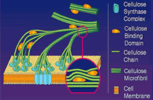
The plasma membranes of land plants and charophyceans possess rosette cellulose-synthesizing complexes that synthesize the cellulose microfibrils of the cell wall.
Each rosette floats in the cell's plasma membrane and "spins" a microfibril into the cell wall.
Contain at least three different cellulose synthase enzymes encoded by CesA genes
Requires chain initiation and elongation, and the two processes are separate.
These complexes contrast with the linear arrays of cellulose-producing proteins in other algae.
Copyright © 2002 Pearson Education, Inc., publishing as Benjamin Cummings

Slide 34
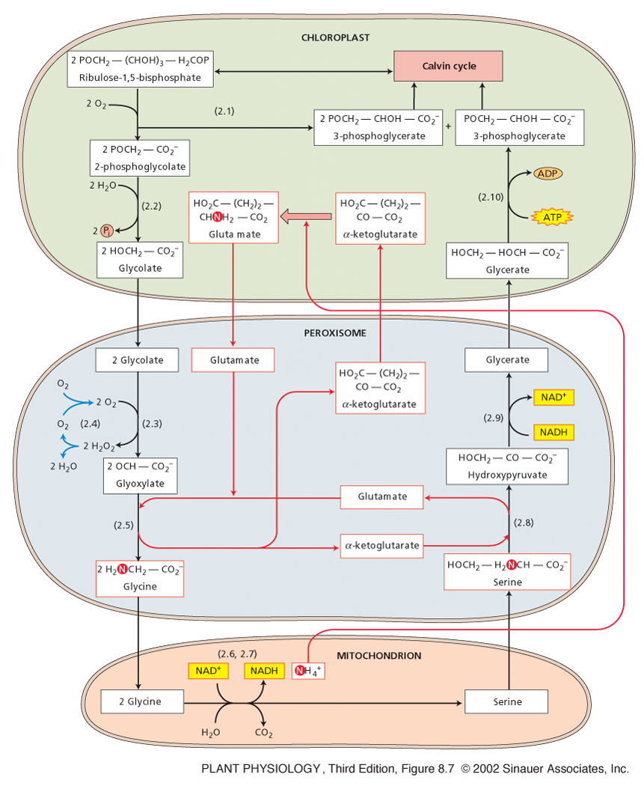
The presence of peroxisomes.
Peroxisomes are typically found in association with chloroplasts.
Enzymes in peroxisomes help minimize the loss of organic products due to photorespiration.
During this process a toxic 2C molecule called phosphoglycolate is produced
The plant immediately gets rid of the phosphate group
converting the molecule to glycolic acid
Then transported to the peroxisome and there converted to glycine (4 carbons) and transported into a mitochondria where it is converted into serine (3 carbons)
Releases CO2

Slide 35
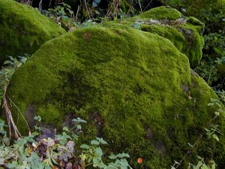
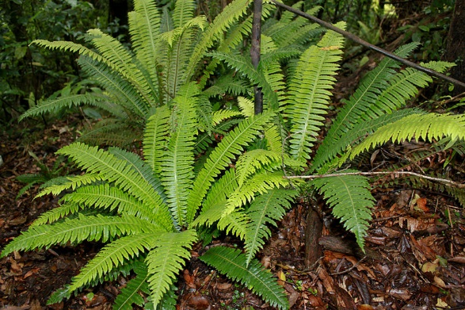
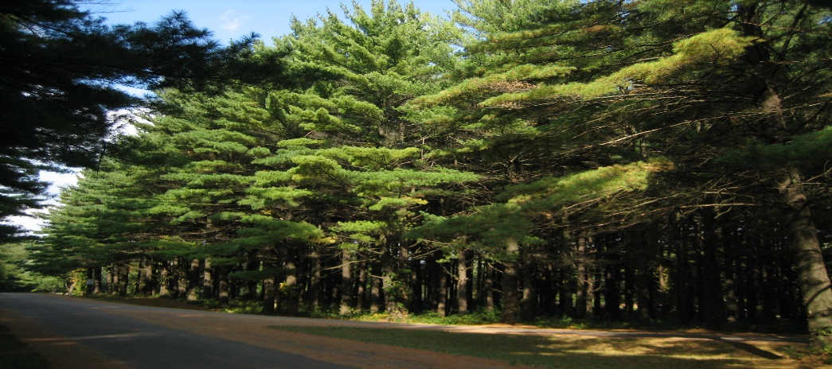
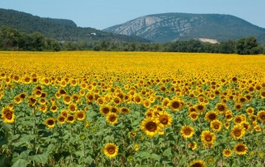
Land Plants – Four main groups
The Bryophytes - most common - mosses.
The Pteridophytes - most common - ferns.
The gymnosperms include pines and other conifers.
The angiosperms are the flowering plants.
Copyright © 2002 Pearson Education, Inc., publishing as Benjamin Cummings

Slide 36
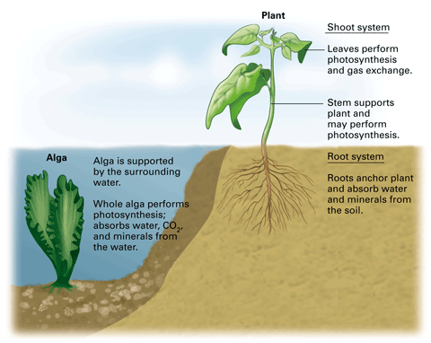
From Sea to Land
In terrestrial habitats, the resources that a photosynthetic organism requires are found in two different places.
Light and carbon dioxide are mainly above ground.
Water and mineral resources are found mainly in the soil.
Therefore, plants show varying degrees of structural specialization for subterranean and aerial organs - roots and shoots in most plants
Copyright © 2002 Pearson Education, Inc., publishing as Benjamin Cummings

Slide 37
From Sea to Land
Several characteristics separate the four land plant groups from their closest algal relatives, including:
apical meristems
multicellular embryos dependent on the parent plant
alternation of generations
gametangia that produce gametes
sporangia that produce walled spores
Copyright © 2002 Pearson Education, Inc., publishing as Benjamin Cummings

Slide 38
Apical Meristems
Copyright © 2002 Pearson Education, Inc., publishing as Benjamin Cummings

Slide 39
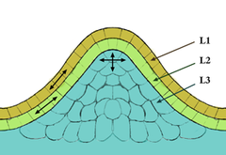
Meristems
The tissue in most plants consisting of undifferentiated cells (meristematic cells), found in zones of the plant where growth can take place.
Meristematic cells are analogous in function to stem cells in animals, are incompletely or not differentiated, and are capable of continued cellular division.
Furthermore, the cells are small and protoplasm fills the cell completely.
The vacuoles are extremely small. The cytoplasm does not contain chloroplasts although they are present in rudimentary form (proplastids).
Meristematic cells are packed closely together without intercellular cavities.
Tunica-Corpus model of the apical
meristem (growing tip). The epidermal
(L1) and subepidermal (L2) layers form
the outer layers called the tunica.
The inner L3 layer is called the corpus.
Cells in the L1 and L2 layers divide in
a sideways fashion which keeps these
layers distinct, while the L3 layer divides in a more random fashion.

Slide 40
Multicellular gametangia
Gametangia are the gametophyte forms of bryophytes, pteridophytes, and gymnosperms. Gametes are produced within these organs.
Female gametangia are called archegonia (produce and retain egg cells)
Male gametangia are called antheridia (produce sperm)

Slide 41
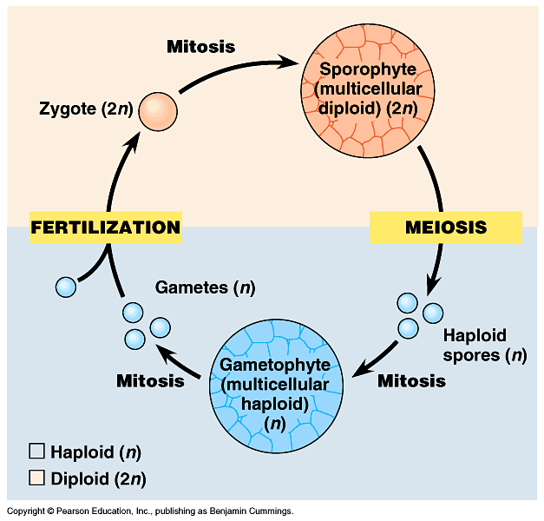
Alternation of Generations
Two multicellular life stages:
(1) Sporophyte:
Diploid
Divides by meiosis to form spores
Spores – haploid cells that can grow into a new, multicellular, haploid organism (the gametophyte) without fusing to another cell.
Gametophyte:
Haploid
Divides by mitosis to form the gametes (egg and sperm)
Egg & sperm fuse to form the diploid zygote, which divides by mitosis to form the sporophyte

Slide 42
Walled spores produced in sporangia
Spores are produced by sporangia
cells in the sporophyte through the process of meiosis.
Durable spores are an adaptation for surviving on land.
Contain Sporopollenin
Can withstand long periods of adverse conditions.
Easily transported by wind and water.
sporocytes

Slide 43
Sporopollenin
Many algae, including charophyceans, live in ephemeral ponds that dry up.
Natural selection favored individuals with traits that best enabled them to survive and/or produce offspring despite drought.
Charophyceans produce a tough polymer, sporopollenin, that covers the zygotes (which are still attached to the mother plant) and protects them from desiccation.
Sporopollenin is also found in plants, where it is a component of the protective covering of plant spores.
Because sporopollenin allowed plants to survive in drier habitats, it facilitated their early colonization of land.
C₉₀H₁₄₄O₃₅
Quilichini et al., (2015) The biosynthesis, composition and assembly of the outer pollen wall: A tough case to crack. Photochemistry, 113, 170-182

Slide 44
Sporopollenin
Because sporopollenin allowed plants to survive in drier habitats, it facilitated their early colonization of land.
Why would a terrestrial existence be an advantage?
Air filters less sunlight than water.
There's more light for photosynthesis.
Air has more CO₂ than water.
There's more fuel for photosynthesis.
Early terrestrial habitats lacked pathogens or predators/herbivores.
Terrestrial soil is richer in nutrients than aquatic soil
One of the earliest exaptations that allowed plants to withstand the harsher environment of land
C₉₀H₁₄₄O₃₅
Quilichini et al., (2015) The biosynthesis, composition and assembly of the outer pollen wall: A tough case to crack. Photochemistry, 113, 170-182

Slide 45
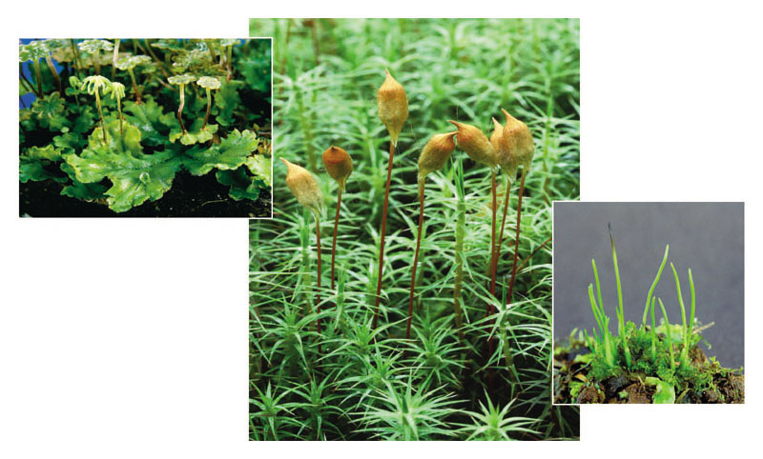
Bryophytes
- the Mosses, Hornworts and Liverworts
Copyright © 2005 Pearson Education, Inc. Publishing as Benjamin Cummings

Slide 46
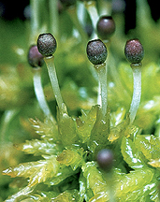
Bryophytes
Lack xylem and phloem (hence, lack true organs)
No vascular tissue absorbing water by capillarity and transporting carbohydrates by diffusion
no true roots, stems, or leaves as lack vascular tissue.
Rhizoids are root-like but are only used for anchorage.
Have a very thin waxy cuticle
Have stomates are fixed in the open position
they cannot be closed
The Peat Moss - from the wikimedia free licensed media file repository

Slide 47
Bryophytes
Release bi-flagellated sperm directly into the environment (and so need water--at least a thin film--for reproduction)
Alternation of generations and gametophyte dominates with gametes formed inside multicellular gameteangia called antheridia (sperm) or archegonia (egg)
have a dominant gametophyte generation, and a short-lived sporophyte
The relatively undifferentiated body of such plants is known as the thallus, the term used to describe a plant (or fungal) "body".
The Peat Moss - from the wikimedia free licensed media file repository

Slide 48
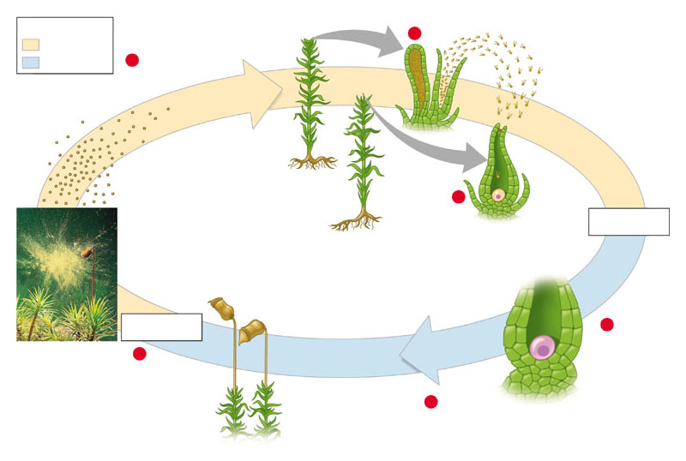
Life cycle of a moss
Gametophytes (n)
Key
1
Haploid (n)
Male
Diploid (2n)
5
Mitosis and development
Sperm must swim in a drop of rain water from an antheridium to an egg in an archegonium
If fertilization takes place, it results in a zygote that develops into a tiny sporophyte on the parent gametophyte plant.
The sporophyte produces haploid spores, and these develop into the next generation of gametophyte plants.
Then the cycle repeats.
Sperm (n) (released from gametangium)
Spores (n)
Egg (n)
Female
1
Fertilization
Sporangium
Stalk
Sporophytes (growing from gametophytes)
Meiosis
2
Sporophyte (2n)
Zygote (2n)
4
3
Mitosis and development
Copyright © 2005 Pearson Education, Inc. Publishing as Benjamin Cummings

Slide 49
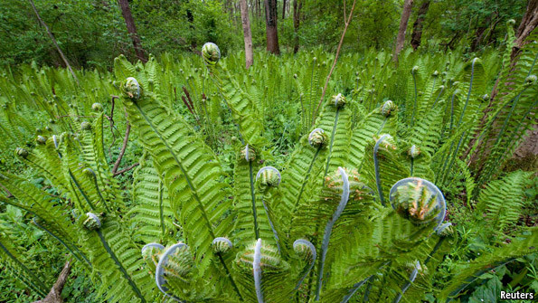
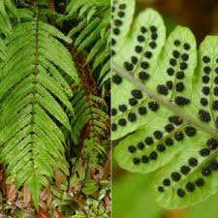
Seedless Plants with a Vascular System
- Ferns, Horsetails, and Club Mosses
From the wikimedia free licensed media file repository

Slide 50
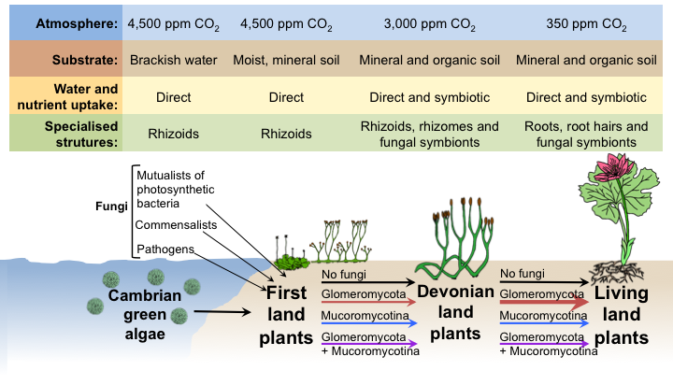
Conquering land relied on a variety of plant-fungal symbiotic strategies still at work today
Field KJ, Pressel S, Duckett JG, Rimington WR, Bidartondo MI. Trends Ecol Evol. 2015

Slide 51
Land Plant Root-Mycorrhizal Associations
Not unusual
83% of dicots, 79% of monocots and all gymnosperms
Ectotrophic Mycorrhizal fungi
Form a thick sheath around root. Some mycelium penetrates the cortex cells of the root
Root cortex cells are not penetrated, surrounded by a zone of hyphae called Hartig net
The capacity of the root system to absorb nutrients improved by this association – the fungal hyphae are finer than root hairs and can reach beyond nutrient-depleted zones in the soil near the root

Slide 52
Land Plant Root-Mycorrhizal Associations
Vesicular arbuscular mycorrhizal fungi
Hyphae grow in dense arrangement , both within the root itself and extending out from the root into the soil
After entering root, either by root hair or through epidermis hyphae move through regions between cells and penetrate individual cortex cells.
Within cells form oval structures – vesicles – and branched structures – arbuscules (site of nutrient transfer)
P, Cu, & Zn absorption improved by hyphae reaching beyond the nutrient-depleted zones in the soil near the root

Slide 53
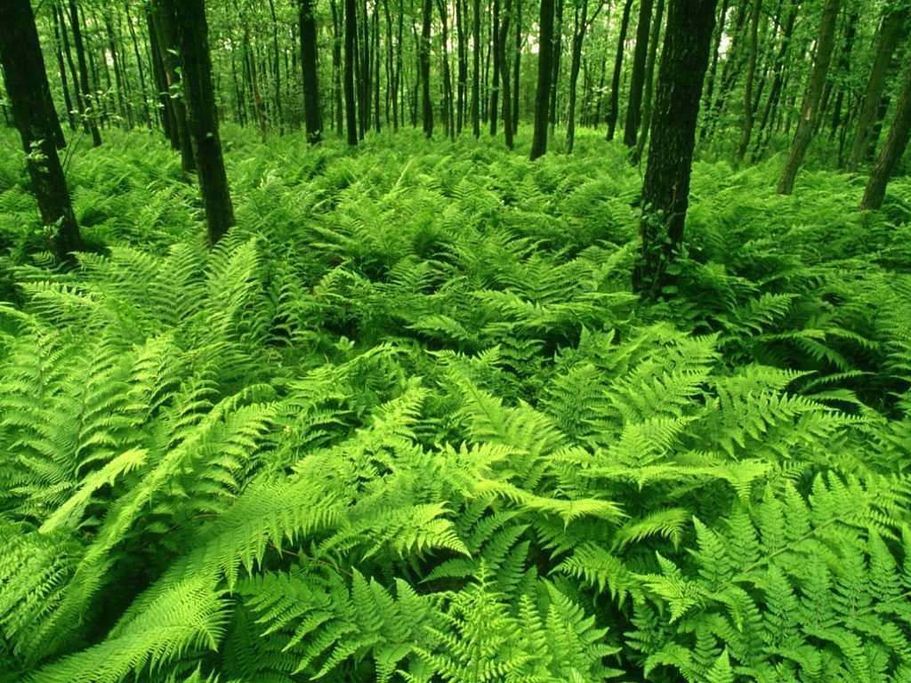
Ferns
An important group of plants – 10,000 species exist
Ferns have developed vascular tissue
Habitat: Moist tropics, woodlands, streambanks
Also exhibit Alternation of Generations, but…
The diploid Sporophyte generation is dominant (larger and more visible)
The haploid Gametophyte is small & short lived.
Ecologically important: Hold and form soil to prevent erosion
From the wikimedia free licensed media file repository

Slide 54
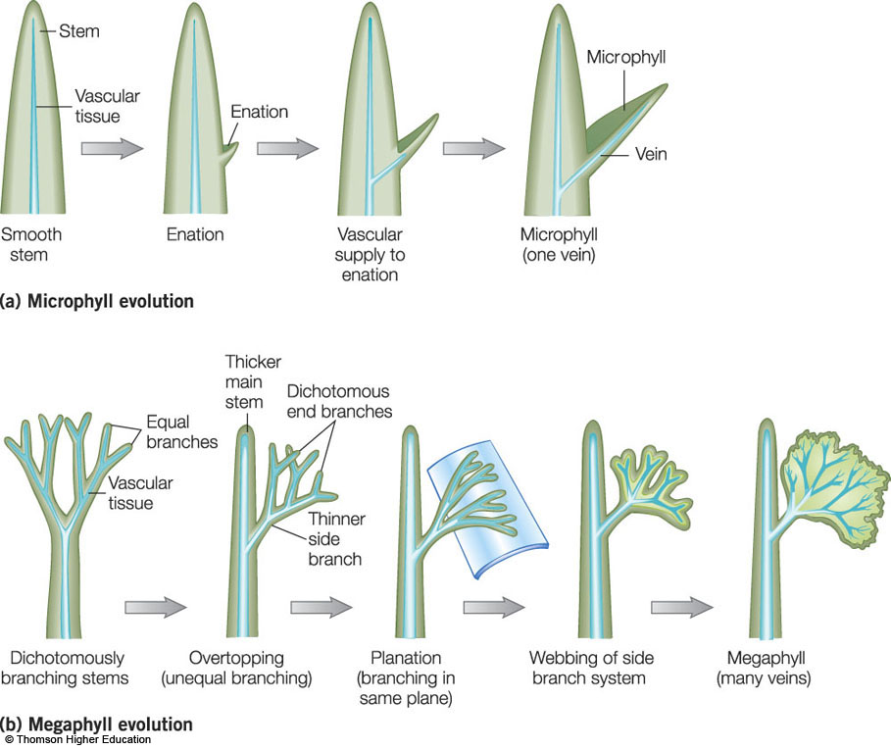
Evolution of Leaves
Two basic types of true leaves:
microphylls
Contains one vascular strand
megaphylls,
Contains multiple vascular strands
Evolved independently of each other

Slide 55
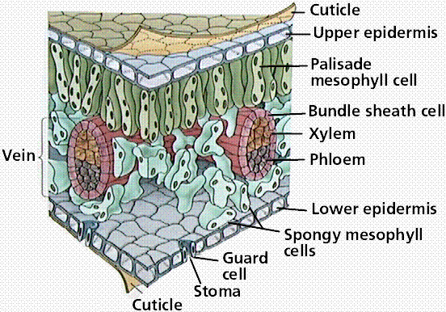
Internal Structure of Leaves
chloroplasts
Copyright © 2002 Pearson Education, Inc., publishing as Benjamin Cummings

Slide 56
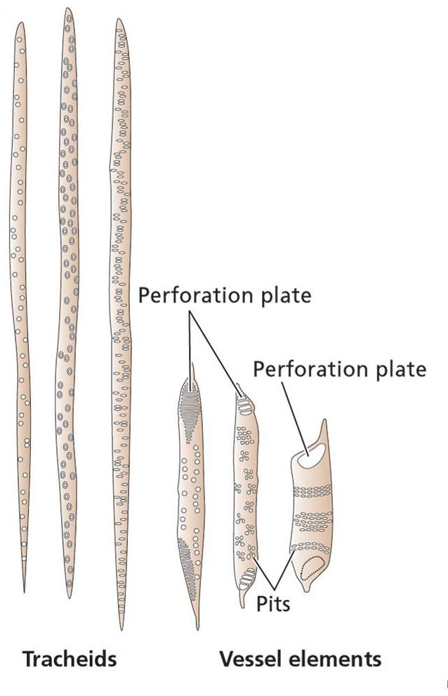
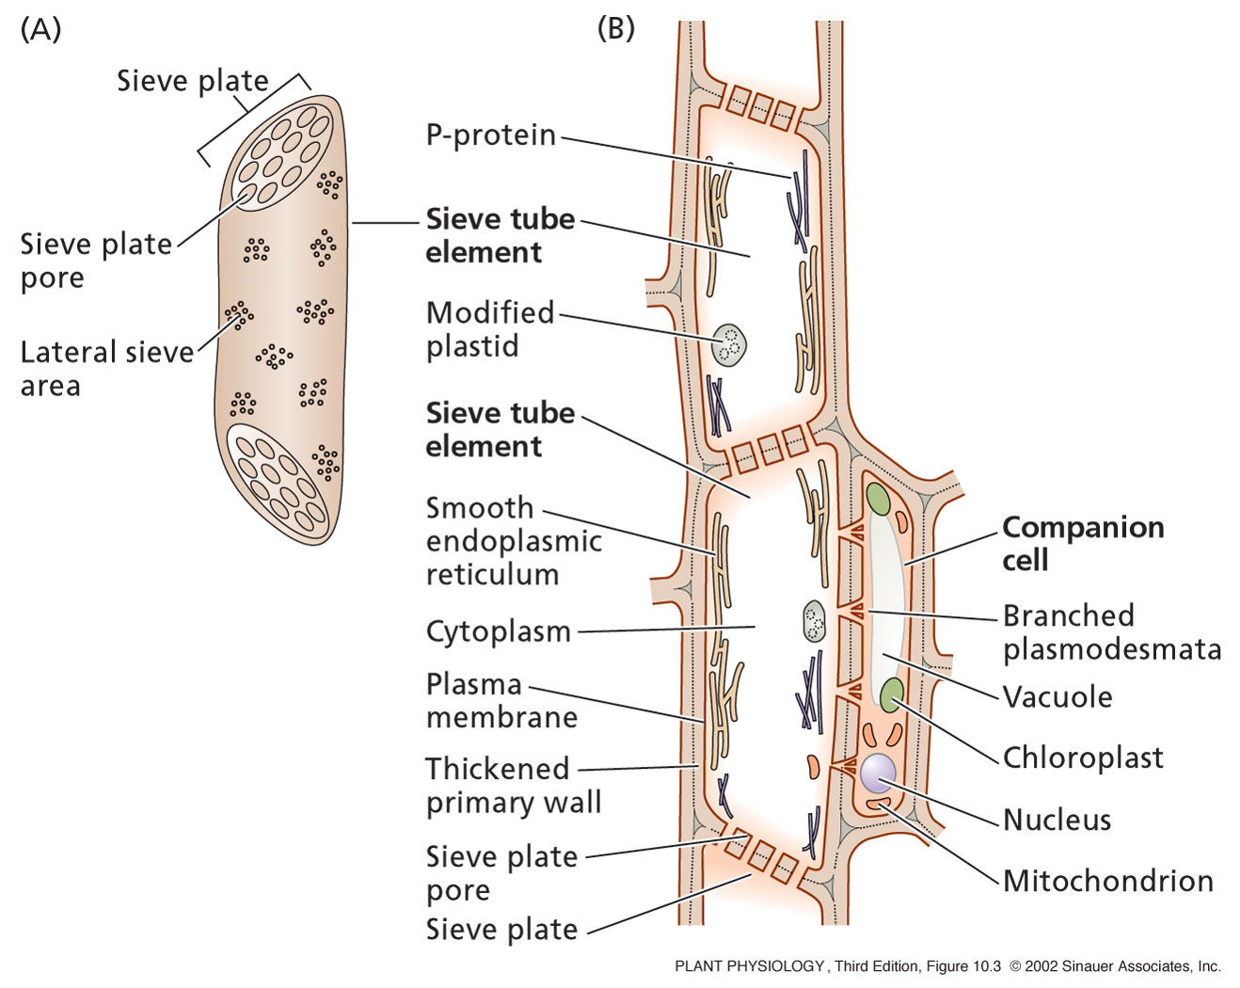
Xylem and Phloem

Slide 57
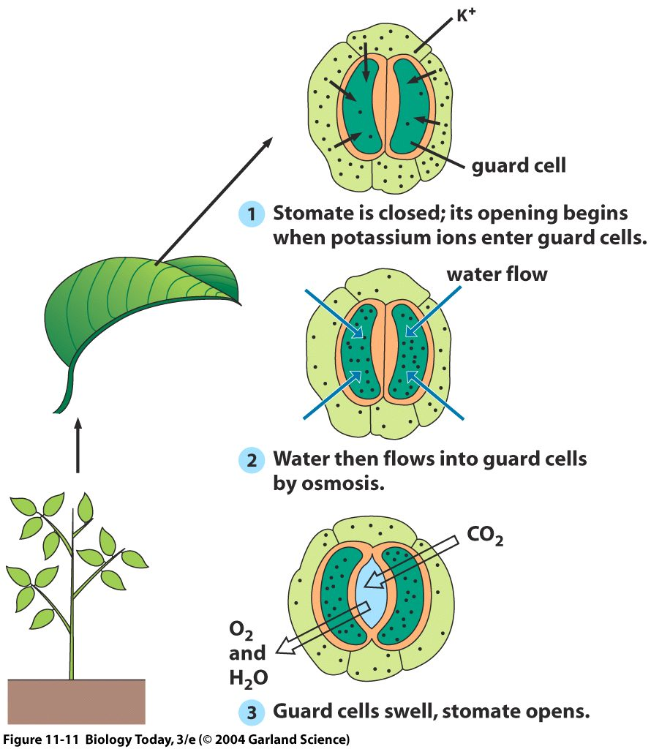
Stomatal control
Almost all leaf transpiration results from diffusion of water vapor through the stomatal pore
waxy cuticle
Provide a low resistance pathway for diffusion of gasses across the epidermis and cuticle
Regulates water loss in plants and the rate of CO₂ uptake
Needed for sustained CO₂ fixation during photosynthesis

Slide 58
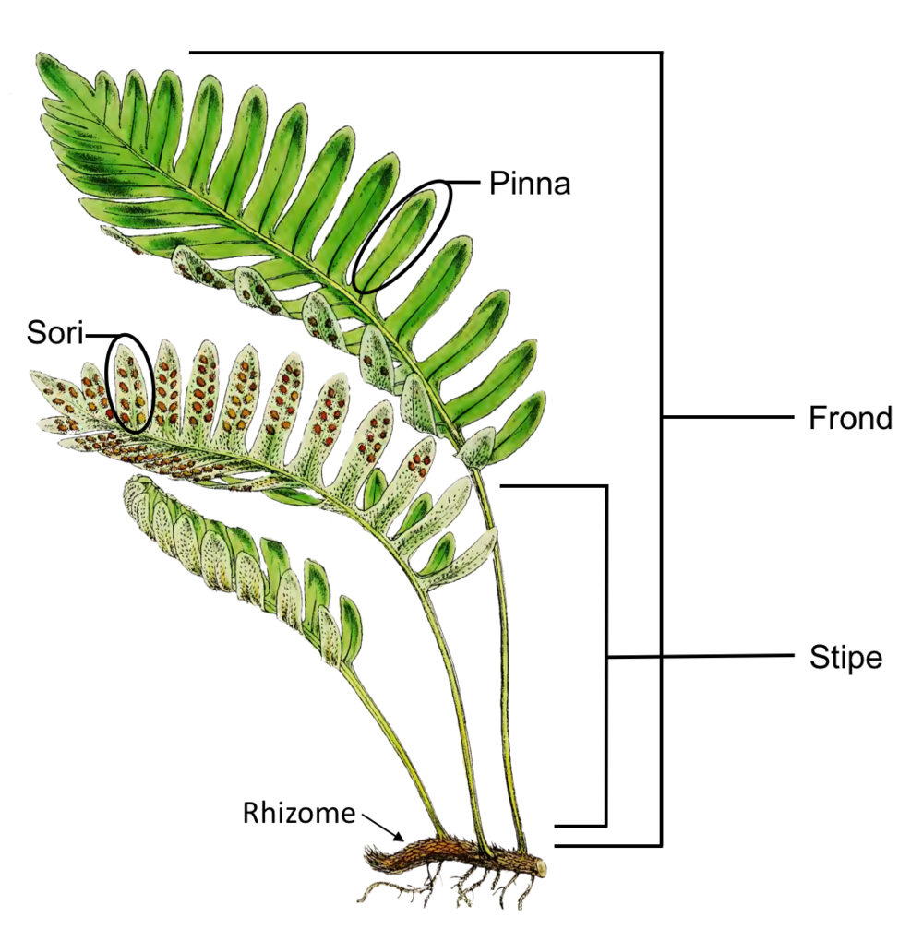
Fern sporophyte morphology
Fern sporophyte has fronds (leaves)
Young fronds are called fiddleheads
True roots arise from the rhizome
From the wikimedia free licensed media file repository

Slide 59
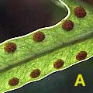
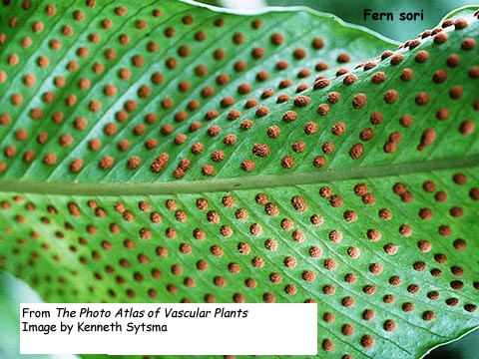
Fronds
Ferns have complex leaves called fronds, for photosynthesis and reproduction
Under the fronds, spores are produced in sporangia in clusters called sori (sorus = singular)
In sporangia, meiosis occurs producing haploid spores
Copyright © 2002 Pearson Education, Inc., publishing as Benjamin Cummings

Slide 60
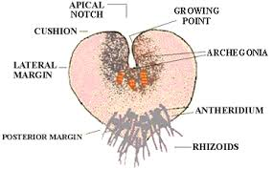
Fern Gametophyte generation (1n)
Single spore grows into the gametophyte plant
Heart-shaped called prothallus, very small.
Archegonia and antheridia produced in prothallus
Female gametophytes produce a chemical that induces spores to produce male gametophytes around it.
From the wikimedia free licensed media file repository

Slide 61
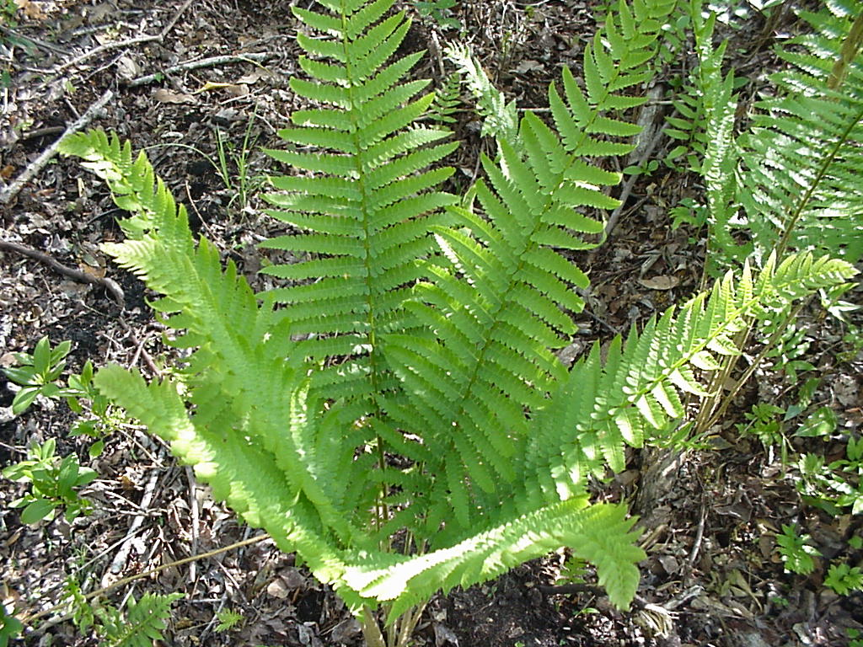
Fern gametophyte
Antheridium produces motile sperm that swim to the archegonia’s egg – fusion occurs and the diploid sporophyte generation begins
Zygote develops into a new embryo – that eventually grows into mature sporophyte
Copyright © 2002 Pearson Education, Inc., publishing as Benjamin Cummings

Slide 62
Fern fronds bear sporangia in clusters (sori)
Meiosis in sporangia produces haploid spores
Fern gametophyte (prothallus) develops from a haploid spore
Bears both archegonia and antheridia
Each archegonium contains a single, nonmotile egg;
each antheridium produces numerous sperm cells
Following fertilization, diploid zygote grows by mitosis into a multicellular embryo (immature sporophyte)

Slide 63
Lichens
- A tail of two organisms
From the wikimedia free licensed media file repository

Slide 64
symbiotic association of cyanobacteria or green algae and fungi.
Lichens are very sensitive to air pollution; used as indicators of air quality.

Slide 65
Bacteria – the Most Abundant Organisms
Bacteria (Staphylococcus aureus; yellow spheres) adhering to nasal cilia.
E. Coli bacteria
Mycoplasma hyopneumoniae
Borrelia burgdorferi, the bacterium that causes Lyme disease.
There are more bacteria in your mouth than there have been people living since the dawn of humans.

Slide 66
More Bacteria!
Don Bryant and David M. Ward, (2007) Science. 317(5837):523-6
Candidatus Chloracidobacterium thermophilum:
Aerobic phototrophic Acidobacterium
New genus and species. It also belongs to the Acidobacteria phylum, a poorly characterized phylum that was not previously known to include bacteria capable of photosynthesis.
Give the hot springs in Yellowstone their remarkable yellow, orange, red, brown and green colors.
From the wikimedia free licensed media file repository

Slide 67
Cyanobacteria
Phoyosynthetic pigments are Phycobilin and phycocyanin
water-soluble pigments, thus found in the cytoplasm, or in the stroma of the chloroplast.
Only photosynthetic prokaryotes able to produce oxygen.
Known as 'cyanobacteria' in order to avoid the term "algae", which in modern usage is restricted to eukaryotes.
Are the origins of chloroplasts in higher plant cells
Copyright © 2002 Pearson Education, Inc., publishing as Benjamin Cummings

Slide 68
FUNGI
Fungi sometimes look like plants, but they’re not!
Fungi can’t photosynthesize, because they don’t have chloroplasts; they get their nutrients from the organic material they live in.
❖ Are Decomposers --feed on dead organic material.
❖ Some fungi feed on living organisms, such as plants, animals and even other fungi. This causes diseases and infections in these organisms (like athlete’s foot and ringworm in humans).
❖ Some fungi live as symbiotic partners with algae. The result: lichen
Other differences from plants:
• fungi don’t have roots, they have a mycelium.
• fungi’s cell walls are made of chitin, not cellulose.

Slide 69
Physiology
Autotrophic associations – algal/fungal cells carry out photosynthesis, lichen depends on net production of organic compounds by photosynthesis
Most of the photosynthate (70-80%) produced by alga is incorporated into the fungus
fungal cells secrete polyalcohols like ribitol
cyanobacteria secrete glucose
Photobiont becomes leaky of carbohydrates when associated with fungus – not so when grown alone

Slide 70
Plant and Lichen Polysaccharides
Amylose (Plant starch)
α-(1-4)-D-glucan
n = 250 to 5,000
Cellulose (Plant cell walls)
β-(1-4)-D-glucan
n = lots
Isolichenin (Lichen starch)
α-(1-3)(1-4)-D-glucan
n = 40 to 50
Lichenin (Lichen starch)
β-(1-3)(1-4)-D-glucan
n = 60 to 70

Slide 71
Growth
Exhibit low growth rates – many grow at rates of 1-4 mm/yr, up to 9 cm/yr
Makes studies difficult
Factors affecting growth
Light – variable – some prefer low light intensities, others high
Temperature – variable
Moisture – appears to be an important variable, do not have water absorbing organs, depend on moisture in air

Slide 72
Moisture
When lichen thallus is wetted, absorbs water quickly by gelatinous matrix in the cortex
Starts growth process
As thallus dries, growth process slows and stops
Dew and humidity are important sources of moisture
Thalli are inactive when dry – only grow when wetted – may be responsible for slow growth rate

Slide 73
Symbiotic association
Traditionally been classified as a mutualistic symbiosis where both symbionts benefit
Fungus appears to be chief benefactor, receives:
Organic compounds as C and energy source
With cyanobacteria, N fixation may occur so that the fungus also receives N source

Slide 74
Symbiotic association
Benefits for autotrophic symbiont are less clear-cut
algal/fungal cells produces substances that absorb water which is provided to alga
algal/fungal cells takes up inorganic nutrients from atmosphere
Protects algal/fungal cells from mechanical injury, predation, and high light intensities
Association allows algal/fungal to achieve a wider distribution than if free-living

Slide 75
Reproduction
Sexual reproduction – characteristic of fungal symbiont
Ascospores are discharged, algal cells are not discharged with them
Thought that after ascospores germinate, they make contact with algal cells
Asexual reproduction – variety of mechanisms – e.g. fragmentation

Slide 76
Gymnosperms and angiosperms
The gymnosperms include pines and other conifers.
The angiosperms are the flowering plants.
Covered in talk eight - Flowers and Reproduction

Slide 77
ANY QUESTIONS?

