Slide 1
Introduction to Water, Soil, and Soil pH

Slide 2
Water balance of plants
Earths atmosphere presents problems to plants
The atmosphere is a source of CO2
Required for photosynthesis
Atmosphere is relatively dry
Can dehydrate the plant
Plants have evolved ways to control water loss from leaves and to replace water loss to atmosphere
Involves
A gradient in water vapor concentration (leaves)
Pressure gradients in xylem and soil

Slide 3
Water and plant cells
80-90% of a growing plant cell is water
This varies between types of plant cells
Carrot has 85-95% water
Wood has 35-75% water
Seeds have 5-15% water
Plant continuously absorb and lose water
Lost through the leaves
Called transpiration

Slide 4
Water is a polar molecule
When electrons are not shared equally in a covalent bond, the molecule is described as polar.
Water molecules are polar. This means that while water molecules are neutral as a whole, one end of the water molecule tends to have a positive charge while the other has a negative charge.
The oxygen end has a slight negative charge while the hydrogen end has a slight positive charge.
Each end of a water molecule is attracted to the opposite charged end of another water molecule.
Water's polarity is responsible for the "stickiness" or cohesion between the molecules.

Slide 5
Water

Slide 6
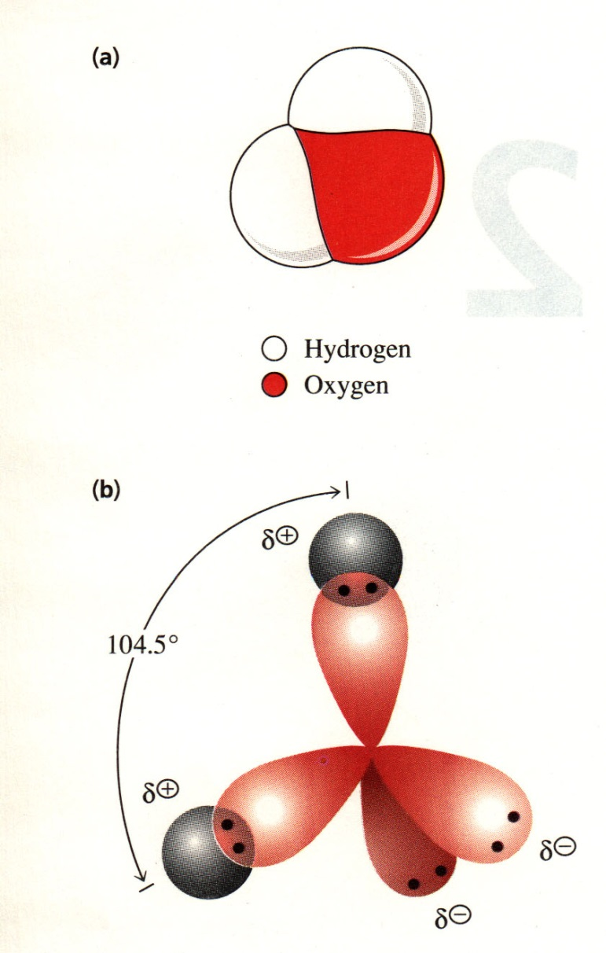
Water is a polar molecule
Water has a dipole moment
“like dissolves like”
Oxygen is more electronegative than hydrogen so there is an uneven distribution of charge in this H-O bond
Uneven distribution is called a dipole and the bond is said to be polar
Notes:
Water is assymmetric. It has an electron rich and an electron poor side to it.
Think about carbon dioxide and ammonia. CO2 is nonpolar whereas NH3 is polar. NH3 is highly soluble in water whereas CO2 is much less soluble.

Slide 7
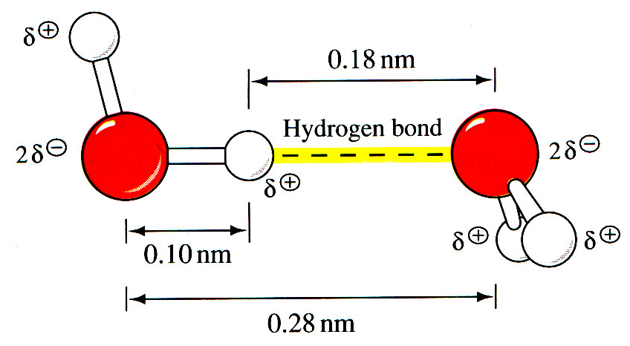
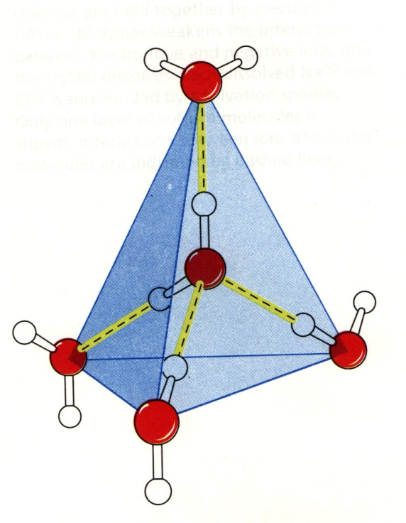
Water has hydrogen bonding potential
H-bonds are non-covalent, weak interactions
H₂O is both a Hydrogen donor and acceptor
One H₂O can form up to four H-bonds
Notes:
Water molecules attact one another.
Orientation is important.
H-bond 20 kJ mol-1
O-H bond 460 kJ mol-1
When all four optimal H-bonds are formed per water, ice is formed.

Slide 8
Water is nucleophilic
Water participates in many chemical reactions
it is electron rich
it is a weak nucleophile
it is present in high concentration
Water weakly ionizes
Notes:
“the ultimate fate of proteins is destruction by hydrolysis.”
How are biopolymers made, then?
Peptide bonds are kinetically stable. Require hydrolases for catalysis.
ATP is required for biosynthesis.
Enzyme active sites exclude water.

Slide 9
Water
(A) Hydrogen bonds between water molecules results in local aggregations of water molecules
(B) Theses are very short lived, break up rapidly to form more random configurations
Due to temperature variations in water

Slide 10
Capillary Action & Surface tension
Cohesion of water causes capillary attraction, which is the ability of water to move upward in small spaces.
Cohesion makes it possible for water to move up the fibers of a plant.
This is how plants get the water they need to survive.
In addition, it moves water upwards in soil.
Cohesion of water also causes surface tension, water's invisible skin which allows water striders to walk on water

Slide 11
Universal Solvent
Water is considered the "universal solvent" because its bipolar molecule enables it to dissolve a wide variety of substances.
Solubility is affected by polarity.
Polar substances can dissolve other polar substances.
Non-polar substances dissolve other non-polar substances.
Polar substances and non-polar substances, however, do not mix.
This means that wherever water goes, either through the ground or through a plant, it takes along valuable chemicals, minerals, and nutrients.

Slide 12
Density
Another property of water is density during phase changes.
The density of most substances increases when a liquid becomes a solid. Solid water is actually less dense than liquid water.
It is for this reason that ice floats.
The fact that ice floats is essential for the survival of many aquatic ecosystems and ultimately life on Earth.

Slide 13
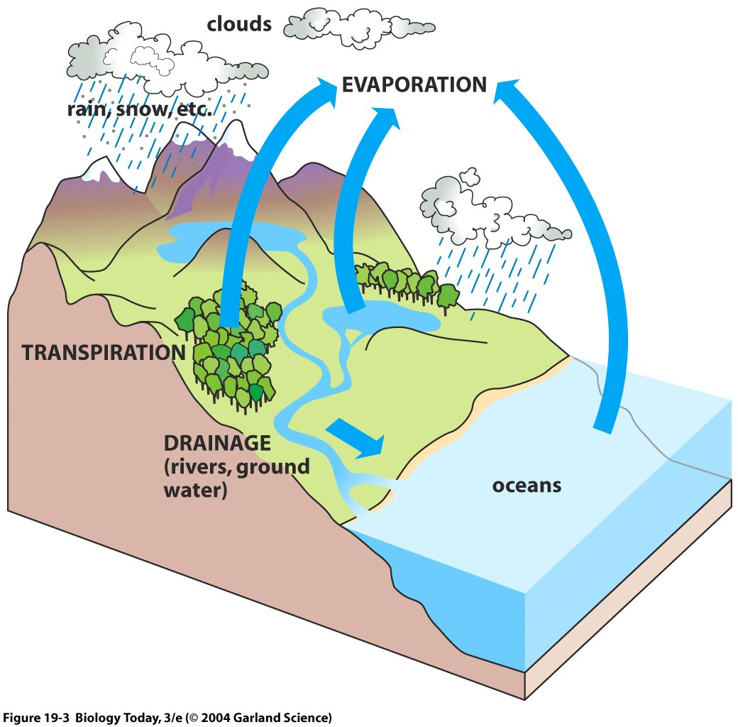
Water Cycle
The resulting water vapor mixes with the atmosphere
At high altitudes where the air is cold enough it condenses to form rain and snow
Falls back to Earth.
Notes:
13

Slide 14
Water Cycle
Water evaporates from bodies of fresh water and the oceans
Much water is lost from the leaves of plants via transpiration.
Also from respiration of almost all living species
Notes:
14

Slide 15
Cell water potential - ψw
The equation ψw = ψs + ψp + ψg
Affected by three factors:
ψs : Solute potential or osmotic potential
The effect of dissolved solutes on water and the cell
ψp : Hydrostatic pressure of the solution. A +ve pressure is known as Turgor pressure
Can be –ve, as in the xylem and cell wall – this is important in moving water long distances in plants
ψg : Gravity - causes water to move downwards unless opposed by an equal and opposite force

Slide 16
Water in the Soil
The main driving forces for water flow from the soil through the plant to the atmosphere include:
Differences in:
[H2O vapor]
Hydrostatic pressure
Water potential
All of these act to allow the movement of water into the plant.

Slide 17
Water absorption from soil
Water clings to the surface of soil particles.
As soil dries out, water moves first from the center of the largest spaces between particles.
Water then moves to smaller spaces between soil particles.
Root hairs make intimate contact with soil particles – amplify the surface area for water absorption by the plant.

Slide 18
Water Moves through soil by bulk flow
Bulk flow:
Concerted movement of groups of molecules en masse, most often in response to a pressure gradient.
Dependant on the radius of the tube that water is traveling in.
Double radius – flow rate increases 16 times!!!!!!!!!!
This is the main method for water movement in Xylem, Cell Walls and in the soil.
Independent of solute concentration gradients – to a point
So different from diffusion

Slide 19
Water Moves through soil by bulk flow
In addition, diffusion of water vapor accounts for some water movement.
As water moves into root – less in soil near the root
Results in a pressure gradient with respect to neighboring regions of soil.
So there is a reduction in ψp near the root and a higher ψp in the neighboring regions of soil.
Water filled pore spaces in soil are interconnected, water moves to root surface by bulk flow down the pressure gradient

Slide 20
Water Moves through soil by bulk flow
The rate of water flow depends on:
Size of the pressure gradient
Soil hydraulic conductivity (SHC)
Measure of the ease in which water moves through soil
SHC varies with water content and type of soil
Sandy soil high SHC
Large spaces between particles
Clay soil low SHC
Very small spaces between particles

Slide 21
Water Moves through soil by bulk flow
As water moves from soil into root the spaces fill with air
This reduces the flow of water
Permanent wilting point
At this point the water potential (ψw) in soil is so low that plants cannot regain turgor pressure
There is not enough of a pressure gradient for water to flow to the roots from the soil
This varies with plant species

Slide 22
The Soil
The biggest ecosystem on Earth!
Animals:
micro-organisms mix soils as they form burrows and pores, allowing moisture and gases to move about. In the same way, plant roots open channels in soils.
Plants:
deep taproots can penetrate many meters through the different soil layers to bring up nutrients from deeper in the profile.
fibrous roots that spread out near the soil surface have roots that are easily decomposed, adding organic matter.

Slide 23
The Soil
Micro-organisms:
including fungi and bacteria, effect chemical exchanges between roots and soil and act as a reserve of nutrients.
Humans:
impact soil formation by removing vegetation cover with erosion as the result.
Also mix the different soil layers, restarting the soil formation process as less weathered material is mixed with the more developed upper layers.

Slide 24
Soil changes with depth
Humus – or humification can occur naturally in soil, or in the production of compost.
Differentiated from decomposing organic matter in that the latter is rough-looking material, with the original plant remains still visible, whereas fully humified organic matter is uniform in appearance.
A chemically stable humus is the fertility it provides to soils in both a physical and chemical sense.
Agricultural experts put a greater focus on other features of it, such as its ability to suppress disease.
Permission from PD-USGov-USDA

Slide 25
Soil changes with depth
Humus has a characteristic black or dark brown color, due to an accumulation of organic carbon.
Soil scientists use the capital letters O, A, B, C, to identify the master horizons,.
(O) An organic horizon on the surface, but this horizon can also be buried.
(A) The surface horizon
(B) The subsoil
(C) The substratum
Permission from PD-USGov-USDA

Slide 26
Soil changes with depth
Helps the soil retain moisture by increasing microporosity and encourages the formation of good soil structure.
The incorporation of oxygen into large organic molecular molecules generates many active forms of plant nutrients.
Allows soil organisms to feed and reproduce, and is often described as the "life-force" of the soil.
Permission from PD-USGov-USDA

Slide 27
Soil texture
This refers to the relative portions of different particle sizes that make up soil, including sand (large), silt (medium) and clay (fine).
The mixture and distribution of these 3 size classes determines important properties like drainage and water holding capacity, and affects fertility.
Soil texture classes include: sand, loamy sands, sandy loams, loam, silt loam, silt, sandy clay loam, clay loam, silty clay loam, sandy clay, silty clay, and clay.
These categories are named based on % content of silt, sand and clay as shown below in the “classic” soil texture
From NRCS Soil Survey Manual, Chapter 3, Figure 3-16

Slide 28
Water in the Soil
Water content in soil and rate of water movement depends on the type and texture of soil
Soil Particle size surface area
(um) per gram (m2)
Course sand 2000 – 200 <1-10
Fine sand 200 – 20 <1-10
Silt 20 – 2 10-100
Clay <2 100-1000
Sandy soil
Low surface area per gram and large spaces between particles
Clay
Large surface area per gram and small spaces between particles

Slide 29
Soil depth composition is dependant on the climate
b

Slide 30
Soil Drainage
Water is one of the most import soil-related resources necessary for plant growth and development.
Soils affect and are affected by the movement of water in the following three ways:
Surface flow.
Infiltration.
Subsurface Flow.
Anelli, J.R., 2005. A Short Course on Soils, MacDaniels Nut Grove, Department of Crop & Soil Sciences, Cornell University, Ithaca, NY.

Slide 31
Surface flow
Erosion can be a serious problem on sites that have been recently logged or otherwise disturbed.
The ability of water to infiltrate soils inversely affects the amount of surface flow that contributes to erosion.
Anelli, J.R., 2005. A Short Course on Soils, MacDaniels Nut Grove, Department of Crop & Soil Sciences, Cornell University, Ithaca, NY.

Slide 32
Infiltration.
Defined as water flow from the surface into the soil profile.
It depends on the soil hydraulic conductivity, which is unique to each soil type, and the wetness of the soil at the time of measurement.
Anelli, J.R., 2005. A Short Course on Soils, MacDaniels Nut Grove, Department of Crop & Soil Sciences, Cornell University, Ithaca, NY.

Slide 33
Subsurface Flow.
Below ground flow of water depends on the size of pores within the soil, which varies in soils of different textures (sand/silt/clay ratio) and soil structures (aggregation).
Furthermore, rate of drainage depends on whether the soil is already saturated with water or is unsaturated (various stages of dryness).
Anelli, J.R., 2005. A Short Course on Soils, MacDaniels Nut Grove, Department of Crop & Soil Sciences, Cornell University, Ithaca, NY.

Slide 34
Mottling.
Soil color, especially mottling may be used as an indirect indicator of soil drainage.
This is because the upper portion of a soil profile that is well drained will rarely be saturated for long, and will remain well oxygenated most of the time.
A poorly drained soil will go through repeated cycles of wetting to the point of saturation for prolonged periods of time followed by periods of drying, as the saturated water table moves up and down.
This repeated cycle of raising and lowering of the upper margin of a perched subsurface water table, over a long period, will cause localized zones of red oxidized iron (insoluable) and/or blue/green reduced (soluable) iron (“leopard spots”)
Anelli, J.R., 2005. A Short Course on Soils, MacDaniels Nut Grove, Department of Crop & Soil Sciences, Cornell University, Ithaca, NY.

Slide 35
Mottling.
If the zone of mottling is found near the soil surface it can be assumed that the surface layer is poorly drained and frequently saturated with water.
If the zone of mottling is deeper, this indicates a well drained surface layer, which is rarely if ever completely saturated.
Anelli, J.R., 2005. A Short Course on Soils, MacDaniels Nut Grove, Department of Crop & Soil Sciences, Cornell University, Ithaca, NY.

Slide 36
Soil pH
Soil pH is considered a master variable in soils as it controls many chemical processes that take place.
It specifically affects plant nutrient availability by controlling the chemical forms of the nutrient.
The optimum pH range for most plants is between 5.5 and 7.0, however many plants have adapted to thrive at pH values outside this range.
Global variation in soil pH. Red = acidic soil. Yellow = neutral soil. Blue = alkaline soil. Black = no data.

Slide 37
Soil pH
Acidity in soils comes from H⁺ and Al₃⁺ ions in the soil solution and combined to soil surfaces.
While pH is the measure of H⁺ in solution, Al₃⁺ is important in acid soils because between pH 4 and 6, Al₃⁺ reacts with water (H₂O) forming AlOH₂⁺, and Al(OH)₂⁺, releasing extra H⁺ ions. Every Al₃⁺ ion can create 3 H⁺ ions.
Many other processes contribute to the formation of acid soils including
rainfall, fertilizer use, plant root activity and the weathering of primary and secondary soil minerals.
Acid soils can also be caused by pollutants such as acid rain and mine spoilings.

Slide 38
Soil pH
Rainfall: Acid soils are most often found in areas of high rainfall. Excess rainfall leaches base cation from the soil, increasing the percentage of Al₃⁺ and H⁺ relative to other cations. Additionally, rainwater has a slightly acidic pH of 5.7 due to a reaction with CO₂ in the atmosphere that forms carbonic acid.
Fertilizer use: Ammonium (NH₄⁺) fertilizers react in the soil in a process called nitrification to form nitrate (NO₃⁻), and in the process release H⁺ ions.
Plant root activity: Plants take up nutrients in the form of ions (NO₃⁻, NH₄⁺, Ca₂⁺, H₂PO₄⁻, etc.), and often, they take up many more cations than anions.
However. plants must maintain a neutral charge in their roots. In order to compensate for the extra positive charge, they will release H+ ions from the root.
Some plants will also exude organic acids into the soil to acidify the zone around their roots to help solubilize metal nutrients that are insoluble at neutral pH, such as iron (Fe).

Slide 39
Soil pH
Weathering of minerals: Both primary and secondary minerals that compose soil contain Al. As these minerals weather, some components such as Mg, Ca, and K, are taken up by plants, others such as Si are leached from the soil, but due to chemical properties, Fe and Al remain in the soil profile.
Highly weathered soils are often characterized by having high concentrations of Fe and Al oxides.
Acid Rain: When atmospheric water reacts with sulfur and nitrogen compounds that result from industrial processes, the result can be the formation of sulfuric and nitric acid in rainwater. However the amount of acidity that is deposited in rainwater is much less, on average, than that created through agricultural activities.
Mine Spoil: Severely acidic conditions can form in soils near mine spoils due to the oxidation of pyrite.
Decomposition of organic matter by micro organisms releases CO₂ which when mixed with soil water forms weak carbonic acid (H₂CO₃)

Slide 40
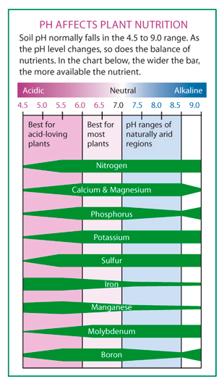
Acid affected soils
Plants grown in acid soils can experience a variety of symptoms including aluminium (Al), hydrogen (H), and/or manganese (Mn) toxicity, as well as potential nutrient deficiencies of calcium (Ca) and magnesium (Mg). Aluminium toxicity is the most widespread problem in acid soils.
Aluminium is present in all soils, but dissolved Al₃⁺ is toxic to plants; Al₃⁺ is most soluble at low pH, above pH 5.2 little aluminum is in soluble form in most soils.
Aluminium is not a plant nutrient, and as such, is not actively taken up by the plants, but enters plant roots passively through osmosis. Aluminium damages roots in several ways:
Permission from PD-USGov-USDA

Slide 41
Acid affected soils
In root tips and Aluminium interferes with the uptake of Calcium, an essential nutrient, as well as bind with phosphate and interfere with production of ATP and DNA, both of which contain phosphate. Aluminium can also restrict cell wall expansion causing roots to become stunted.
Below pH 4, H⁺ ions themselves damage root cell membranes.
In soils with high content of manganese (Mn) containing minerals, Manganese toxicity can become a problem at pH 5.6 and below.
Manganese, like aluminium becomes increasingly more soluble as pH drops, and Manganese toxicity symptoms can be seen at pH's below 5.6. Mn is an essential plant nutrient, so plants transport manganese into leaves. Classic symptoms of manganese toxicity are crinkling or cupping of leaves.
Permission from PD-USGov-USDA

Slide 42
Decreasing pH of basic soil
Iron sulphates or aluminium sulphate as well as elemental sulfur (S) reduce pH through the formation of sulfuric acid.
Urea, urea phosphate, ammonium nitrate, ammonium phosphates, ammonium sulphate and mono-potassium phosphate fertilizers.
organic matter in the form of plant litter, compost, and manure will decrease soil pH through the decomposition process. Certain acid organic matter such as pine needles, pine sawdust and acid peat are effective at reducing pH.

Slide 43
Soil pH
pH 4.5–5.0:
Blueberry, Cranberry, Hydrangea for blue, (less acidic for pink), Liquidambar or Sweet Gum, Orchid, Pin Oak
pH 5.0–5.5:
Heather, Rhododendron, Ferns, Iris, Orchids, Parsley, Conifers (e.g., Pine), Maize, Millet, Rye, Oat, Radish, Potato,
pH 5.5–6.0:
Brussels sprout, Kohlrabi, Carrot, Bean, Crimson Clover, Peanut, Soybean, Rhubarb, Violet, daffodil, Primrose.
pH 6.0–6.5
Broccoli, Cabbage, Cauliflower, Turnip, Cucumber, Pumpkin, Squash, Pea, Red Clover, White clover, Gladiolus, Poppy, Cannabis, Rose, Strawberry, Eggplant, Tomato, Sweet corn.
pH 6.5–7.0:
Beet, Spinach, Celery, Asparagus, Onion, Lettuce, Alfalfa, Sweet pea, Melons, Tulip.
pH 7.1–8.0
Lilac

Slide 44
Summary
Water is the essential medium of life.
Land plants faced with dehydration by water loss to the atmosphere
There is a conflict between the need for water conservation and the need for CO2 assimilation
This determines much of the structure of land plants
1: extensive root system – to get water from soil
2: low resistance path way to get water to leaves – xylem
3: leaf cuticle – reduces evaporation
4: stomata – controls water loss and CO2 uptake
5: guard cells – control stomata.

Slide 45
The End!
Any Questions?

