Slide 1
Roots and Structure

Slide 2
Roots!!!!!!!
The main driving forces for water flow from the soil through the plant to the atmosphere include:
Differences in:
[H2O vapor]
Hydrostatic pressure
Water potential
All of these act to allow the movement of water into the plant.
Copyright © 2002 Pearson Education, Inc., publishing as Benjamin Cummings

Slide 3
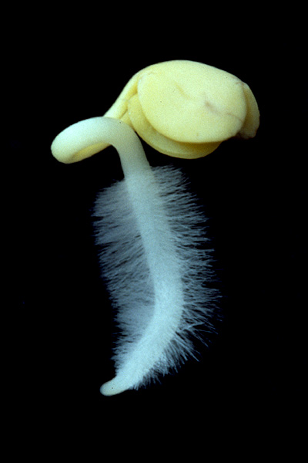
Roots: Function
Roots anchor the plant in the substratum or soil.
Roots absorb water and dissolved nutrients or solutes (nitrogen, phosphorous, magnesium, boron, etc.) needed for normal growth, development, photosynthesis, and reproduction.
In some plants, roots have become adapted for specialized functions.
Copyright © 2002 Pearson Education, Inc., publishing as Benjamin Cummings

Slide 4
Plant Root Zones
Meristematic zone
Cells divide both in direction of root base to form cells that will become the functional root and in the direction of the root apex to form the root cap
Elongation zone
Cells elongate rapidly, undergo final round of divisions to form the endodermis. Some cells thicken to form casparian strip
Maturation zone
Fully formed root with xylem and phloem – root hairs first appear here

Slide 5
Primary Growth in Roots
Root Cap: covers root tip & protects the meristem as the root pushes through the abrasive soil during primary growth.
The cap also secretes a lubricating slime.
Growth in length is concentrated near the root’s tip, where three zones of cells at successive stages of primary growth are located.
zone of cell division
zone of elongation
zone of maturation
Copyright © 2002 Pearson Education, Inc., publishing as Benjamin Cummings

Slide 6
Root Cap
thimble-shaped mass of parenchyma cells at the tip of each root
protects the root from mechanical injury
Golgi bodies release a mucilaginous lubricant (mucigel) cells lasts less than a week, then these die
possibly important in perception of gravity (i.e., geotropism or gravitropism)
amyloplasts (also called statoliths) appear to accumulate at the bottom of cells

Slide 7
Primary Growth in Roots
The zone of cell division includes the apical meristem and its derivatives, primary meristems.
Near the middle is the quiescent center (or radicle)
This forms the primary root of a young plant.
cells that divide more slowly than other meristematic cells.
These cells are relatively resistant to damage from radiation and toxic chemicals.
They may act as a reserve that can restore the meristem if it becomes damaged.
Copyright © 2002 Pearson Education, Inc., publishing as Benjamin Cummings

Slide 8
Primary Growth in Roots
The zone of cell division blends into the zone of elongation where cells elongate, sometimes to more than ten times their original length.
It is this elongation of cells that is mainly responsible for pushing the root tip, including the meristem, ahead.
The meristem sustains growth by continuously adding cells to the youngest end of the zone of elongation.
Copyright © 2002 Pearson Education, Inc., publishing as Benjamin Cummings

Slide 9
Primary Growth in Roots
In the zone of maturation, cells begin to specialize in structure and function.
In this root region, the three tissue systems produced by primary growth complete their differentiation, their cells becoming functionally mature
Three primary meristems give rise to the three primary tissues of roots.
The epidermis develops from the dermal tissues.
The ground tissue produces the endodermis and cortex.
The vascular tissue produces the stele, the pericycle, pith, xylem, and phloem.
Copyright © 2002 Pearson Education, Inc., publishing as Benjamin Cummings

Slide 10
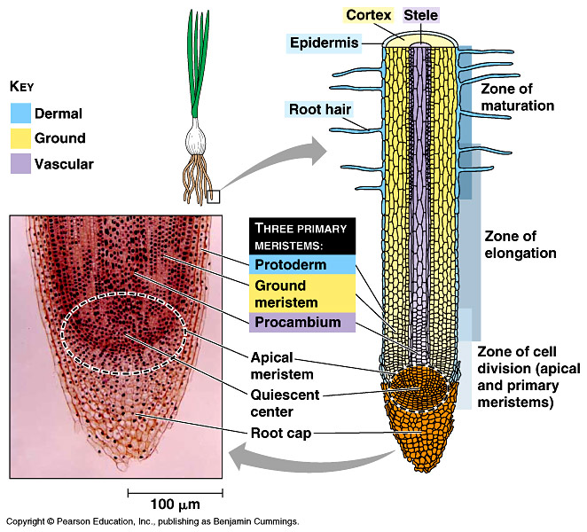
Primary Growth in Roots
The protoderm, the outermost primary meristem, produces the single cell layer of the epidermis
Water and minerals absorbed by the plant must enter through the epidermis.
Root hairs enhance absorption by greatly increasing the surface area.
The procambium gives rise to the stele, which in roots is a central cylinder of vascular tissue where both xylem and phloem develop.
Copyright © 2002 Pearson Education, Inc., publishing as Benjamin Cummings

Slide 11
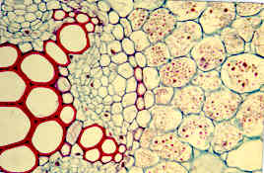
The procambium gives rise to the stele, which in roots is a central cylinder of vascular tissue where both xylem and phloem develop.
Stele
Copyright © 2002 Pearson Education, Inc., publishing as Benjamin Cummings

Slide 12
Primary Growth in Roots
The ground tissue between the protoderm and procambium gives rise to the ground tissue system.
These are mostly parenchyma cells between the stele and epidermis.
They store food and are active in the uptake of minerals that enter the root with the soil solution.
The innermost layer of the cortex, the endodermis, is a cylinder one cell thick that forms a boundary between the cortex and stele.
Copyright © 2002 Pearson Education, Inc., publishing as Benjamin Cummings

Slide 13
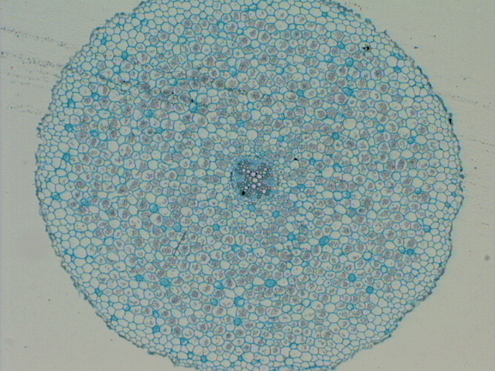
Dicot Root Anatomy
cortex
endodermis
pericycle
epidermis
cortex
stele
xylem
phloem

Slide 14
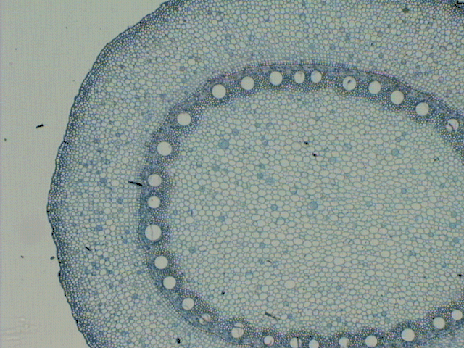
Monocot Root Anatomy
epidermis
cortex
endodermis
cortex
pericycle
stele
pith
phloem
xylem
pith

Slide 15
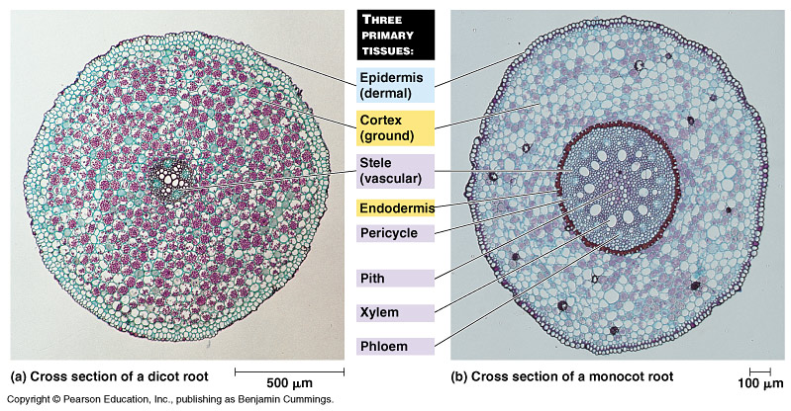
Dicot
Monocot

Slide 16
Mycorrhizal associations
Not unusual
83% of dicots, 79% of monocots and all gymnosperms
Ectotrophic Mycorrhizal fungi
Form a thick sheath around root. Some mycelium penetrates the cortex cells of the root
Root cortex cells are not penetrated, surrounded by a zone of hyphae called Hartig net
The capacity of the root system to absorb nutrients improved by this association – the fungal hyphae are finer than root hairs and can reach beyond nutrient-depleted zones in the soil near the root

Slide 17
Mycorrhizal associations
Vesicular arbuscular mycorrhizal fungi
Hyphae grow in dense arrangement , both within the root itself and extending out from the root into the soil
After entering root, either by root hair or through epidermis hyphae move through regions between cells and penetrate individual cortex cells.
Within cells form oval structures – vesicles – and branched structures – arbuscules (site of nutrient transfer)
P, Cu, & Zn absorption improved by hyphae reaching beyond the nutrient-depleted zones in the soil near the root

Slide 18
Water transport processes
Moves from soil, through plant, and to atmosphere by a variety of mediums
Cell wall
Cytoplasm
Plasma membranes
Air spaces
How water moves depends on what it is passing through

Slide 19
Water absorption from soil
Water clings to the surface of soil particles.
As soil dries out, water moves first from the center of the largest spaces between particles.
Water then moves to smaller spaces between soil particles.
Root hairs make intimate contact with soil particles – amplify the surface area for water absorption by the plant.

Slide 20
Water across plant membranes
There is some diffusion of water directly across the bi-lipid membrane.
Auqaporins: Integral membrane proteins that form water selective channels – allows water to diffuse faster
Facilitates water movement in plants
Alters the rate of water flow across the plant cell membrane – NOT direction

Slide 21
Osmosis and Tonicity
Osmosis is the diffusion of water across a plasma membrane.
Osmosis occurs when there is an unequal concentration of water on either side of the selectively permeable plasma membrane.
Remember, H2O
CAN cross the plasma membrane.
Tonicity is the osmolarity of a solution--the amount of solute in a solution.
Solute--dissolved substances like sugars and salts.
Tonicity is always in comparison to a cell.
The cell has a specific amount of sugar and salt.

Slide 22
Tonic Solutions
A Hypertonic solution has more solute than the cell. A cell placed in this solution will give up water (osmosis) and shrink.
A Hypotonic solution has less solute than the cell. A cell placed in this solution will take up water (osmosis) and become turgid.
An Isotonic solution has just the right amount of solute for the cell. A cell placed in this solution will stay the same.

Slide 23
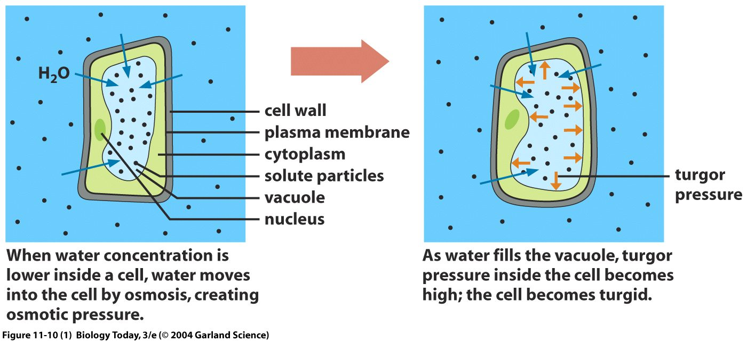
Plant cell in hypotonic solution
Flaccid cell in 0.1M sucrose solution.
Water moves from sucrose solution to cell – swells up –becomes turgid
This is a Hypotonic solution - has less solute than the cell. So higher water conc.
Pressure increases on the cell wall as cell expands to equilibrium

Slide 24
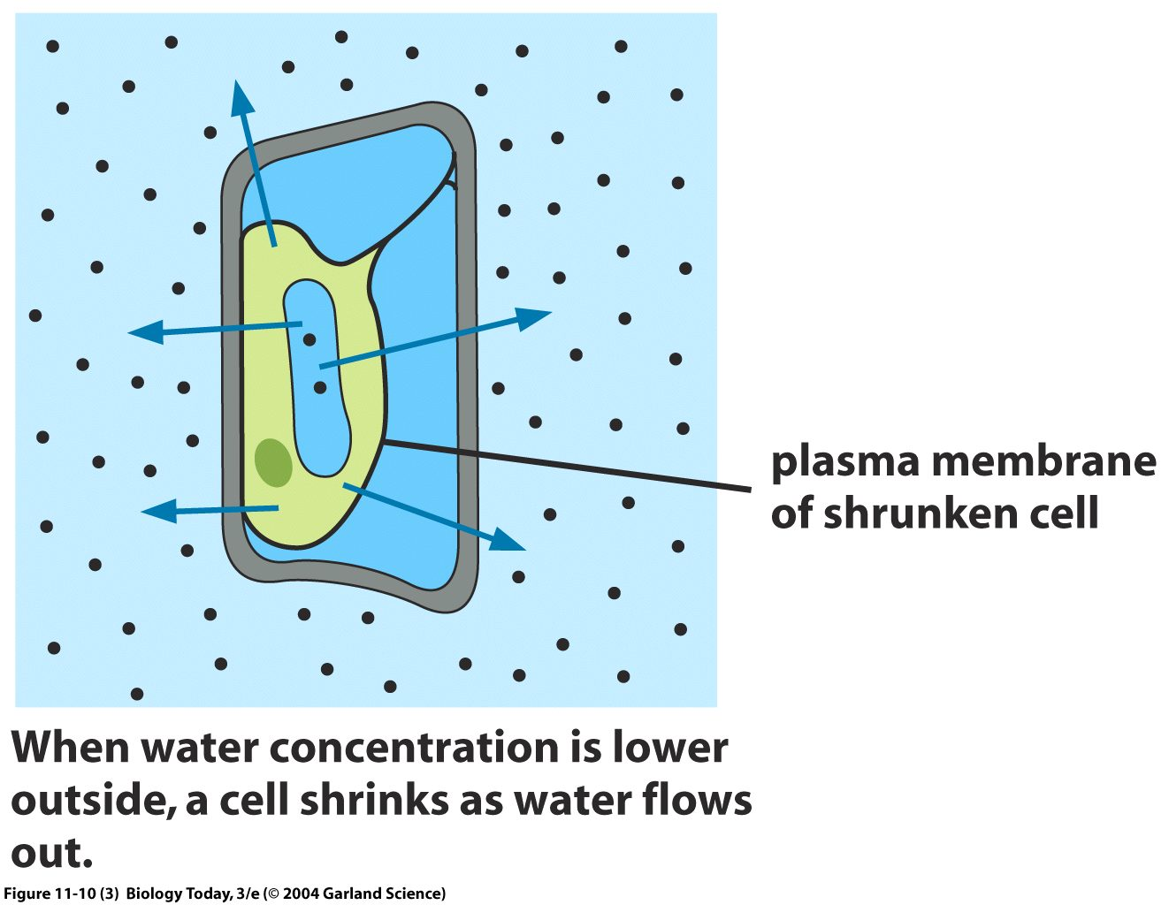
Plant cell in hypertonic solution
Turgid cell in 0.3M sucrose solution
Water movers from cell to sucrose solution
A Hypertonic solution has more solute than the cell. So lower water conc
Turgor pressure reduced and protoplast pulls away from the cell wall

Slide 25
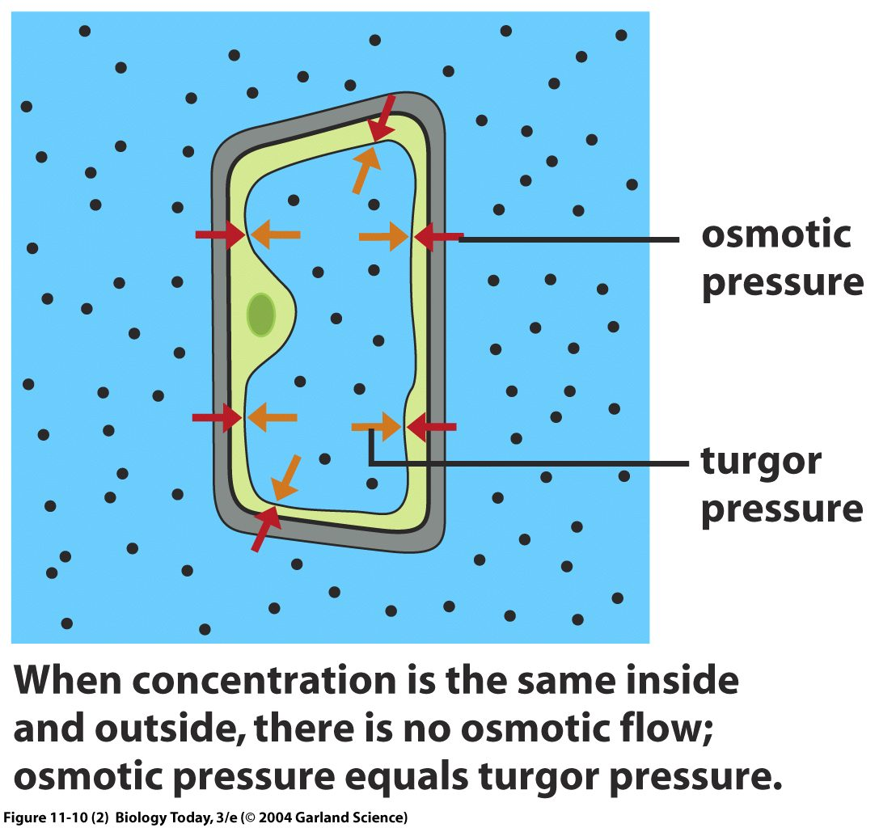
Plant cell in Isotonic solution
Water is the same inside the cell and outside
An Isotonic solution has the same solute than the cell. So no osmotic flow
Turgor pressure and osmotic pressure are the same
This is of NO real benefit to a plant cell and it enters a state known as Flacid. Chemical reactions will still occur, BUT the plant cell can’t help support the structure of the entire plant.

Slide 26
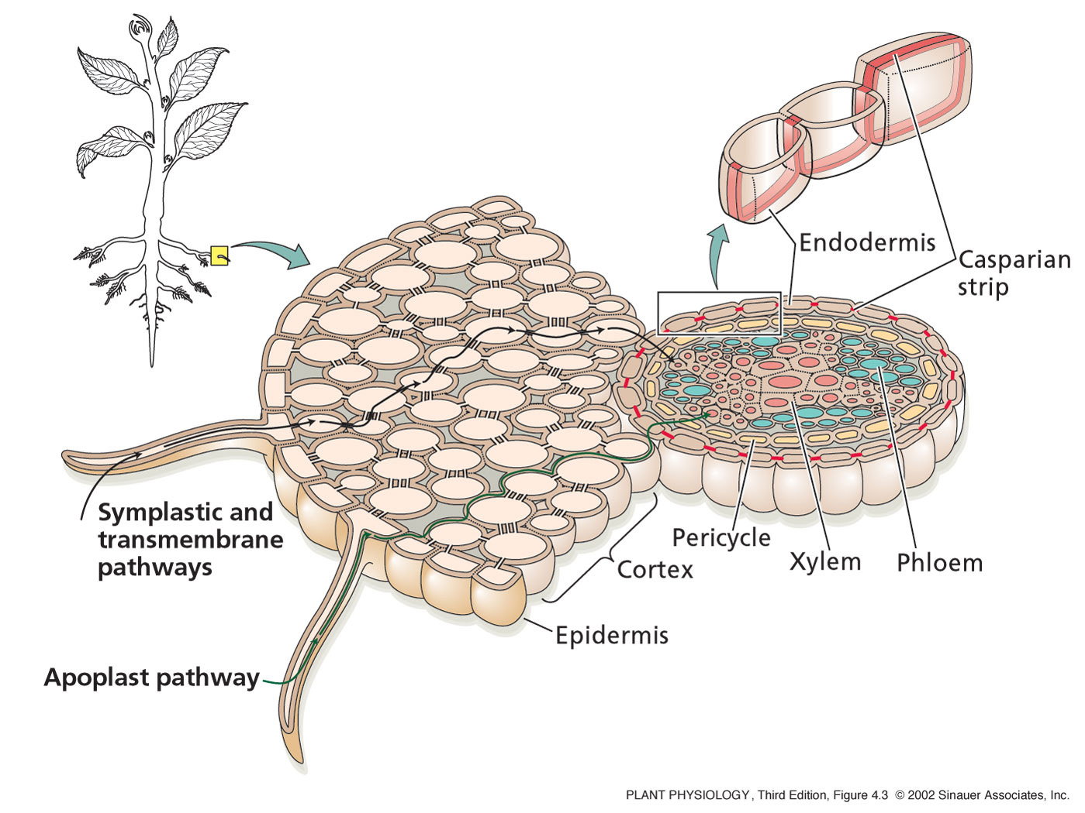
Water uptake in the roots
Root hairs increase surface area of root to maximize water absorption.
From the epidermis to the endodermis there are three pathways in which water can flow:
1: Apoplast pathway:
Water moves exclusively through cell walls without crossing any membranes
The apoplast is a continuous system of cell walls and intercellular air spaces in plant tissue

Slide 27
Water uptake in the roots
2: Transmembrane pathway:
Water sequentially enters a cell on one side, exits the cell on the other side, enters the next cell, and so on.
3: Symplast pathway:
Water travels from one cell to the next via plasmodesmata.
The symplast consist of the entire network of cell cytoplasm interconnected by plasmodesmata

Slide 28
Water uptake in the roots
At the endodermis:
Water movement through the apoplast pathway is stopped by the Casparian Strip
Band of radial cell walls containing suberin , a wax-like water-resistant material
The casparian strip breaks continuity of the apoplast and forces water and solutes to cross the endodermis through the plasma membrane
So all water movement across the endodermis occurs through the symplast

Slide 29
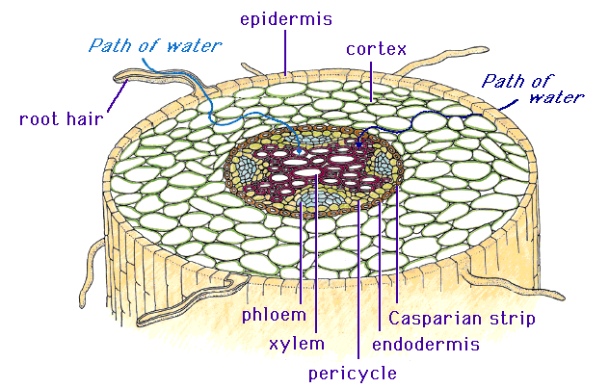
Water transport to the xylem
After water moves through the Casparian Strip via the symplast pathway
Water traveling from one cell to the next via plasmodesmata
It enters the xylem system
Compared with water movement across root tissue the xylem is a simple pathway of low resistance
Water movement through xylem needs less pressure than movement through living cells.
Cohesion-tension theory:

Slide 30
Water transport to the xylem
Cohesion-tension theory:
Relies on the fact that water is a polar molecule
Water is constantly lost by transpiration in the leaf.
When one water molecule is lost another is pulled along.
Transpiration pull, utilizing capillary action and the inherent surface tension of water, is the primary mechanism of water movement in plants.

Slide 31
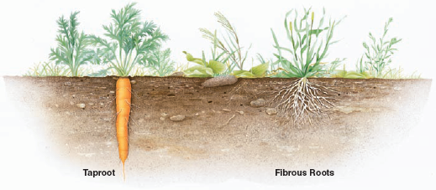
Comparison of Root Systems
Types of roots:
Taproot - A thick primary root that grows long and is found mainly in dicots
Adventitious (Fibrous) roots – branch extensively and are found mainly in monocots
From the wikimedia free licensed media file repository

Slide 32
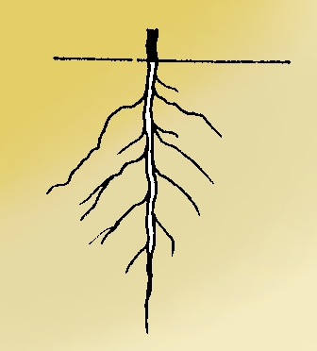
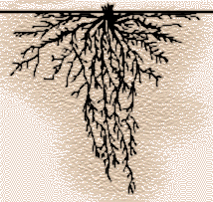
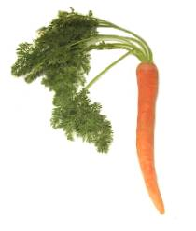
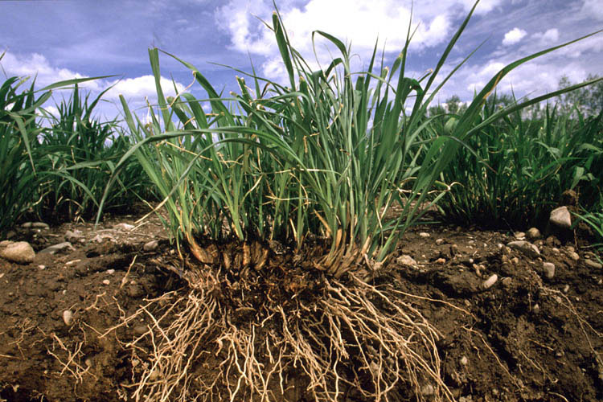
The Tap root
A taproot is a very large, somewhat straight to tapering plant root that grows downward. It forms a center from which other roots sprout laterally
Plants with taproots are difficult to transplant. The presence of a taproot is why weeds are hard to uproot—the top is pulled, but the long taproot stays in the ground, and resprouts
Dicots, one of the two divisions of angiosperms, start with a taproot, which is one main root forming from the enlarging radicle of the seed.
The tap root can be persistent throughout the life of the plant but is most often replaced later in the plant's development by a fibrous root system
From the wikimedia free licensed media file repository

Slide 33
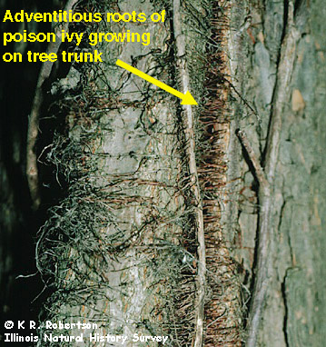
Adventitious (fibrous) Roots:
Roots that arise from anything other than the radicle
A fibrous root system is universal in monocotyledonous plants and ferns
Adventitious rooting may be a stress-avoidance acclimation for some species, driven by such inputs as:
hypoxia/anoxia or nutrient deficiency.
Arise out-of-sequence from the more usual root formation of branches of a primary root, and instead originate from the stem, branches, leaves, or old woody roots.
Adventitious roots dry out quicker, thus cannot tolerate drought
Better able to hold within soil, giving plant better stability
From the wikimedia free licensed media file repository

Slide 34
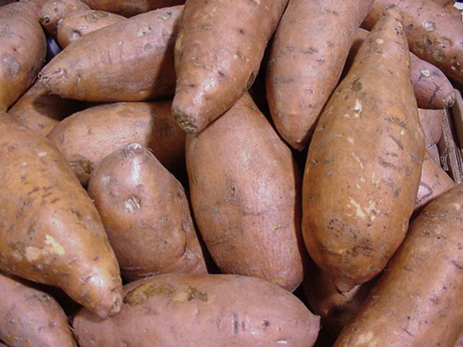
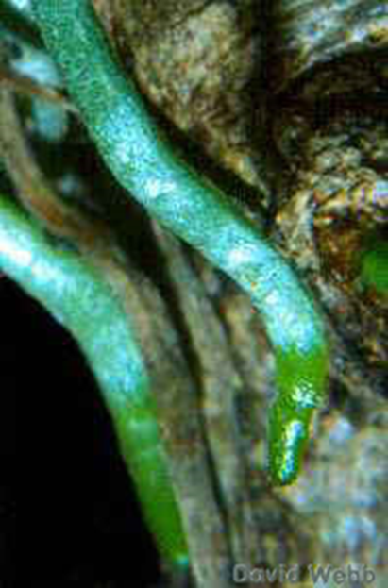
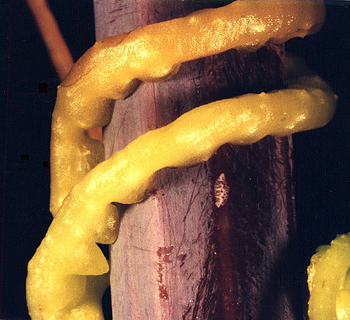
Modified Roots
Food storage
swollen with nutrients and water to prepare for unfavorable conditions.
Some are swollen main roots - carrots.
Others are swollen branched roots or advertitious – sweet potato
Photosynthetic roots
Parasitic roots
Some plants live on other plants and get food materials from their hosts. Parasitic roots are used to absorb food materials form their hosts.
From the wikimedia free licensed media file repository

Slide 35
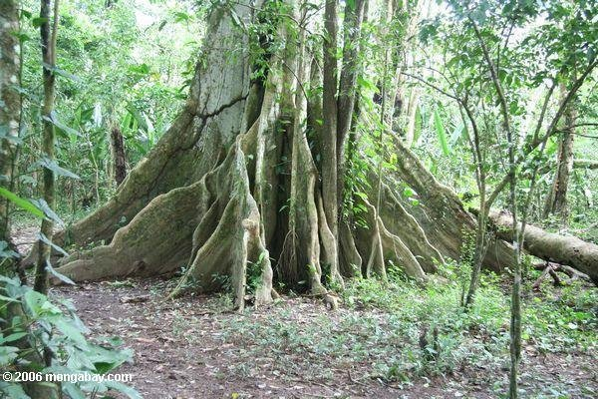
Modified Roots
Buttress roots
large roots on all sides of a tall or shallowly rooted tree.
Typically they are found in rain forests where soils are poor so roots don't go deep.
They prevent the tree from falling over and help gather more nutrients.
They are there to anchor the tree and soak minerals and nutrients from the ground, a function that would prove difficult if the tree was unsoundly rooted.
Examples: silk cotton
From the wikimedia free licensed media file repository

Slide 36
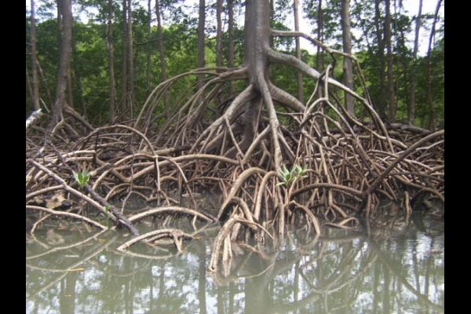
Modified Roots
Aerial roots
roots above the ground.
They are almost always adventitious.
They can absorb water from the air.
They are also used to hold on to their support.
They are found in diverse plant species which include:
the orchids
tropical coastal swamp trees such as mangroves.
From the wikimedia free licensed media file repository

Slide 37
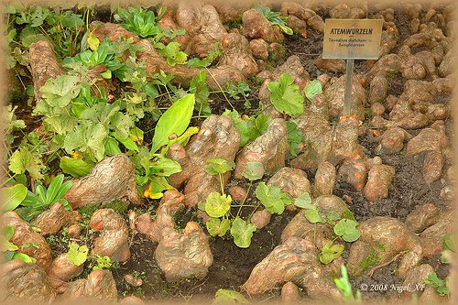
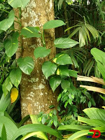
Modified Roots
Respiratory roots
Some plants in swampy areas have branch roots that grow upwards, through the mud and into the air.
The exposed parts of the roots are spongy and they take in air for respiration - red mangrove
Clasping roots
grow from the nodes of the soft stem to cling on to other plants. Examples: pepper, ivy
From the wikimedia free licensed media file repository

Slide 38
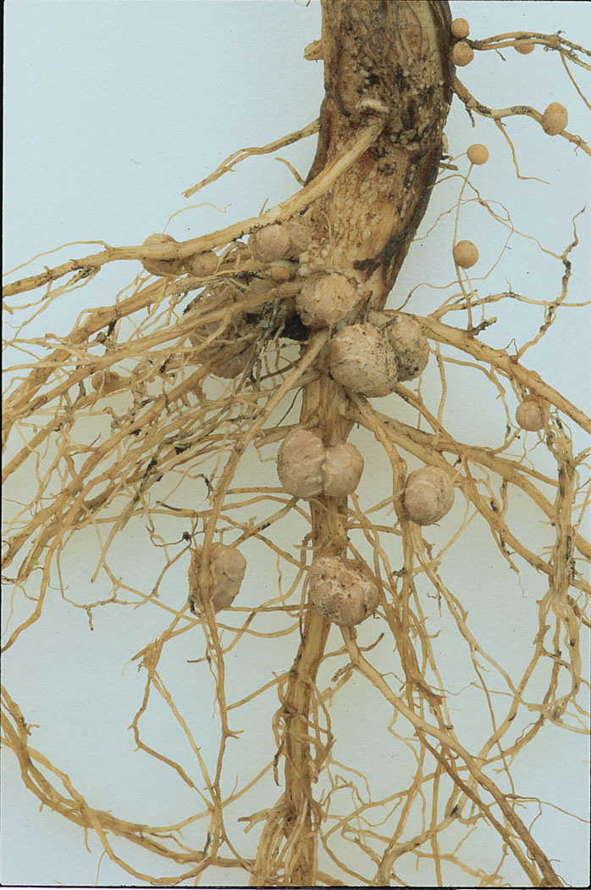
Symbiotic Roots
Legumes
Legumes seedlings germinate without any association to rhizobia
Under nitrogen limiting conditions, the plant and the bacteria seek each other out by an elaborate exchange of signals
The first stage of the association is the migration of the bacteria through the soil towards the host plant
From the wikimedia free licensed media file repository

Slide 39
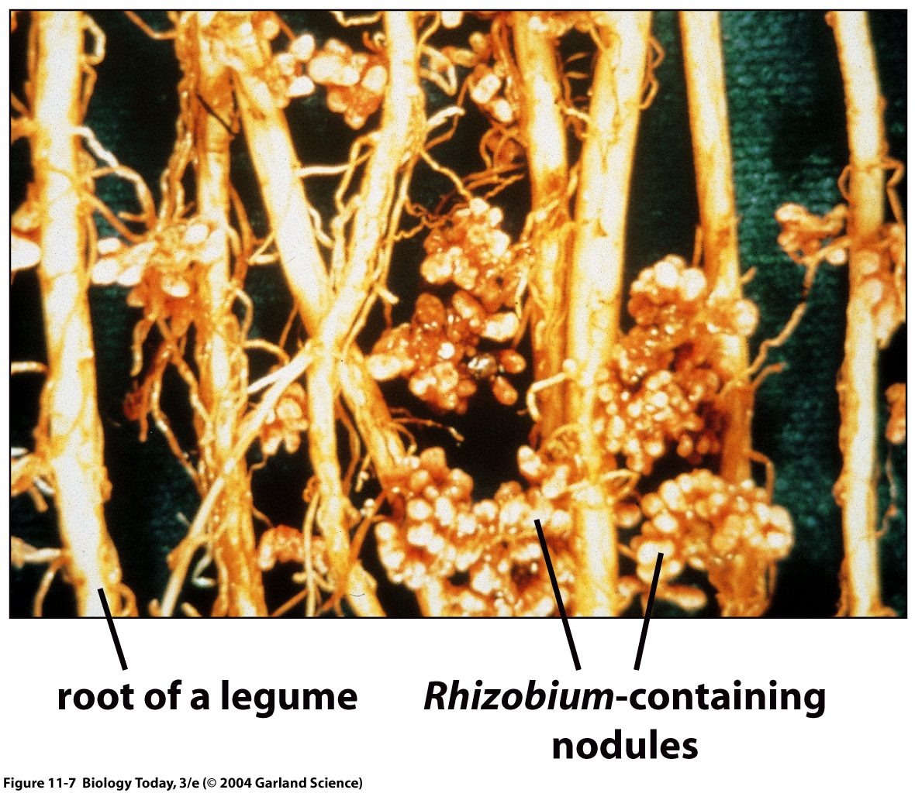
Symbiotic Roots
Nodule formation results a finely tuned interaction between the bacteria and the host plant
Involves the recognition of specific signals between the symbiotic bacteria and the host plant
The bacteria forms NH₃ which can be used directly by the plant
The plant gives the bacteria organic nutrients.
Notes:
39

Slide 40
Nodule formation
During root nodule formation, two process occur simultaneously
Infection and Nodule Organogenesis
(A) Rhizobia attach to the root hairs and release nod factors that produce a pronounced curling of the root hair cell
(B) Rhizobia get caught and curl, degrade the root hair cell wall allowing the bacterial cells direct access to the outer surface of the plant plasma membrane

Slide 41
Nodule formation
(C) Then the infection thread forms
Formed from Golgi depositing material at the tip at the site of infection. Local degradation of root hair cell wall also occurs
(D) Infection thread reaches the end of the cell, and thread plasma membrane fuses with plasma membrane of root hair cell
Then bacterial cells are released into the fused plasma membranes

Slide 42
Nodule formation
(E) Rhizobia are released into the apoplast and enter the middle lamella,
This leads to the formation of a new infection thread, which forms an open channel with the first
(F) Infection thread expands and branches until it reaches target cells
Vesicles composed of plant membrane enclose bacterial cells and they are released into the cytoplasm

Slide 43
The End.
Any Questions?
Notes:
43

Slide 44
Movement of pathogens from cell to cell
Fungi, Bacteria, and Viruses all move through the plant in the same when following a successful penetration.
Movement proteins (MP) are proteins dedicated to enlarging the pore size of plasmodesmata and actively transporting the pathogen into the adjacent cell.
Thereby allowing local and systemic spread of pathogen in plants.

Slide 45
Movement of pathogens from cell to cell
So, from the entry point (1) the pathogen moves from cell to cell via the plasmodesmata (2).
As a pathogen travels it also reproduces. Some of the pathogen can exit the infected plant by stomata and infect nearby plants (3).
If the pathogen gets to the bundle sheath it can rapidly be transported through the plant by the xylem and phloem (4)

