Slide 1
Tissues and Primary Growth of Stems

Slide 2
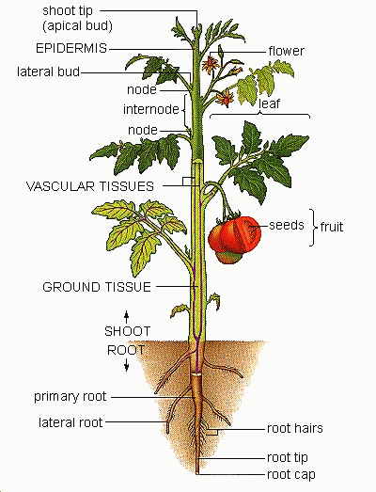
The Plant Body: Stems
FUNCTION OF STEMS
Stems support leaves and branches.
Stems transport water and solutes between roots and leaves.
Stems in some plants are photosynthetic.
Stems may store materials necessary for life (e.g., water, starch, sugar).
In some plants, stems have become adapted for specialized functions.
Used with permission from http://education-portal.com

Slide 3
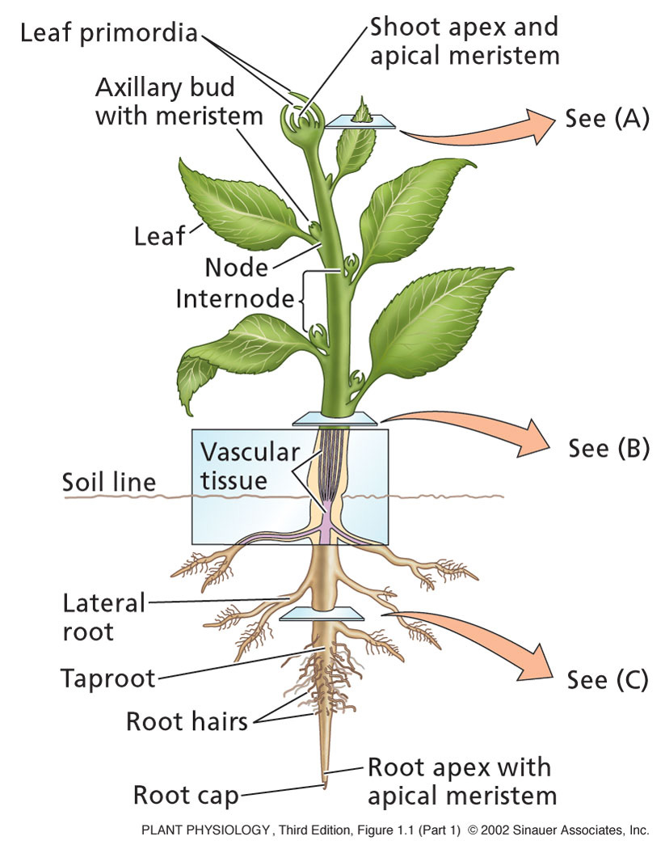
  May be vegetative (leaf bearing) or reproductive (flower bearing).
  Node- area of stem where leaf is born
  Internodes- stem area between nodes
  Buds: Stem elongation. Embryonic tissue of leaves and stem (not flower bud)
    Terminal bud- Located at tip of stems or branches.
    Axillary bud- Gives rise to branches
  Apical Dominance: Prevention of branch formation by terminal bud

Slide 4
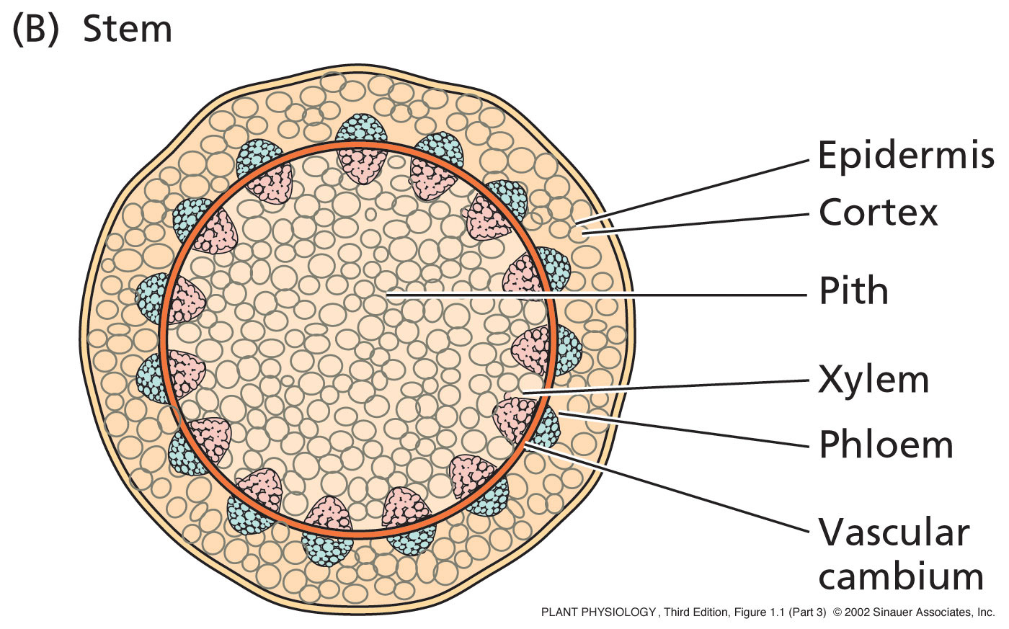
The stem

Slide 5
Parts of the Stem
  Xylem
Water and minerals travel up to other plant parts
  Phloem
Manufactured food travels down to other plant parts
  Cambium
  Separates xylem and phloem

Slide 6
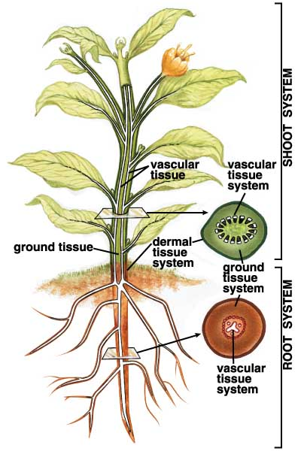
Plant Tissues
1) Dermal Tissue System
  Outer covering
  Protection
2) Vascular Tissue System
  “Vessels” throughout plant
  Transport materials
3) Ground Tissue System
  “Body” of plant
  Photosynthesis; storage; support
Used with permission from http://education-portal.com

Slide 7
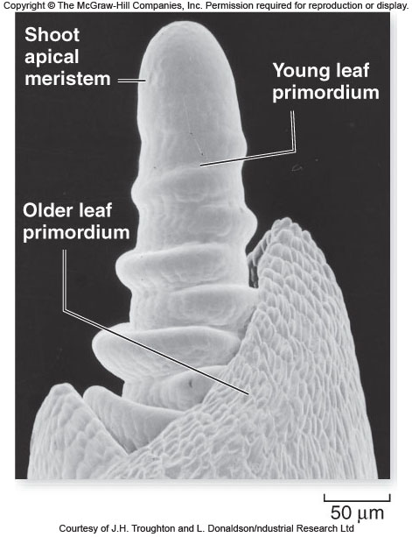
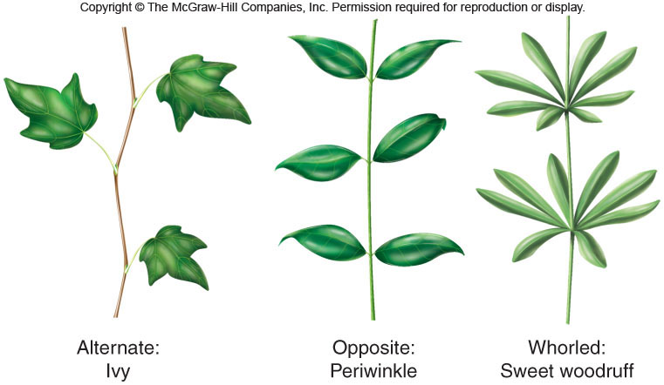
Stems – Structure and Development
Stems have all three types of plant tissue
Grow by division at meristems
  Develop into leaves, other shoots, and even flowers
Leaves may be arranged in one of three ways
Notes:
7

Slide 8
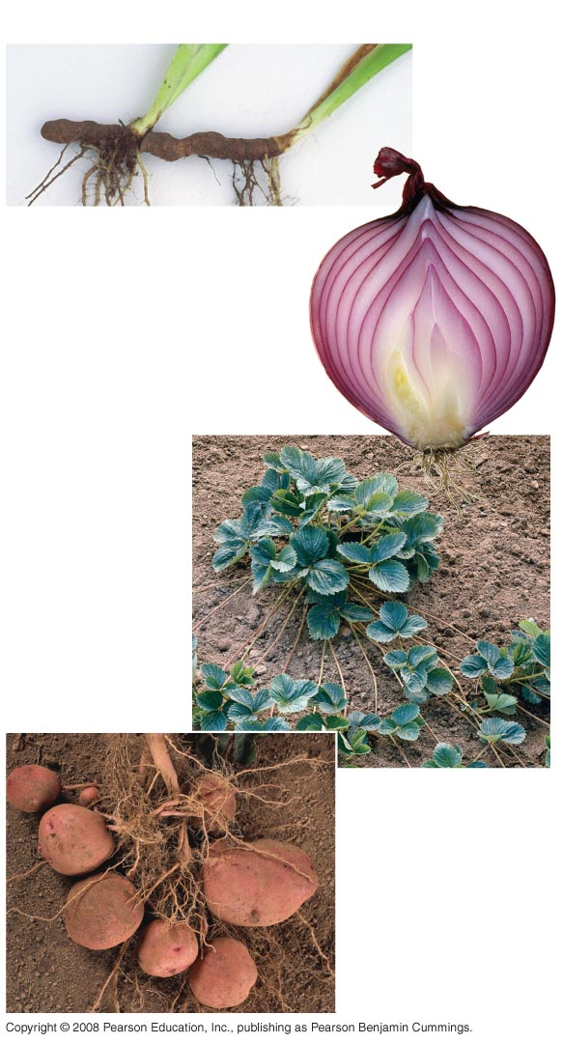
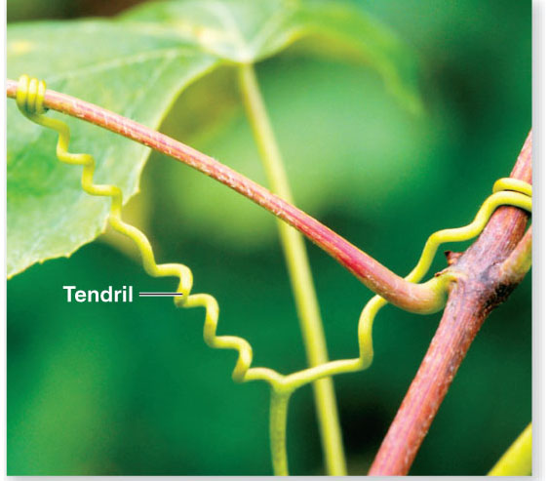
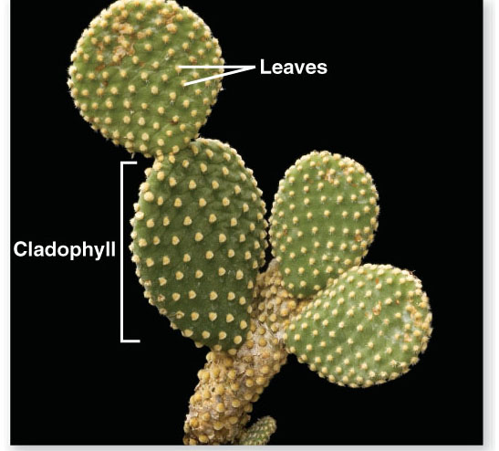
Rhizomes
Stems – Many Plants Have Modified Stems
Bulbs
Storage leaves
Stem
Stolons
Stolon
Tubers
Notes:
8
Figure 35.5 Modified stems

Slide 9
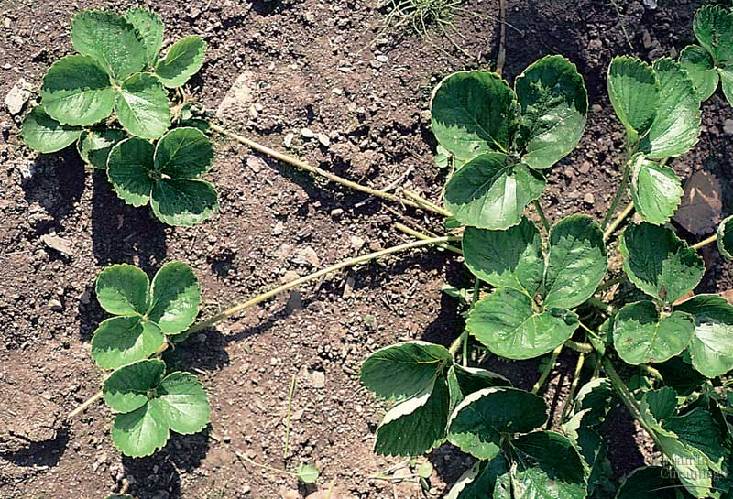
Modified shoots with diverse functions have evolved in many plants.
  These shoots, which include stolons, rhizomes, tubers, and bulbs, are often mistaken for roots.
  Stolons, such as the “runners” of strawberry plants, grow on the surface and enable a plant to colonize large areas asexually when a parent plant fragments into many smaller offspring.
Fig. 35.4a
Copyright © 2002 Pearson Education, Inc., publishing as Benjamin Cummings

Slide 10
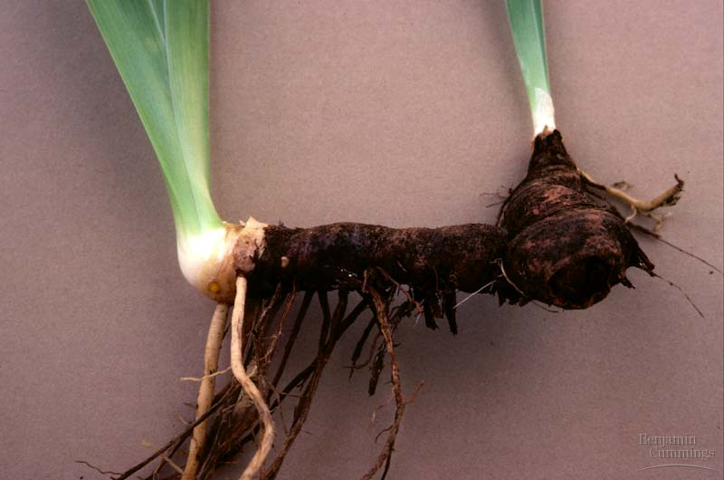
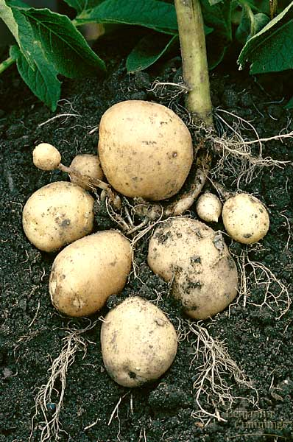
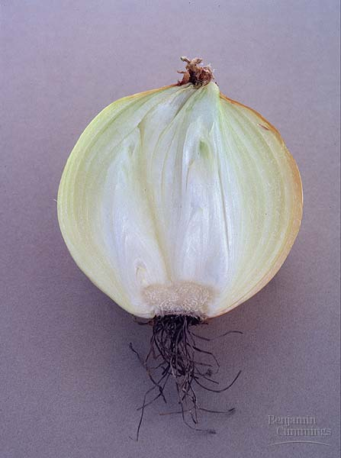
  Rhizomes, like those of ginger, are horizontal stems that grow underground.
  Tubers, including potatoes, are the swollen ends of rhizomes specialized for food storage.
  Bulbs, such as onions, are vertical, underground shoots consisting mostly of the swollen bases of leaves that store food.
Fig. 35.5b-d
Copyright © 2002 Pearson Education, Inc., publishing as Benjamin Cummings

Slide 11
Plant Tissues – Ground Tissue
Some major types of plant cells:
  Parenchyma
  Collenchyma
  Sclerenchyma
Tissues that are neither dermal nor vascular are ground tissue
Ground tissue internal to the vascular tissue is pith; ground tissue external to the vascular tissue is cortex
Ground tissue includes cells specialized for storage, photosynthesis, and support
Notes:
11

Slide 12
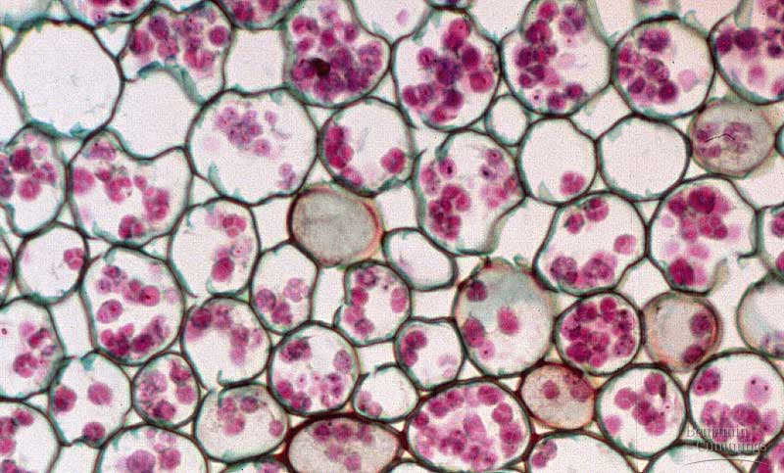
Parenchyma
Characteristics
  least specialized cell type
  only thin primary cell wall is present
  possess large central vacuole
  generally alive at functional maturity
Functions
  make up most of the ground tissues of the plant
  storage
  photosynthesis
  can help repair and replace damaged organs by proliferation and specialization into other cells

Slide 13
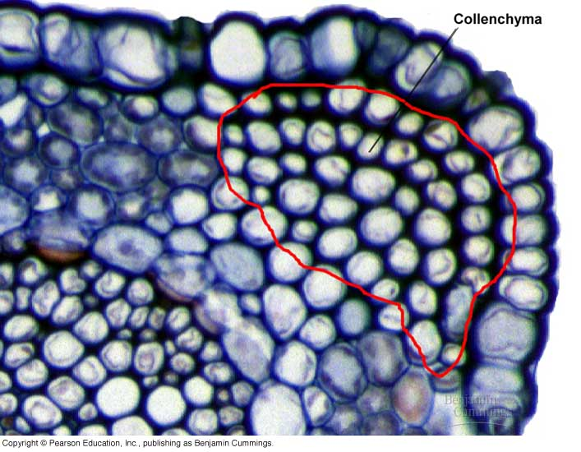
Collenchyma
Characteristics
  possess thicker primary cell walls the that of parenchyma
  no secondary cell wall present
  generally alive at functional maturity
Functions
  provide support without restraining growth

Slide 14
Sclerenchyma
Characteristics
  have secondary cell walls strengthened by lignin
  often are dead at functional maturity
  two forms: fibers and sclereids
Functions
  rigid cells providing support and strength to tissues

Slide 15
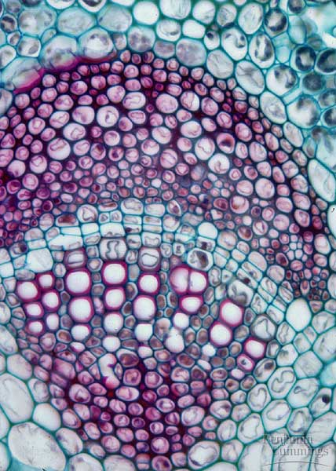
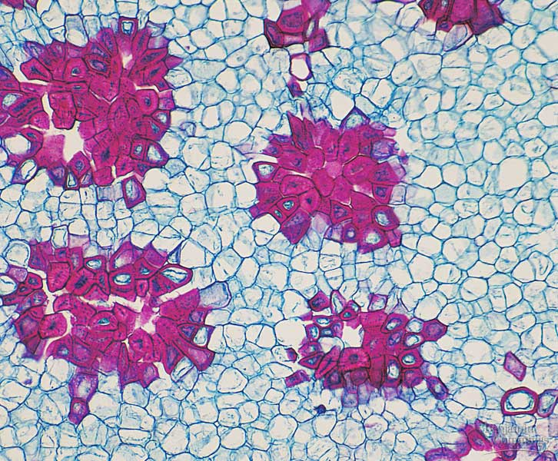
Sclerenchyma
  Fibers are long, slender and tapered, and usually occur in groups.
    Those from hemp fibers are used for making rope and those from flax for weaving into linen.
  Sclereids, shorter than fibers and irregular in shape
    impart the hardness to nutshells and seed coats and the gritty texture to pear fruits.

Slide 16
Vascular Tissue
Vascular tissue:
Runs continuous throughout the plant
transports materials between roots and shoots.
  Xylem transports water and dissolved minerals upward from roots into the shoots. (water the xylem)
  Phloem transports food from the leaves to the roots and to non-photosynthetic parts of the shoot system. (feed the phloem)

Slide 17
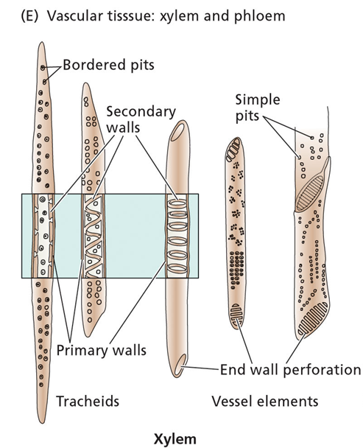
Overview of Plant Structure
Xylem:
  Main water-conducting tissue of vascular plants.
  arise from individual cylindrical cells oriented end to end.
  At maturity the end walls of these cells dissolve away and the cytoplasmic contents die.
  The result is the xylem vessel, a continuous nonliving duct.
  carry water and some dissolved solutes, such as inorganic ions, up the plant

Slide 18
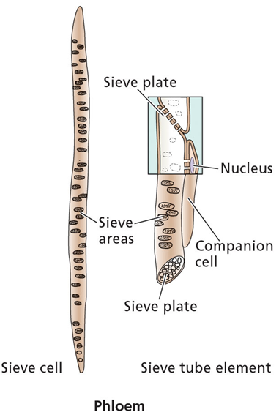
Overview of Plant Structure
Phloem:
  The main components of phloem are
    sieve elements
    companion cells.
  Sieve elements have no nucleus and only a sparse collection of other organelles . Companion cell provides energy
  so-named because end walls are perforated - allows cytoplasmic connections between vertically-stacked cells .
  conducts sugars and amino acids - from the leaves, to the rest of the plant

Slide 19
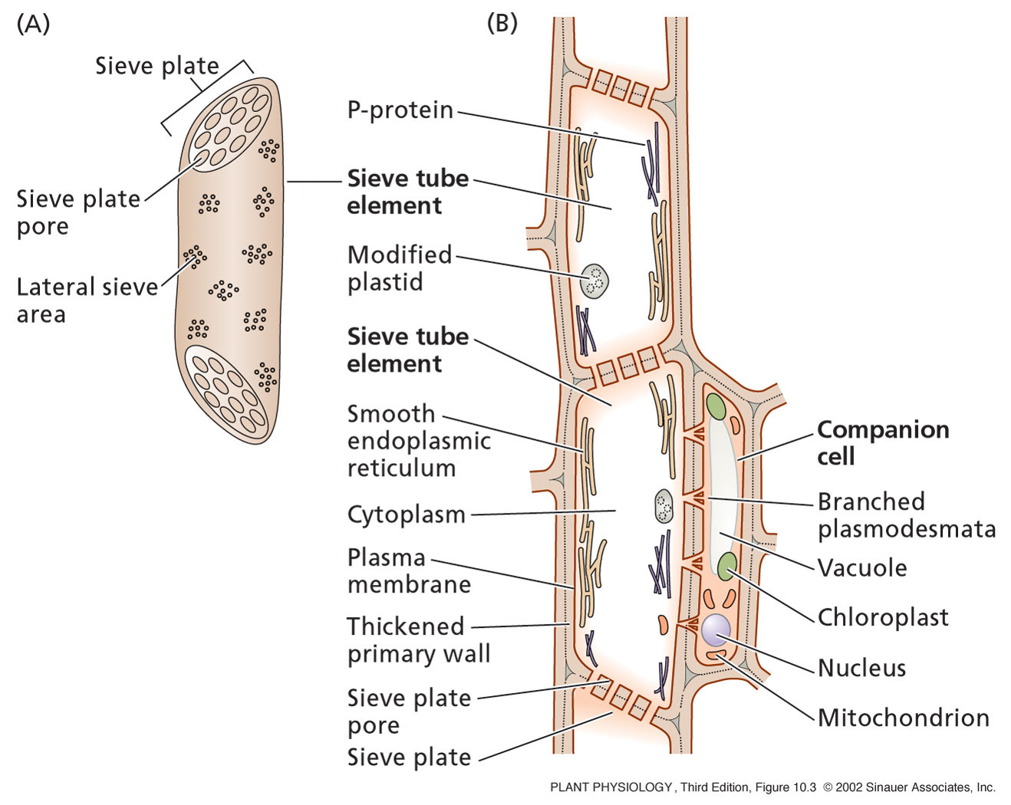
Phloem transport requires specialized, living cells
Sieve tubes elements join to form continuous tube
Pores in sieve plate between sieve tube elements are open channels for transport
Each sieve tube element is associated with one or more companion cells.
  Many plasmodesmata penetrate walls between sieve tube elements and companion cells
  Close relationship, have a ready exchange of solutes between the two cells

Slide 20
Phloem transport requires specialized, living cells
Companion cells:
  Role in transport of photosynthesis products from producing cells in mature leaves to sieve plates of the small vein of the leaf
  Synthesis of the various proteins used in the phloem
  Contain many, many mitochondria for cellular respiration to provide the cellular energy required for active transport
  There ate three types
    Ordinary companion cells
    Transfer cells
    Intermediary cells

Slide 21
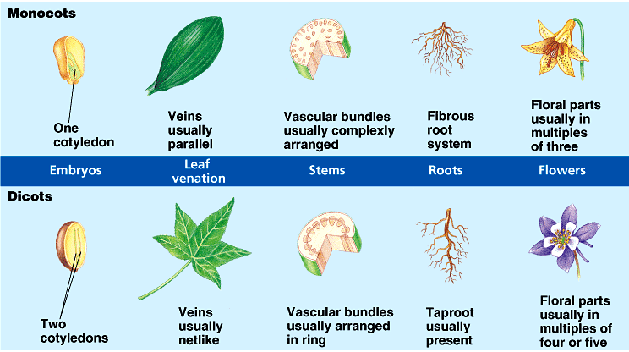
Plant Classification – Monocots vs. Dicots
Basic categories of plants based on structure and function
Copyright © 2002 Pearson Education, Inc., publishing as Benjamin Cummings

Slide 22
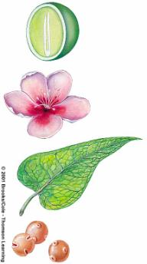
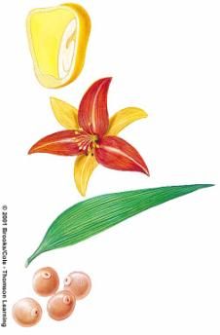
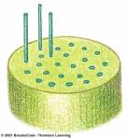
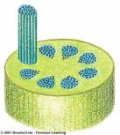
Plant Classification – Monocots vs. Dicots
1 cotyledon
2 cotyledons
4 or 5 floral parts
3 floral parts
Parallel veins
Netlike veins
1 pore in pollen
3 pores in pollen
Stem vascular bundles dispersed
Stem vascular bundles in ring

Slide 23
Remember Plant Tissues?
1) Dermal Tissue System
  Outer covering
  Protection
2) Vascular Tissue System
  “Vessels” throughout plant
  Transport materials
3) Ground Tissue System
  “Body” of plant
  Photosynthesis; storage; support
Used with permission from http://education-portal.com

Slide 24
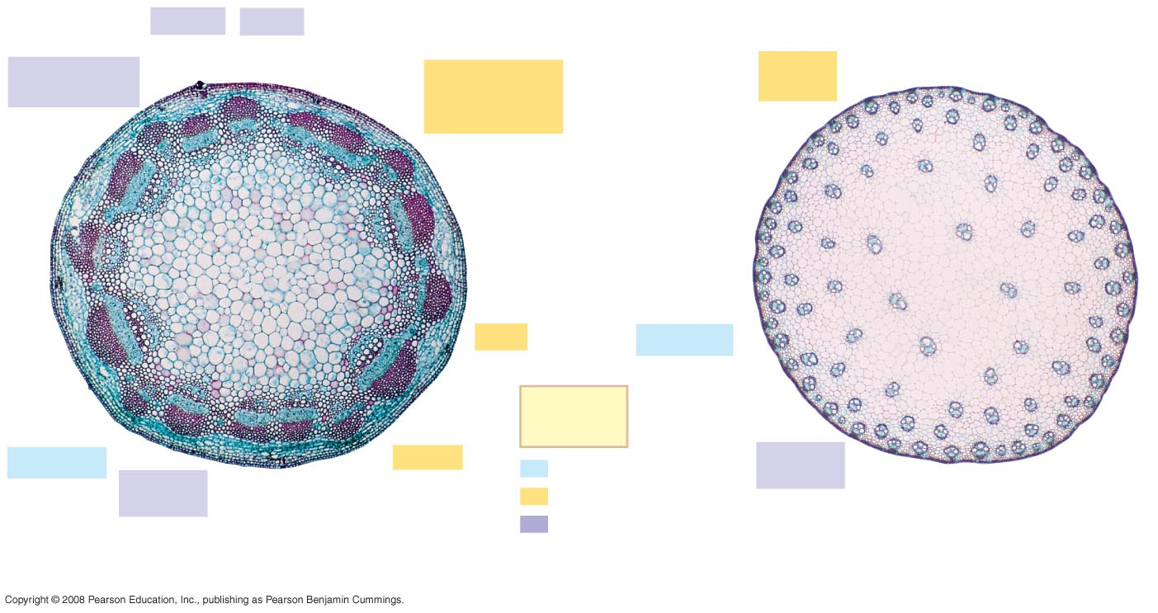
Vasculature - Comparisons
In most monocot stems, the vascular bundles are scattered throughout the ground tissue, rather than forming a ring as with Dicots
Phloem
Xylem
Sclerenchyma
(fiber cells)
Ground tissue
connecting
pith to cortex
Ground
tissue
Pith
Epidermis
Key
to labels
Epidermis
Cortex
Dermal
Vascular
bundles
Vascular
bundle
Ground
1 mm
Vascular
1 mm
(a)
Cross section of stem with vascular bundles forming
a ring (typical of dicots)
(b)
Cross section of stem with scattered vascular bundles
(typical of monocots)
Copyright © 2002 Pearson Education, Inc., publishing as Benjamin Cummings
Notes:
24
Figure 35.17 Organization of primary tissues in young stems

Slide 25
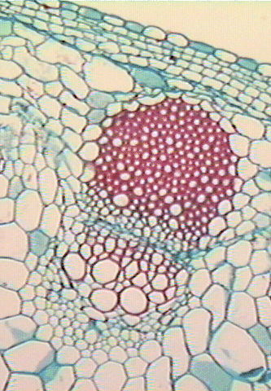
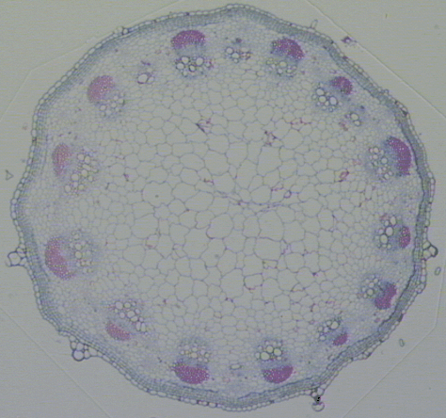
Dicot Stem Anatomy
epidermis
phloem
cortex
vascular bundle
pith
vascular
cambium
xylem
Copyright © 2002 Pearson Education, Inc., publishing as Benjamin Cummings

Slide 26
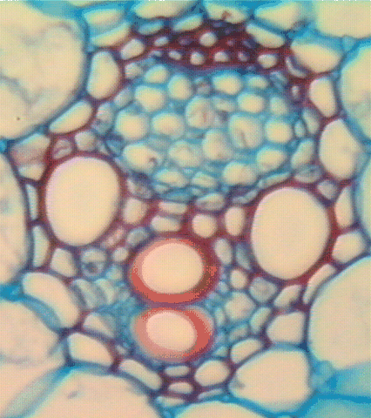
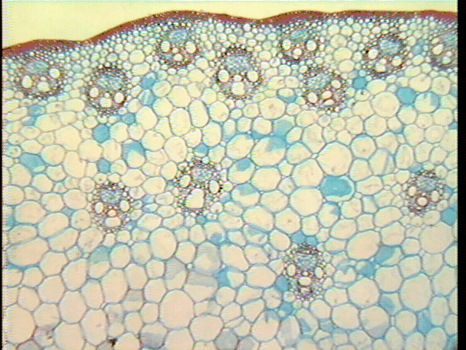
Monocot Stem Anatomy
phloem
epidermis
vascular bundles
ground tissue
xylem
Copyright © 2002 Pearson Education, Inc., publishing as Benjamin Cummings

Slide 27
Plant stem growth
Vegetative development is based on meristems, in which cell division occurs throughout life, producing cells that go on to differentiate.
When a meristem is converted from vegetative to reproductive development, regulatory transcription factors are activated that control the identity and position of floral organs.

Slide 28
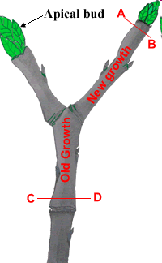
Plant Growth
1) Primary Growth:
Apical Meristems:
Mitotic cells at “tips” of roots / stems
length
1) Increased length
2) Specialized structures (e.g. fruits)
2) Secondary Growth:
girth
Lateral Meristems: Mitotic cells “hips” of plant
Responsible for increases in stem/root diameter

Slide 29
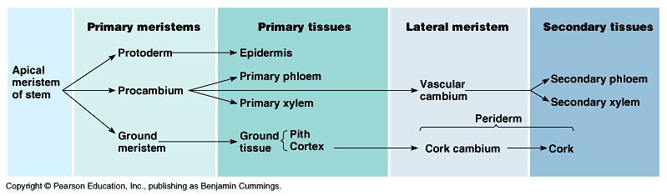
Plant Growth
1) Indeterminate: Grow throughout life
2) Growth at “tips” (length) and at “hips” (girth)
Growth patterns in plant:
1) Meristem Cells: Dividing Cells
2) Differentiated Cells: Cells specialized in structure & role
Form stable, permanent part of plant

Slide 30
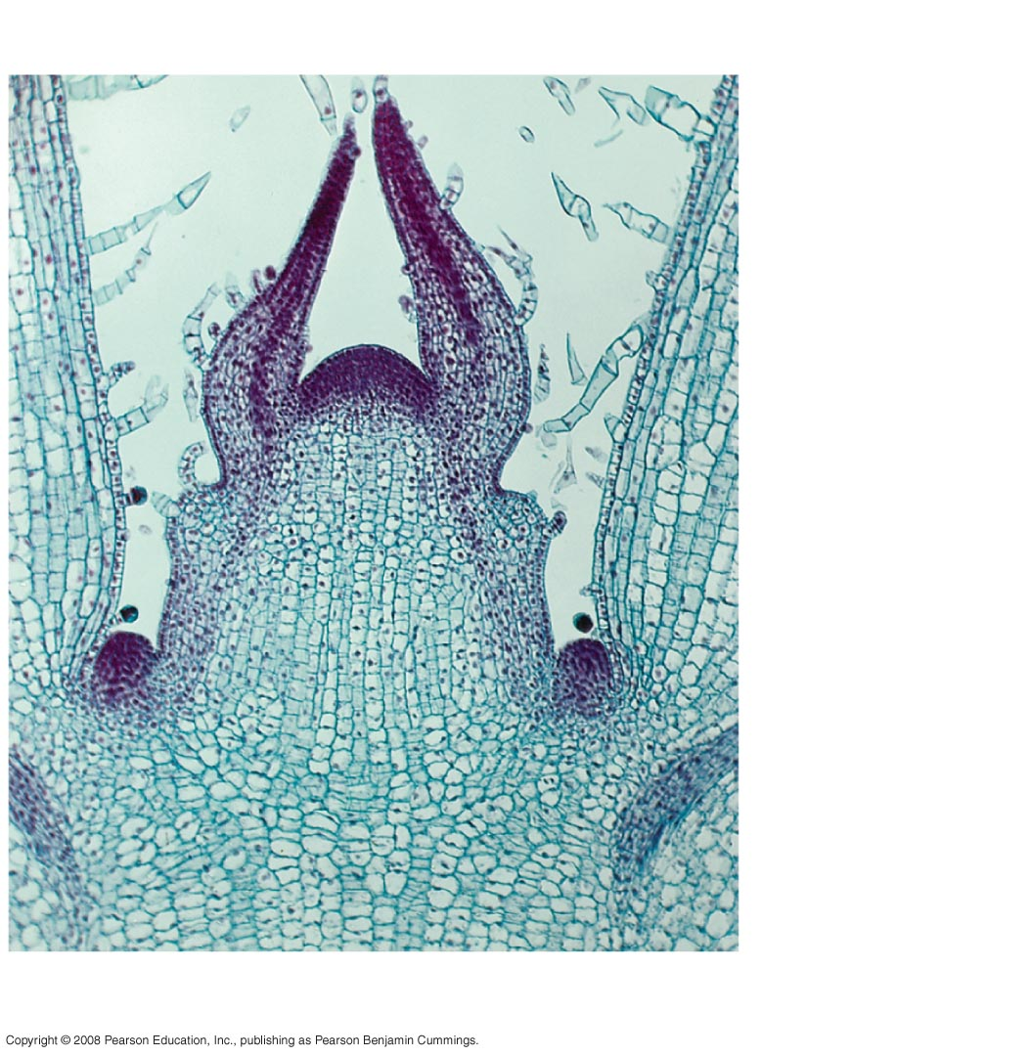
Plant Growth
Shoot apical meristem
Leaf primordia
Young
leaf
Developing
vascular
strand
Axillary bud
meristems
Copyright © 2002 Pearson Education, Inc., publishing as Benjamin Cummings
Notes:
30
Figure 35.16 The shoot tip

Slide 31
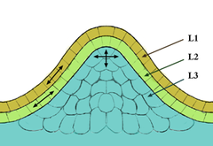
Meristems
The tissue in most plants consisting of undifferentiated cells (meristematic cells), found in zones of the plant where growth can take place.
Meristematic cells are analogous in function to stem cells in animals, are incompletely or not differentiated, and are capable of continued cellular division.
Furthermore, the cells are small and protoplasm fills the cell completely.
The vacuoles are extremely small. The cytoplasm does not contain chloroplasts although they are present in rudimentary form (proplastids).
Meristematic cells are packed closely together without intercellular cavities.
Tunica-Corpus model of the apical
meristem (growing tip). The epidermal
(L1) and subepidermal (L2) layers form
the outer layers called the tunica.
The inner L3 layer is called the corpus.
Cells in the L1 and L2 layers divide in
a sideways fashion which keeps these
layers distinct, while the L3 layer divides in a more random fashion.

Slide 32
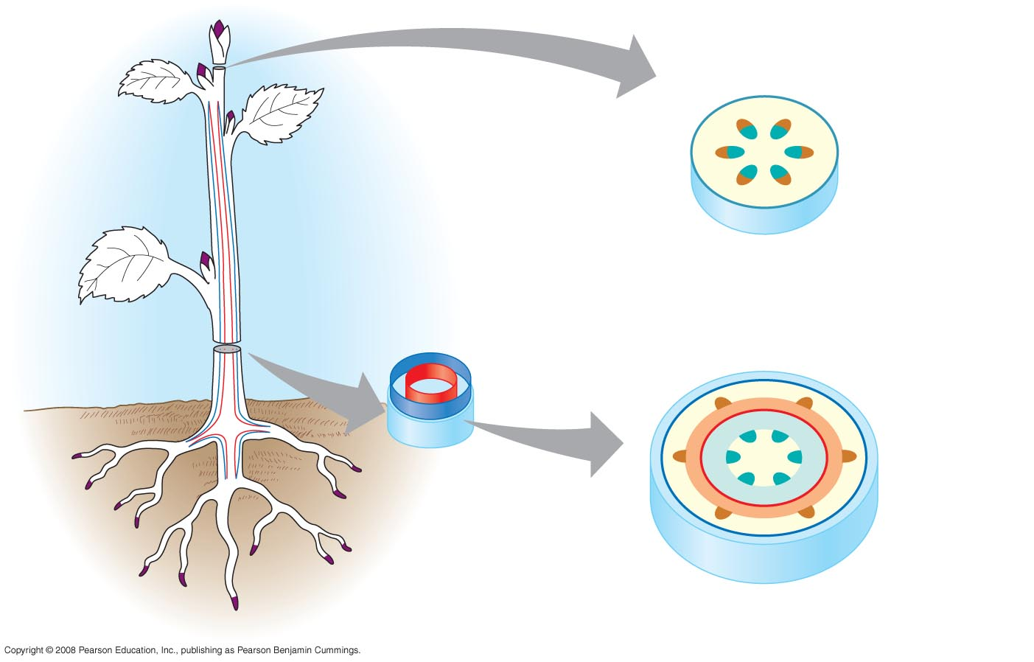
Plant Growth
Two lateral meristems: vascular cambium and cork cambium
Primary growth in stems
Epidermis
Cortex
Shoot tip (shoot
apical meristem
and young leaves)
Primary phloem
Primary xylem
Pith
Lateral meristems:
Vascular cambium
Secondary growth in stems
Cork cambium
Axillary bud
meristem
Periderm
Cork
cambium
Cortex
Pith
Primary
phloem
Primary
xylem
Root apical
meristems
Secondary
phloem
Secondary
xylem
Vascular cambium
Copyright © 2002 Pearson Education, Inc., publishing as Benjamin Cummings
Notes:
32
Figure 35.11 An overview of primary and secondary growth

Slide 33
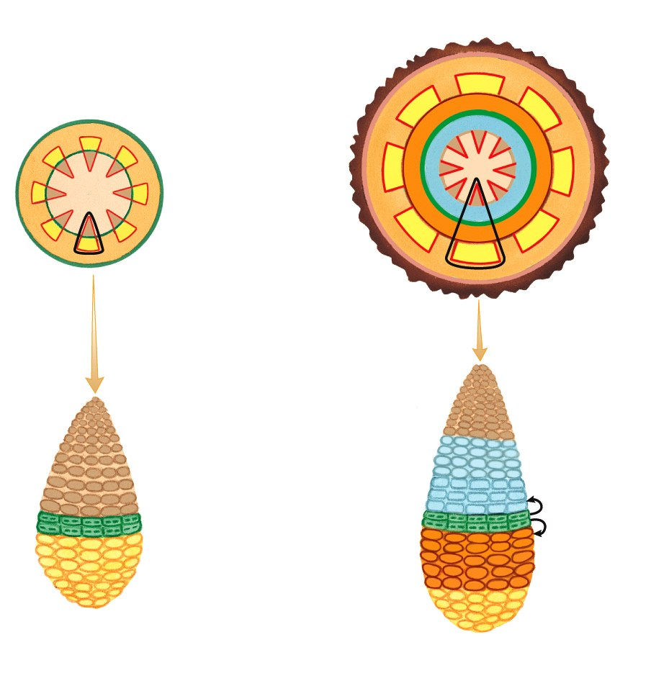
Plant Growth
Stem – Secondary Growth:
primary phloem
  thicker, stronger stems
  Vascular Cambium: between primary xylem and phloem
vascular cambium
primary xylem
epidermis
  Produces inside stem:
pith
A) Secondary xylem
  moves H₂O, inward
B) Secondary phloem
  moves sugars, outward
cortex
primary xylem
dividing
vascular
cambium
primary phloem

Slide 34
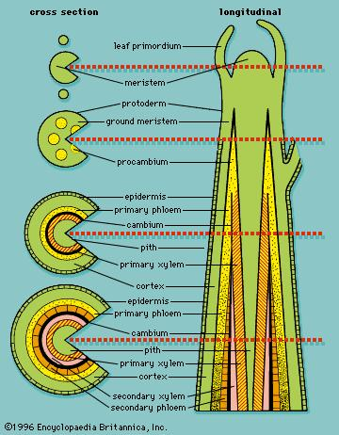
Vascular cambium
Is a lateral meristem in the vascular tissue of plants.
It is a cylinder of unspecialized meristematic cells that divide to give rise to cells that further divide, differentiate and specialize to form the secondary vascular tissues.
The vascular cambium is the source of both the secondary xylem (inwards, towards the pith)
And the secondary phloem
  (outwards),
And is located between these tissues in the stem and root.

Slide 35
Vascular cambium
Made from, procambium that remains undifferentiated between the primary xylem and primary phloem.
Upon maturity, this region is known as the fascicular cambium, and the area of cells between the vascular bundles (fascicles) called pith rays becomes what is called the interfascicular cambium.
The fascicular and inter-fascicular cambiums, therefore, represent a continuous ring which bisects the primary xylem and primary phloem.
The vascular cambium then produces secondary xylem on the inside of the ring, and secondary phloem on the outside, pushing the primary xylem and phloem apart.

Slide 36
Vascular cambium
The vascular cambium usually consists of two types of cells:
  Fusiform initials (tall cells, axially orientated.
  Ray initials (almost isodiametric cells - smaller and round to angular in shape).
Remember:
The vascular cambium is a type of meristem - tissue consisting of embryonic (incompletely differentiated) cells from which other (more differentiated) plant tissues originate.
Primary meristems are the apical meristems on root tips and shoot tips.

Slide 37
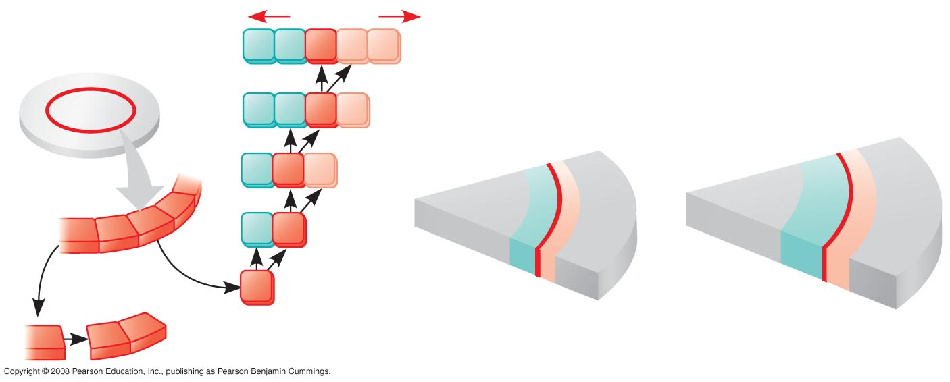
Plant Growth
Vascular Cambium:
primary
xylem
Secondary growth
new
secondary
xylem
secondary phloem
dividing
vascular
cambium
primary phloem
primary xylem
secondary xylem
new
secondary
phloem
primary
phloem
vascular cambium
pith
cortex
Vascular cambium
Growth
Vascular
cambium
X
X
C
P
P
Secondary
xylem
Secondary
phloem
X
X
C
P
C
X
C
P
C
C
C
C
X
C
C
C
After one year
of growth
After two years
of growth
C
C
Copyright © 2002 Pearson Education, Inc., publishing as Benjamin Cummings

Slide 38
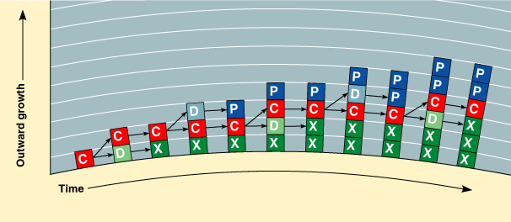
Production of Secondary Xylem and Phloem
  The accumulation of this tissue over the years accounts for most of the increase in diameter of a woody plant.
  Secondary xylem forms to the interior and secondary phloem to the exterior of the vascular cambium.
C=cambium cell
X=2º xylem
P=2º phloem
D=derivative
Copyright © 2002 Pearson Education, Inc., publishing as Benjamin Cummings

Slide 39
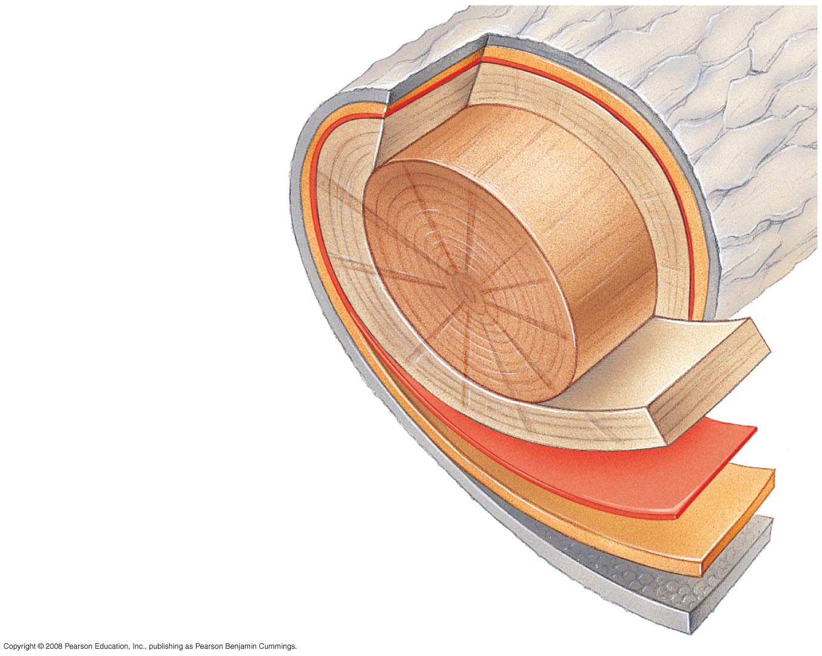
Cork cambium
Another lateral meristem is the cork cambium, which produces cork, part of the bark.
Together, the secondary vascular tissues (produced by the vascular cambium) and periderm (formed by the cork cambium) makes up the secondary plant body.
Vascular cambia are found in dicots and gymnosperms but not monocots, which usually lack secondary growth.
In wood, the vascular cambium is the obvious line separating the bark and wood.
Capon, Brian (2005). Botany for Gardeners (2nd ed.). Portland, OR: Timber Publishing
Growth
ring
Vascular
ray
Heartwood
Secondary
xylem
Sapwood
Vascular cambium
Secondary phloem
Bark
Layers of periderm

Slide 40
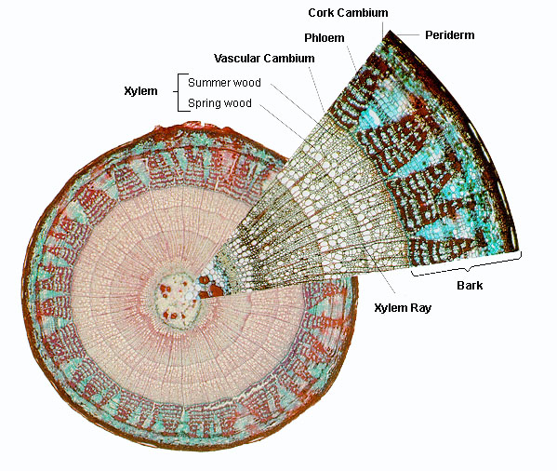
Cork Cambium
The cork cambium is a lateral meristem and is responsible for secondary growth that replaces the epidermis in roots and stems.
It is found in woody and many herbaceous dicots, gymnosperms and some monocots, which usually lack secondary growth.
Growth and development of cork cambium is very variable between different species, and is also highly dependent on age, growth conditions, etc. as can be observed from the different surfaces of bark:
  smooth, fissured, tesselated, scaly, flaking off, etc.

Slide 41
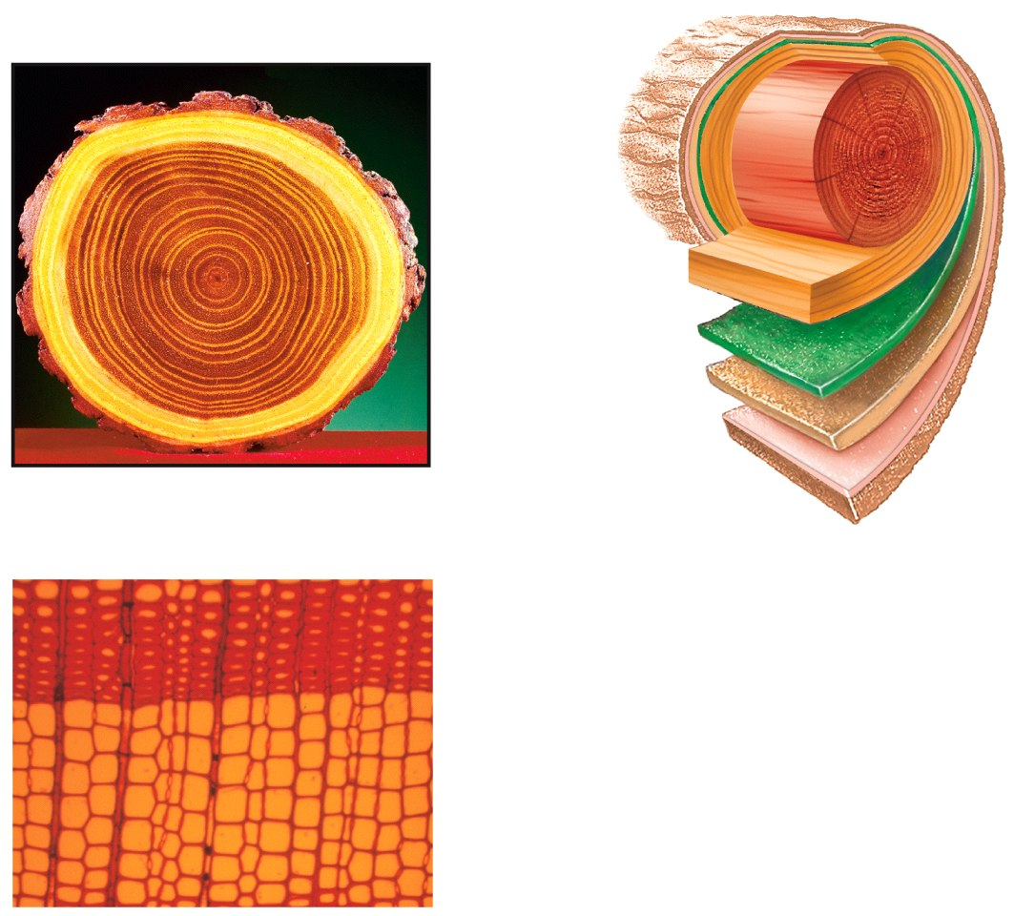
Plant Growth
Stem – Secondary Growth:
heartwood
(xylem)
sapwood
(xylem)
vascular
cambium
phloem
annual ring
Sapwood = Young xylem, water
Heartwood = Old xylem, support
Seasonal Growth = annual rings
Secondary phloem = grows outward older phloem crushed
late
xylem
early
xylem
Copyright © 2002 Pearson Education, Inc., publishing as Benjamin Cummings
Notes:
41

Slide 42
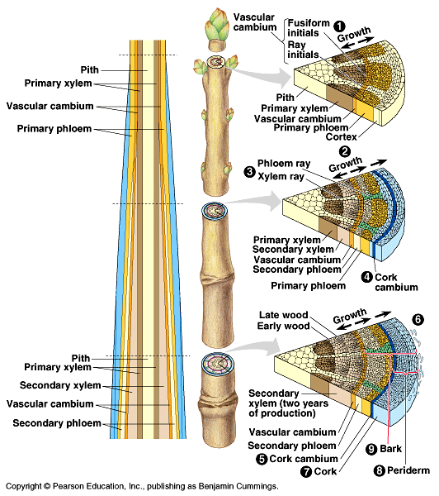
Secondary Growth of a Stem
Copyright © 2002 Pearson Education, Inc., publishing as Benjamin Cummings

Slide 43
ANY QUESTIONS?

