Slide 1
Life cycles and reproductive structures

Slide 2
Outline
The production of new individuals or offspring in plants, can be accomplished by sexual or asexual means.
Sexual reproduction produces offspring by the fusion of gametes, resulting in offspring genetically different from the parent or parents.
Asexual reproduction produces new individuals without the fusion of gametes, genetically identical to the parent plants and each other, except when mutations occur.
In seed plants, the offspring can be packaged in a protective seed, which is used as an agent of dispersal.

Slide 3
Outline
Several aspects of plant development contrast sharply with animals:
plants develop continuously,
commit certain cells to gamete production late in development
Numerous species produce gametes by mitosis
In flowering plants, double fertilization results in the production of a zygote and a nutritive tissue that supports embryogenesis.
Embryogenesis results in the formation of the major body axes and three types of embryonic tissue.

Slide 4
Outline
Vegetative development is based on meristems, in which cell division occurs throughout life, producing cells that go on to differentiate.
When a meristem is converted from vegetative to reproductive development, regulatory transcription factors are activated that control the identity and position of floral organs.

Slide 5
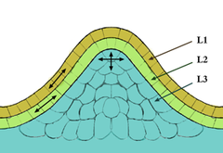
Meristems
The tissue in most plants consisting of undifferentiated cells (meristematic cells), found in zones of the plant where growth can take place.
Meristematic cells are analogous in function to stem cells in animals, are incompletely or not differentiated, and are capable of continued cellular division.
Furthermore, the cells are small and protoplasm fills the cell completely.
The vacuoles are extremely small. The cytoplasm does not contain chloroplasts although they are present in rudimentary form (proplastids).
Meristematic cells are packed closely together without intercellular cavities.
Tunica-Corpus model of the apical
meristem (growing tip). The epidermal
(L1) and subepidermal (L2) layers form
the outer layers called the tunica.
The inner L3 layer is called the corpus.
Cells in the L1 and L2 layers divide in
a sideways fashion which keeps these
layers distinct, while the L3 layer divides in a more random fashion.

Slide 6
Floral Meristems
When plants begin the developmental process known as flowering, the shoot apical meristem is transformed into an inflorescence meristem .
Goes on to produce the floral meristem which produces the familiar sepals, petals, stamens (Male), and carpels (Female) of the flower.
Responsible for determinate growth, the limited growth of the flower to a particular size and form.
The transition from shoot meristem to floral meristem requires floral meristem identity genes, that both specify the floral organs and cause the termination of the production of stem cells.
From the wikimedia free licensed media file repository

Slide 7
Floral Meristems
The transition from shoot meristem to floral meristem requires floral meristem identity genes, that both specify the floral organs and cause the termination of the production of stem cells.
AGAMOUS (AG) is a floral homeotic gene required for floral meristem termination and necessary for proper development of the stamens and carpels.
AG is necessary to prevent the conversion of floral meristems to inflorescence shoot meristems, but is not involved in the transition from shoot to floral meristem
From the wikimedia free licensed media file repository

Slide 8
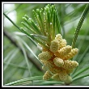
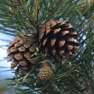
Gymnosperm reproduction
Term "gymnosperm" comes from the Greek word
gymnospermos, "naked seeds", after the unenclosed condition of their seeds (ovules in their unfertilized state).
Gymnosperm seeds develop either on the surface of scale- or leaf-like appendages of cones, or at the end of short stalks (Ginkgo).
From the wikimedia free licensed media file repository

Slide 9
Gymnosperm reproduction
The life cycle of a pine illustrates the three key adaptations to terrestrial life in seed plants:
increasing dominance of the sporophyte
seeds as a resistant, dispersal stage
pollen as an airborne agent bringing gametes together.
The pine tree, a sporophyte, produces its sporangia on scalelike sporophylls that are packed densely on cones.
From the wikimedia free licensed media file repository

Slide 10
The life cycle of a pine demonstrates the key reproductive adaptations of seed plants
The life cycle of a pine illustrates the three key adaptations to terrestrial life in seed plants:
increasing dominance of the sporophyte
seeds as a resistant, dispersal stage
pollen as an airborne agent bringing gametes together.
The pine tree, a sporophyte, produces its sporangia on scale like sporophylls that are packed densely on cones.

Slide 11
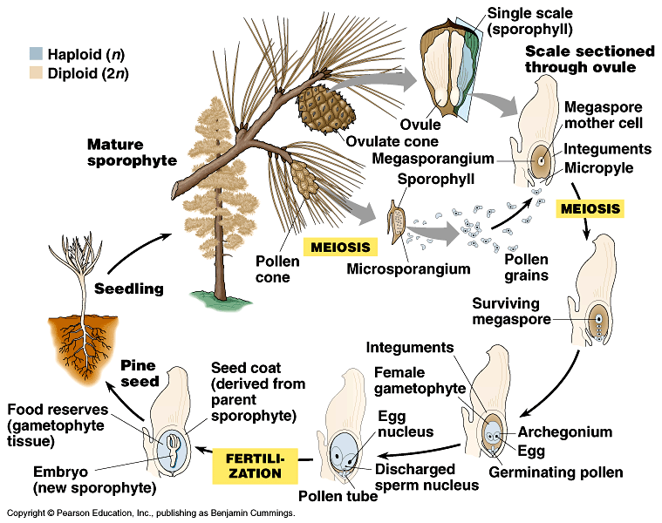
Copyright © 2002 Pearson Education, Inc., publishing as Benjamin Cummings

Slide 12
Reproduction in pines begins with the appearance of cones on a pine tree.
1. Most species produce both pollen cones and ovulate cones.
2. A pollen cone contains hundreds of microsporangia held on small sporophylls.
Cell in the microsporangia undergo meiosis to form haploid microspores that develop into pollen grains.
3. An ovulate cone consists of many scales, each with two ovules.
Each ovule includes a megasporangium.

Slide 13
Reproduction in pines begins with the appearance of cones on a pine tree.
4. During pollination, windblown pollen falls on the ovulate cone and is drawn into the ovule through the micropyle.
The pollen grain germinates in the ovule, forming a pollen tube that digests its way through the megasporangium.
5. The megaspore mother cell undergoes meiosis to produce four haploid cells, one of which will develop into a megaspore.
The megaspore grows and divides mitotically to form the immature female gametophyte.
6. Two or three archegonia, each with an egg, then develop within the gametophyte

Slide 14
Reproduction in pines begins with the appearance of cones on a pine tree.
7. At the same time that the eggs are ready, two sperm cells have developed in the pollen tube which has reached the female gametophyte.
Fertilization occurs when one of the sperm nuclei fuses with the egg nucleus
8. The pine embryo, the new sporophyte, has a rudimentary root and several embryonic leaves.
The female gametophyte surrounds and nourishes the embryo.
The ovule develops into a pine seed, which consists of an embryo (new sporophyte), its food supply (derived from gametophyte tissue), and a seed coat derived from the integuments of the parent tree (parent sporophyte).

Slide 15
conifers
The conifers, phylum Coniferophyta, is the largest gymnosperm phylum.
The term conifer comes from the reproductive structure, the cone, which is a cluster of scalelike sporophylls.
Although there are only about 550 species of conifers, a few species dominate vast forested regions in the Northern Hemisphere where the growing season is short.
From the wikimedia free licensed media file repository

Slide 16
Angiosperm Reproduction
The Bits required

Slide 17
Flower Production
Four genetically regulated pathways to flowering have been identified
1. The light-dependent pathway
2. The temperature-dependent pathway
3. The gibberellin-dependent pathway
4. The autonomous pathway
Plants can rely primarily on one pathway, but all four pathways can be present

Slide 18
The ABC Model
hypothesis for genetic control of flower development is called the ABC model.
Three basic ideas underlie the ABC model:
three genes set up the position of flower organs, and each gene is expressed in two adjacent whorls,
(2) a total of four different combinations of gene products can occur, and
(3) each of the four combinations of gene products triggers the development of a different floral organ.

Slide 19
B
B
A
C
C
A
1
2
3
4
3
2
1
sepal
petal
carpel
petal
sepal
stamen
stamen

Slide 20
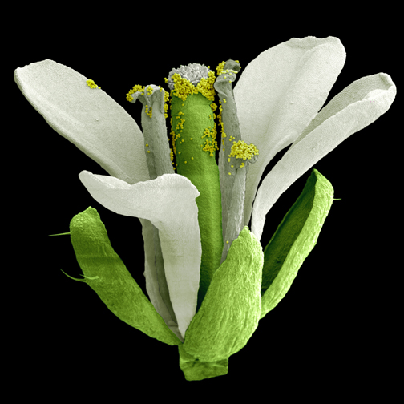
Arabidopsis showing 4 floral organs
Carpels-C
StamensB&C
Petals-A&B
Sepals-A
Copyright © 2002 Pearson Education, Inc., publishing as Benjamin Cummings

Slide 21
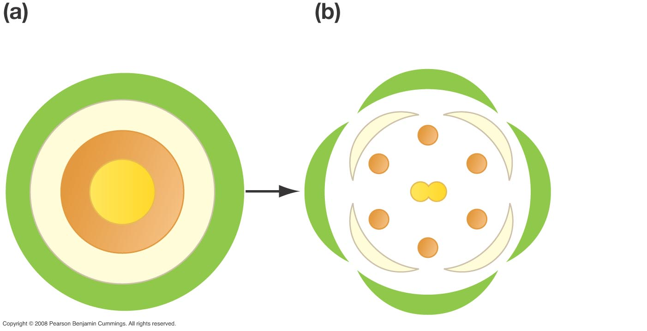
Flowers Are Composed of Four Organs
Whorls of cells in
floral meristem
Whorls of organs
in flower
1
Sepal
2
Petal
3
Stamen
4
Carpel
Copyright © 2002 Pearson Education, Inc., publishing as Benjamin Cummings

Slide 22
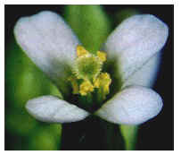
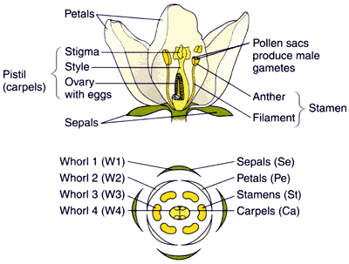
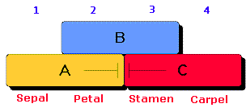
Organ identity genes ABC model
Model describes the interactions of different genes that control floral organ identity
Copyright © 2002 Pearson Education, Inc., publishing as Benjamin Cummings

Slide 23
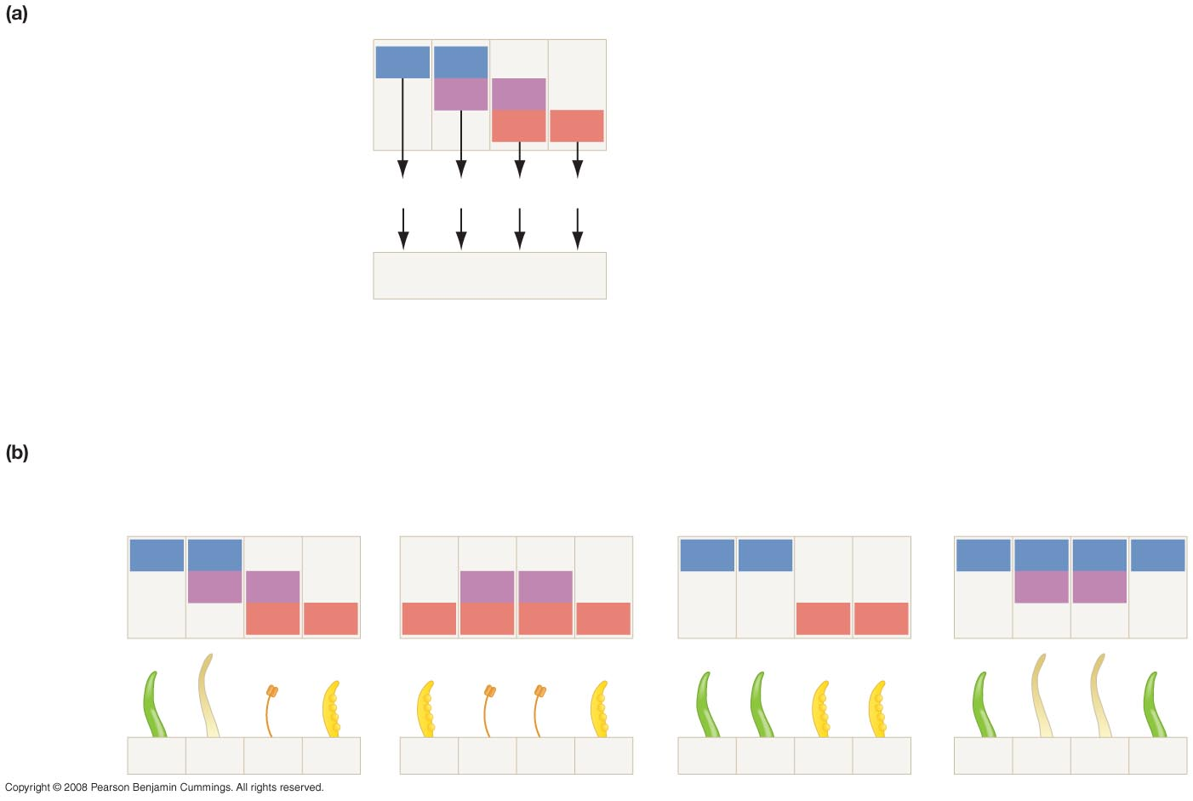
The ABC Model
Copyright © 2002 Pearson Education, Inc., publishing as Benjamin Cummings
The ABC model
Whorl:
1
2
3
4
Idea 1: Three genes pattern
the flower. Each gene is
expressed in two adjacent
whorls.
Gene A:
A
A
Gene B:
B
B
Gene C:
C
C
Idea 2: A total of four different
combinations of gene products occurs.
A
A + B
B + C
C
Idea 3: Each of the four combinations
of gene products triggers the
development of a different floral organ.
Sepal
Petal
Stamen
Carpel
(Se)
(Pe)
(St)
(Ca)
Assumption: Presence of gene A product
inhibits expression of gene C. Presence of
gene C product inhibits expression of gene A.
No A + C
Testing the ABC model
Wild type: ABC intact
Gene A missing
Gene B missing
Gene C missing
Whorls
1
2
3
4
1
2
3
4
1
2
3
4
1
2
3
4
A
A
A
A
A
A
A
A
Active genes
B
B
B
B
B
B
C
C
C
C
C
C
C
C
Identity of
floral organ
in whorl
Se
Pe
St
Ca
Ca
St
St
Ca
Se
Se
Ca
Ca
Se
Pe
Pe
Se

Slide 24
Model for Flowering
The ABC model proposes that three organ identity gene classes specify the four whorls
1. Class A genes alone – Sepals
2. Class A and B genes together – Petals
3. Class B and C genes together – Stamens
4. Class C genes alone – Carpels
When any one class is missing, aberrant floral organs occur in predictable positions

Slide 25
Testing the ABC Model
Researchers tested the ABC model and found it to be supported, with the modification that two of the proteins act to inhibit the production of each other.
They also found that the DNA sequences of floral organ identity genes all contain a segment that encodes a DNA-binding domain called a MADS box.
They suggested that MADS-box genes are part of the regulatory cascade that controls the floral organ identity genes.
Although different genes are involved, the logic of how to put a multicellular body together is similar in plants and animals.

Slide 26
What are MADS box genes?
The MADS box is a highly conserved sequence motif found in a family of transcription factors. The conserved domain was recognized after the first four members of the family, which were MCM1, AGAMOUS, DEFICIENS and SRF (serum response factor). The name MADS was constructed form the "initials" of these four "founders".
The MADS box genes in flowering plants are the "molecular architects" of flower morphogenesis.
Length of the MADS-box reported by various researchers varies somewhat, but typical lengths are in the range of 168 to 180 base pairs.
Shown to have an important role in the integration of molecular flowering time pathways. These genes are essential for the correct timing of flowering, and help to ensure that fertilization occurs at the time of maximal reproductive potential.

Slide 27
Stamen (Male)
The male reproductive organs, are the sporophylls that produce microspores that will give rise to gametophytes.
Consists of a stalk (the filament) and a terminal sac (the anther) where pollen is produced, AND which contains microsporangia
A typical anther contains four microsporangia.

Slide 28
Stamen (Male)
Microsporangia form sacs or pockets (locules) in the anther.
The two separate locules on each side of an anther may fuse into a single locule.
Each microsporangium is lined with a nutritive tissue layer called the tapetum and initially contains diploid pollen mother cells.

Slide 29
Stamen (Male)
These undergo meiosis to form haploid spores. The spores may remain attached to each other in a tetrad or separate after meiosis.
Each microspore then divides mitotically to form an immature microgametophyte called a pollen grain.

Slide 30
Carpels (Female)
Female sporophylls that produce megaspores and their products, female gametophytes.
At the tip of the carpal is a sticky stigma that receives pollen.
A style leads to the ovary at the base of the carpal.
Ovules and, later, seeds are protected within the ovary.

Slide 31
Carpels (Female)
Carpels are the building blocks of the gynoecium. If a gynoecium has a single carpel, it is called monocarpous.
If a gynoecium has multiple, distinct (free, unfused) carpels, it is apocarpous.

Slide 32
The Carpel
Copyright © 2002 Pearson Education, Inc., publishing as Benjamin Cummings

Slide 33
Angiosperm Reproduction
All angiosperms are heterosporous,
produce microspores that form male gametophytes
megaspores that form female gametophytes.
The immature male gametophytes are contained within pollen grains and develop within the anthers of stamens.
Each pollen grain has two haploid cells.
Ovules, which develop in the ovary, contain the female gametophyte, the embryo sac.
It consists of only a few cells, one of which is the egg

Slide 34
The life cycle of an angiosperm begins with the formation of a mature flower on a sporophyte plant and culminates in a germinating seed.

Slide 35
Angiosperm Reproduction
The anthers of the flower produce :
microspores that form
male gametophytes (pollen).
(4) Ovules produce megaspores that form
(5) female gametophytes (embryo sacs).

Slide 36
Angiosperm Reproduction
(6) After its release from the anther, pollen is carried to the sticky stigma of a carpal.
Although some flowers self-pollinate, most have mechanisms that ensure cross-pollination, transferring pollen from flowers of one plant to flowers of another plant of the same species.
The pollen grain germinates (begins growing) from the stigma toward the ovary.

Slide 37
Angiosperm Reproduction
When the pollen tube reaches the micropyle, a pore in the integuments of the ovule, it discharges two sperm cells into the female gametophyte.
(7) In a process known as double fertilization, one sperm unites with the egg to form a diploid zygote and the other fuses with two nuclei in the large center cell of the female gametophyte.

Slide 38
Angiosperm Reproduction
(8) The zygote develops into a sporophyte embryo packaged with food and surrounded by a seed coat.
The embryo has a rudimentary root and one or two seed leaves, the cotyledons.
Monocots have one seed leaf and dicots have two
Monocots store most of the food for the developing embryo in endosperm which develops as a triploid tissue in the center of the embryo sac
Beans and many dicots transfer most of the nutrients from the endosperm to the developing cotyledons.

Slide 39
Angiosperm Reproduction
One hypothesis for the function of double fertilization is that it synchronizes the development of food storage in the seed with development of the embryo.
Double fertilization may prevent flowers from squandering nutrients on infertile ovules.
The seed consists of the embryo, endosperm, sporangium, and a seed coat from the integuments.
As the ovules develop into seeds, the ovary develops into a fruit.
After dispersal by wind or animals, a seed germinates if environmental conditions are favorable.
During germination, the seed coat ruptures and the embryo emerges as a seedling.
It initially uses the food stored in the endosperm and cotyledons to support development.

Slide 40
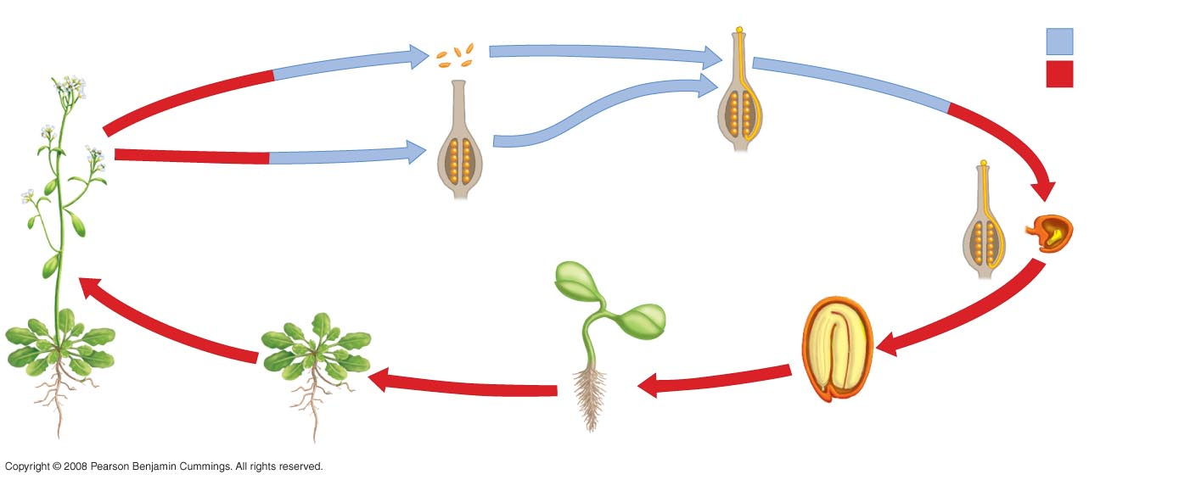
An Overview of Development in Arabidopsis
hgchgc
Pollen grains produce
sperm cells
Pollen grain
Haploid (n)
GAMETOGENESIS
Diploid (2n)
FERTILIZATION
Sperm cells
move down
pollen tube,
toward egg
GAMETOGENESIS
Many ovules—
each contains
an egg cell
Fertilized
egg (zygote)
inside ovule
Cotyledons
Embryo
EMBRYOGENESIS
REPRODUCTIVE
DEVELOPMENT
Hypocotyl
VEGETATIVE
DEVELOPMENT
GERMINATION
Root
Seed
(mature ovule)
Seedling
Copyright © 2002 Pearson Education, Inc., publishing as Benjamin Cummings

Slide 41
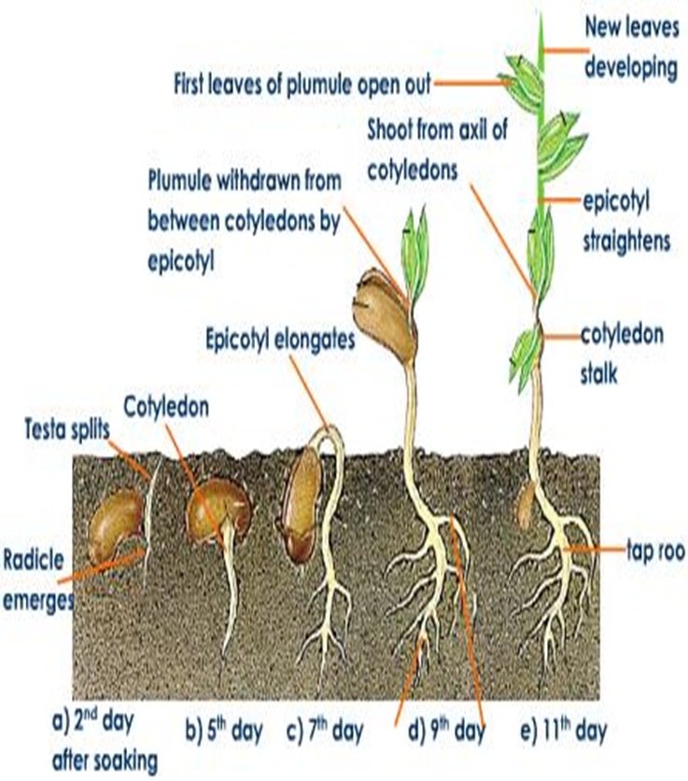
Germination
Defined as the emergence of the radicle (first root) from the seed coat
Germination begins when a seed absorbs water
Mature seeds are often extremely dry
need enough water to moisten the seeds but not enough to soak them.
The uptake of water by seeds is called imbibition, which leads to the swelling and the breaking of the seed coat
Oxygen is available for metabolism
Often requires an additional environmental signal such as specific wavelength of light
Others need to be passed through an animal's digestive tract to weaken the seed coat enough to allow the seedling to emerge
From the wikimedia free licensed media file repository

Slide 42
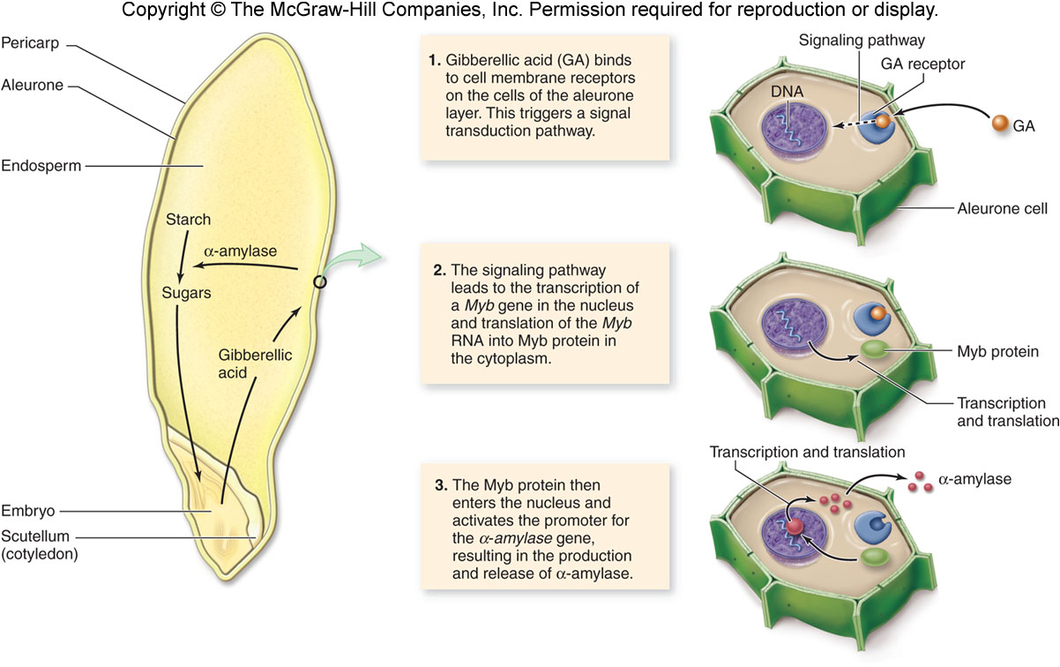
Releasing Sugars From Cotyledon...So the Embryo Can Grow
Copyright © 2002 Pearson Education, Inc., publishing as Benjamin Cummings

Slide 43
Releasing Sugars From Cotyledon...So the Embryo Can Grow
Embryo produces gibberellic acid
-This hormone signals the aleurone (outer endosperm layer) to produce α-amylase
-Breaks down the endosperm’s starch into sugars that are passed to embryo

Slide 44
Germination
New growth comes from delicate meristems
As the sporophyte pushes through the seed coat, it orients with the environment such that the root grows down & shoot grows up
-Usually, the root emerges before the shoot
-The shoot becomes photosynthetic, and the postembryonic phase is under way
Cotyledons may be held above or below the ground
-May become photosynthetic or shrivel
From the wikimedia free licensed media file repository

Slide 45
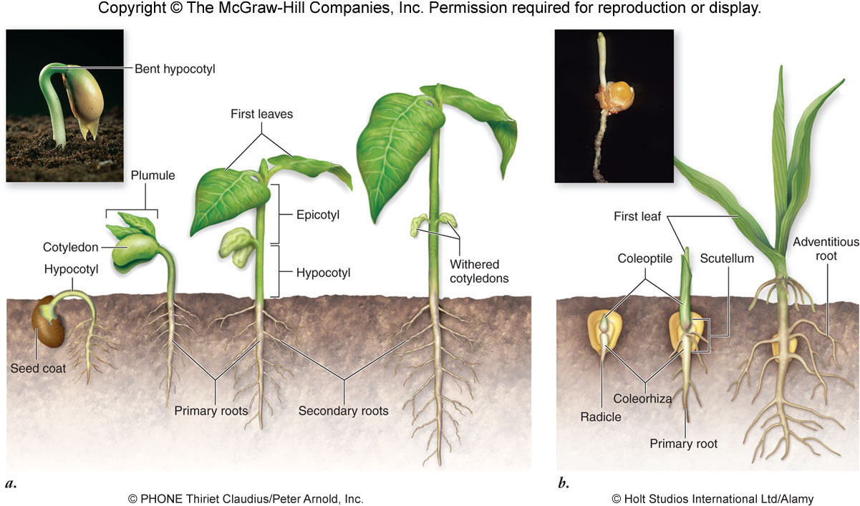
Germination
Copyright © 2002 Pearson Education, Inc., publishing as Benjamin Cummings

Slide 46
ANY QUESTIONS?

