Slide 1
Plant Physiology talk Two
Plant Cells

Slide 2
Overview of Plant Structure
Plants are Earth’s Primary Producers
  Harvest Energy from sunlight by converting light energy into chemical energy
They store this Chemical Energy in bonds formed when the synthesize Carbohydrates from Carbon Dioxide and Water.
Non- motile
  Have evolved to grow towards resources throughout their life span.

Slide 3
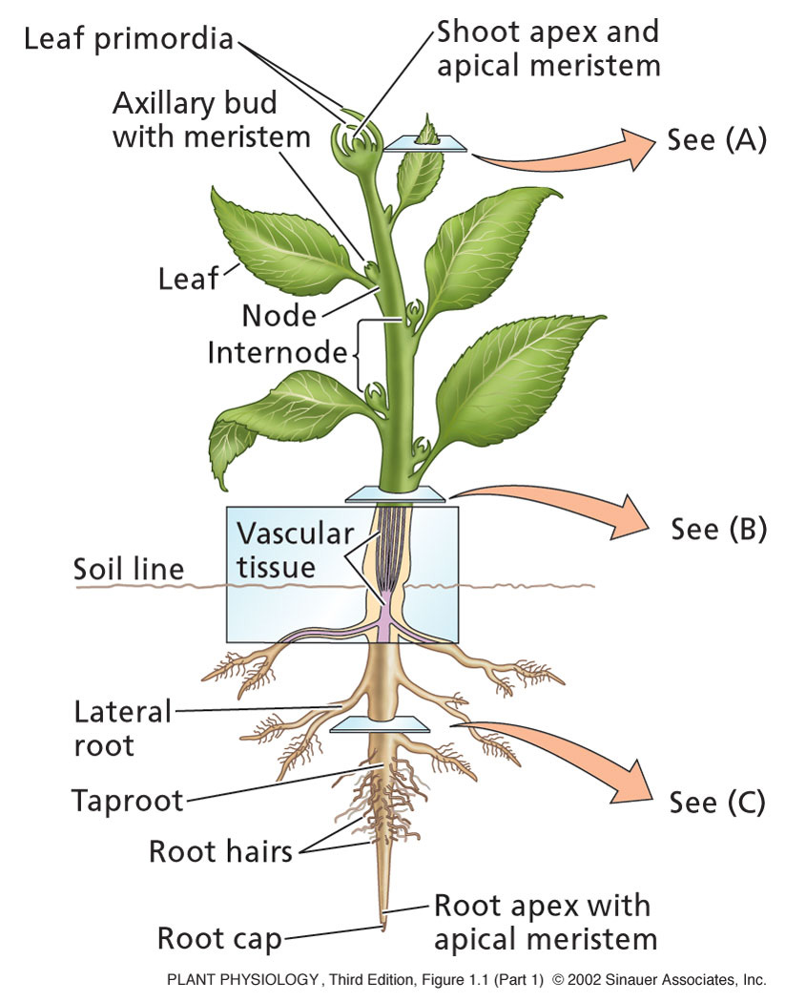
Overview of Plant Structure
The vegetative body consists of:
Leaf: Photosynthesis
Stem: Support
Roots: anchorage and absorption of water & minerals.
Nodes: leaf attached to stem.
Internode: Region of stem between two nodes

Slide 4
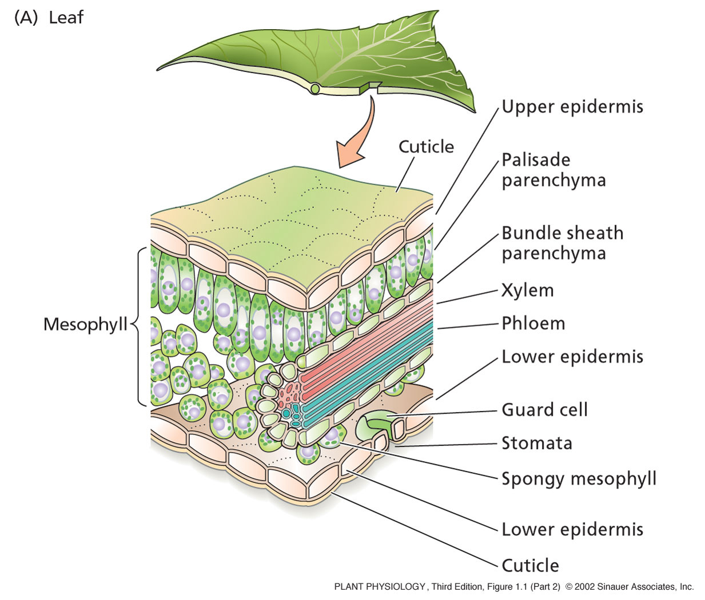
The leaf

Slide 5
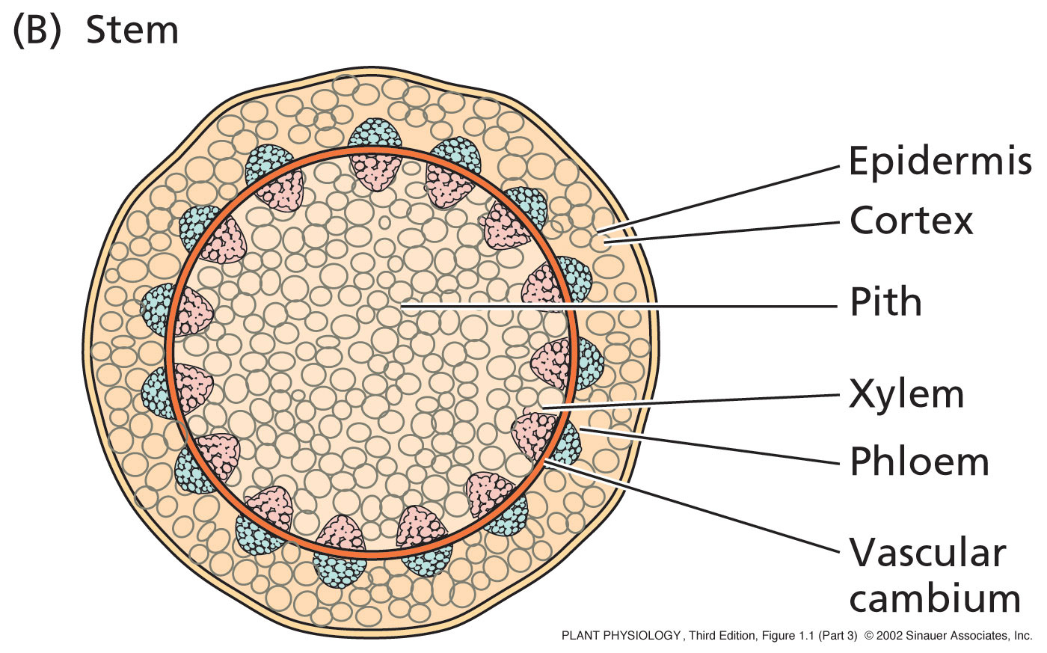
The stem

Slide 6
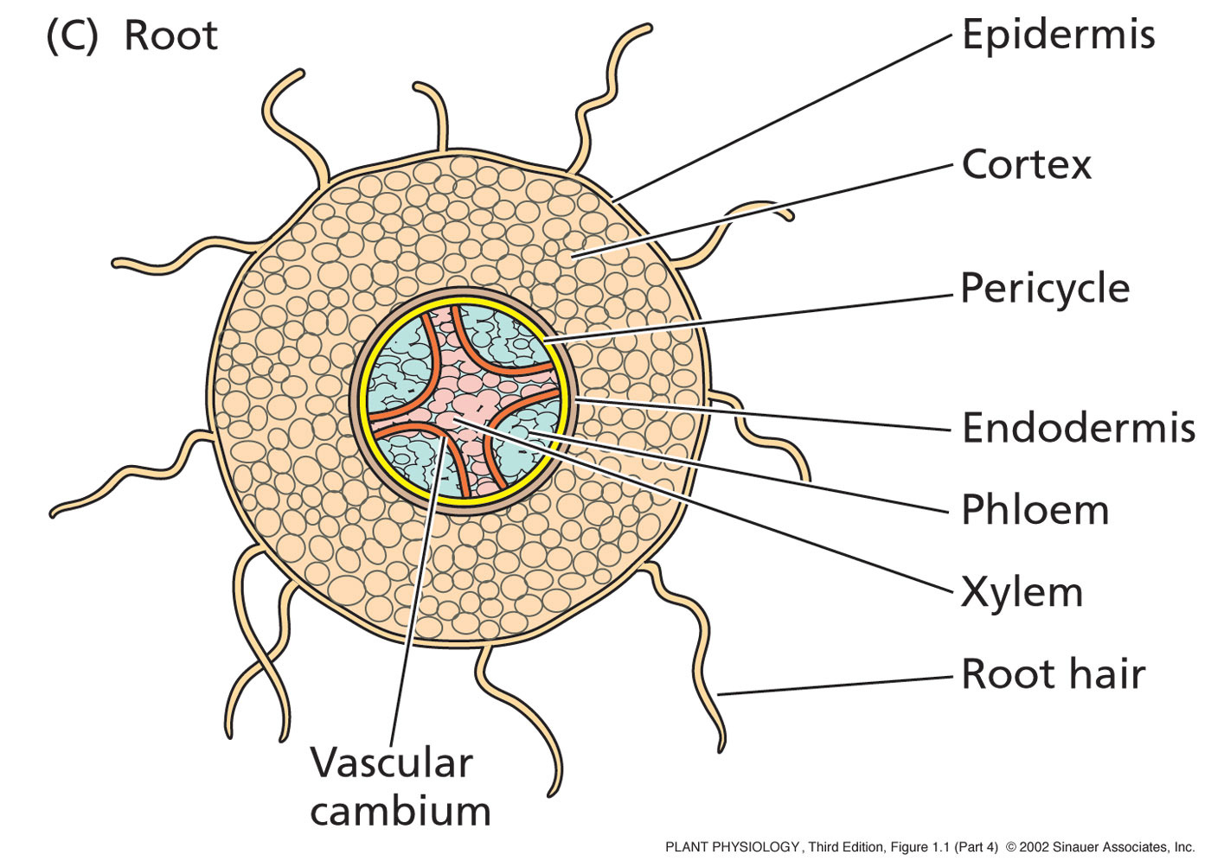
The Root

Slide 7
Overview of Plant Structure
Two general types of plants:
Angiosperms:
  More advanced type of plant
    About 250,000 species known
    Major innovation is the Flower
      So these are also known as flowing plants!
Gymnosperms:
  Less advanced than angiosperms
    About 700 species known
    Largest group is the conifer (cone bearer)
      ie, pine, fir, spruce, and redwood

Slide 8
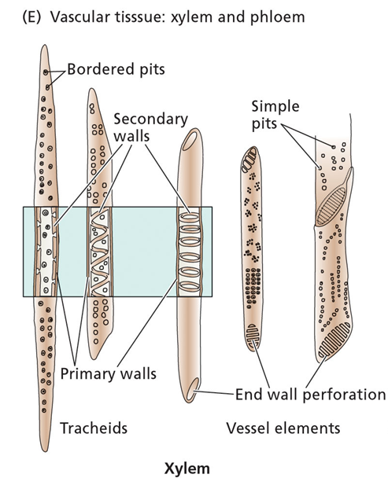
Overview of Plant Structure
Xylem:
  Main water-conducting tissue of vascular plants.
  arise from individual cylindrical cells oriented end to end.
  At maturity the end walls of these cells dissolve away and the cytoplasmic contents die.
  The result is the xylem vessel, a continuous nonliving duct.
  carry water and some dissolved solutes, such as inorganic ions, up the plant

Slide 9
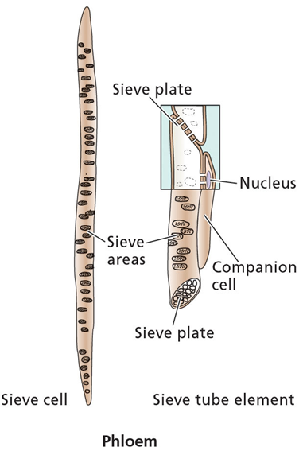
Overview of Plant Structure
Phloem:
  The main components of phloem are
    sieve elements
    companion cells.
  Sieve elements have no nucleus and only a sparse collection of other organelles . Companion cell provides energy
  so-named because end walls are perforated - allows cytoplasmic connections between vertically-stacked cells .
  conducts sugars and amino acids - from the leaves, to the rest of the plant

Slide 10
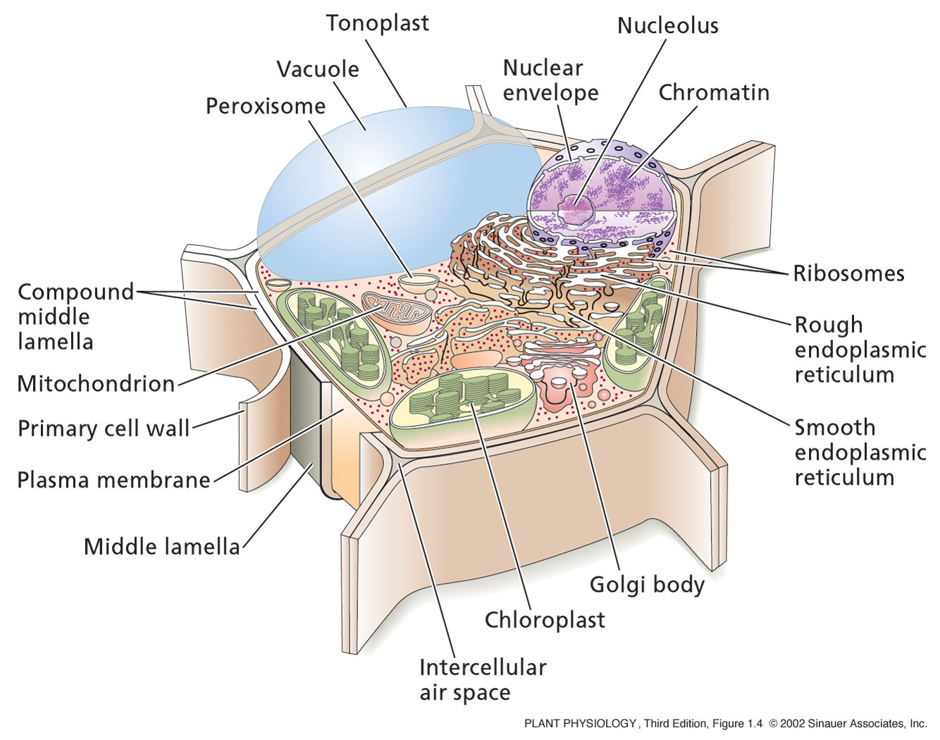
The Plant Cell

Slide 11
The Plant Cell
All plant cells have the same basic eukaryotic organization
  However, at maturity when they become specialized, plant cells may differ greatly from one another in their structures and functions
    Even those physically next to each other.
    Even the nucleus can be lost in some plant cells
Contains many organelles with specific functions
Enclosed by a membrane which defines their boundaries
Don’t Forget the Cell Wall!!!!!!!!!!

Slide 12
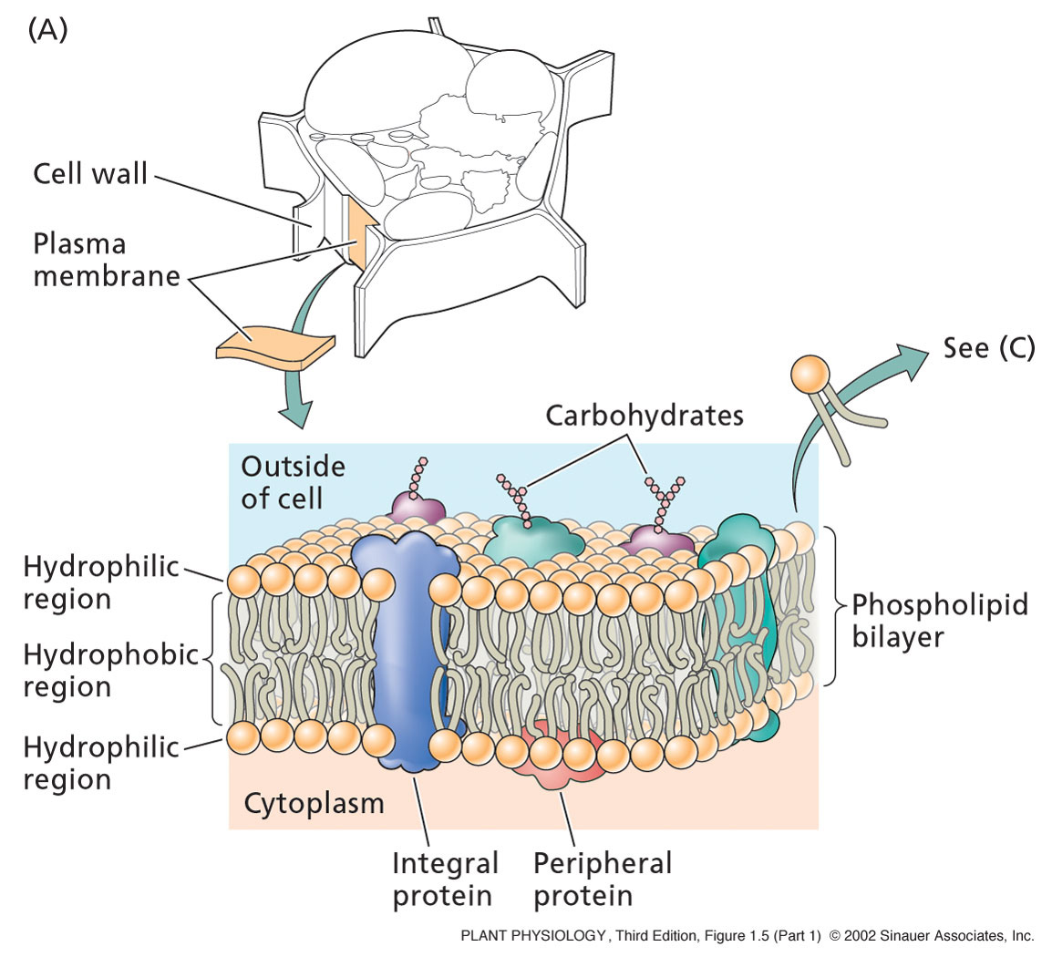
The Plasma Membrane
Composed of a phospholipid bilayer and proteins.
The phospholipid sets up the bilayer structure
Phospholipids have hydrophilic heads and fatty acid tails.
The plasma membrane is fluid--that is proteins move in a fluid lipid background

Slide 13
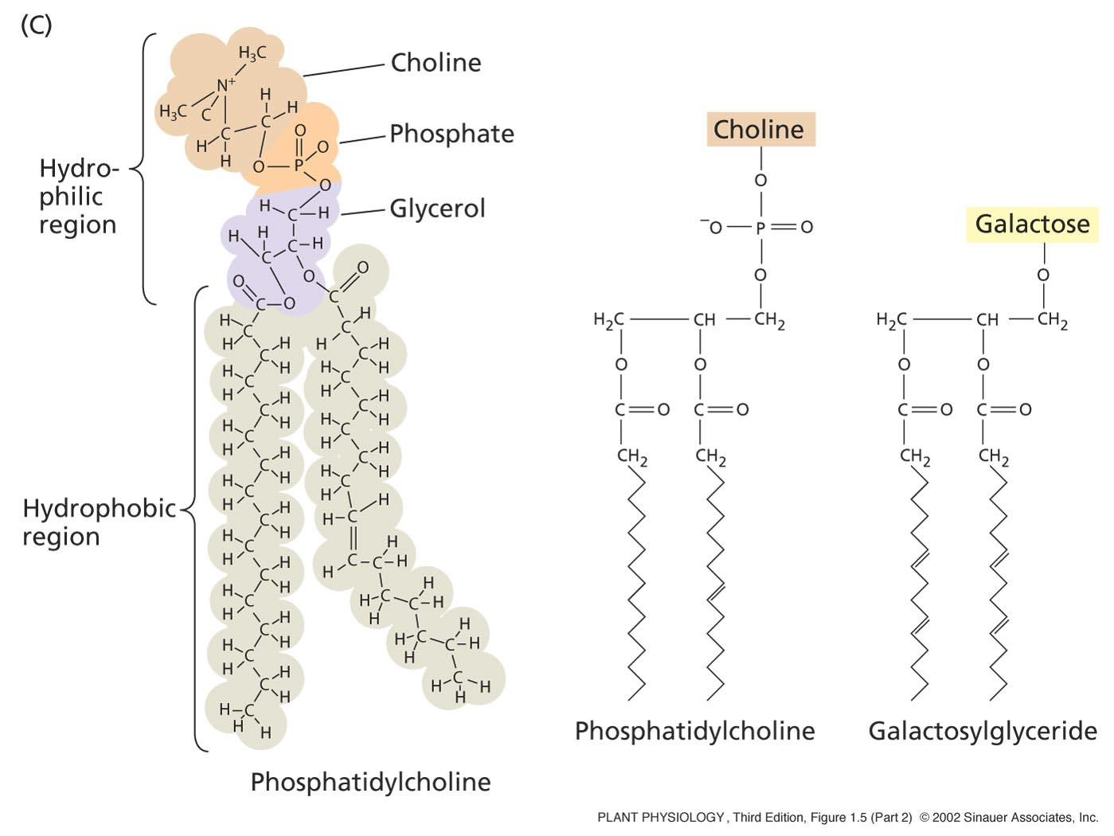
The Plasma Membrane
Phospholipids:
Two fatty acids covalently linked to a glycerol, which is linked to a phosphate.
All attached to a “head group”, such as choline, an amino acid.
Head group POLAR – so hydrophilic (loves water)
Tail is non-polar -hydrophobic
The tail varies in length from 14 to 28 carbons.

Slide 14
The Fluid Mosaic Model
Originally proposed by S. Jonathan Singer and Garth Nicolson in 1972.
Allows for dynamic nature of membrane
Little transition of lipids can take place without specific enzymes to mediate transfer - flippase.

Slide 15
Flippase
Enzymes located in the membrane responsible for aiding the movement of phospholipid molecules between the two leaflets that compose a cell's membrane
Two types:
  Transverse
  Lateral

Slide 16
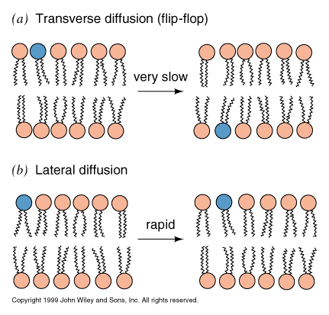
Transverse Diffusion
Or flip-flop involves the movement of a lipid or protein from one membrane surface to the other.
Is a fairly slow process due to the fact that a relatively significant amount of energy is required for flip-flopping to occur.
Notes:
16

Slide 17
Transverse Diffusion
Most large proteins do not flip-flop due to their extensive polar regions, which are unfavorable in the hydrophobic core of a membrane bilayer.
This allows the asymmetry of membranes to be retained for long periods, which is an important aspect of cell regulation.
Notes:
17

Slide 18
Lateral Diffusion
Refers to the lateral movement of lipids and proteins found in the membrane.
Membrane lipids and proteins are generally free to move laterally if they are not restricted by certain interactions.
Is a fairly quick and spontaneous process

Slide 19
Flippase
Potential role of ATP-dependent lipid flippases in vesicle formation.
ATP-dependent lipid translocation might help deform the membrane by moving lipid mass towards the cytoplasmic leaflet

Slide 20
Flippase
This area asymmetry will increase the spontaneous curvature of the bilayer, and may thus help deform the membrane during vesicle budding.
Lem3-Cdc50 proteins regulate the localization and activity of P4-ATPases.
P4-ATPases play a pivotal role in the biogenesis of intracellular transport vesicles, polarized protein transport and protein maturation.

Slide 21
Flippase
Interaction of P4-ATPases with peripheral guanine nucleotide-exchange factors (GEFs) might cause activation of small GTPases.
GTPases subsequently bind to the membrane and facilitate the assembly of coat proteins (if required)
And thus, the endo-membrane system allows gene expression, post-translational modification, and secretion to occur!

Slide 22
The Plasma Membrane
Proteins:
Integral proteins:
  Embedded in lipid bylayer – serve as “ion pumps”
  They pump ions across the membrane against their concentration gradient
Peripheral proteins:
  Bound to membrane surface by ionic bonds.
  Interact with components of the cytoskeleton
Anchored proteins:
  Bound to surface via lipid molecules

Slide 23
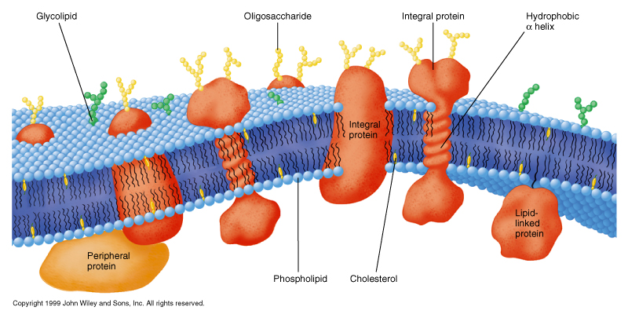
Proteins - Add function and structure to membrane
Extrinsic proteins (peripheral)
  Loosely attached to membrane
  ionic bonds with polar head groups and carbohydrates
  hydrophobic bonds with lipid
  proteins have lipids tails
Notes:
23

Slide 24
Integral proteins
tightly bound to membrane - span both sides
Protein has both polar and hydrophobic sections removed only through disrupting membrane with detergents
Notes:
24

Slide 25
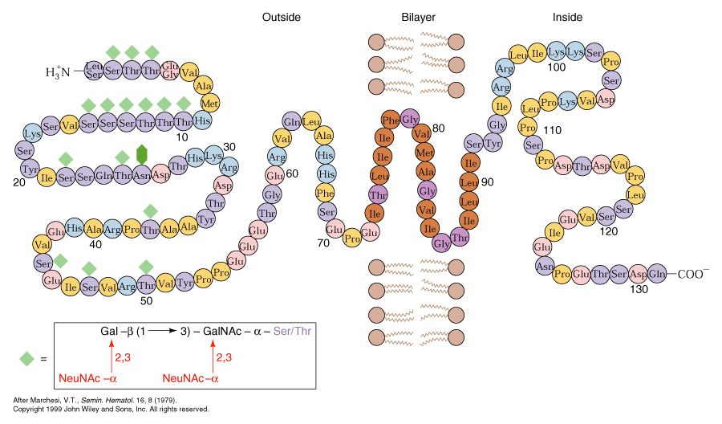
Transmembrane proteins
Has a total molecular weight of about 31,000 and is approximately 40% protein and 60% carbohydrate.
The primary structure consists of a segment of 19 hydrophobic amino acid residues with a short hydrophilic sequence on one end and a longer hydrophilic sequence on the other end.
The 19-residue sequence is just the right length to span the cell membrane if it is coiled in the shape of an α-helix.
The large hydrophilic sequence includes the amino terminal residue of the polypeptide chain.

Slide 26
Transmembrane proteins
General “Rules of thumb”
takes about 20 aa to cross membrane
  many proteins cross many times
  odd # of transmembrane regions,
      -COOH terminal usually cytosolic
      -NH₃⁺ terminal extracellular
  can be predicted by amino acid sequence
  high % of side chains will be hydrophobic

Slide 27
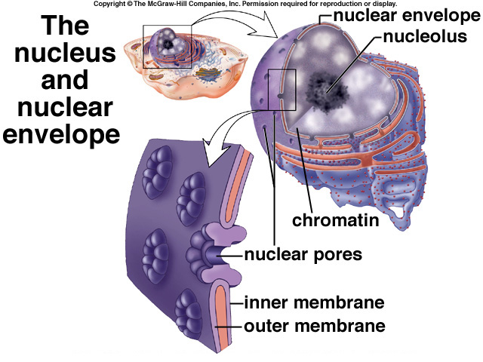
The nucleus
Contains almost all of the genetic material
What it contains is called the nuclear genome – this varies greatly between plant species.
Surrounded by nuclear envelope- double membrane - same as the plasma membrane.
The nuclear pores allow for the passage of macromolecules and ribosomal subunits in and out of the nucleus.

Slide 28
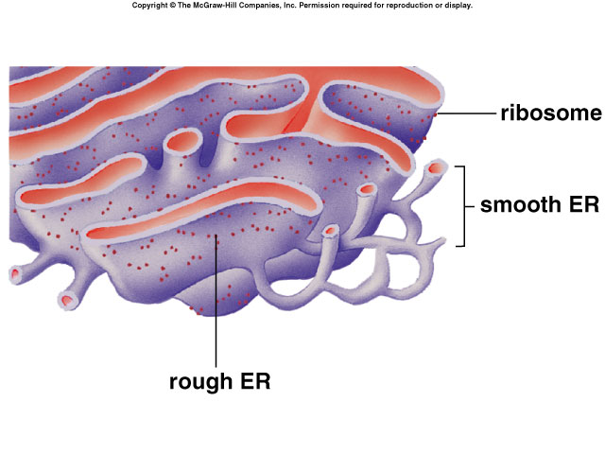
The Endoplasmic reticulum
Connected to the nuclear envelope
3D-network of continuous tubules that course through the cytoplasm.
Rough ER: Synthesize, process, and sort proteins targeted to membranes, vacuoles, or the secretory pathway.
Smooth ER: Synthesize lipids and oils.
Also:
  Acts as an anchor points for actin filaments
  Controls cytosolic concentrations of calcium ions

Slide 29
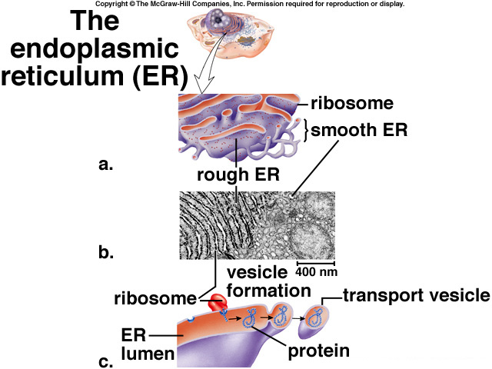
The Endoplasmic reticulum
Proteins are made in the Rough ER lumen by an attached ribosome.
Protein detaches from the ribosome
The ER folds in on itself to form a transport vesicle
This transport vesicle “buds off” and moves to the cytoplasm
Either:
  Fuses with plasma membrane
  Fuses with Golgi Apparatus

Slide 30
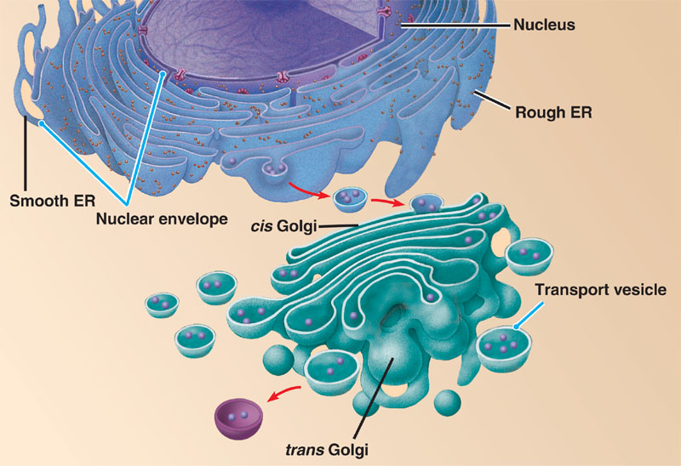
The Golgi Network
Proteins or lipids made in the ER contained in transport vesicles fuse with the Golgi.
The Golgi modifies proteins and lipids from the ER, sorts them and packages them into transport vesicles.
This transport vesicle “buds off” and moves to the cytoplasm.
Fuse with plasma membrane.

Slide 31
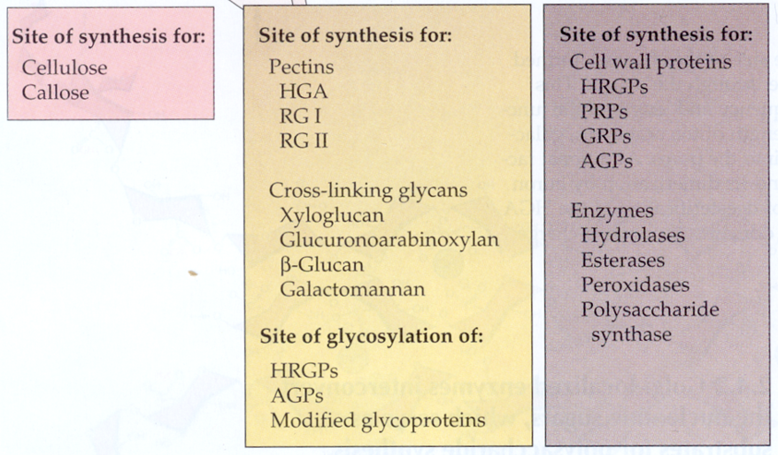
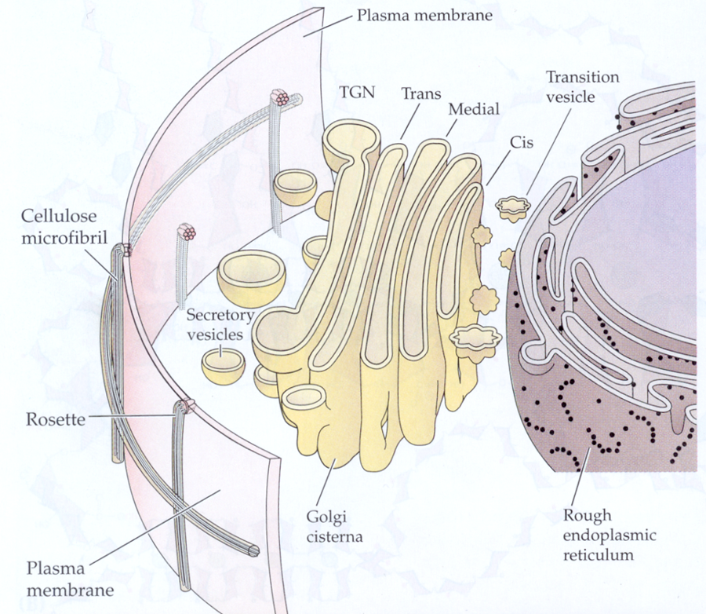
The Golgi Network

Slide 32
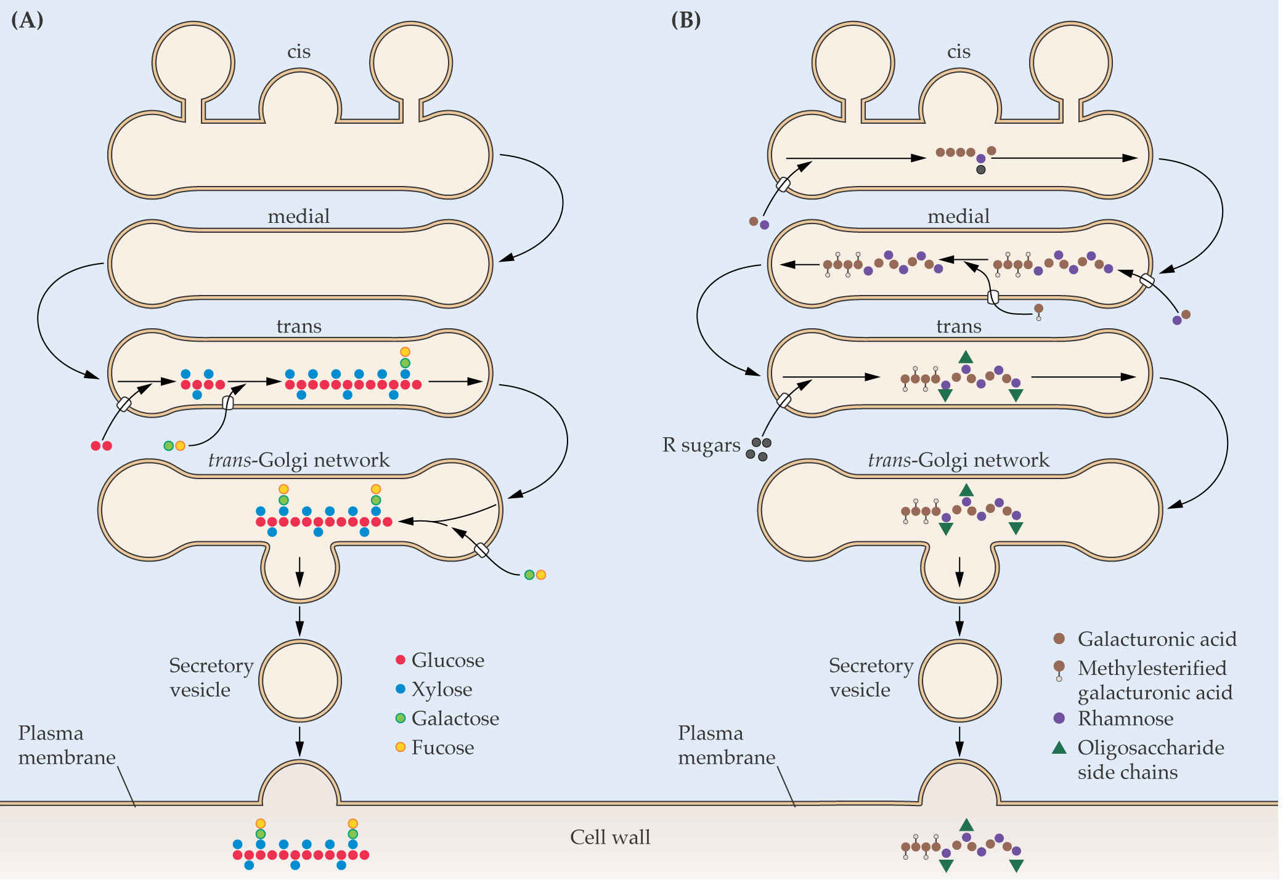
Golgi Trafficking
Xyloglucan Pectins

Slide 33
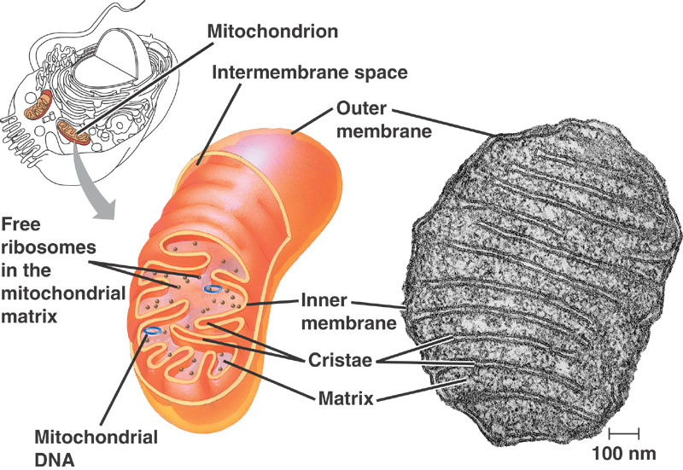
The Mitochondria
Contain their own DNA and protein-synthesizing machinery
  Ribosomes, transfer RNAs, nucleotides.
  Thought to have evolved from endosymbiotic bacteria.
  Divide by fusion
  The DNA is in the form of circular chromosomes, like bacteria
  DNA replication is independent from DNA replication in the nucleus

Slide 34
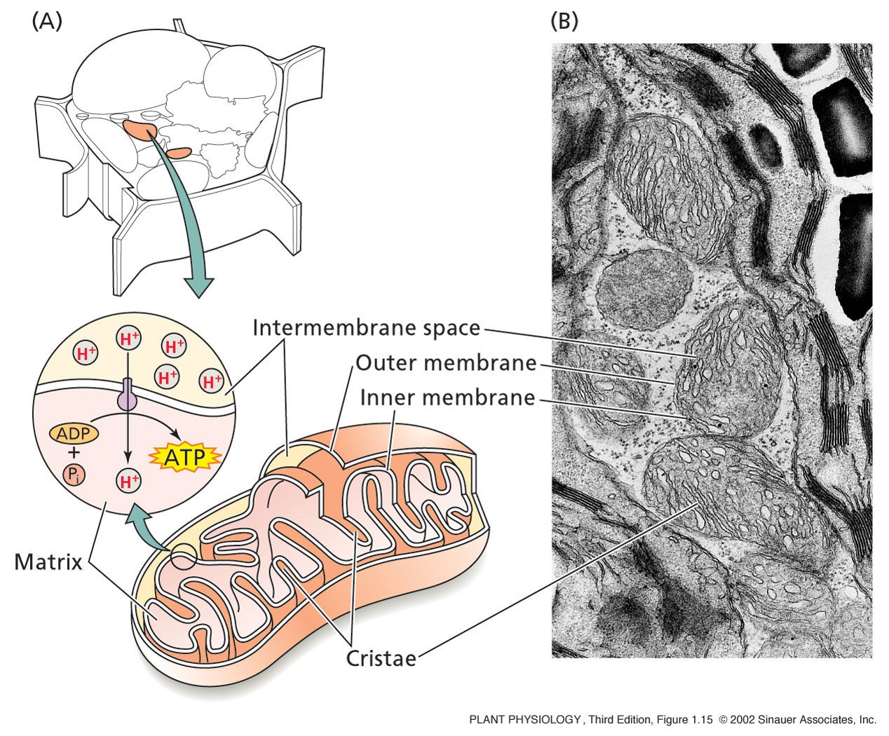
The Mitochondria
  Site of Cellular Respiration
This process requires oxygen.
Composed of three stages:
  Glycolysis--glucose splitting, occurs in the cell. Glucose is converted to Pyruvate.
  Krebs cycle--Electrons are removed--carriers are charged and CO2 is produced. This occurs in the mitochondrion.
  Electron transport--electrons are transferred to oxygen. This produces H2O and ATP. Occurs in the mito.

Slide 35
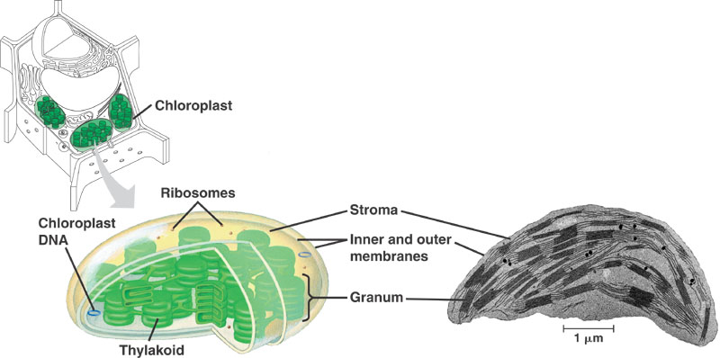
The Chloroplast
Contain their own DNA and protein-synthesizing machinery
  Ribosomes, transfer RNAs, nucleotides.
  Thought to have evolved from endosymbiotic bacteria.
  Divide by fusion
  The DNA is in the form of circular chromosomes, like bacteria
  DNA replication is independent from DNA replication in the nucleus

Slide 36
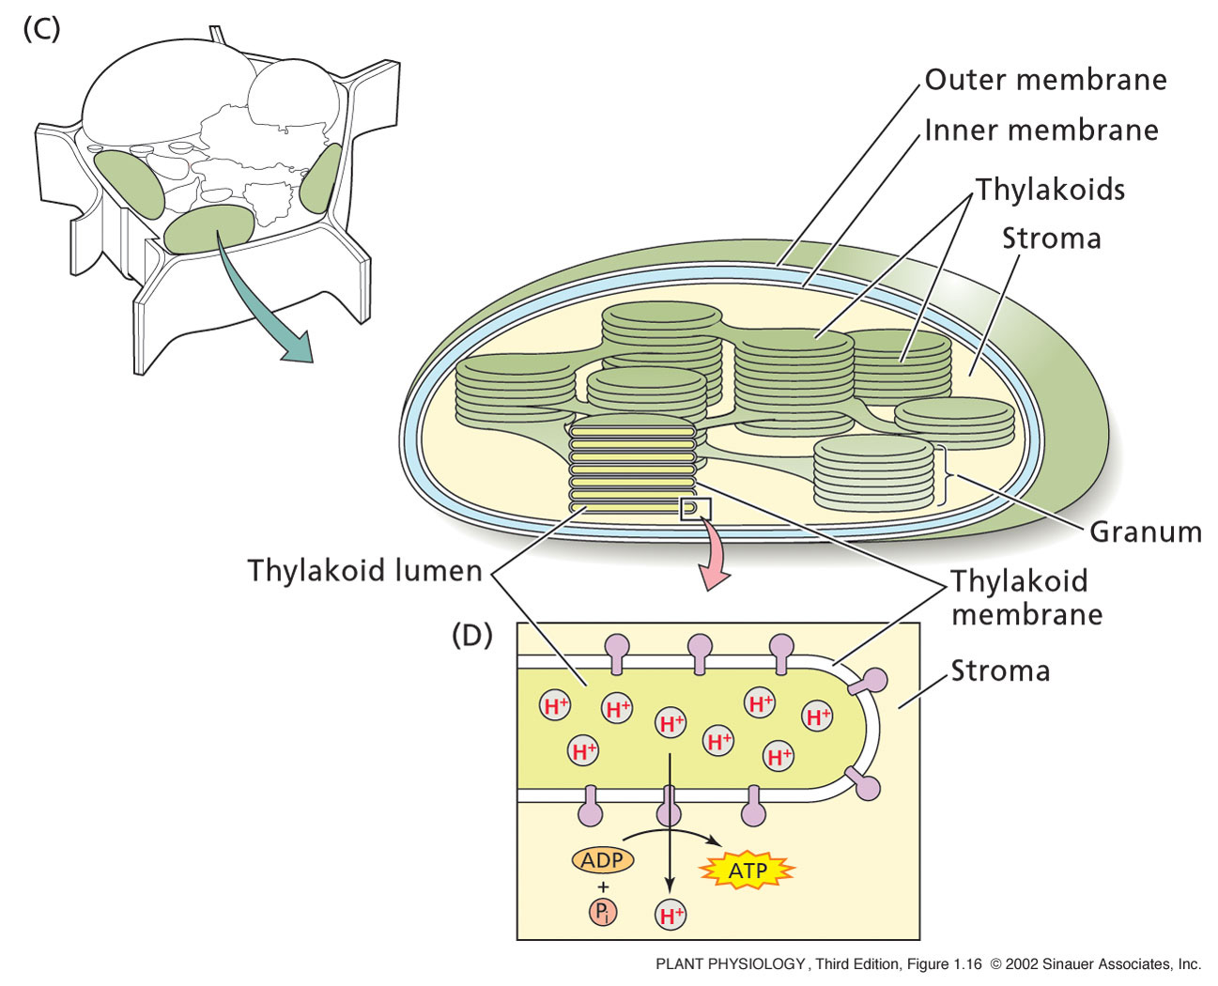
The Chloroplast
Membranes contain chlophyll and it’s associated proteins
  Site of photosynthesis
Have inner & outer membranes
3rd membrane system
  Thylakoids
Stack of Thylakoids = Granum
Surrounded by Stroma
  Works like mitochondria
During photosynthesis, ATP from stroma provide the energy for the production of sugar molecules

Slide 37
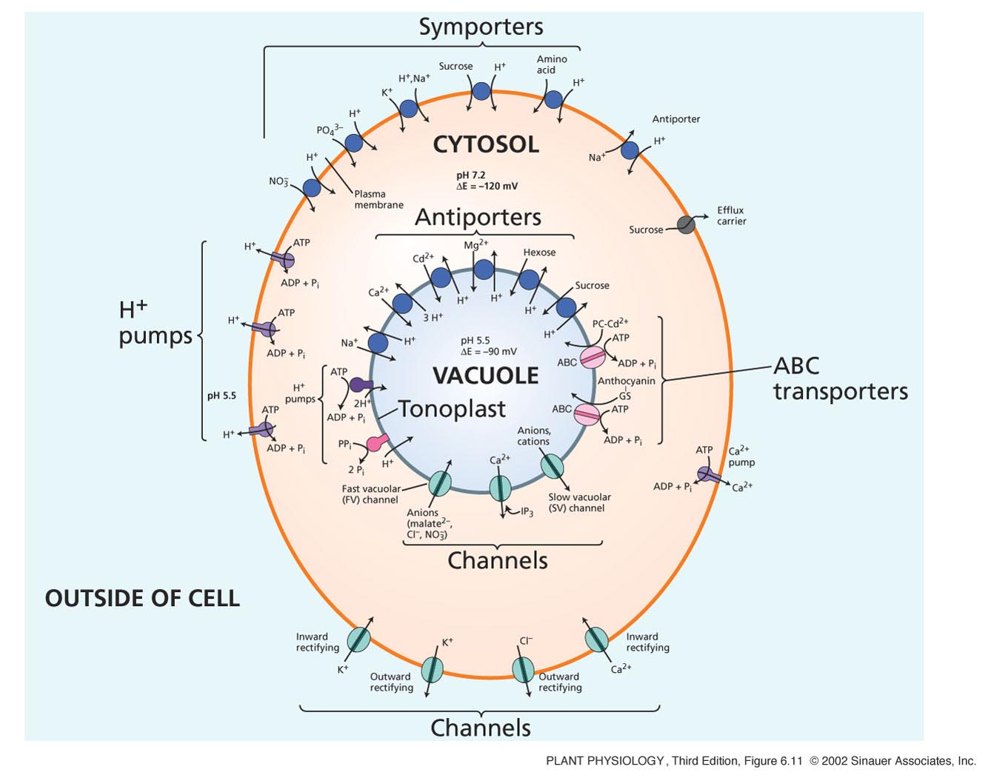
The Vacuole
Can be 80 – 90% of the plant cell
Contained within a vacuolar membrane (Tonoplast)
Contains:
  Water, inorganic ions, organic acids, sugars, enzymes, and secondary metabolites.
Required for plant cell enlargement
The turgor pressure generated by vacuoles provides the structural rigidity needed to keep herbaceous plants upright.

Slide 38
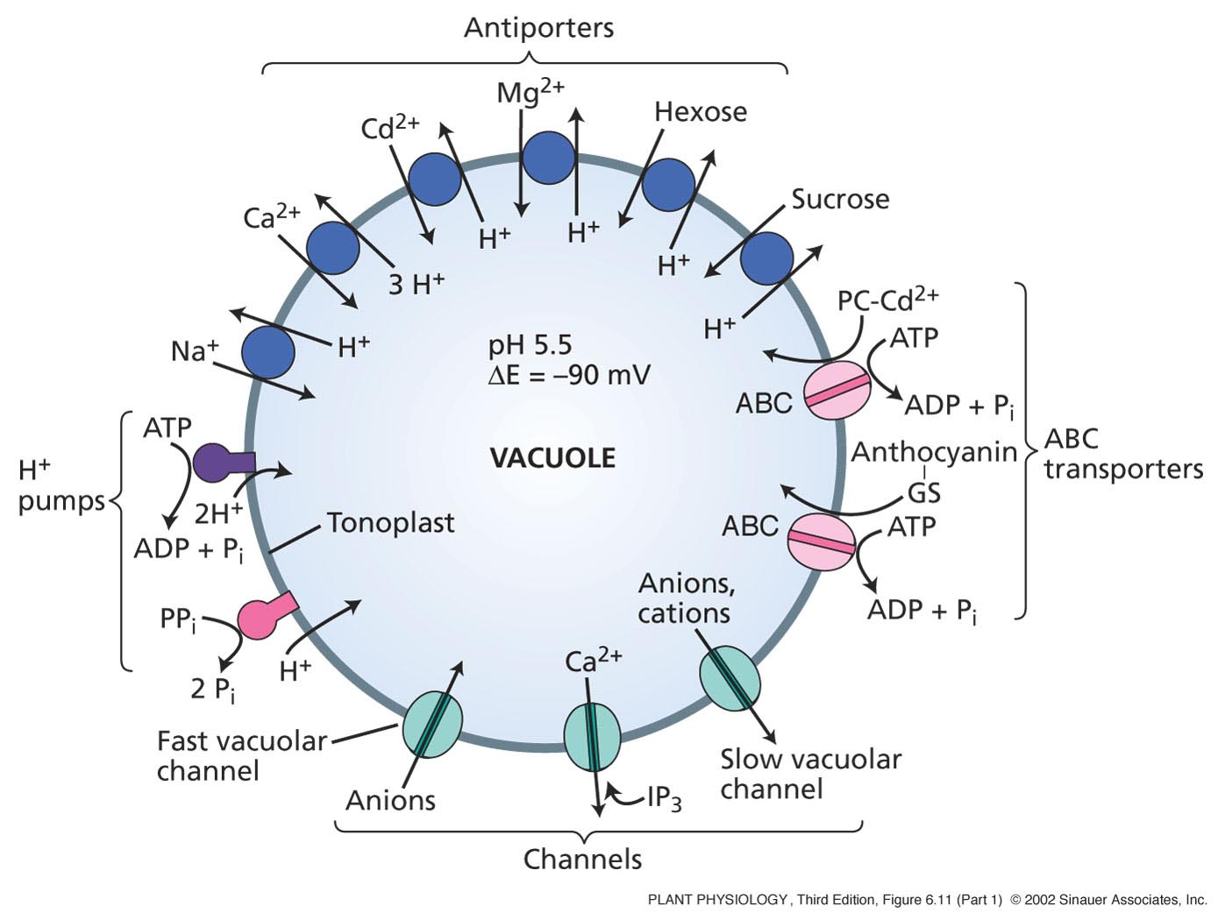
The Vacuole
In general, the functions of the vacuole include:
Isolating materials that might be harmful or a threat to the cell
Containing waste products
Containing water in plant cells
Maintaining internal hydrostatic pressure or turgor within the cell
Maintaining an acidic internal pH
Containing small molecules
Exporting unwanted substances from the cell
Allows plants to support structures such as leaves and flowers due to the pressure of the central vacuole
In seeds, stored proteins needed for germination are kept in 'protein bodies', which are modified vacuole

Slide 39
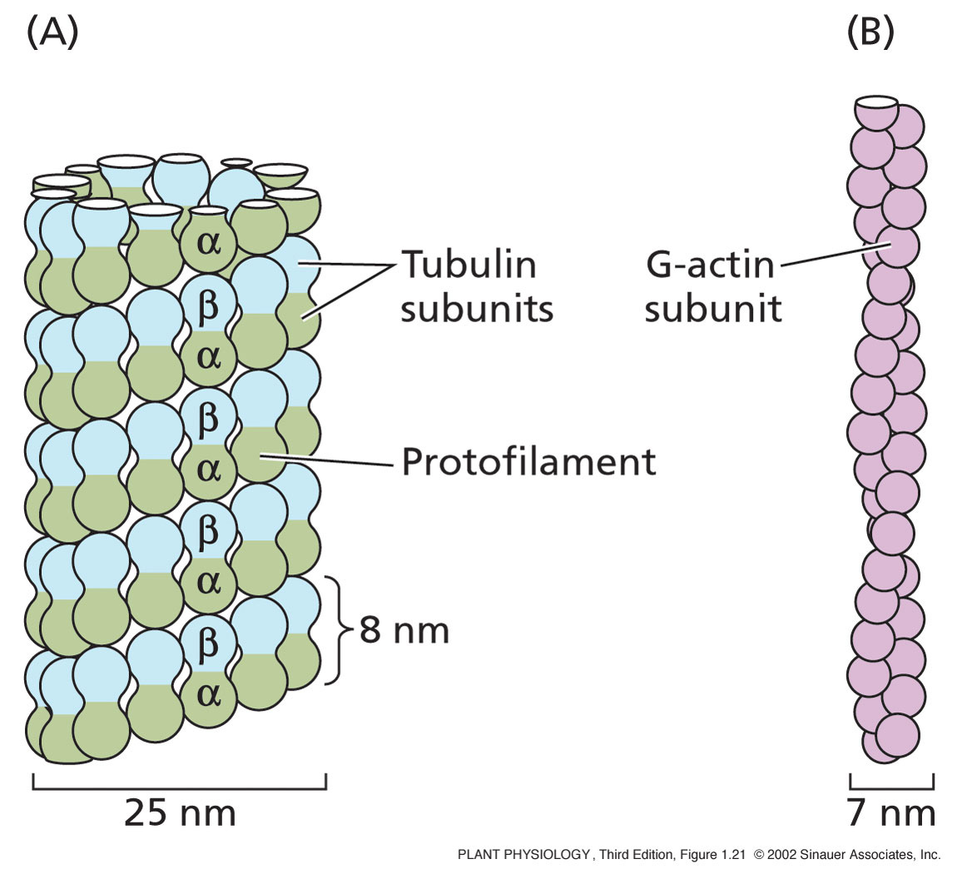
The cytoskeleton
Three main components:
Microtubules: are α and β proteins that create scaffolding in a cell. MTs are formed from the protein tubulin. 13 rows of tubulin =1 microtubule
Microfilaments: solid (7 nm) made from G-actin protein. Consists of 2 chains of actin subunits that intertwine in a helical fashion

Slide 40
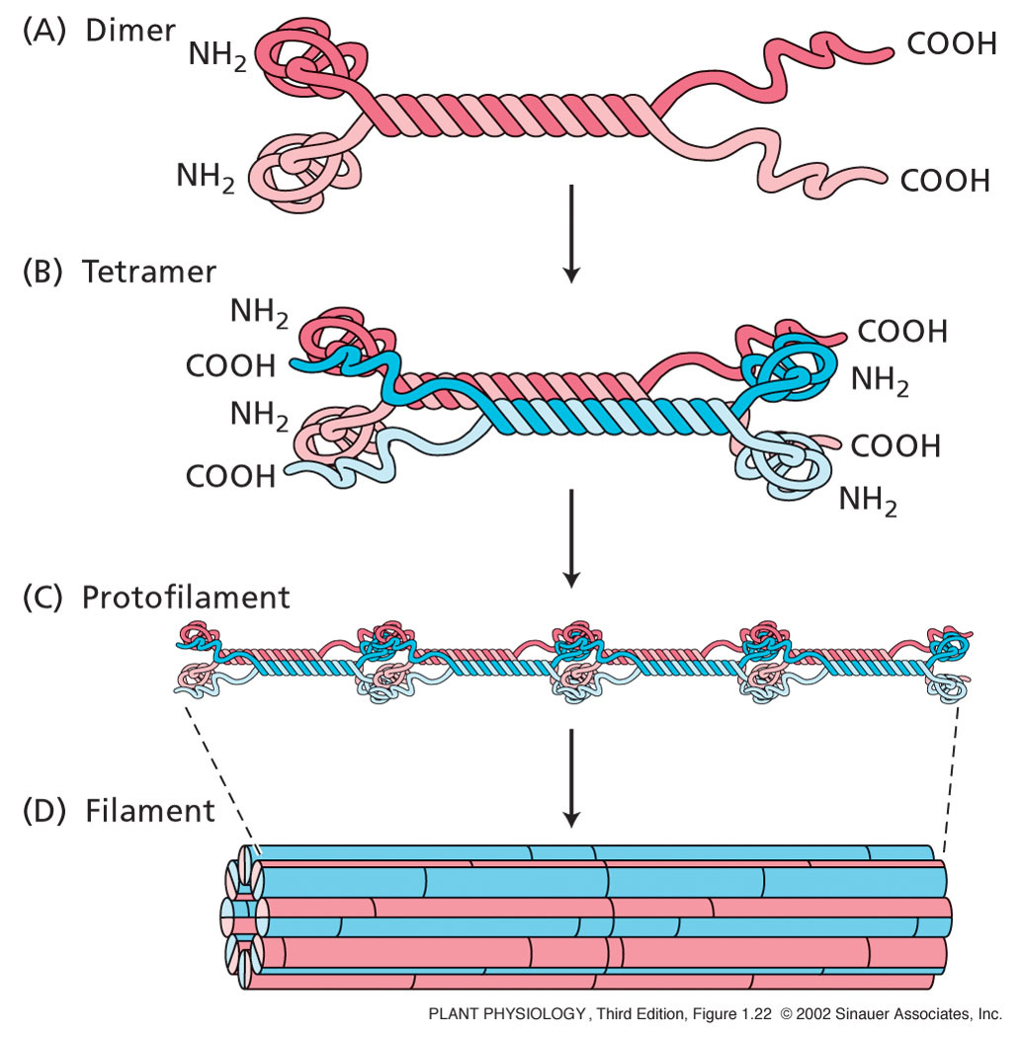
The cytoskeleton
Intermediate filaments: a diverse group of helically wound linear proteins.
Dimers line up parallel to each other
These form anti-parallel Tetramers
These join together to form a filament

Slide 41
The cytoskeleton
All these elements can assemble and disassemble
Involved in plant cell division
  During mitosis
    Process of division that produces two daughter cells with identical chromosomal content of parent cell

Slide 42
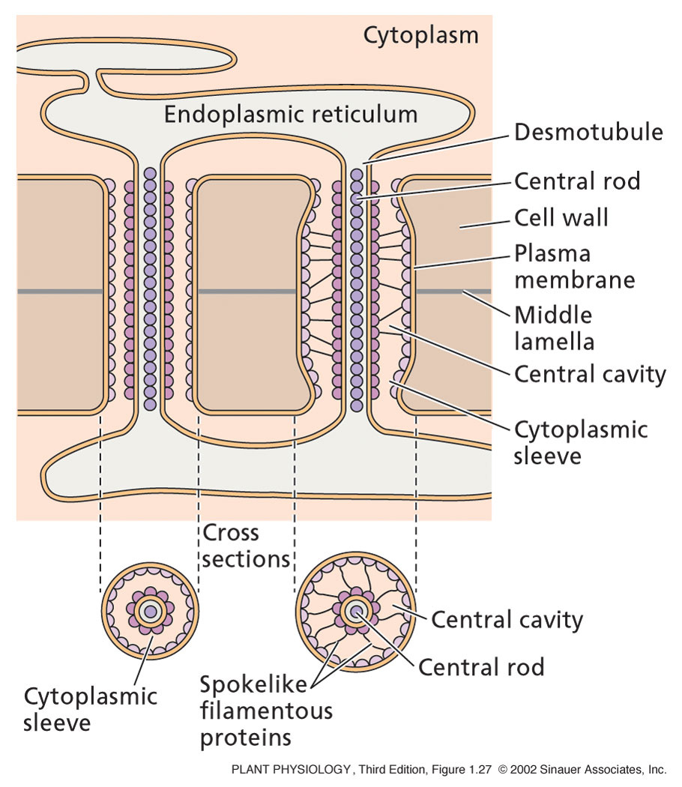
Plamodesmarta
Each contains a tube called a Desmotubule, which is part of the ER.
This is what connects adjacent cell and allow chemical communication and transport of material throughout the whole plant.
The restriction acts to control the size of the molecules which pass through.

Slide 43
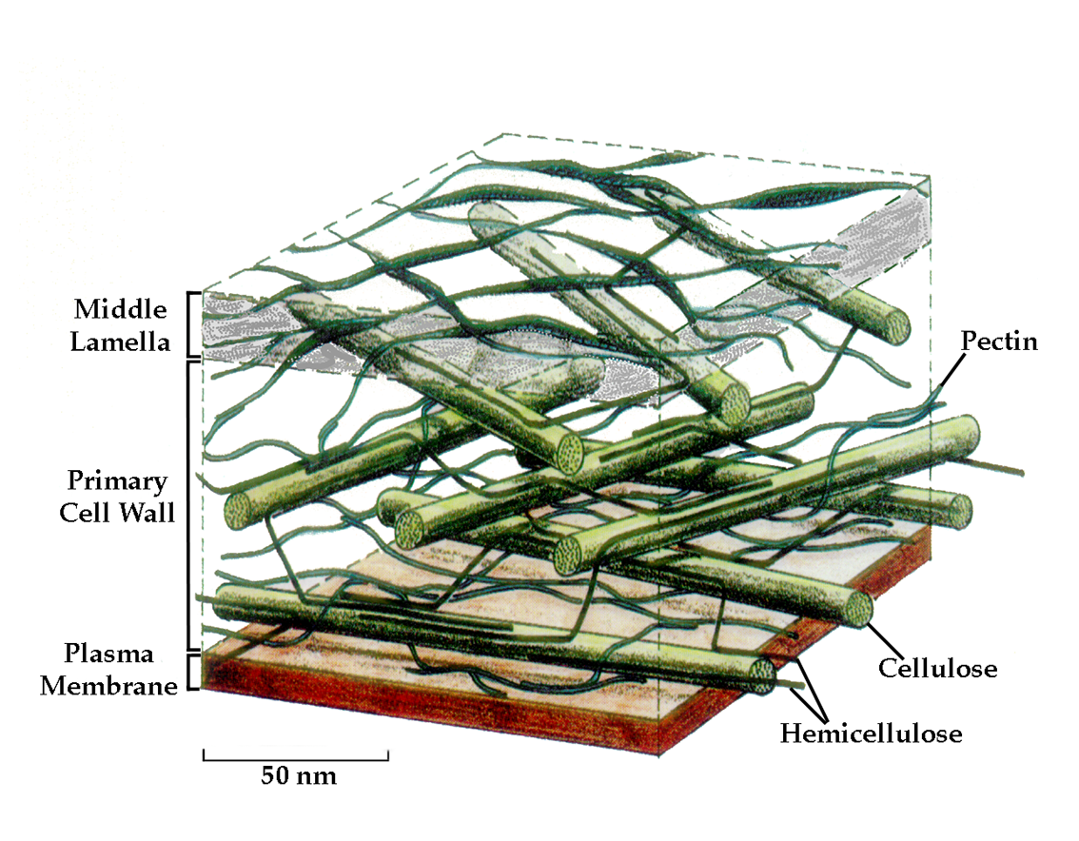
The Plant Cell wall
The cell wall is the organelle that ultimately controls the shape of plant cells and consequently of organs and whole organisms.
It is sometimes naturally strengthened and made considerably more resistant to such abuses as pathogen infection by the release of specific oligosaccharides and enzymes and by overlaying or impregnation with cutin, suberin, waxes or silica

Slide 44
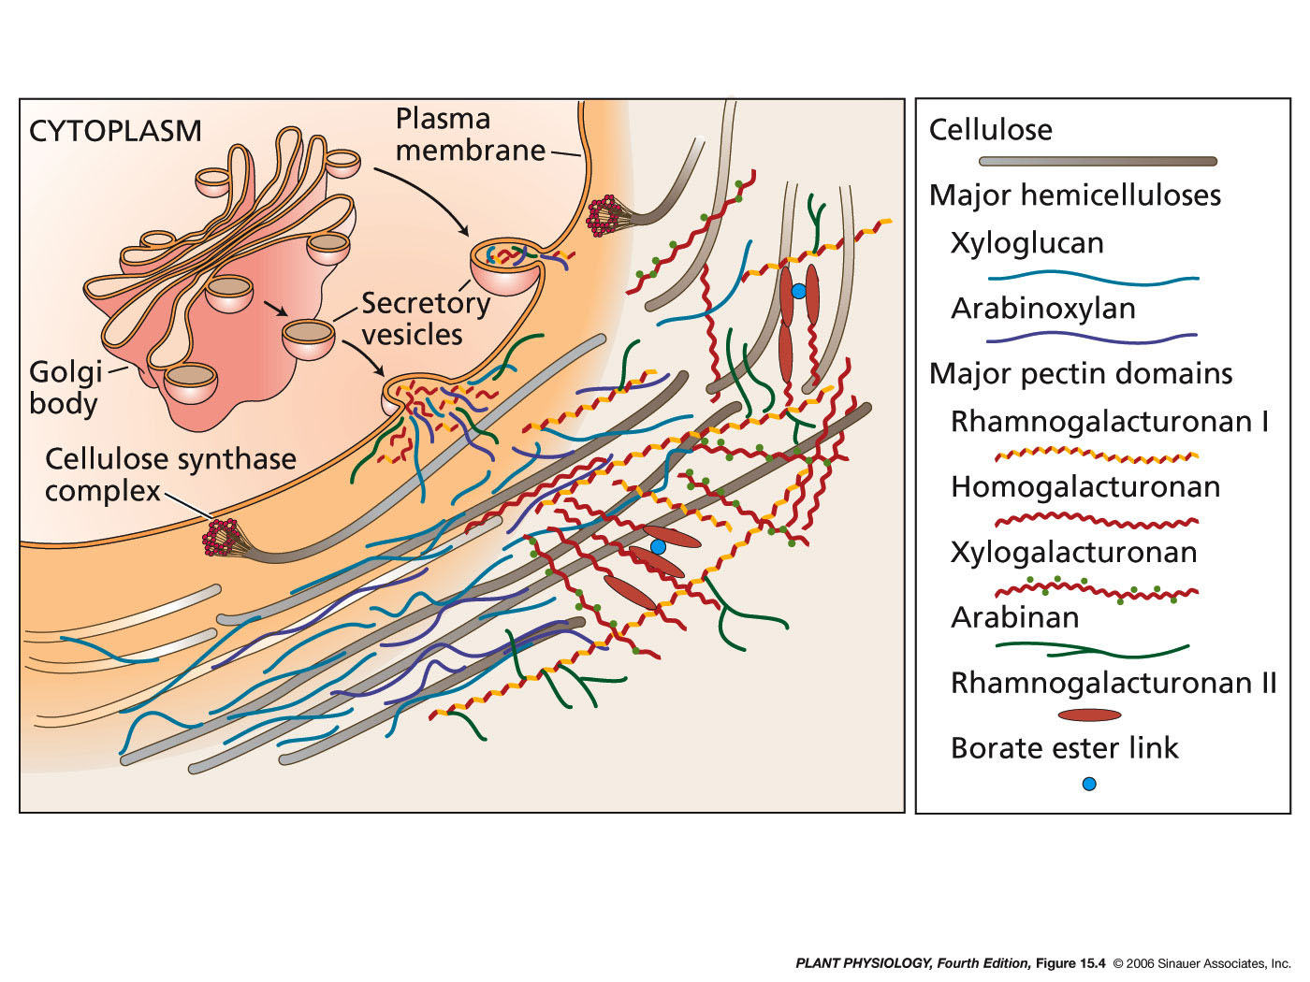
Major structural components of the primary cell wall and their likely arrangement

Slide 45
The Plant cell wall
    Critical to:
    plant cell growth
    plant growth and development
    differentiation
    response to biotic and abiotic stress
    Impact human activities in many ways:
    wood
    paper
    textile
    fuel
    food
    livestock feed
    brewing
    pharmaceuticals

Slide 46
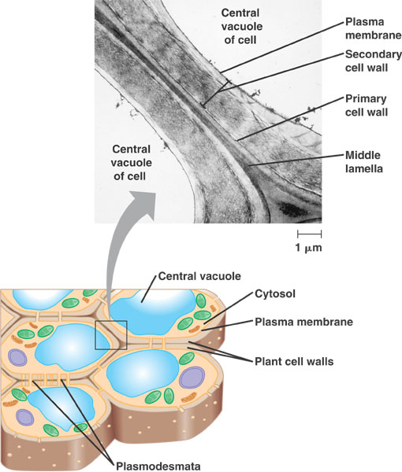
The Plant Cell wall
Cell walls are held together by the middle Lamella.
Made up of:
Cellulose
Xyloglucan
Pectin
Proteins
Ca ions
Lignin
other ions
Water

Slide 47
ANY QUESTIONS?

