Slide 1
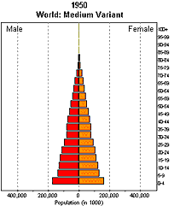
Population Pyramids

Slide 2
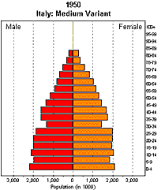
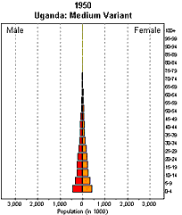
Italy and Uganda: Population by age and sex, 1950-2050

Slide 3
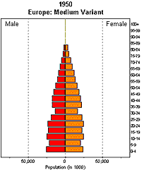
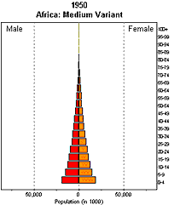
Europe and Africa: Population by age and sex, 1950-2050

Slide 4
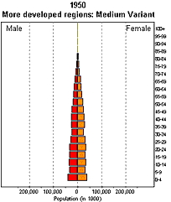
More and Less Developed Regions: Population by age and sex, 1950-2050

Slide 5
Developed vs. underdeveloped

