Slide 1
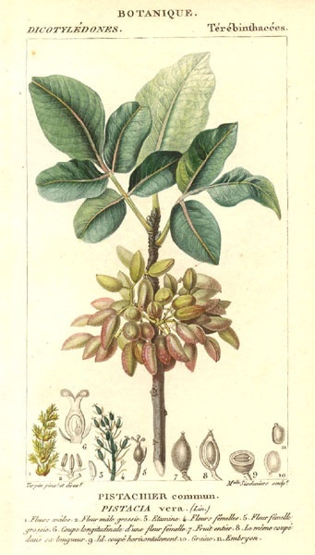
Anacardiaceae- Cashew Family
By: Jaclyn Kuklock
Ex. Mango, pistachio, poison ivy, and poison
oak.

Slide 2
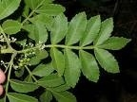
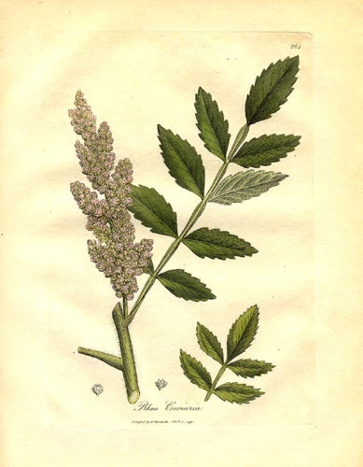
Leaves and Structure
Leaves pinnately compound and simple
4 to 5 carpels
Hypanthium sometimes present but small.
77 genera
600 species
Mainly in tropical,
areas and North
America and Eurasia.
Trees or shrubs, woody climbers or perennial herbs, blackening when wounded.
Flowers small and often imperfect, 3-5 merous, receptacle sometimes elongated and barrel-shaped.
Sepals fused basally or lobed.
Petals free to extended receptacle.
Anthers oblong with 4 pollen sacs.
Ovary superior, sometimes half-inferior or inferior.

Slide 3
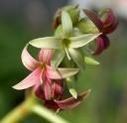
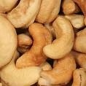
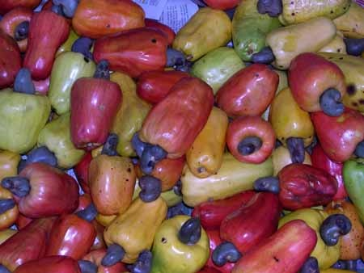
Anacardium occidentale- Cashew
Both the seed and the base of the fruit are edible.
Perennial tree 12 m tall
Leaves are simple and alternate
Male or female (Imperfect)
Radially Symmetrical
5 sepals, 5 petals, 10 stamens, one ovary
Flowering takes a few weeks, can grow/tolerate anywhere except the cold.

Slide 4
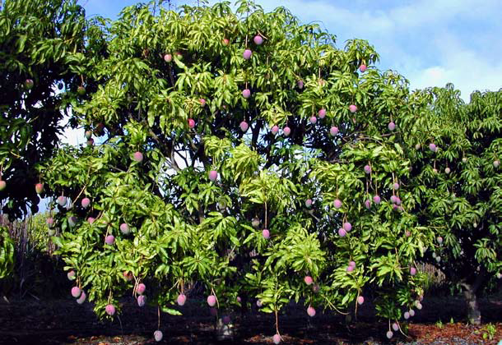
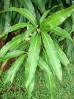
Mangifera indica- Mango
Leaves are alternate and simple, oblong and pinnate venation.
Found in tropical and subtropical regions.
Can grow to about 1200 m (3950 ft).
Skin is leathery and waxy.
Can cause allergic and respiratory problems for some people.
Self-fertile (Asexual)
The fruits grow at the end of a long,
string-like stem.
The seed may produce one ovary;
alternate bearing.

Slide 5
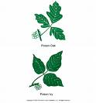
Toxicodentron diversilobum- Poison Oak
Vine or shrub, perennial
One of the most painful plants in North America- Allergen.
They have two embryonic leaves (dicotyledons)
It’s a single trunk with branches.
It has a berry- like fruit, drupe which is mature by August to November with a grayish- white color.
Spread mainly by animals.
Rhymes that describe the appearance of poison oak:
"Leaves of three, let it be.“
"One, two, three? Don't touch me.“
"Berries white, run in fright" and "Berries white, danger in sight."

Slide 6
Plants of Anacardiaceae Family:
Pistacia vera- Pistachio
Pistacia chinensis- Chinese Pistachio
Mangifera indica- Mango
Harpehyllum caffrum- Wild plum
Schinus molle- California Pepper Tree
Rhus Integrifolia- Lemonade Sumac
Rhus virens- Evergreen Sumac
Rhus aromatica- Lemon Sumac

Slide 7
References:
www.botany.hawaii.edu/faculty/carr/Anacardi.htm
http://www.hort.purdue.edu/newcrop/duke_energy/Anacardium_occidentale.html#Description
http://hort.ufl.edu/trees/MANINDA.pdf
Vascular Plant Taxonomy. Fifth Edition. Walters, Dirk R et al. 2006.

