Slide 1
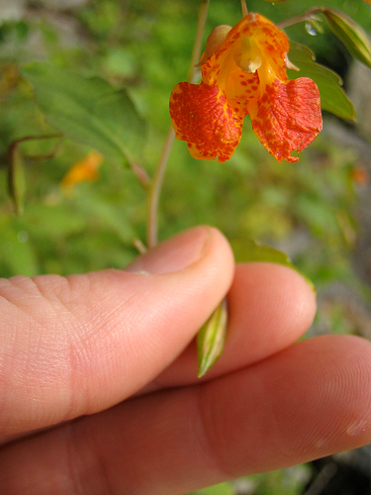
Balsaminaceae Touch me….NOT!!!
By Jerry Warmbold
http://images.google.com/imgres?imgurl=http://farm1.static.flickr.com/79/247242513_ea8cec03b5.jpg%3Fv%3D0&imgrefurl=http://www.flickr.com/photos/bradlauster/247242513/in/set-72157594290624049/&usg=__OV0TqnpHPpgzLdpyGdtQM3FsxBU=&h=500&w=375&sz=91&hl=en&start=41&um=1&itbs=1&tbnid=ZYQkyfqQmTEj_M:&tbnh=130&tbnw=98&prev=/images%3Fq%3Dtouch%2Bme%2Bnot%2Bseed%26ndsp%3D18%26hl%3Den%26client%3Dfirefox-a%26rls%3Dorg.mozilla:en-US:official%26sa%3DN%26start%3D36%26um%3D1

Slide 2
Balsaminaceae Characteristics
Herbs or shrubs; up to 8 feet tall, but most are much shorter
Annual succulent plants
Dicotyledons
Leaves alternate, opposite, or whorled; simple, estipulate, and coarse, gland-tipped white teeth
Inflorescence of solitary flowers, axillary clusters, racemes or panicles
3-5 Distinct sepals, the lowermost spurred or saccate
5 Petals distinct or the lateral petals connate in pairs
5 stamens & 5 carpels
Ovary superior with 5 locules
1 – many axile ovules
Gets name from explosive projectile seeds after being touched
Notes:
Locule- compartment
Corolla 5 (but often simulating three by fusion of the lateral pairs to form two equally or unequally bilobed ‘petals’)
Raceme-An inflorescence having stalked flowers arranged singly along an elongated unbranched axis
Panicle- A branched cluster of flowers in which the branches are racemes.
Saccate- shapped like a sac….likely because holds the seeds
Connate- togetherness—kind of like fused

Slide 3
Impatiens pallida “Pale Jewelweed” or “Yellow Jewelweed”
Found in moist to wet soils
Flowers from midsummer to fall
Up to 8 ft. tall
Shade tolerant
http://en.wikipedia.org/wiki/File:Impatiens_pallida_flower_and_buds_001.JPG
Notes:
Although, our DNR sheet just has the genus of this plant, there are two common to Minnesota

Slide 4
Impatiens capensis “Orange Jewelweed”
Often found growing near Impatiens pallida
3 lobbed corolla
sepals similar in color to the petals
Up to 5 ft tall
Shade tolerant
Home remedy for bee stings and poison ivy
http://en.wikipedia.org/wiki/Impatiens_capensis

Slide 5
References
Walters, Dirk., Keil, David., Murrell, Zack. 2006. Vascular Plant Taxonomy . 5th ed. U.S.: Kendall/Hunt. 180. Print.
USDA. Plant Database. (2010). Received Feb. 2010., http://www.plants.usda.gov/java/profile?symbol=IMPA
http://en.wikipedia.org/wiki/Impatiens_capensis
http://en.wikipedia.org/wiki/Impatiens_pallida

