Slide 1
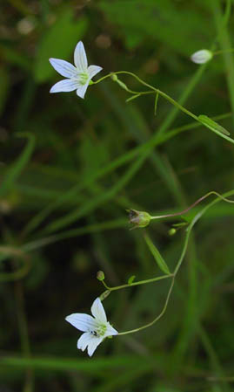
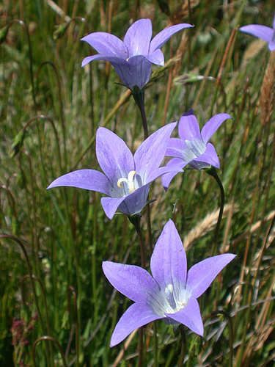
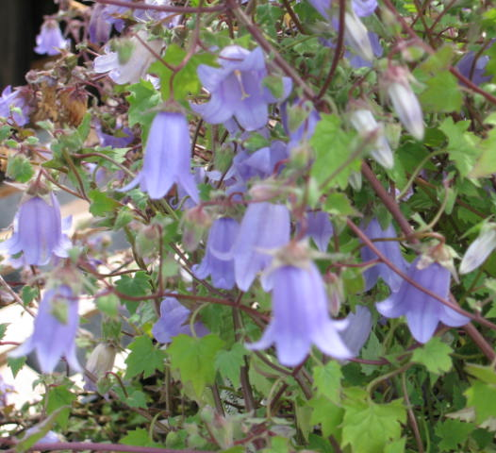
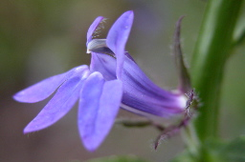
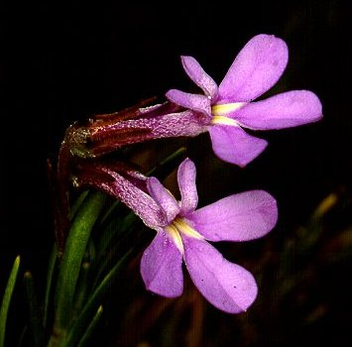
Campanulaceae
“Bellflower family”
http://farm3.static.flickr.com/2052/2088225501_d6f021ab12.jpg
http://www.wildgingerfarm.com/images/Symphyandrazanzugar.JPG
http://www.ct-botanical-society.org/galleries/campanulaapar.html
http://www.biodiversityexplorer.org/plants/campanulaceae/images/enb04940.jpg
http://www2.dpes.gu.se/staff/aleant/pictures/Lobelia_siphilitica.JPG

Slide 2
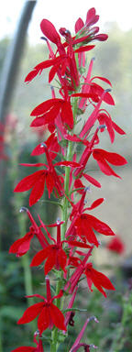
Campanulaceae
70-84 genera and 1800-2000 species
Herbs, shrubs and rarely small trees
Non-toxic milky sap
Leaves alternate, simple and estipulate
Usually 5-merous
Flowers vary considerably
2 subfamilies
Campanuloideae
Actinomorphic (Radial symmetry)
Lobelioideae
Zygomorphic (Bilateral symmetry)
http://www.thearknativeplants.com/index.php?n=Wetland.Wetland

Slide 3
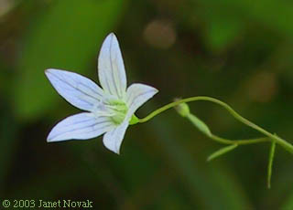
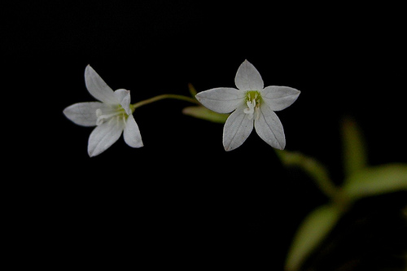
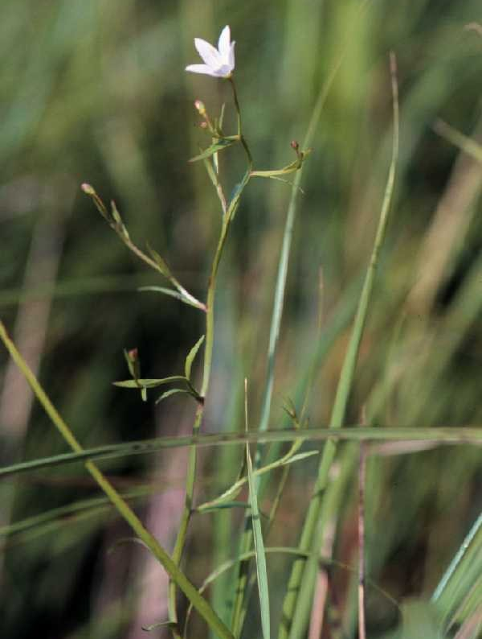
Marsh Bellflower
Campanula aparinoides
http://www.ct-botanical-society.org/galleries/campanulaapar.html
Plant height is 8-24 inches
Flower color is pale blue
Found in damp meadows and swamps
http://plants.usda.gov/java/largeImage?imageID=caap2_003_avp.tif
http://farm4.static.flickr.com/3531/3710779115_32ab2b40d5.jpg

Slide 4
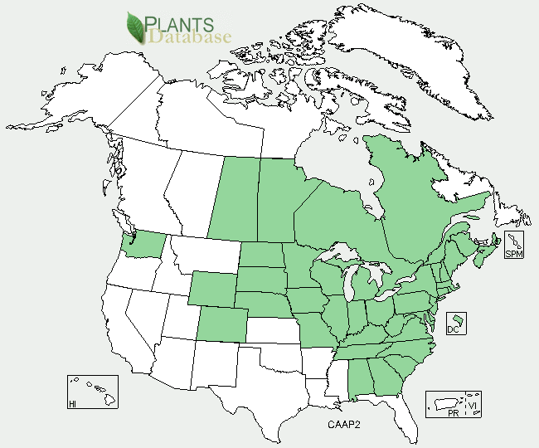
Distribution of Campanula aparinoides
http://plants.usda.gov/java/profile?symbol=CAAP2

Slide 5
References
Gleason, Henry A., Cronquist, Arthur. Manual of Vascular Plants of Northeastern United States and Adjacent Canada. 2nd ed. New York botanical Garden, Bronx, New York. pp 213-215.
Walters, Dirk R., Keil, David J., Murrell, Zack E. 2006. Vascular Plant Taxonomy. 5th ed. Kendall/Hunt Publishing Company, Dubuque, Iowa.

