Slide 1
Dennstaedtiaceae The Bracken Family
Kathy Germann

Slide 2
Denstaedtiaceae
17-20 genera and 400 species
They occur all over the world
Leaves are simple or 1 – several times pinnately compound
They are homosporous they produce spores of the same size and type (heterosporous is when they produce two different sizes of spores on large, female, and one small, male)
Sporangia stalked with an erect partial annulus and variously organized into continuous or discontinuous marginal or sub marginal sori on the under surface of the leaf blade.
Sori often covered by reflexed leaf margin

Slide 3
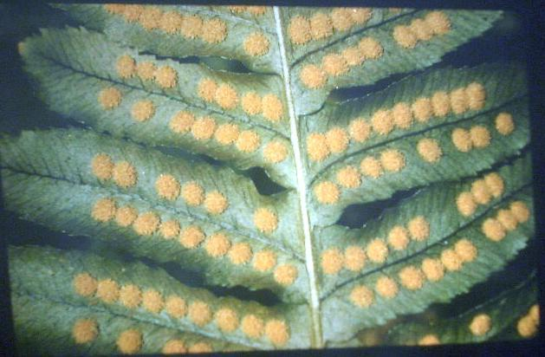
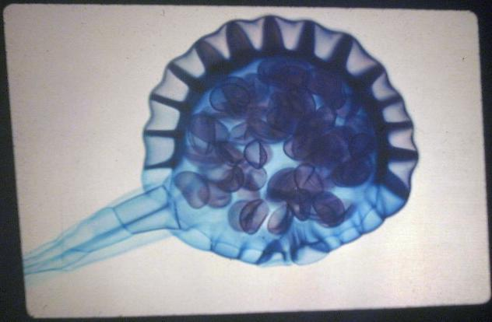
Sori (plural)
Sorus (singular)
http://www.dscc.edu/bwilliams/Biology2/bio2plantslide.htm
Sporangia

Slide 4
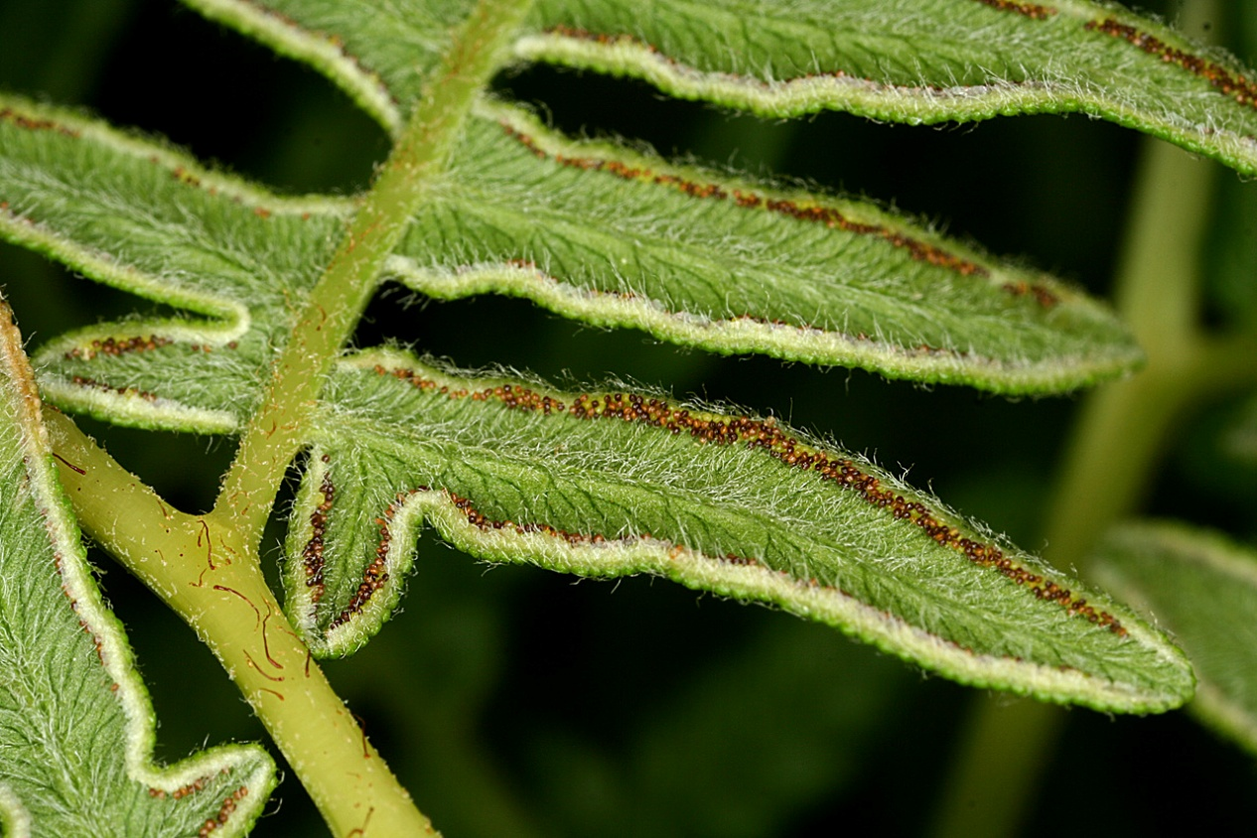
Pteridium aquilinum Bracken Fern
Grows around 2 to 8 feet tall
From large colonies of ferns
Sori appear along the rolled edge of the under side of the frond
Fronds can get 3 feet long and are usually horizontal
Resistant to herbicides
Found around the world, it is the most widespread of all the ferns
They are listed as an edible wild plant and people often eat the fiddle heads but they have proved carcinogenic in mice and rats and face masks are recommended when working in dense bracken
http://www.wnmu.edu/academic/nspages2/gilaflora/p_aquilinum1.jpg

Slide 5
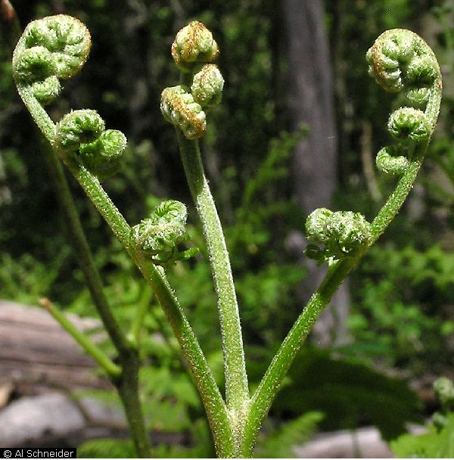
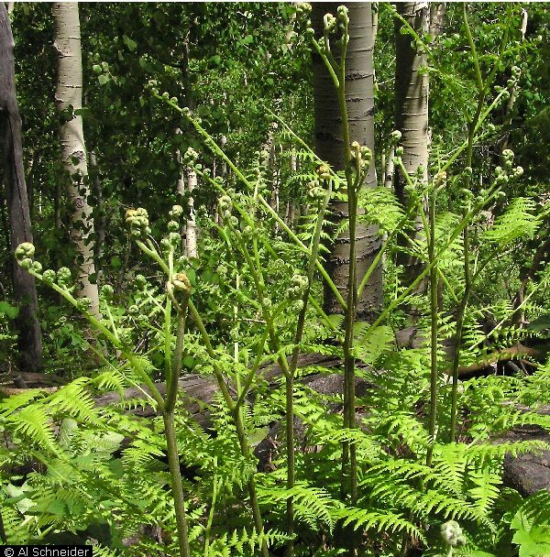
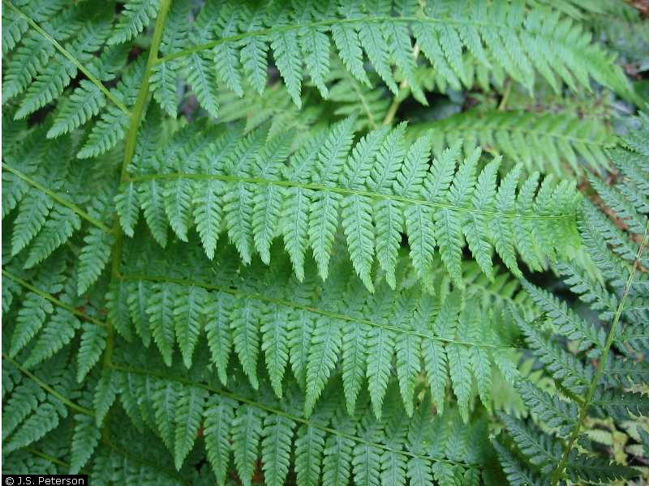
http://plants.usda.gov/java/largeImage?imageID=ptaq_005_ahp.jpg

Slide 6
References
http://plants.usda.gov/java/imageGallery?category=sciname&txtparm=Pteridium&familycategory=all&growthhabit=all&duration=all&origin=all&wetland=all&imagetype=all&artist=all&copyright=all&location=all&stateSelect=all&cite=all&viewsort=25&sort=sciname
http://www.rook.org/earl/bwca/nature/ferns/pteridiumaqui.html
Vascular Plant Taxonomy, Fifth Edition, Dirk R Walters, David J Keil, Zack E. Murrell, 2006

