Slide 1
Summer Internship With the DNR
By: Levi Eggermont
Based in Grand Rapids, MN

Slide 3
Forest Inventory and Analysis operated by USDA Forest Service &DNR
FIA has been in operation under various names (Forest Survey, Forest Inventory and Analysis) for some 70 years. They cover forests on all forest lands within the US. It was first in 1897created under President McKinley.
The program projects how forests are likely to appear 10 to 50 years from now.

Slide 4
FIA continued
FIA reports on the status and trends in forest area and location; in the species, size, and health of trees; in total tree growth, mortality, and removals by harvest.

Slide 5
Phase Three
Phase 3 consists of a subset of the phase two plots (approximately 1 every 96,000 acres) which are visited during the growing season in order to collect an extended suite of ecological data including full vegetation inventory, tree and crown condition, soil data, lichen diversity, coarse woody debris, and ozone damage.

Slide 7
Plots and subplots

Slide 8
Plots continued

Slide 9
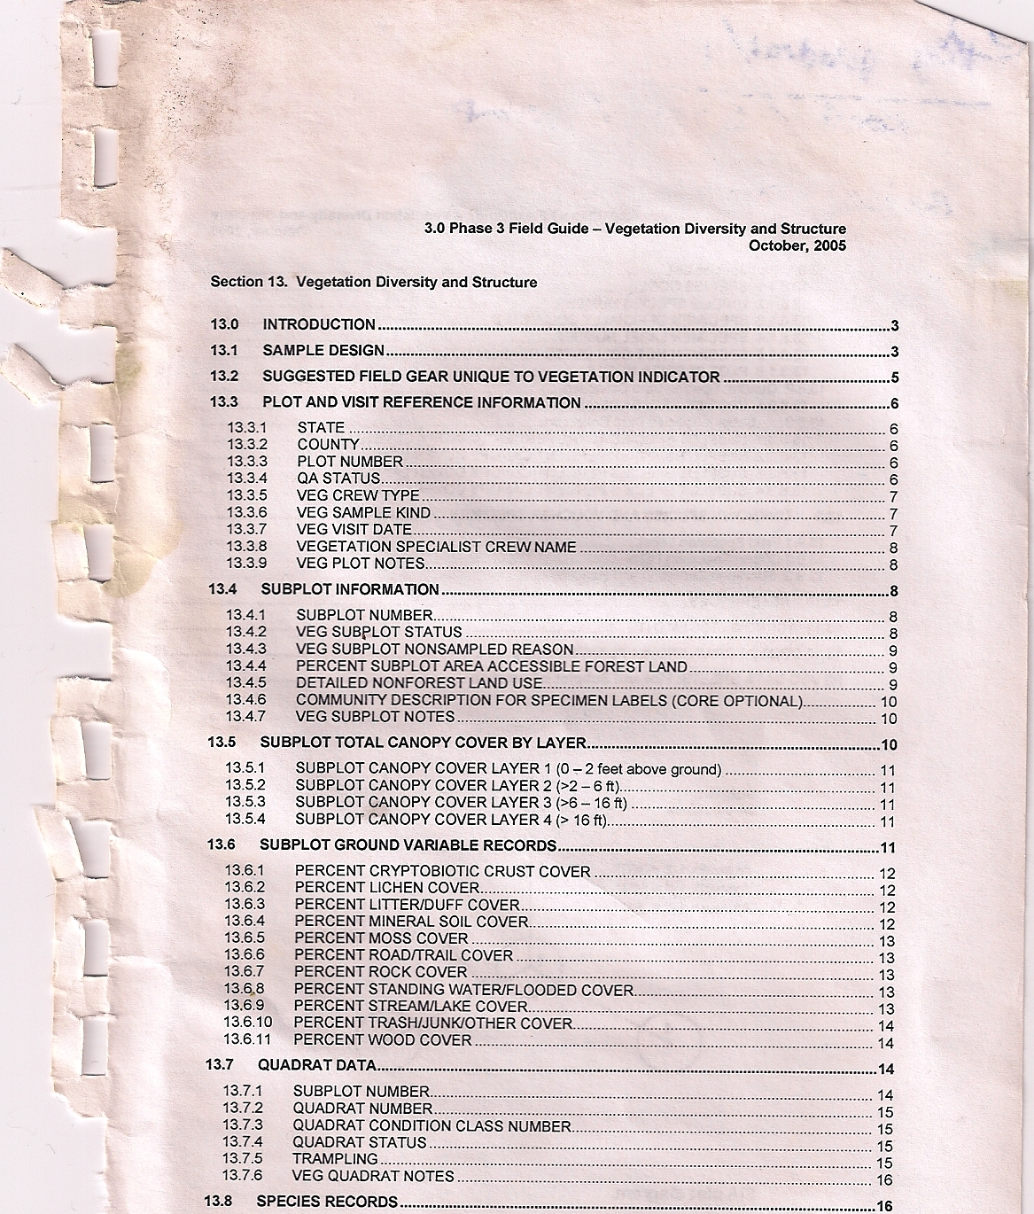

Slide 14
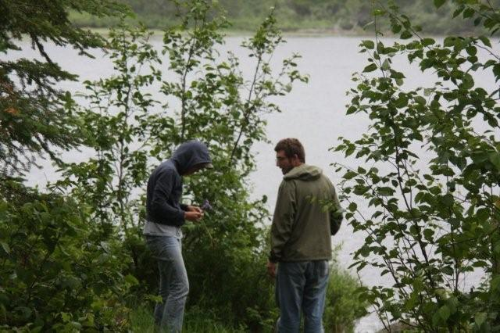

Slide 15
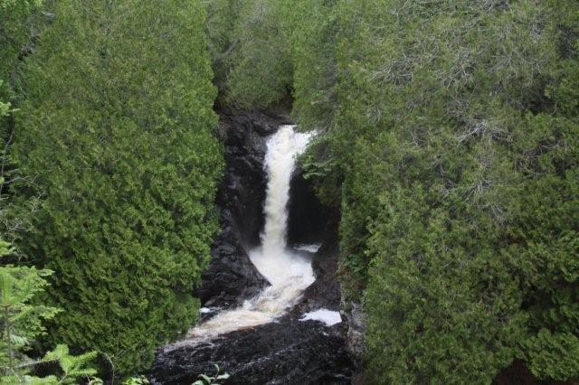

Slide 16
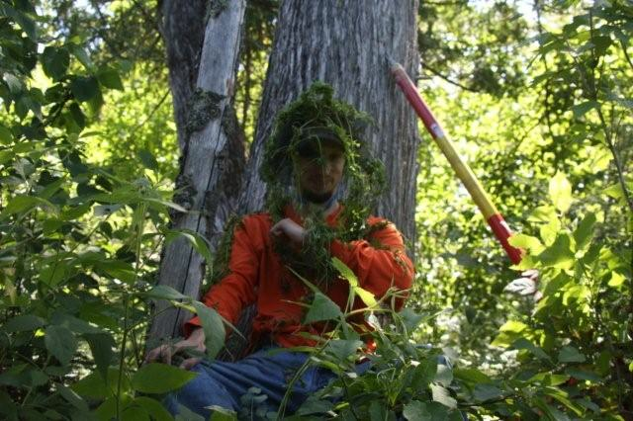
Dan Woitella AKA “Sticky Willy”

Slide 17
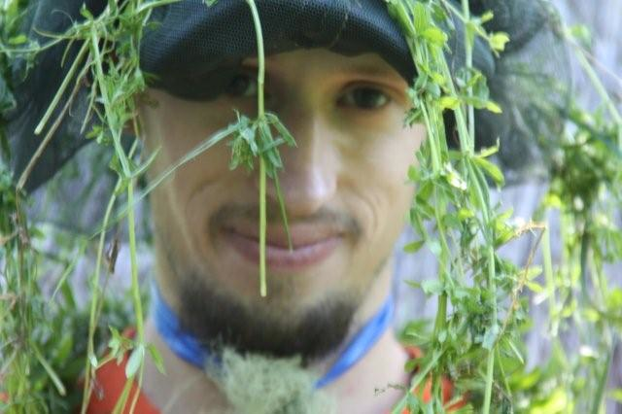

Slide 19
Monotropa uniflora

Slide 20
References & Acknowledgements
Thank You Dr. Stockram for the job hook up!
Pictures from Nikki Walters, Dan Woitella, Brittany Wedgewood.
FIA info pulled from http://fia.fs.fed.us/program-features/
MN Map from maps.com
Thank you Dr. Pemble for sparking my interest

