Slide 1
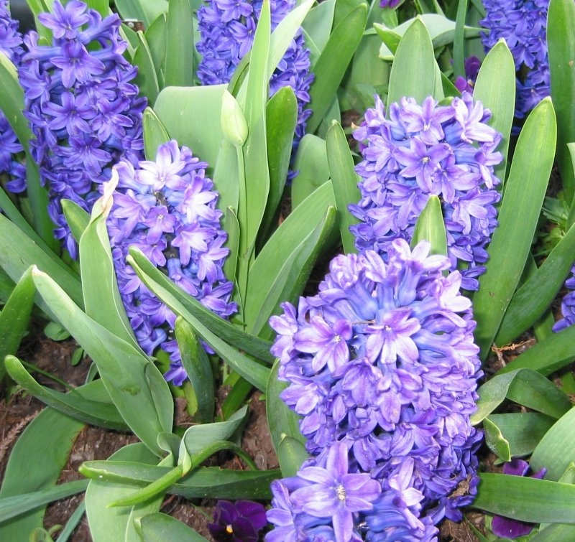
Liliaceae
Lily Family

Slide 2
Structure of Liliaceae
This is one of the largest plant families,
with about 3500 species distributed
throughout the world. 15 genera
They are mainly ornamental plants, including:
(Onion, garlic, chives and asparagus)
The majority are herbaceous with a swollen
storage organ, but there are also evergreen
succulents (Aloe) and woody evergreen
climbers.
Seeds: The ovary is usually superior (inside the
flower) with 3 chambers.
Have bulbs or other storage organs Long, thin leaves Six petals Six stamens

Slide 3
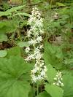
Trillium cernuum Nodding Trillium Trillium: Latin tres for three and lilium for lily cernuum: drooping, nodding
Habitat: wet to moderate moisture; woods, forests
Flower color: white, occasionally pink
Green sepals and petals are about equal in length.
Fruit: dark red, oval berry.
Leaf: Widely oval with a pointed
tip in 1 whorl of 3 leaves at the
top of the stem.

Slide 4
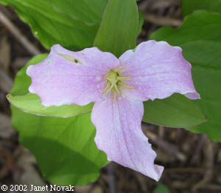
Trillium grandiflorum Large-Flowered Trillium
Habitat: rich woods
Flower color: white, turning pink with age.
It consists of a central stem with 3 terminal leaves;
a mature plant will produce a single flower.
The stem, glabrous, and pale green
or pale reddish-green. The terminal leaves are
arranged in a whorl at the apex of this stem.
Each leaf is oval in shape, medium
green, and glabrous. Each leaf has smooth margins
and parallel primary veins.
Commonly found in the east and northeast of Illinois.
The flowers are very showy and the leaves have a
nice glossy surface

Slide 5
Clintonia borealis Bluebead Lily
General - a perennial with glossy, dark green leaves
in a rosette at the base; growing 30 cm high.
Leaves: parallel, 2 or 3.
Flowers pale yellow, 3 to 8 on leafless stalk
Fruit bright round porcelain blue;
mildly poisonous to humans.
Northern North America, south in mountains
Habitat: Open shade & moist sites and pine forest.
Monocot- one seed leaf

Slide 6
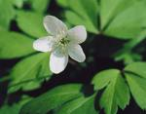
Maianthemum canadense Canada Mayflower
Perennial
Leaves are ovate-oblong to oval in shape.
Upper leaf surface is medium green and glabrous,
while the lower surface is pale green and finely pubescent.
Flowers typically occur in pairs; individual flowers have 4 stamens with
white filaments and pale yellow anthers, and a white to greenish white pistil.

Slide 7
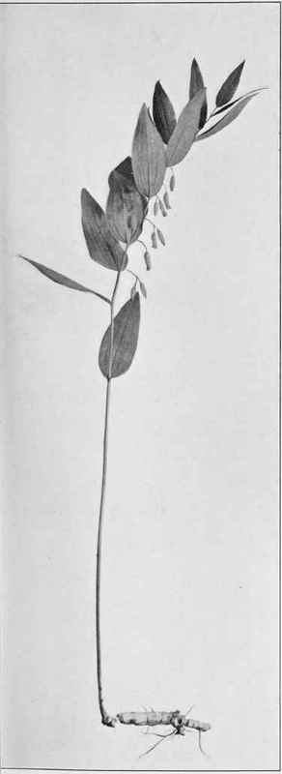
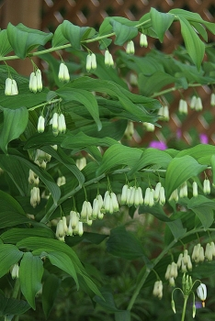
Polygonatum biflorum Giant Solomon’s Seal
Flowers - Whitish-green.
6 tepals and stamens,
with superior ovary.
Habitat: wet and mild climates, shady woodland conditions.
Leaves are smooth and have dangling white flowers on arching stems. Alternate, sessile, glabrous, entire, acute, to +18cm long, +7cm wide.
It spreads out and forms a dense carpet of arching stems.
Stems - To +1m tall, glabrous, herbaceous,
simple, single from base.

Slide 8
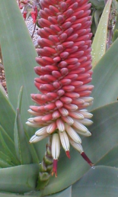
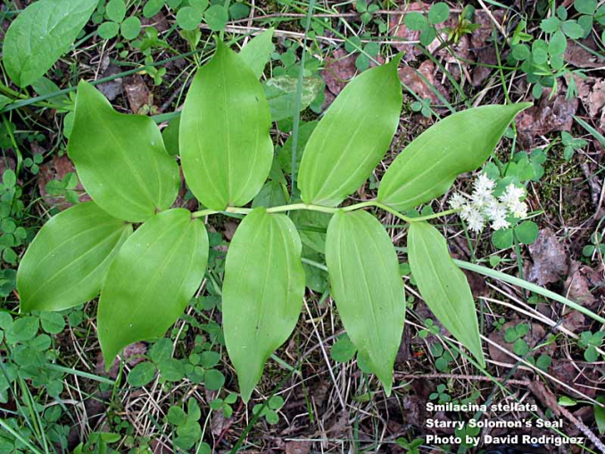
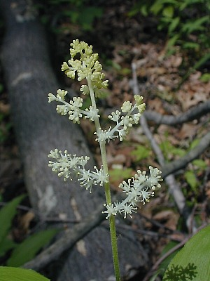
Smilacina racemosa Common False Solomon’s Seal Smilacina comes from a Greek word meaning "small and thorny“ Racemosa comes from theLatin and means "having a raceme”
Raceme
The stem grows in a slight zigzag fashion.
Smooth along the margins, glabrous on the upper
surface.
Parallel venation, while at the base they are
mostly sessile against the stem. The central stem
has 20-80 white flowers.
Habitat: light shade to partial sun, moist to
slightly dry conditions.
Flowers consist of 6 tepals, 6 stamens, and a
central pistil.

Slide 9
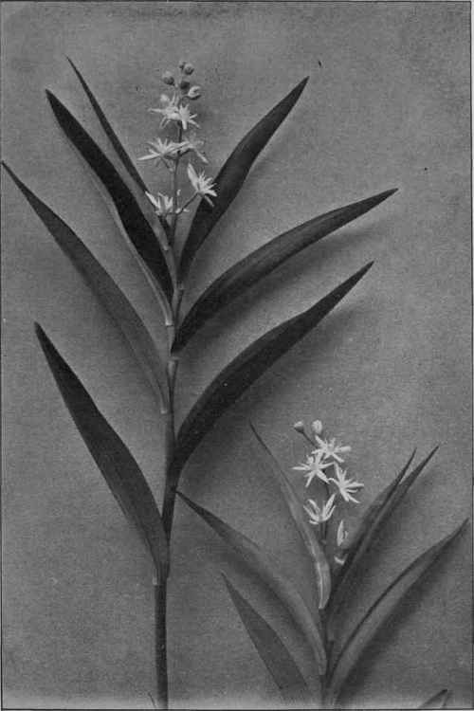
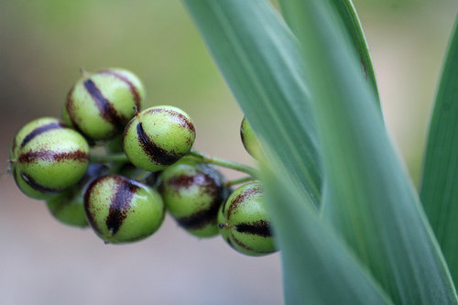
Smilacina stellata Starry False Solomon’s Seal
Leaves: Alternate and narrowly ovate with parallel veins and smooth margins. They
have short petioles.
The undersides of the leaves are slightly pubescent. The central
stem consists of small white flowers.
The berries are initially green with purple or black stripes, but later become bright red.

Slide 10
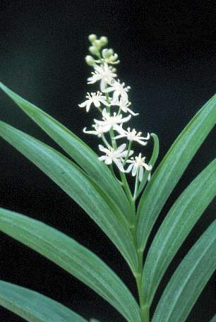
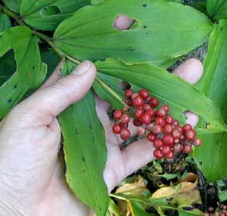
Smilacina trifolia Three-Leaved False Solomon’s Seal
General - a slender, erect, perennial herb growing up to 20 cm tall (sometimes to 30 cm).
Leaves - alternate, three, 3 - 13 cm long, oval to oblong shaped, hairless.
Flowers - Unbranched clusters at the stem tips; flowers are white to greenish white.
Fruit - Dark red berries, up to 6 mm wide
Habitat: Swamps, moist woods and openings

Slide 11
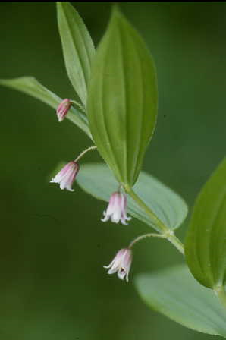
Streptopus roseus Rose Twistedstalk
General - a perennial, growing up to 30 cm tall.
Leaves: ovate to oblong & sessile, alternate.
Flowers: white or greenish yellow with reddish-purple streaks or spots with white tips.
Fruit - an elongated red berry.
If berries are consumed in quantity,
diarrhea symptoms can result.

Slide 12
Uvularia grandiflora Large-Flowered bellwort
Stem has one or two leaves with
round stems are glabrous.
6 stamens, 1 pistil, 3 styles.
Leaves: oblong, alternate and
Sessile, they are light green or pale reddish green.

Slide 13
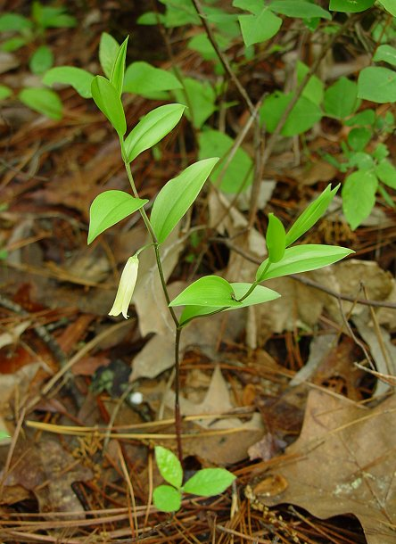
Uvularia sessilifolia Pale Bellwort
Habitat: Deciduous forests
at low elevation.
*Flowers pale yellow to
straw-colored, six petals,
hanging from stalk.
* Leaves sessile (not
surrounding stem), with
pale undersides.
* Fruit a triangular pod,
hanging beneath the stem.
* Found: Northeastern and
central United States.

Slide 14
References:
http://wisplants.uwsp.edu/scripts/detail.asp?SpCode=TRICER
http://www.ct-botanical-society.org/galleries/trilliumgran.html
http://www.ces.ncsu.edu/depts/hort/consumer/factsheets/wildflowers/maianthemum_canadense.html
http://www.illinoiswildflowers.info/woodland/plants/cn_mayflower.htm
http://chestofbooks.com/flora-plants/flowers/Wild-Flowers-New-York/Large-Flowered-Bellwort-Uvularia-Grandiflora-J-E-Smith-Plate-20b.html
http://www.borealforest.org/herbs/herb36.htm
http://www.borealforest.org/herbs/herb35.htm
http://www.illinoiswildflowers.info/savanna/plants/starry_solomon.htm
http://ncnatural.com/wildflwr/fsseal.html
http://www.illinoiswildflowers.info/woodland/plants/fs_solomon.htm
http://www.perennialreference.com/perennials/polygonatum.html

