Slide 1
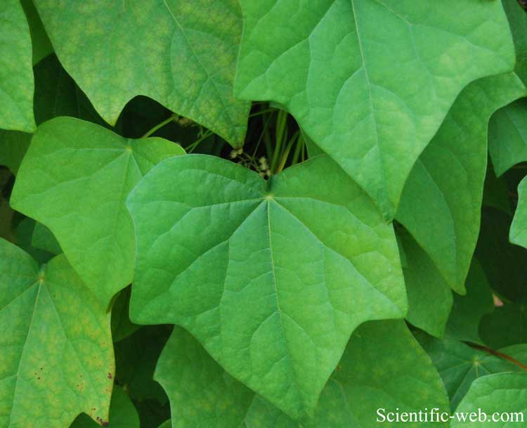
Menispermaceae “Moonseed Family”

Slide 2
Menispermaceae
70-73 genera
400 species
Tropics to subtropics, few temperate
Shrubs or wood vines (less commonly trees).
Leaves alternate, simple, estipulate.
Dioecios
Inflorescences various, cymose or paniculiform.
Flowers imperfect, regular.
Sepals 6 in two series, distinct
Petals 6-9 in 2-3 series, distinct.
Stamens 6-many, distinct
Carpels 2-6, distinct; ovaries superior with 1-2 marginal ovules; style 1 per carpel or stigmas sessile.
Fruit an aggregate of drupes

Slide 3
Menispermum canadense
A climbing vine with small, greenish-white flowers in small loose clusters in axils of large leaves; each leafstalk attached just inside leaf’s edge.
The poisonous fruit of this plant ripens in September and resembles whitish-powdered grapes. The fruit is highly toxic, may be fatal if eaten.
Duration: Perennial Habit: Vine Fruit Color: Black
Bloom Color: White , Green , Brown Bloom Time: Jun , Jul
Native Habitat: Woodland edges, thickets, and streambanks.
Light Requirement: Sun , Part Shade , Shade Soil Moisture: Moist

Slide 4
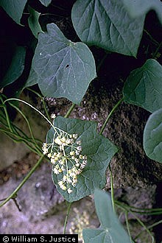
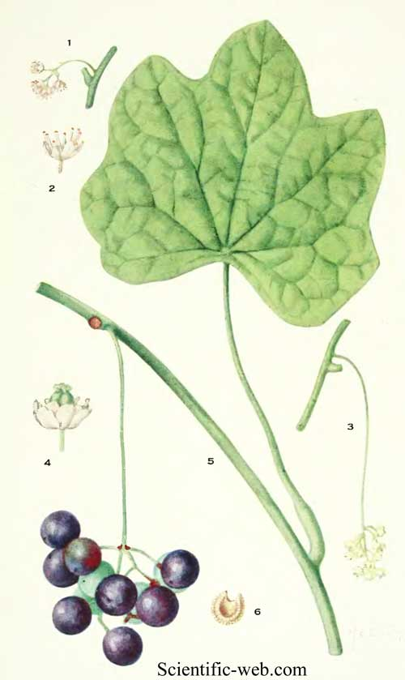
Menispermum canadense

Slide 5
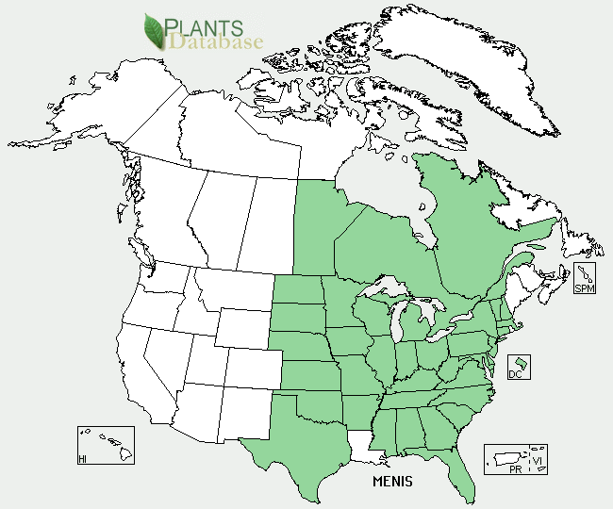
Distribution of Menispermaceae throughout the US.

Slide 6
References
© 2010 Lady Bird Johnson Wildflower Center http://www.wildflower.org/plants/result.php?id_plant=MECA3
http://www.scientific-web.com/en/Biology/Plants/Magnoliophyta/MenispermumCanadense01.html
http://plants.usda.gov/java/profile?symbol=MENIS&format=Print&photoID=
Vascular Plant Taxonomy Fifth Edition Dirk R. Walters, David J. Keil, and Zack E. Murrell

