Slide 1
Myricaceae “The Bayberry Family”
By Jerry Warmbold

Slide 2
Myricaceae
3 Genera
Comptonia – the sweet ferns
Myrica – the sweet gales
Morella – the bayberries
50 Species

Slide 3
Myricacea Characteristics
Shrubs or small trees
Evergreen or deciduous
Often aromatic and resinous
Catkins with bracts
Leaves alternate, simple or pinnatifid
Usually monoecious can be dioecious
Flowers most often imperfect having petals and sepals absent

Slide 4
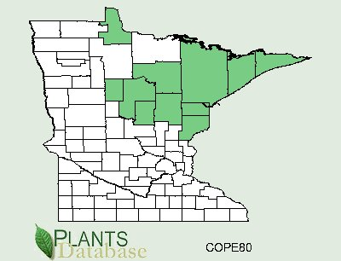
Geographical Distribution of Comptonia peregrina
http://plants.usda.gov/java/county?state_name=Minnesota&statefips=27&symbol=COPE80
http://www.discoverlife.org/mp/20q?search=Comptonia+peregrina

Slide 5
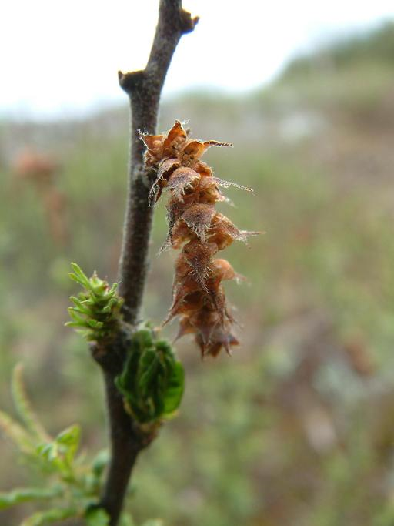
Comptonia peregrina “Sweet Ferns”
Half shrub up to 4 ft tall
Leaves alternate, and pinnately cut
Pubescent trichomes
Leaves are aromatic when crushed
The fruit is in catkins composed of a cluster of bur like nutlets
Stipules present
Monoecious
http://calphotos.berkeley.edu/cgi/img_query?query_src=dl&enlarge=0000+0000+0408+1562
http://calphotos.berkeley.edu/cgi/img_query?query_src=dl&enlarge=0000+0000+0408+1557

Slide 6
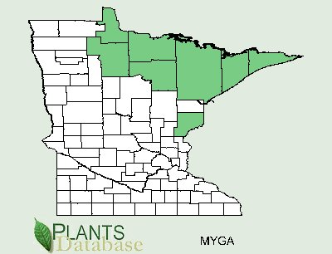
Geographical Distribution of Myrica gale
http://plants.usda.gov/java/county?state_name=Minnesota&statefips=27&symbol=MYGA
http://plants.usda.gov/java/profile?symbol=MYGA

Slide 7
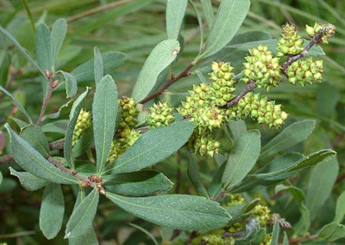
Myrica gale “Sweet Gale”
2-4 feet tall
Leaves alternate, obovate, entire or serrate-denticulate, more serrated at leaf apex, dotted with yellow glands
Water-dispersing seeds
Stipules absent
Catkins short with 2-6 bracts
Dioecious
http://www.silkmoths.bizland.com/Myricagale.jpg

Slide 8
References
Walters, Dirk., Keil, David., Murrell, Zack. 2006. Vascular Plant Taxonomy . 5th ed. U.S.: Kendall/Hunt. 180. Print.
N.A., 2002. “Discover Life”. Web. 26 Jan 2010. http://www.discoverlife.org/mp/20q?search=Comptonia+peregrina
Bornstein, Allen. "Myricaceae." Flora of North America. Web. 26 Jan 2010. <http://www.efloras.org/florataxon.aspx?flora_id=1&taxon_id=10594>.

