Slide 1
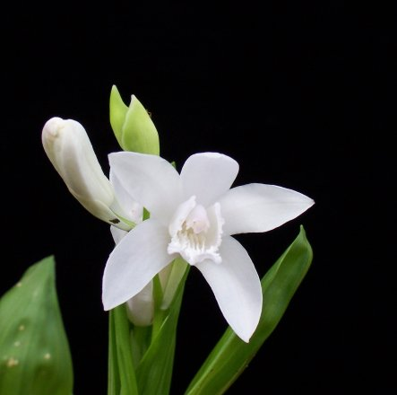
Orchidaceae
“The Orchid Family”

Slide 2
Orchidaceae
The largest family of the flowering plants. With 880 genera and anywhere from 26,000 to 30,000 species.
Perennial, terrestrial,tubes, of thickened rootstocks. Aerial stem often swollen at the base into pseudobulb, and often with adventitious or aerial roots.
Leaves usually entire (having a continuous smooth margin, lacking serrations), often distichous (arranged in two opposite rows so as to lie in one plane, e.g. Vanda spp.), sheathing at base, sometimes reduced to scales.
Flowers bisexual, zygomorphic, in spikes, inflorescences, or panicles, or solitary. Perianth mostly petaloid, of six segments in two whorls, free or variously connate, occasionally joined to form a tube; the middle segment in each whorl usually different from the two lateral ones, the middle petal or labellum often differing greatly in size, shape or outgrowths (calli) from the others and usually directed downwards

Slide 3
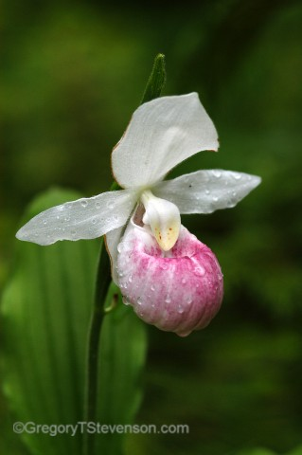
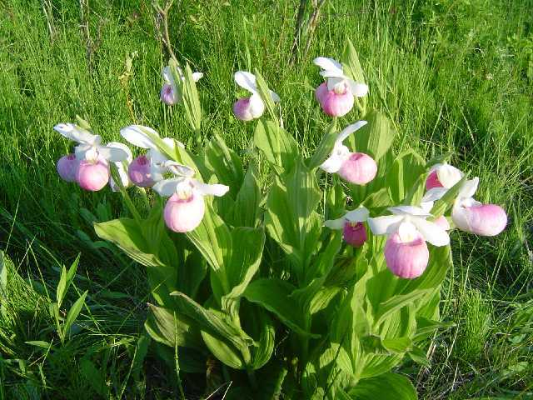
Showy lady's slipper (Cypripedium reginae)
Minnesota’s state flower. Native perennial, 1-2', in fens, swamps, drainages. Flowers, 1-3 on a stalk, have a large white and pink pouch with narrow, white petals. Blooms in June-July. The scientific name means “queen’s slipper.” The hairs on the large, veiny leaves and stalk of this and other Cypripediums may cause severe rashes.

Slide 4
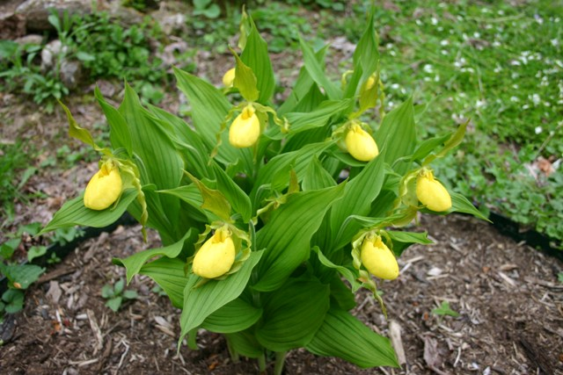
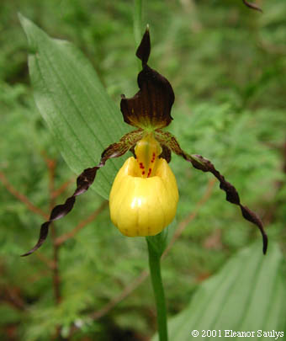
Yellow Lady Slipper (Cypripedium calceolus)
Alternate, sheathing stem leaves up to 9cm wide, parallel veins, hairy above and below. Flowers are large, yellow “lady’s slippers” with three long, twisted, brown bracts.

Slide 5
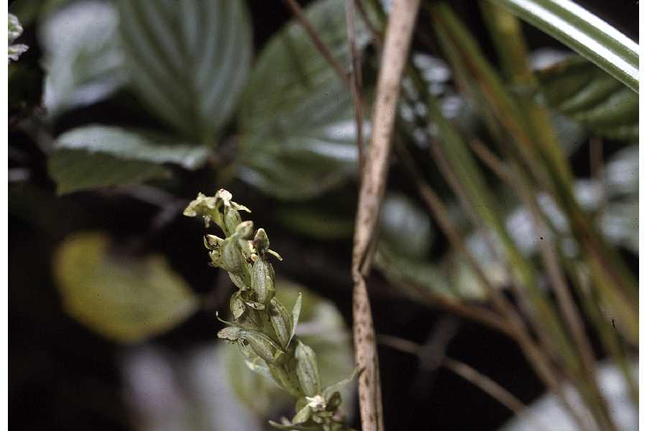
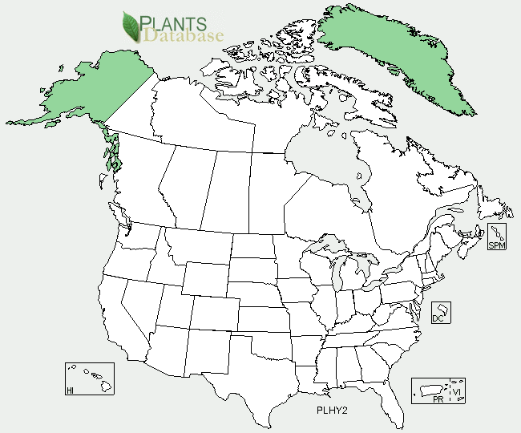
Tall Northern Bog-Orchid (Habenaria hyperborea=Plantanthera hyperborea)

Slide 6
References
http://en.wikipedia.org/wiki/Orchidaceae
http://www.naturemoncton.org/images/Showy%20Lady%27s%20Slipper1.jpg
http://www.dnr.state.mn.us/wildflowers/showyladysslipper.html
http://www.gardensoftheblueridge.com/native_orchids.htm
http://www.ct-botanical-society.org/galleries/cypripediumparv.html
http://plants.usda.gov/java/profile?symbol=PLHY2

