Slide 1
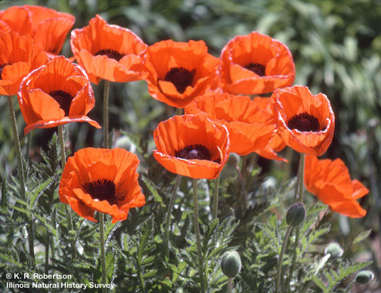
Papaveraceae The Poppy Family
Kathy Germann
http://www.life.illinois.edu/help/digitalflowers/picts/Papaveraceae/07-%20Papaver%20flowers.jpg

Slide 2
Family Characteristics
44 genera and 760 species
Mostly comprised of herbaceous plants
Plants in this family are commonly used in gardens and medicine
Most species are in the Northern Hemisphere
They have a paracarpous gynoecium (see next slide)

Slide 3
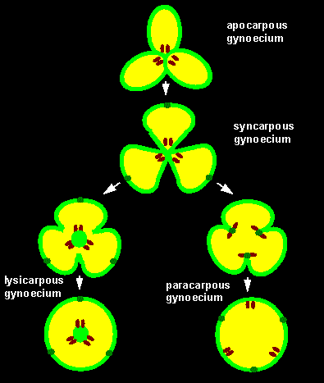
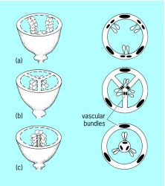
What is a paracarpous gynoecium?
(a) parietal, (b) axile, and (c) free central
Theorized evolution of gynoecium

Slide 4
Sanguinaria canadensis Bloodroot
This is the only species in the genus Sanguniaria
Habitat is usually woods
Height 6 to 12 inches
Flower color is white and they flower in March to May
The flowers only last a short time then are replaced by the fruit
When the roots are injured they produce blood red sap, hence the name.
Some people use of the roots of this plant is to treat ringworm, warts, polyps and other things
It has been FDA approved for use in toothpaste and mouthwash; however, if used improperl,y it can be toxic and the juice of the is escharotic (basically it is corrosive)

Slide 5
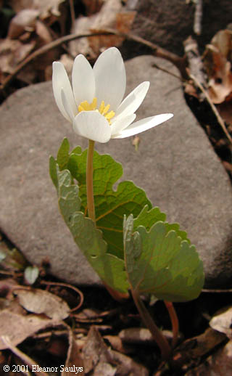
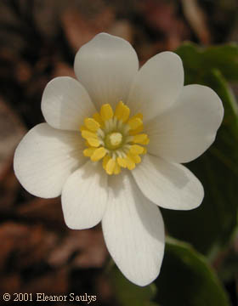
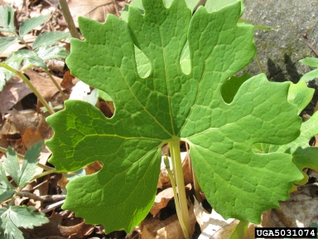
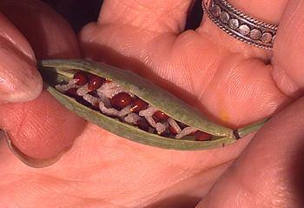
http://www.forestryimages.org/browse/detail.cfm?imgnum=5031074
http://www.ct-botanical-society.org/galleries/sanguinariacana.html

Slide 6
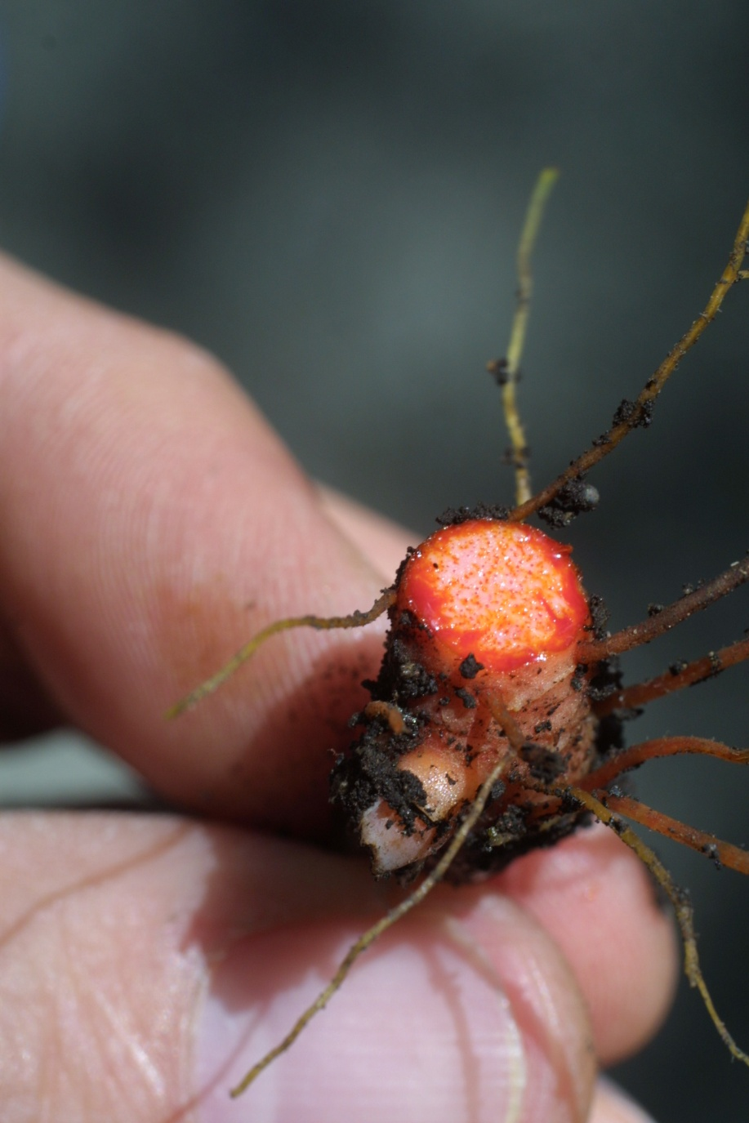
References
http://www.britannica.com/EBchecked/topic/441900/Papaveraceae
http://www.ct-botanical-society.org/galleries/sanguinariacana.html
http://images.google.com/imgres?imgurl=http://img.tfd.com/mgh/ceb/thumb/Placentation-a-parietal-b-axile-and-c-free-central.jpg&imgrefurl=http://encyclopedia2.thefreedictionary.com/flower&usg=__TNMPq6kjo1VwWQv--VZgR7DiHdA=&h=250&w=222&sz=13&hl=en&start=10&um=1&itbs=1&tbnid=IrLFgJtXYWwcCM:&tbnh=111&tbnw=99&prev=/images%3Fq%3Dapocarpous%2Bgynoecium%26um%3D1%26hl%3Den%26sa%3DN%26rlz%3D1G1GGLQ_ENUS275%26tbs%3Disch:1
http://www.biologie.uni-hamburg.de/b-online/ge02/16.gif
https://pantherfile.uwm.edu/hoot/www/papav.html

