Slide 1
Poaceae The Grass Family
Alex Stalboerger

Slide 2
Poaceae
900 Genera
9,000 – 10,000 species of “true grasses”
Monocot, flowering plants
Comprise 20% of vegetation on Earth
Considered the most important family in respect to Human economy, used for agriculture, lawn foliage, forage grasses, etc.

Slide 3
Poaceae Characteristics
Grasses have hollow stems called culms, which are plugged in intervals called nodes.
Leaves are alternate, distichous (one-planed), rarely spiral, and are parallel-veined.
Each leaf is differentiated into a lower sheath which hugs the stem for a distance
Blades usually have entire margins

Slide 4
http://en.wikipedia.org/wiki/File:Grass-plant-structure.png

Slide 5
Poaceae Characteristics
Flowers of Poaceae are arranged in spikelets, each having one or more florets.
Spikelet consists of two, or fewer, bracts at the base, called glumes, followed by one or more florets.
Parianth reduced to two scales, called lodicules, that expand and contract to spread the lemma and palea (interpreted both as modified sepals)

Slide 6
http://en.wikipedia.org/wiki/File:En_Anatomia.png

Slide 7
Poaceae Growth
Three general classifications of growth habit present in grasses: bunch types (caespitose), stoloniferous, and rhizomatous.
Two physiological groups C3 and C4
Determined by metabolic pathway of photosynthetic efficiency
C3 ex. Wheat, Rye, Oat
C4 ex. Corn, Pearl millet, Big Bluestem

Slide 8
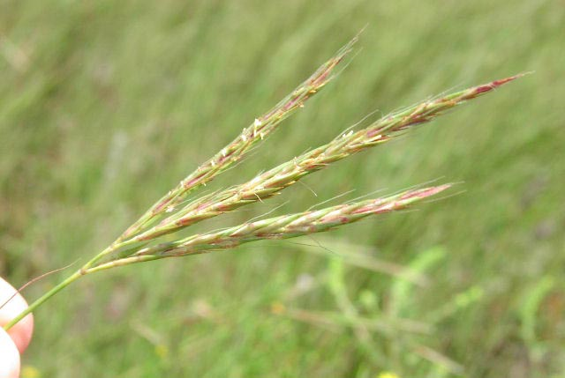
Andropogon gerardii – Big Bluestem
Perennial
4-8ft tall
Seedhead usually branched into three parts and resembles a turkey’s foot.
http://www.google.com/imgres?imgurl=http://www.sbs.utexas.edu/bio406d/images/pics/poa/Andropogon%2520gerardii%2520infl1.jpg&imgrefurl=http://www.sbs.utexas.edu/bio406d/images/pics/poa/andropogon_gerardii.htm&usg=__IwsLgW1DTHrztOs0ykdMAxUOu84=&h=429&w=640&sz=35&hl=en&start=1&itbs=1&tbnid=o5N3hkn7IWm9hM:&tbnh=92&tbnw=137&prev=/images%3Fq%3Dandropogon%2Bgerardii%26hl%3Den%26gbv%3D2%26tbs%3Disch:1

Slide 9
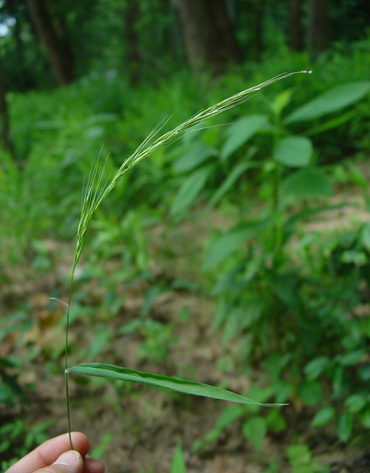
Brachyelytrum erectum – Bearded shorthusk
Perennial
1-2ft tall
Upper leaf surface is hairless but lower margin is slightly hairy
http://www.missouriplants.com/Grasses/Brachyelytrum_erectum_page.html

Slide 10
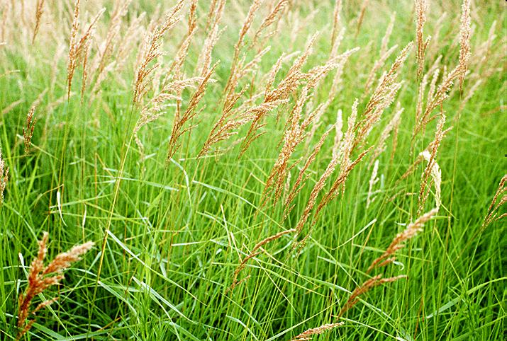
Calamagrostis canadensis - Bluejoint
Perennial
3-5ft tall
Many slender stems arise from small rhizomes
Each topped with large, slightly nodding, branched inflorescence.
http://www.google.com/imgres?imgurl=http://botit.botany.wisc.edu/images/veg/Wet_Prairie/Calamagrostis_canadensis_VK.jpg&imgrefurl=http://botit.botany.wisc.edu/images/veg/Wet_Prairie/Calamagrostis_canadensis_VK.php%3Fhighres%3Dtrue&h=482&w=715&sz=105&tbnid=HHc8EFi2qUXQlM:&tbnh=94&tbnw=140&prev=/images%3Fq%3Dcalamagrostis%2Bcanadensis&hl=en&usg=__gTfWUxxQd6LGfnGkvJtGpGCjdYQ=&ei=KKvVS8TmHoSCNuPd9dID&sa=X&oi=image_result&resnum=1&ct=image&ved=0CA0Q9QEwAA

Slide 11
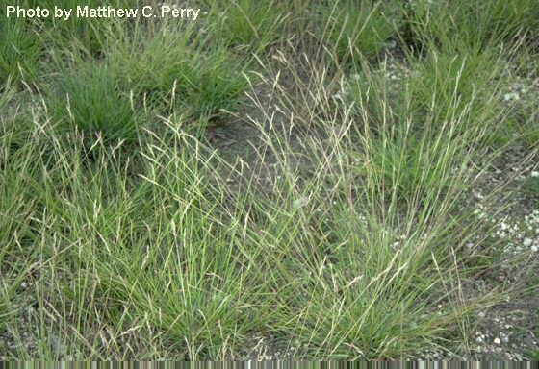
Danthonia spicata – Poverty grass
Perennial
1-1.5ft tall
Blades 5” long, often curving left or right
Small tuft of hairs at apex of sheath
http://www.google.com/imgres?imgurl=http://www.mbr-pwrc.usgs.gov/herbarium/danthonia_spicata.jpg&imgrefurl=http://www.mbr-pwrc.usgs.gov/herbarium/danthonia_spicata.htm&h=384&w=560&sz=44&tbnid=WRPpEteB7eaLZM:&tbnh=91&tbnw=133&prev=/images%3Fq%3Ddanthonia%2Bspicata&hl=en&usg=__rRFvq2zFPBm1nlcGRJs4M1jqoLs=&ei=5qvVS_TCCJWINM_r6NcG&sa=X&oi=image_result&resnum=4&ct=image&ved=0CA4Q9QEwAw

Slide 12
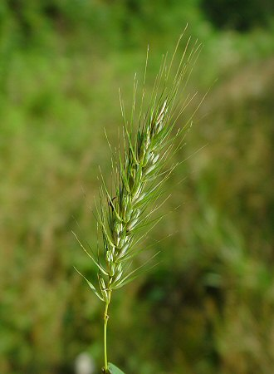
Elymus virginicus – Virginia wild rye
Perennial
2.5-4ft tall
Each leaf is 2/3” wide and 1ft long, shortly pubescent
Floral spikes are 2-6” tall and erect
http://www.missouriplants.com/Grasses/Elymus_virginicus_inflorescence.jpg

Slide 13
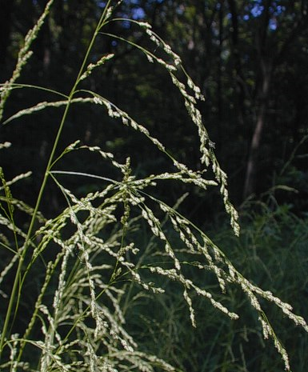
Glyceria striata – Fowl manna grass
Perennial
2-3.5ft tall
6 alternate leaves along its length
Tendency to drupe downwards
http://www.illinoiswildflowers.info/grasses/plants/fm_grass.htm

Slide 14
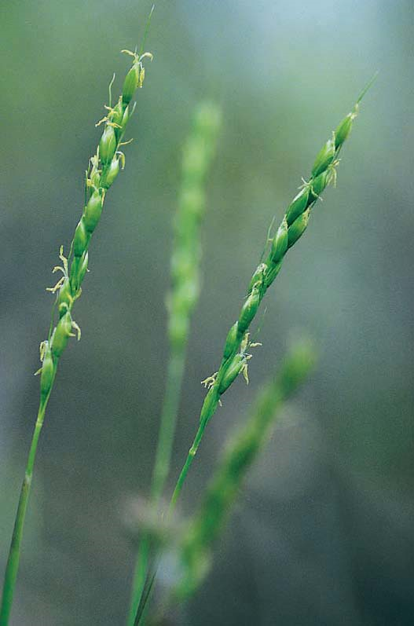
Oryzopsis asperifolia – Mountain rice grass
Perennial
20-70cm tall
Most leaves at stem base, 3-10mm wide, tape at both ends
Hairy fringes at ends
Simple, few-flowered, spike-like panicle
http://www.agf.gov.bc.ca/range/RangeID/Images/oryzopsis%20asperifolia1.jpg

Slide 15
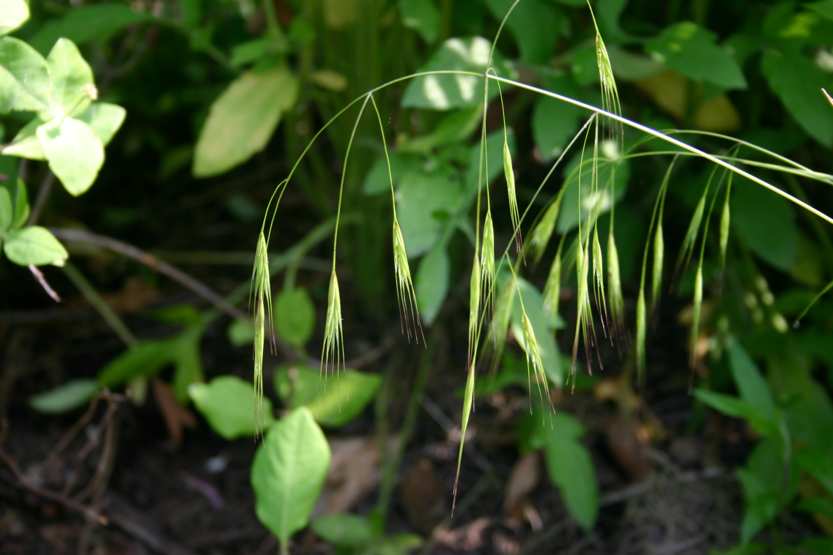
Schizachne purpurascens – False melic grass
Perennial
40-80cm tall
Leaves 1-6mm wide, narrow at base, sheaths closed at first but split at maturity
Drupes at stem inflorescens
http://upload.wikimedia.org/wikipedia/commons/e/e7/Schizachne_purpurascens_flowers_001.JPG

Slide 16
Sources
http://en.wikipedia.org/wiki/Poaceae
www.borealforest.org
plants.usda.gov
All images cited at base

