Slide 1
PolemoniaceaE
The Phlox Family

Slide 2
POLEMONIACEAE
Family Description: Herbs or shrubs (rarely woody vines or trees).
Leaves alternate or opposite, simple to variously divided or compound, estipulate.
Plants synoecious (i.e., all flowers on the plant are perfect).
Inflorescence variously cymose, sometimes corymbiform or headlike, or flowers solitary.
Flowers perfect, regular (occasionally irregular).
Sepals 5, connate, the membrane connection adjacent sepals often transparent or translucent.
Petals 5, connate.
Stamens 5, alternate with petals; filaments adnate to corolla.
Carpels 3 (2-4), connate; ovary superior with 3 (2-4) locules and 1-many axile ovules or with 1 locule and 3-many parietal ovules; style 1, entire or 3 (2-4) branched.
Fruit is a capsule.

Slide 3
POLEMONIACEAE
Family Notes
18-20 genera and 300 species
Most occur in the New World and the family is particularly well represented in the arid regions of the American southwest. More than half the species in the family occur in California.
Most temperate members of the family are herbaceous plants, and many of these are annuals.
The tropical American members of the Polemoniacea include trees, shrubs and woody vines.

Slide 4
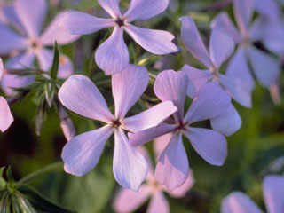
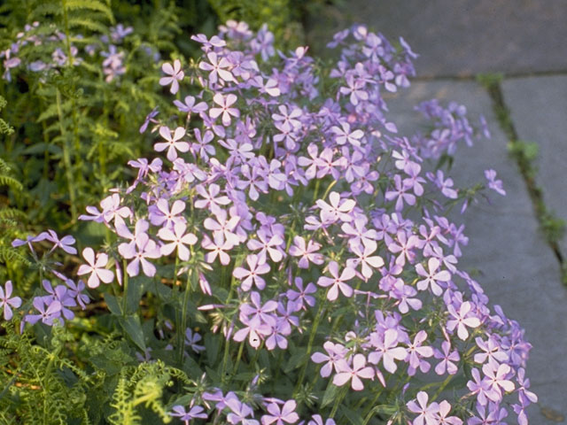
Phlox divaricata “The Blue phlox”
Plant Characteristics
Duration: Perennial Habit: Herb Leaf Retention: Evergreen Size Class: 0-1 ft. Fruit Type: Capsule Size Notes: 8 to 18 inches Leaf Color: Green Flower Size: up to 1 inch across
Bloom Information
Bloom Color: White , Red , Pink , Purple Bloom Time: Mar , Apr , May Bloom Notes: Normally blue, lavender, or white.
Native Habitat: Moist, rich, deciduous woods and bluffs
Growing Conditions
Water Use: Medium Light Requirement: Part Shade , Shade Soil Moisture: Moist Soil pH: Alkaline (pH>7.2) , Acidic (pH<6.8) CaCO3 Tolerance: High Soil Description: Rich, moist, acid soils, but also found in calcareous areas. Sandy, Sandy Loam, Medium Loam, Clay Loam, Clay

Slide 5
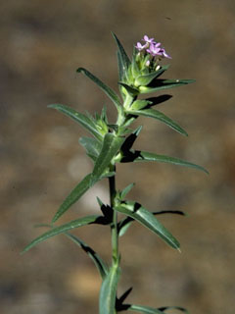
Collomia linearis
A phlox-like annual, 4-16 in. tall, with small, lilac to white, tubular flowers and narrow, lance-shaped alternate leaves. The slightly hairy stem may be simple or branched above. Several flowers occur in the axils of the crowded upper leaves, forming a dense, head-like cluster.
Plant Characteristics
Duration: Annual Habit: Herb Size Class: 1-3 ft.
Bloom Information
Bloom Color: White , Purple Bloom Time: May , Jun , Jul , Aug
Growing Conditions
Light Requirement: Part Shade Soil Description: Sandy or gravelly soils. Conditions Comments: Easy to cultivate.

Slide 6
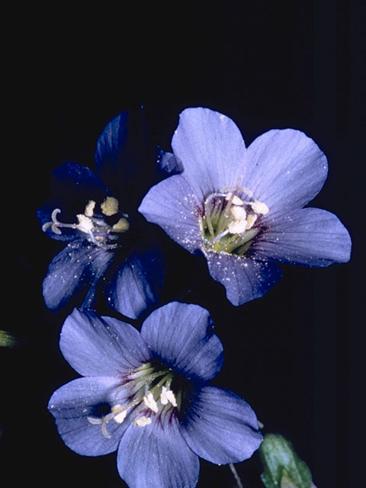
Polemonium reptans
The attractive, pinnately compound leaves and the loose flower clusters of this perennial arise on separate stalks. The stalks are slender and somewhat weak, rising 10-15 in. A smooth, weak-stemmed plant with light blue to purple, bell-shaped flowers in loose clusters. The large, bell-shaped flowers are blue or pink in color.
Plant Characteristics
Duration: Perennial Habit: Herb Size Class: 1-3 ft. Fruit Type: Capsule
Bloom Information
Bloom Color: Pink , Blue Bloom Time: Apr , May Native Habitat: Moist, deciduous woods; stream banks

Slide 7
References
© 2010 Lady Bird Johnson Wildflower Center http://www.wildflower.org/plants/result.php?id_plant=MECA3
Vascular Plant Taxonomy Fifth Edition Dirk R. Walters, David J. Keil, and Zack E. Murrell

