Slide 1
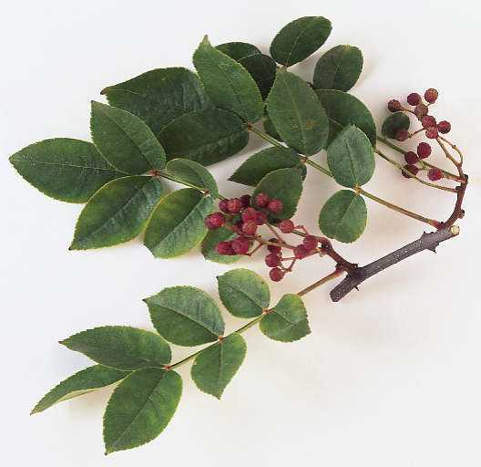
Rutaceae: The Rue Family
By: Josh Carlson
http://www.dkimages.com/discover/previews/869/20150594.JPG

Slide 2
Rutaceae
150 genera
1500 species
Also has many citrus trees in the family
Dicotyledonous
Found near wet areas: rivers, lakes, or valleys

Slide 3
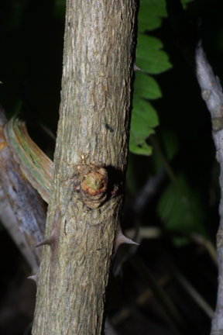
Zanthoxylum americana: Prickly Ash
Also known as toothache tree
Leaves: alternate, pinnateley compound, up to 11 leaflets
Leaflets: ovate (p.33) up to 3 inches
Bark: spines 5-15 mm
http://www.cas.vanderbilt.edu/bioimages/species/zaam.htm#Bark

Slide 4
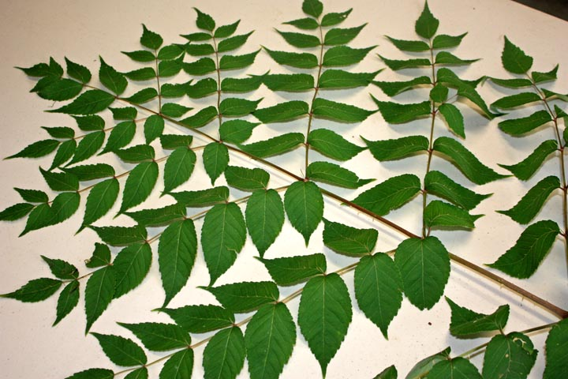
http://natlands.typepad.com/.a/6a00d8341d654453ef0120a5c2ceb4970c-800wi

Slide 5
References
Rutaceae, http://www.botany.hawaii.edu/Faculty/Carr/rut.htm,
Zanthoxylum americanum P. Mill., http://www.biosurvey.ou.edu/shrub/zant-ame.htm, 9/23/99
Vascular Plant Taxonomy, Fifth Edition, Dirk R Walters. David J Keil. Zack E Murrell, 2006

