Slide 1
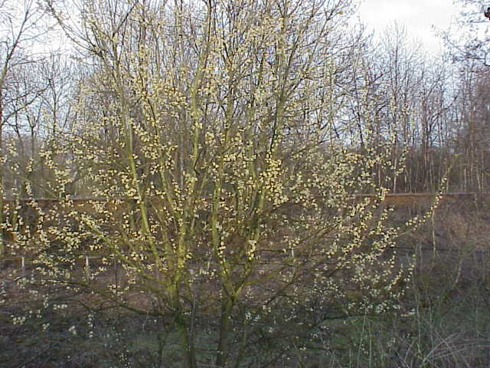
Salicaceae(The Willow Family)

Slide 2
Salicaceae
The Salicaceae consists of only two genera, Salix (willow) and Populus (aspen, poplar, and cottonwood.
The family is mostly north temperate in its distribution with a few species extending into the tropics and south temperate lattitudes in South America and Africa. It is absent from the Australian region.
All are dioecious trees or shrubs with imperfect flowers borne in catkins.

Slide 3
Description and Information
Any shrub or tree of the genus Salix, family Salicaceae, native mostly to northern temperate regions, and common in lowland and marshy areas. Willows are valued as ornamentals and for their shade, erosion control, and timber. Certain species yield salicin, the source of salicylic acid used in pain relievers. All species have alternate, usually narrow leaves, catkins, and seeds with long, silky hairs.
Catkins-A spike-like or racemelike inflorescence of apetalous stamnate or pistillate flowers, often with scaly bracts and wind pollination. Catkins are often lax and drooping.

Slide 4
Balsam poplar(Populus balsamifera)
Tree, with alternate, simple, ovate-lanceolate leaves with small rounded teeth and bronze-glutinous below. Buds are sticky and fragrant. Flowers in catkins, the females producing small seeds with cottony hairs.
Plant Characteristics
Duration: Perennial Habit: Tree Size Class: 36-72 ft. Leaf Color: Yellow-Green Autumn Foliage: yes Fruit Color: Brown

Slide 5
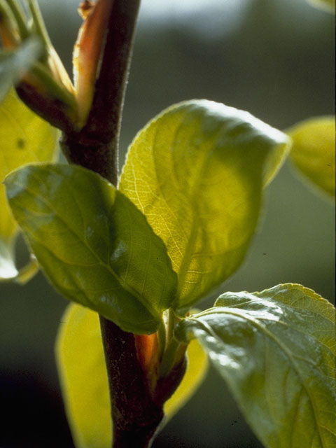
Balsam poplar

Slide 6
Cottonwood (Populus deltoides)
Tree, with alternate, simple, triangular leaves with coarse teeth, the leaf base straight across flattened petiole. Flowers in catkins, the females producing small seeds with cottony hairs.
Plant Characteristics
Duration: Perennial Habit: Tree Size Class: 12-36 ft. Fruit Type: Capsule Leaf Color: Green Autumn Foliage: yes Fruit Color: Yellow, Green

Slide 7
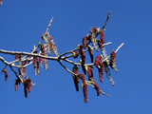
Cottonwood (Populus deltoides)

Slide 8
Peach-leaved willow (Salix amygdaloides)
Tree with alternate, simple, ovate-lanceolate leaves with long narrow tips, green above and pale green (glaucous) and hairless below. Twigs green-yellow, maturing to brownish branchlets.
Plant Characteristics
Duration: Perennial Habit: Tree Size Class: 36-72 ft. Breeding System: Dioecious Fruit Type: Capsule Leaf Color: Green Fruit Color: Red

Slide 9
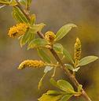
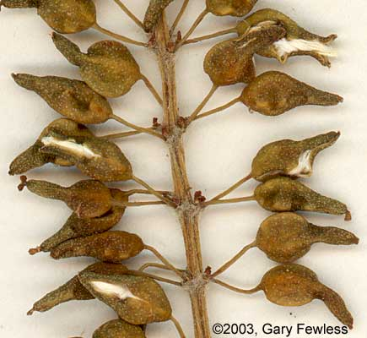
Peach-leaved willow

Slide 10
References
© 2010 Lady Bird Johnson Wildflower http://www.wildflower.org/plants/result.php?id_plant=POBA2 Center
Vascular Plant Taxonomy Fifth Edition Dirk R. Walters, David J. Keil, and Zack E. Murrell.
http://www.uwgb.edu/biodiversity/herbarium/trees/salamy_young_leaves01_web.jpg

