Slide 1
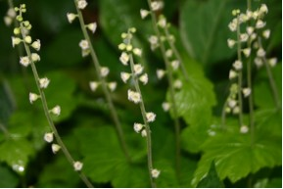
http://www.synodresourcecenter.org/pg/devotions/0007/0041/index.html
Saxifragaceae
“Saxifrage Family”

Slide 2
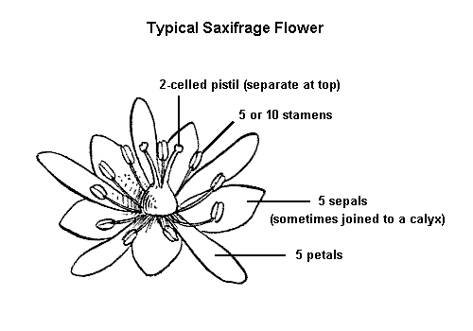
Saxifragaceae
Dicot
30-41 genera
300- 700 species
Most of perennial herbs, some subshrubs
Usually grow in rocky places (“stone-breaker”)
Usually have a whorl of basal leaves that lack stipules
Leaves often palmately veined and lobed
Usually 5-merous , sometimes 4-merous
Flowers usually perfect and regular
Usually petaloid-distinct petals and sepals but appearance of colors and textures is similar
http://montana.plant-life.org/families/Saxifragaceae.htm

Slide 3
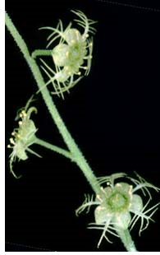
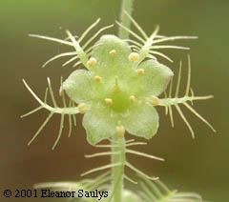
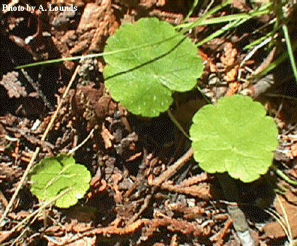
Mitella nuda – naked miterwort
Low, colonial herb
Plant height is ~0.07-0.2 meters (3-8 inches)
Round, coarsely toothed, basal leaves
Leaves are palmately veined
“Naked” comes from the leafless stem
Flowers are a pale green
Found in rich woods in cool areas
http://www.ct-botanical-society.org/galleries/mitellanuda.html
http://www.deq.state.mi.us/pw/Mitnud.shtml
http://www.borealforest.org/herbs/herb24.htm

Slide 4
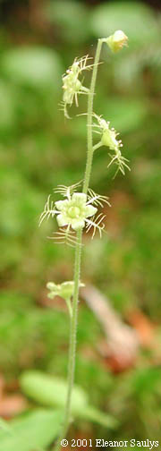
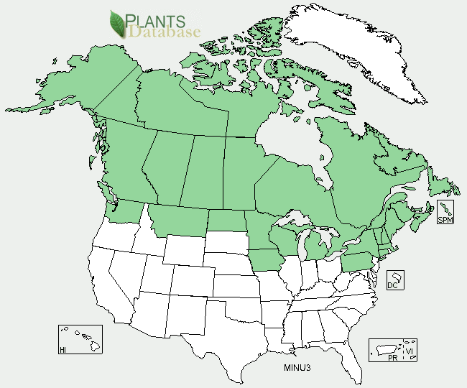
http://www.ct-botanical-society.org/galleries/mitellanuda.html
Mitella nuda – naked miterwort
Listed as species of special concern in Connecticut
Listed as an endangered species in Pennsylvania
http://plants.usda.gov/java/profile?symbol=MINU3

Slide 5
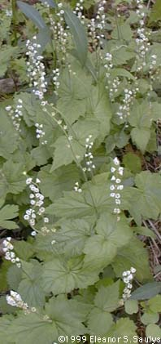
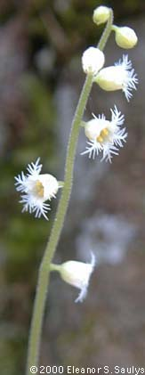
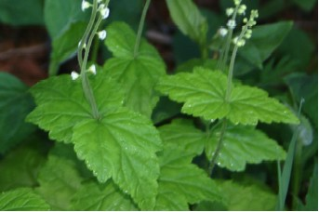
Mitella diphylla
– two-leaved miterwort
Low herb
Plant height is ~0.2-0.5 meters (8-18 inches)
Single pair of opposite sessile leaves on stem
Maple-like, basal leaves
Flowers are a white
5-20 flowers on a stem
Found in rich woods
http://www.ct-botanical-society.org/galleries/mitelladiph.html
http://www.synodresourcecenter.org/pg/devotions/0007/0041/index.html

Slide 6
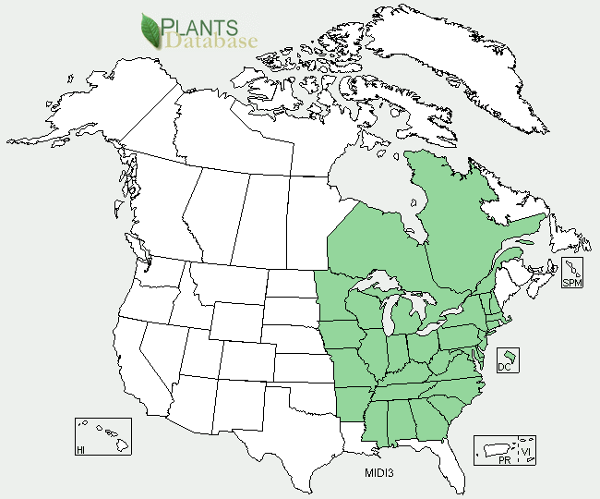
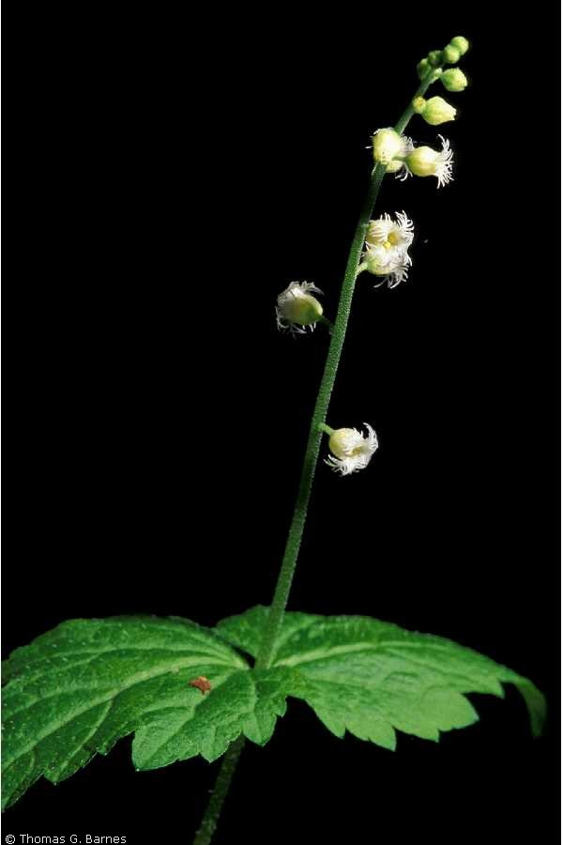
Mitella diphylla – two-leaved miterwort
http://www.plants.usda.gov/java/profile?symbol=MIDI3
http://www.plants.usda.gov/java/profile?symbol=MIDI3

Slide 7
References
Gleason, Henry A., Cronquist, Arthur. Manual of Vascular Plants of Northeastern United States and Adjacent Canada. 2nd ed. New York botanical Garden, Bronx, New York. pp 213-215.
Walters, Dirk R., Keil, David J., Murrell, Zack E. 2006. Vascular Plant Taxonomy. 5th ed. Kendall/Hunt Publishing Company, Dubuque, Iowa.
Picture references located near photos.

