Slide 1
Family
Scheuchzeriaceae
By Jerry Warmbold

Slide 2
Scheuchzeriaceae
Consists of 1 genus with 1 species
    Scheuchzeria palustris
  Found in the cooler regions of the northern hemisphere
  And in semi-aquatic environments

Slide 3
Scheuchizeria palustris
Leaves alternate and basal, simple and entire, linear, basally sheathing and ligulate, tubular with a pore at the tip
Synoecious
Raceme inflorescence
Flowers perfect, regular, 3 green sepals, 3 petals, 6 stamens, carpels 3 or 6 nearly distinct connate only at the base,
Ovaries superior with 1 locule, 2 plus basal ovules per carpel
Styles absent, stigmas sessile
Fruits are pod-like capsules in groups of 3
Notes:
Ligulate Strap-shaped.
Synoecious – male and female in same flower

Slide 4
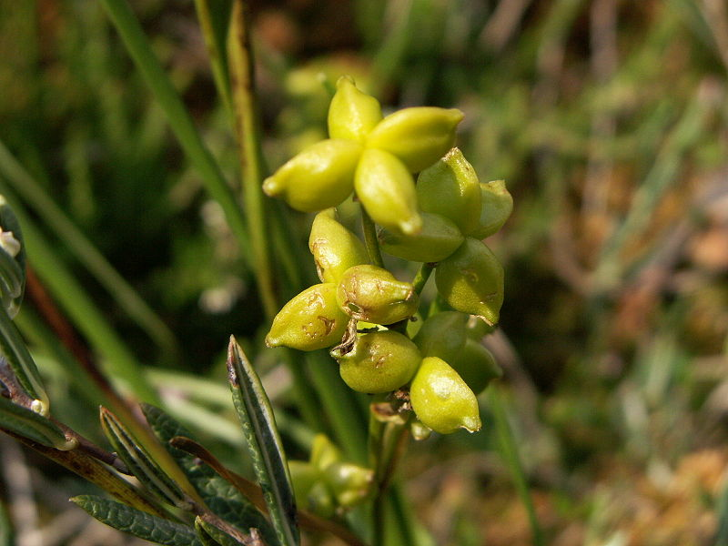
Scheuchizeria palustris
http://en.wikipedia.org/wiki/File:Scheuchzeria_pal_fruits.jpg

Slide 5
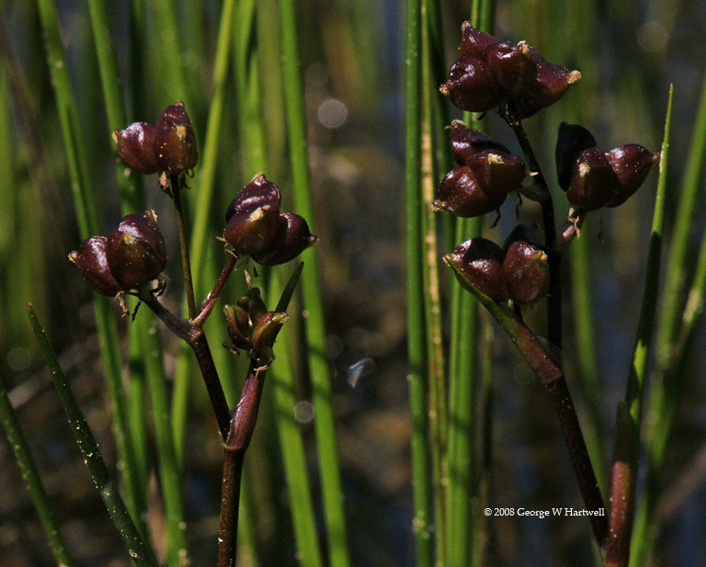
Scheuchizeria palustris
http://calphotos.berkeley.edu/cgi/img_query?query_src=dl&enlarge=0000+0000+0708+2132

Slide 6
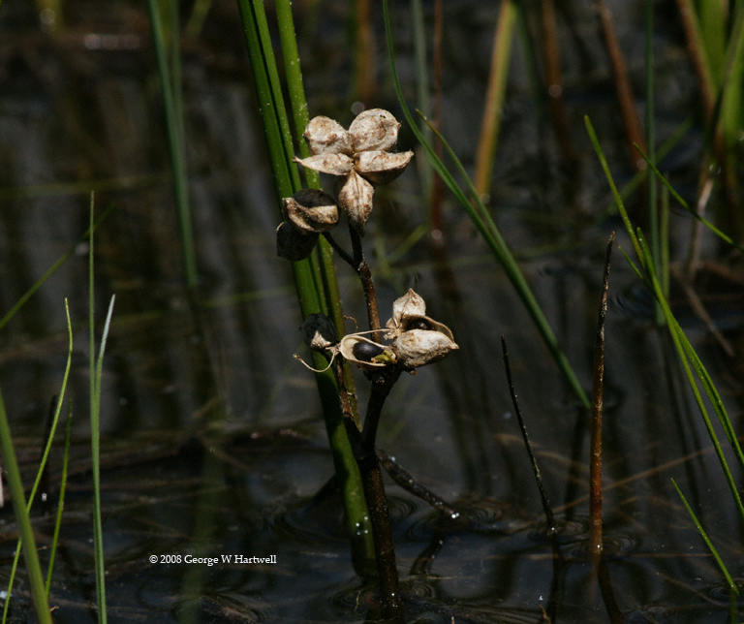
Scheuchizeria palustris
http://calphotos.berkeley.edu/cgi/img_query?query_src=dl&enlarge=0000+0000+0708+2131

Slide 7
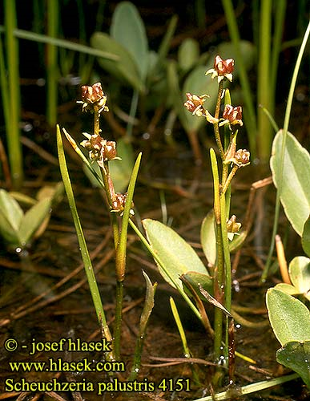
Scheuchizeria palustris

Slide 8
References
Walters, Dirk., Keil, David., Murrell, Zack. 2006. Vascular Plant Taxonomy . 5th ed. U.S.: Kendall/Hunt. 423. Print.

