Slide 1
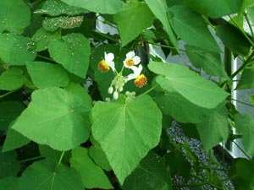
Tiliaceae The Linden Family
Ashlyn Kuklock

Slide 2
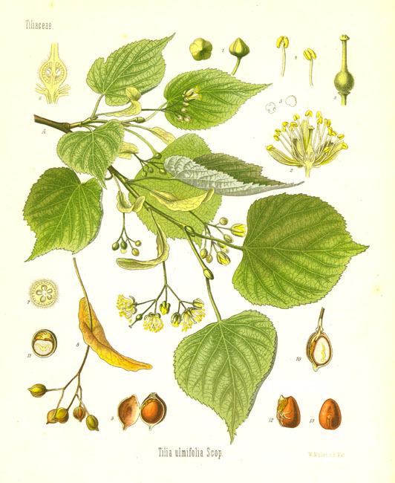
Tiliaceae…
-Are trees, shrubs, or rarely herbs
-Contain 50 genera and 450 species that are characterized by the presence of branched or star-shaped hairs
http://www.uvm.edu/~uvmwalks/3/plantimages/Tiliaamericana.jpg
http://www.google.com/imgres?imgurl=http://www.meemelink.com/prints%2520images/24005.

Slide 3
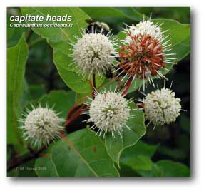
Leaf and Stem Anatomy
peltate
-Leaves have complex hairs that are peltate, stellate, or capitate
-Stomata present
-Mucus secreting epidermis
-Hairs are eglandular or glandular and unicellular or multicellular
-Stems have secretory cavities with mucilage
-Cork cambium that is responsible for secondary growth that replaces the epidermis is present
-Vascular tissue is in cylinder bundles
http://www.botany.wisc.edu/garden/UW-Botanical_Garden/garden_images_3/Tiliaceae.jpg
http://utc.usu.edu/factsheets/CarexFSF/CIG/platanus_capitate_inflor_lg.jpg

Slide 4
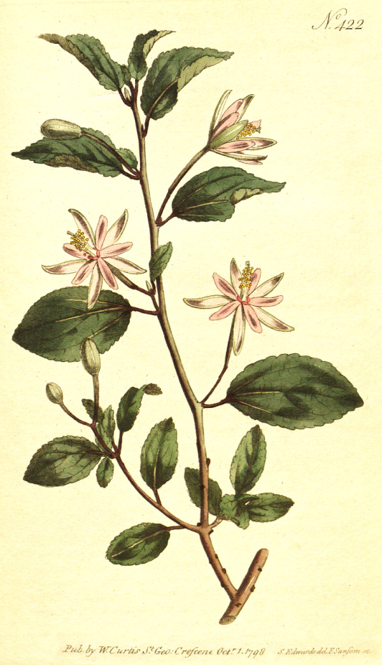
Flower and Fruit
Flowers are perfect
Usually 5 sepals
Normally 5 petals
The fruit is a capsule, a drupe, or a nut
http://florabase.calm.wa.gov.au/science/timage/f220ic1.jpg
http://delta-intkey.com/angio/images/bmag422.jpg

Slide 5
Tilia americana
-American basswood
-Native to eastern North America
The leaves are alternate
Flowers are yellowish-white
http://en.wikipedia.org/wiki/Tilia_americana

Slide 6
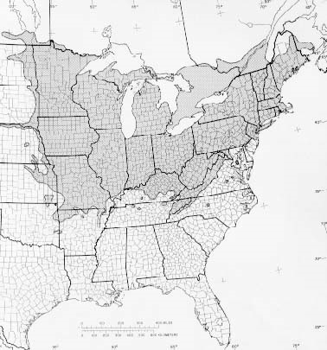
References
Watson,L. and Dallwitz, M.J. 1992. The families of flowering plants. 20 January 2010. http://delta-intkey.com
Sullivan, Janet. 1994. Tilia americana. Fire Effects Information System.U.S. Department of Agriculture, Forest Service, Rocky Mountain Research Station, Fire Sciences Laboratory http://www.fs.fed.us/database/feis

