Slide 1
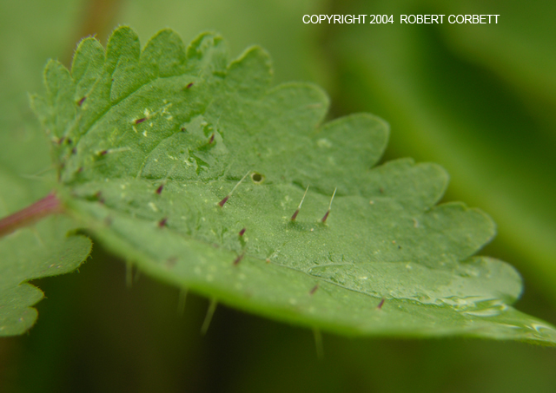
Urticaceae The Nettle Family
Urtica chamaedryoides
By Kathy Germann

Slide 2
Family Characteristics
45-48 genera, 700-1000 species
They are herbs, trees or shrubs sometimes with stinging hairs
Most of the members of the family are tropical, the genus most common in the north temperate zone is Urtica; these are the stinging nettles.
The needles that protect these plants penetrate the skin and break off, and then irritating fluid is injected beneath the skin
Flowers are small in inconspicuous and for the most part imperfect

Slide 3
Urtica dioica Stinging nettle
It grows to a height of 2-4 feet
It is shade tolerant and grows in flood plains, forests and along rivers.
It can be cooked and eaten like spinach because cooking softens the hairs and destroys the irritating fluid.
It is often used as a herbal remedy
You can buy dried leaves online for about $10 a pound or $15 a pound for certified organic leaves.

Slide 4
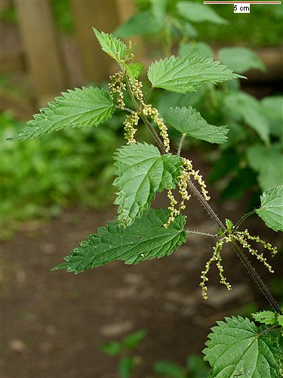
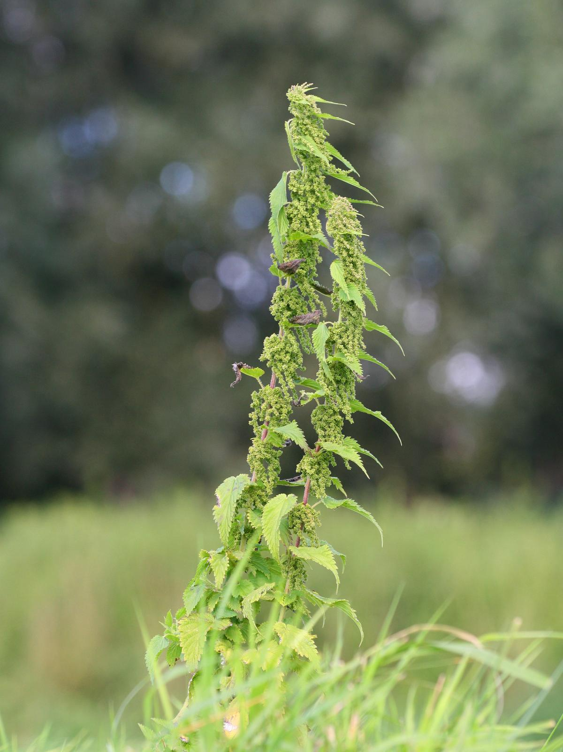
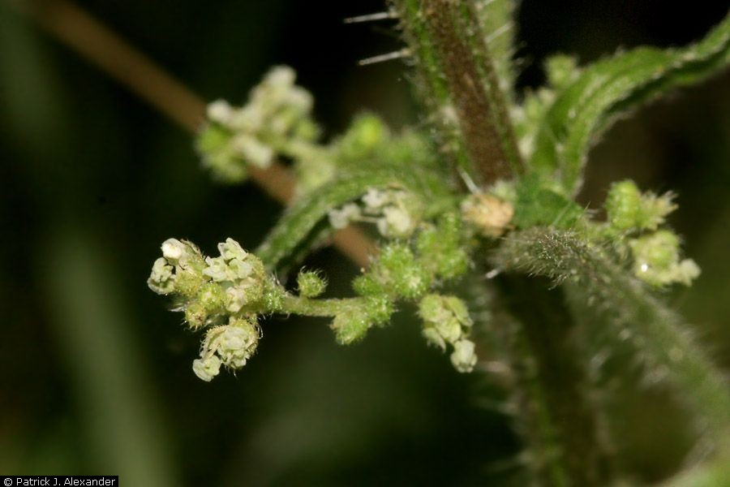
Urtica dioica
http://zufglobus.com/newsite/UserImages/herbs/urtica_dioica.jpg
http://upload.wikimedia.org/wikipedia/commons/c/c7/Urtica_dioica.jpeg
http://plants.usda.gov/java/largeImage?imageID=urdi_004_ahp.jpg

Slide 5
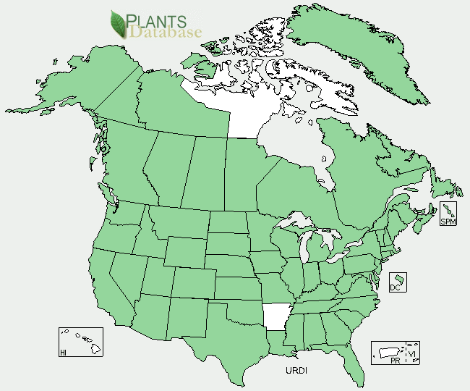
http://plants.usda.gov/java/profile?symbol=URDI&photoID=urdi_004_ahp.jpg

Slide 6
Refrences
http://www.blueplanetbiomes.org/stinging_nettle.htm
http://botany.cs.tamu.edu/FLORA/pic03/DSCN6122.JPG
Vascular Plant Taxonomy, Fifth Edition, Dirk R Walters, David J Keil, Zack E. Murrell, 2006

