Slide 1
Rates and Incidence of Unplanned and Unwanted Teenage Pregnancy and STDs
Allison Edmonds Cari Van Overbeke Carl Fjeld Crystal Smith Ishan Kodagoda Peiris Julia Mead Katelyn Fisher Lacey Nohrenberg Lance Pearson Scott Roepke

Slide 2
The Problem
Who
American teenagers and young adults (ages 13-25) affected by unplanned and unwanted pregnancies and STDs
Sex education programs that teach nothing about sex and methods of preventing pregnancy and STDs by any other means than abstinence
Parents who do not educate their children about sex
SR

Slide 3
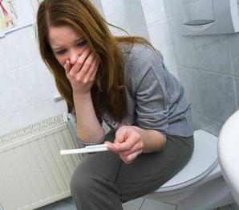
The Problem
What
Average American teenager and young adult are undereducated and unaware of the risks of being sexually active and the levels of sexual activity.
American teenagers and young adults cost American taxpayers for STDs and unplanned pregnancies.
LN

Slide 4
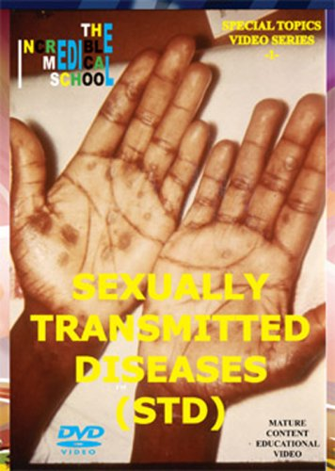
The Problem
What
An estimated 750,000 teenagers in the United States will become pregnant this year.¹
The age range 15 to 25 contract half of all the nation’s 19 million STIs¹
Cost of teen Pregnancy to the U.S. taxpayers is $9.1 billion a year²
In Minnesota in 2004 pregnancies of teenagers cost taxpayers $142 million³
STDs add an estimated $14.7 billion to the Nation’s healthcare costs each year
LN

Slide 5
The Problem
Where
Teen Birth Rate per 1000 by race (2006)
27 (Non-Hispanic White)
83 (Hispanics)
64 (Non-Hispanic Blacks)
55 (Native Americans)
17 (Asian/Pacific Islanders)
Teen Pregnancy Rates per 1000 by race (2005)
43 (Non-Hispanic White)
123 (African American)
125 (Hispanic)
LP

Slide 6
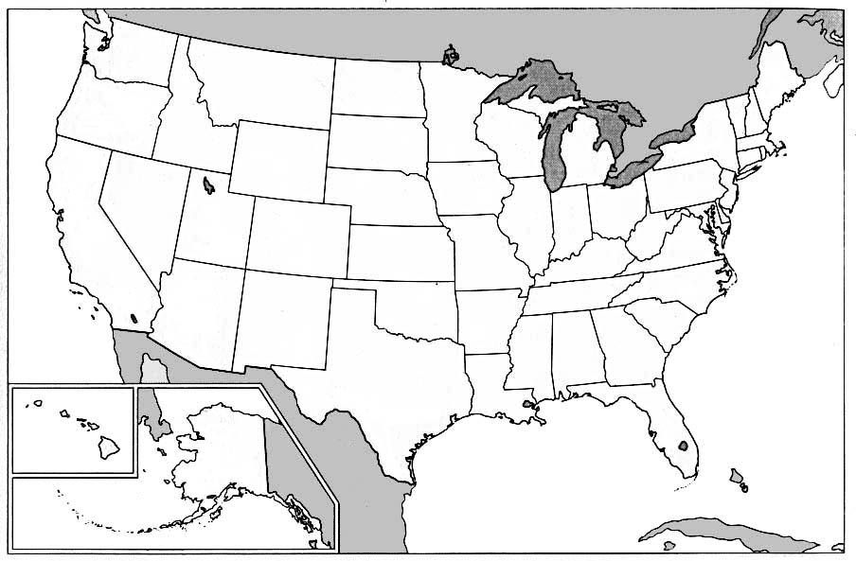
The Problem
Where
Teen Birth rate per 1000 (by state)
68.4 (Mississippi)
64.1 (New Mexico)
63.1 (Texas)
62.3 (Arkansas)
62.0 (Arizona)
24.9 (New Jersey)
23.5 (Connecticut)
21.3 (Massachusetts)
20.8 (Vermont)
18.7 (New Hampshire)
LP

Slide 7
The Problem
Where
Teen Pregnancy Rate per 1000
93 (New Mexico)
90 (Nevada)
89 (Arizona)
88 (Texas)
85 (Mississippi)
45 (South Dakota)
43 (Minnesota, Maine)
40 (Vermont)
33 (New Hampshire)
JM

Slide 8
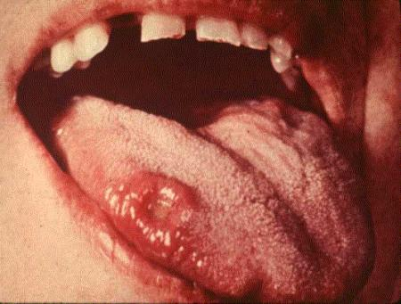
The Problem
Where
Teen Chlamydia per 100,000 by state
654.7 (Mississippi)
609.4 (Alaska)
482 (New Mexico)
457.2 (Guam)
422 (Hawai’i)
164 (Utah)
157.1 (West Virginia)
157.1 (Kentucky)
134.8 (New Hampshire)
92.5 (Puerto Rico)
LP

Slide 9
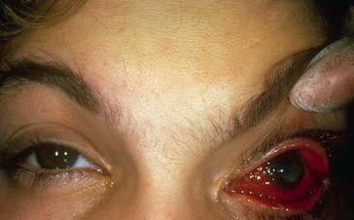
The Problem
Where
Teen Gonorrhea per 100,000 by state
248.6 (Mississippi)
234.4 (Louisiana)
221.1 (South Carolina)
182.3 (Alabama)
181.7 (Georgia)
11.8 (Wyoming)
10.8 (New Hampshire)
9.6 (Montana)
7.5 (Idaho)
6.9 (Puerto Rico)
JM

Slide 10
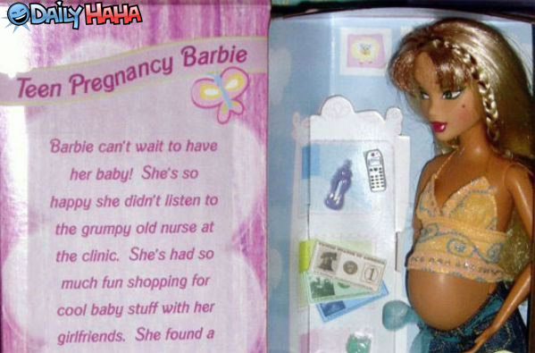
The Problem
When
Perception of teenage pregnancy as a problem has increased in the past several decades
teenage pregnancy rates have actually decreased.
Giving birth under age 20
1950s
90/1000
1978
52/1000
2002
53/1000
Average marriage age has increased and the number of intentional teen pregnancies has decreased⁵
SR

Slide 11
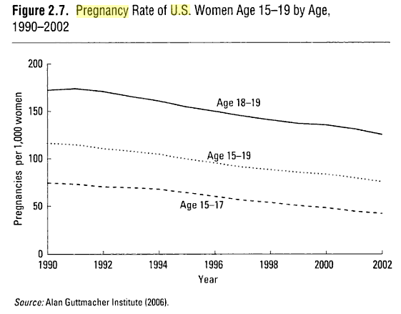
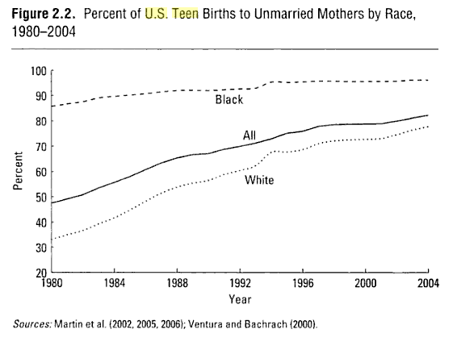
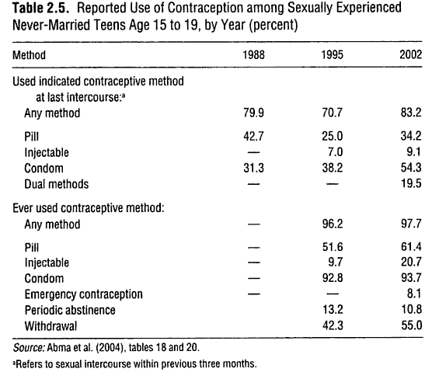
The Problem
When
KF

Slide 12
Media Influences
Increased access to mass media
“media influences accounted for 13% of the variance in intentions to have sexual intercourse in the near future” among adolescents⁵
Juno
MTV’s 16 and Pregnant
The Secret Life of the American Teenager
SR

Slide 13
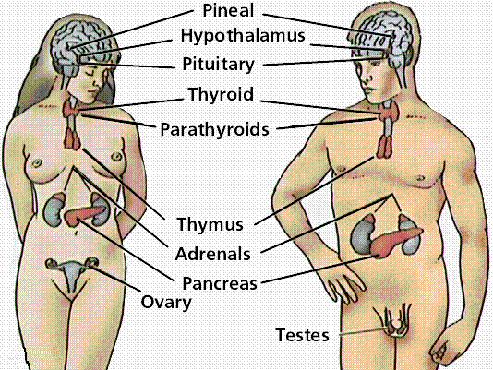
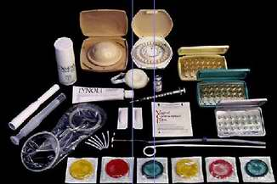
The Problem
Why⁸
Poor education about contraceptives
Tendency to live for the moment
Failure to use contraceptives because of feeling invincible
Poor education about STDs in general
Lack of support for teens with STDs to seek medical help
Poor education regarding the endocrine system
CS

Slide 14
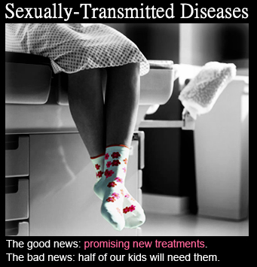
The Problem
Why
Abstinence only education is not working to prevent teen pregnancy or STIs/STDs
Lack of knowledge about help centers if a problem or question arises from sexual activity
Lack of support for pregnant teens to seek medical attention
Poor education about options for pregnant teens
AE

Slide 15
The Problem
How (does this affect the teens and society)
Associated with lower annual income for mother
80% of teen mothers must rely on welfare at some point
Teenage mothers are more likely to drop out of school
1/3 of teen mothers obtain a high school diploma.
Associated with increased rates of alcohol and substance abuse, lower educational level, and reduced earning potential in teen fathers
In the U.S., annual cost of teen pregnancies estimated at $7 billion⁶
Estimated in 2007 there were 2 million people under 15 living with HIV, and globally AIDS is the second most common cause of death among 20-24 year olds⁷
IKP

Slide 16
The Ideal State
The best way to help teens and young adults prevent STDs/STIs and unintended pregnancies is to provide them with comprehensive, medically accurate, age-appropriate information
The information will cover abstinence as well as contraception. This information will be provided in all public education institutions (high school and college levels)
In high schools the information will be incorporated into a mandatory health class with standardized test taken by all students to ensure the information is being provided correctly
Colleges will inform their students through their health centers or other related centers
The institutions that choose not include this information would have any funding cut which they receive from the federal or state governments¹
LN

Slide 17
Procedure of Treatment
Create a standardized sex education curriculum that includes all sexualities, choices, risks, and contraceptives and the risks and benefits of each contraceptive including abstaining from sex
Primary emphasis on abstinence
Provide information on the risks involved with various sexual behaviors
Provide information on STDs
Provide information on available contraceptives and where and how they may be obtained
Provide information about the endocrine system
Provide information on easily accessible help and/or counseling for pregnancies, STDs, and other issues arising from sexual activity
CS

Slide 18
Procedure of Treatment
Include the economic consequences to teen pregnancies and health care for treatment of STDs in the standardized sex education
Implement this standardized sex education in all schools
Provide parents with the same sex education material
Link governmental financial support to the teaching of this comprehensive, medically accurate, age-appropriate information.
Abolish laws that prohibit teachers to teach or guide students to the correct facilities that can help the student understand their choices
Emphasize the importance of encouraging young people who need assistance to the best places they can be helped
KF

Slide 19
Range of Application
Who IS included in this treatment strategy?
13-25 years old
Sexually active
Thinking about being sexually active
Contraceptive Non-users
AE

Slide 20
Range of Application
Who is NOT included in this treatment strategy
Elementary age students
Married/Life partner
Contraceptive Users
The elderly
AE

Slide 21
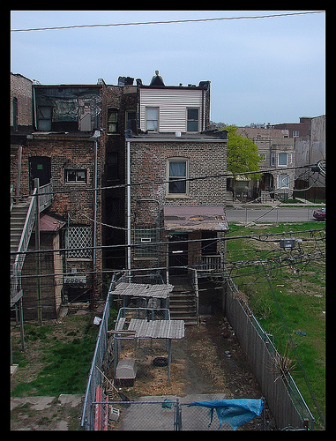
Unintended Consequences
Private schools may reject the curriculum
Religiously affiliated schools may reject curriculum
Parents may withdraw children from public schools
Teachers may refuse to present information on alternative sexualities
Students may object on moral grounds to the material
Students become more sexually active
High risk areas become stigmatized
SR

Slide 22
Success
Teen pregnancy and STD rates are similar to other first world countries
2004 Pregnancy Rates
U.S. 72/1000
Germany 18/1000
France 25/1000
Netherlands 13/1000
2004 Gonorrhea rates
U.S. 458/100,000
Netherlands 14/100,000
More sexually active teens using contraceptives
Fewer teens becoming sexually active or practicing safe sex
More teens getting tested for STDs
JM

Slide 23
Failure
Students becoming more sexually active
Teaches may refuse to teach alternatives, students could be ignorant about alternative sexualities
Students not retaining what is been taught or becoming over confident in sexual activity
More pregnancies
More STDs
Schools refraining from implementing the system.
Sexually active students dismiss curriculum because of primary emphasis on abstinence
Stigmatization of those who become pregnant or get STDs
IKP

Slide 24
Theoretical Support
Harrell W. Chesson, John M. Blandford, Thomas L. Gift, Guoyu Tao and Kathleen L. Irwin “The Estimated Direct Medical Cost of Sexually Transmitted Diseases Among American Youth” (2000)
Hillard Weinstock, Stuart Berman and Willard Cates, Jr. “Sexually Transmitted Diseases Among American Youth: Incidence and Prevalence Estimates” (2000)
Jonathan D. Klein, MD, MPH “Adolescent Pregnancy: Current Trends and Issues” (2005)
LN

Slide 25
Theoretical Support
⁵Kelly Ladin L’Engle, Ph.D., M.P.H., Jane D. Brown, Ph.D., and Kristin Kenneavy, M.A. “The mass media are an important context for adolescents’ sexual behavior” (2004)
SR

Slide 26
Other Sources
aasect (American Association of Sexuality Educators, Counselors and Therapists)
⁷Avert (International AIDS/HIV charity)
³Center for Disease Control and Prevention (National Prevention Information Network
⁸Guttmacher Institute
⁶Healthcommunities.com
Kids having Kids: Economic costs & Social Consequences of Teen pregnancy (Saul D. Hoffman and Rebecca A. Maynard) ©2008
Minnesota Department of Health
²The National Campaign (to Prevent Teen and Unplanned Pregnancy)
¹Planned Parenthood
Pregnant Teen Help (Teen Pregnancy Statistics, Prevention and Facts)
IKP

Slide 27
QUESTIONS?

