Slide 1
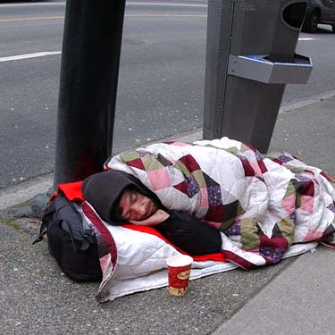
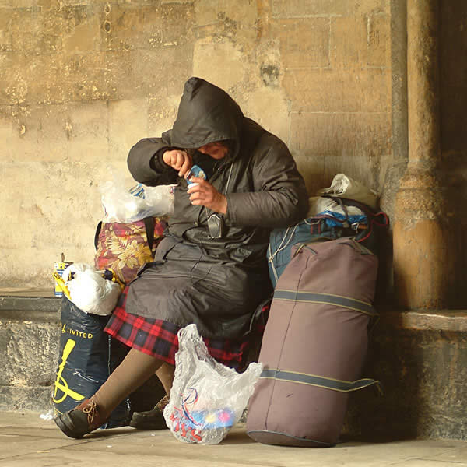
Preventing Homelessness: Early Intervention
Paruj Acharya
Ashley Cornwell
Nicole Grandalen
Kristen McCarren
Benjamin Meyer
Chelsie Peters
Bibek Rai
Sarah Violette
Jesse White

Slide 2
Statement of Problem: What
Homelessness in the Nation, State and Region.
The term “homeless” or “homeless individual” includes an individual who
(1) lacks a fixed, regular, and adequate nighttime residence; and
(2) has a primary nighttime residence that is
(a) a supervised, publicly or privately operated shelter designed to provide temporary living accommodations (including welfare hotels, congregate shelters, and transitional housing for the mentally ill),
(b) an institution that provides a temporary residence for individuals intended to be institutionalized, or
(c) a public or private place not designed for, or ordinarily used as, a regular sleeping accommodation for human beings.

Slide 3
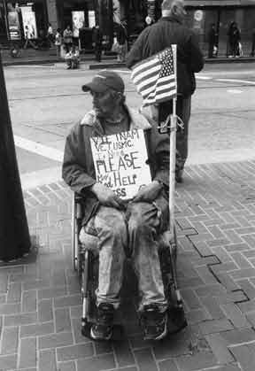
Statement of Problem: Who
Nation
The annual number of people experiencing homelessness in America is estimated between 2.3 and 3.5 million.
An estimated 671,888 people experienced homelessness in one night in January 2007.
Some 58% of them were sheltered in shelters and transitional housing and, 42%were unsheltered.

Slide 4
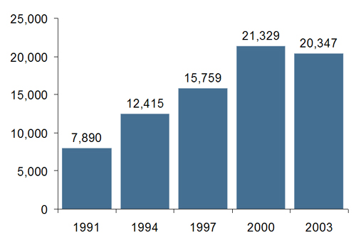
Statement of Problem: Who (Continued)
Minnesota
Each Night, approximately 9000 people experience
homelessness ( 2006), this number remains almost
unchanged since 2003
45% of the homeless are children, youths and young
adults under the age of 21
On any given night, between 550-650 unaccompanied youths are without permanent shelter, and over the course of a year, an estimated 10,000 to 12,000 youth s experience at least one episode of homelessness
89% of the homeless youth are enrolled in school
In a state that is 80% white, 38% of homeless adults, and 25% of homeless youth s are African American

Slide 5
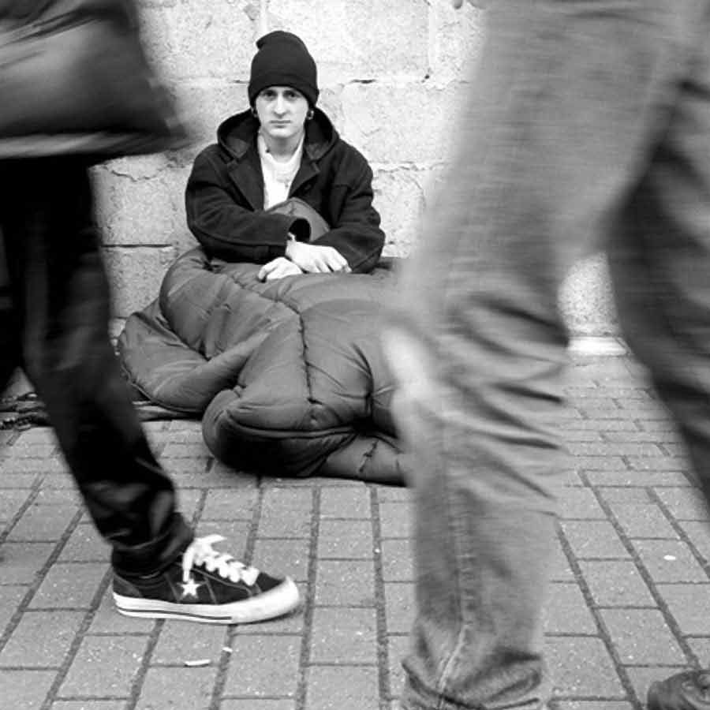
Statement of Problem: Who (Continued)
Fargo-Moorhead
The total homeless population identified in the Fargo-Moorhead area on October 26, 2006 was 587 persons (351 in Fargo & 236 in Moorhead). This is 49% higher than in 2003.
Men made up the majority of homeless adults in the area (64% in Fargo and 71% in Moorhead).
49 homeless parents had children with them.
24 youth (ages 13-17) & 33 young adults (ages 18-20), were homeless without a parent.

Slide 6
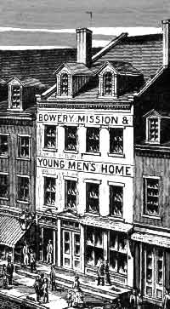
Statement of Problem: When
Rural area family homelessness has increased by 56% in the last year.
During economic recessions.
When the system fails.
So basically it happens all the fucking time.

Slide 7
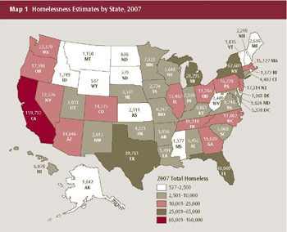
Statement of Problem: Where
Homelessness is a social problem that affects the United States as a whole.
The homelessness in Minnesota and the rest of the country share similar traits.

Slide 8
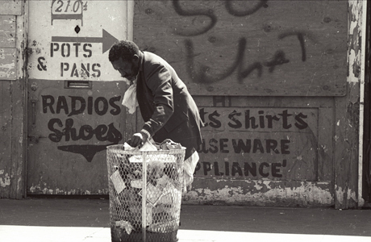
Statement of Problem: Why
There are many reasons why people become homeless, including:
Loss of employment
Long-term illness
Domestic violence
Lack of affordable housing
Lack of preventative services to keep people from losing their housing
Inadequate treatment programs for those suffering from substance abuse and mental illness

Slide 9
Statement of Solution
Early Intervention
should be offered to every homeless individual. This strategy will allow individuals to gain assistance before their situation becomes chronic.
will be aimed to prevent homeless students from dropping out of school and joining the homeless sub-culture.
should target people who have high risk levels.
promises to avoid or reduce the significant costs associated with homelessness.
seeks to equip parents with the skill as well as desire to create and maintain a sound family environment for their children. Hence, reducing the risk of them running away.

Slide 10
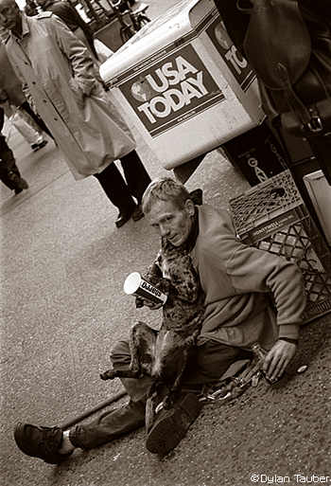
Procedure of the Solution
Provide: counseling, support, transportation, mentoring, advocacy, and group work.
Assist with: links in the community (jobs), minimize exposure to high-risk situations and address immediate issues leading to homelessness.
ND & MN have a law from October-April cannot turn off heat in apartments
Increase minimum wage so those who are working can actually live off their paychecks
Access to a yearly check-up/doctor appointments

Slide 11
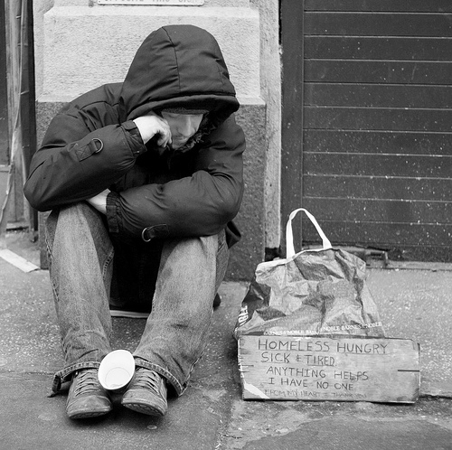
Parent Conceptual Themes
Johnson, Guy, & Chamberlain, Chris 2008. From youth to adult homelessness. The Australian Journal of Social Issues Vol. 43 (No.4): 563-578. (This article focuses on the effects of prolonged exposure to homelessness. The social adaptation argument proposes that the longer people are homeless the more likely they adapt to homelessness as a way of life. Four connected
propositions are common to the social adaptation
argument. These include: the establishment of new
social ties, the range of sites where homeless people
become involved in the homeless sub-culture, the
strategies learned from other homeless people that
help them survive, and the likelihood of sleeping
rough.)

Slide 12
Parent Conceptual Themes (Continued)
Wireman, Kenneth R. 2007. Preventing homelessness: A consumer perspective. J Primary Prevent Vol. 28:205-212. (Found that the shift from giving relief to individuals who are already homeless to helping prevent homelessness is a positive, recovery-oriented, consumer-friendly approach.)
VanWormer, R. 2003. Homeless youth seeking assistance: A research based study from Duluth, MN. Child & Youth Care Forum Vol. 32 (No. 2):89-103. (The St. Louis County document indicates that there is a need for more emergency, transitional, and permanent housing for homeless youth. According to the Wilder Research Center’s 1998 report on youth homelessness in MN estimates that 730 youth aged 17 and younger are without permanent shelter on any given night.)

Slide 13
Range of Application
The proposed solution through “ Early Intervention” in the context of homeless youths, not only targets the individuals concerned, but also the families, schools, communities as well as the Government itself. Youngsters coming from disruptive family backgrounds tend to leave home at an early age confident in their hopes of building a better life for themselves. However, most of the time contrary to their aspirations, they are faced with numerous obstacles and difficulties along the way resulting in them becoming homeless. So, the “Early Intervention” procedure here would be to make the parents more attentive to their children’s emotional and psychological needs, thus creating a more stable and warm family setting. However, only the family's’ efforts are not sufficient. The collective collaboration between parents, schools, community members and the Government is crucial in ensuring the ‘well being’ of our children.

Slide 14
Range of Application (Continued)
“Early Intervention” is not just limited to the homeless or those at risk of becoming homeless. It calls out to the larger society as well as the Government to make structural and priority readjustments at all levels, in order to ensure the ‘well being’ of it’s people over everything else. The “Early Intervention” starts before the womb – it is needed in the system – it is needed in the status quo. All social problems, including homelessness originate from flawed policies, defected world visions and the failure to realize true human potential. While realizing what is broken and going on to fixing it is commendable; not letting it break in the first place is wiser. Especially when it has repeatedly happened numerous times in the past…

Slide 15
Auxiliary Assumptions
The possibility that those who remain homeless even after the implementation of ‘Early Intervention’ programs will be blamed for their sorry state and hence, further ostracized.
Despite it’s long term benefits, “Early Intervention” is a very taxing policy; both monetarily and emotionally. Sometimes the effort required to overcome the inertia of habit for something new is harder than parting with one’s precious money..
Rebellion:
“Lock me within heaven’s doors and I will look for a wall to jump over immediately.”
The homeless population may feel intruded upon as a result of the ‘Early Intervention” programs and hence rebel against it.

Slide 16
Evaluation of Success or Failure
Looking at the levels of poverty will then show whether or not it has been successful and if there are changes to be made.
Since homelessness is such a problem nationally the poverty levels would have to be looked at least twice a year to see if any changes have been made.
The most evident measure of success or failure is the outcomes of the homeless shelters at the end of their stay.
Way to measure...
comparison of the homeless population before and after early intervention services are provided.
comparison of individuals who received early intervention services to those who did not, this will measure the effects of this strategy on an individual basis.

Slide 17
Resources…
www.census.gov
www.endhomelessness.org
Johnson, Guy, & Chamberlain, Chris 2008. From youth to adult homelessness. The Australian Journal of Social Issues Vol. 43 (No.4): 563-578.
www.merceralliance.org
www.mnhomelesscoalition.org
Owen, G. P. (2007). Homeless adults and their children in Fargo, North Dakota and Moorhead, Minnesota. Saint Paul, Minnesota: Wilder Research.
www.pbs.org/now/shows/526/homeless-facts.html
VanWormer, R. 2003. Homeless youth seeking assistance: A research based study from Duluth, MN. Child & Youth Care Forum Vol. 32 (No. 2):89-103.
Wireman, Kenneth R. 2007. Preventing homelessness: A consumer perspective. J Primary Prevent Vol. 28:205-212.

