Slide 1
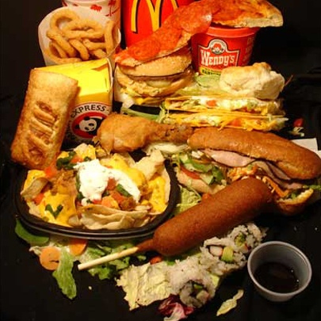
The American Diet
Ryan N., Kara L., Nikki W., Madison H., Kyle S., Alex C., Susan J., Jesse S.
Wednesday, April 29 2009

Slide 2
The Problem : Who
American society (us)
Slaves to convenience
Bureaucracy of the food industry.
“We live to eat, rather than eat to live.”

Slide 3
The Problem : What
Average American citizens are undereducated and unaware of basic nutritional needs & impacts
Heart disease will kill 1 in 3 Americans.
Obesity-related health problems cost us $117 BILLION annually in health-related costs.

Slide 4
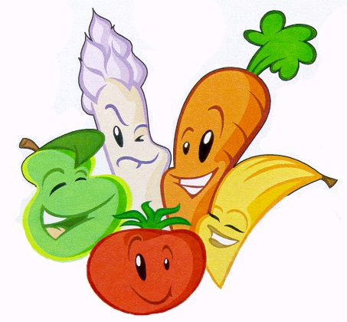
The Problem : When
The increased size of average Americans between 1950 and today has been directly linked to dietary causes.
Teaching nutrition at an early age
“Taste preference for fat is learned in early childhood”

Slide 5
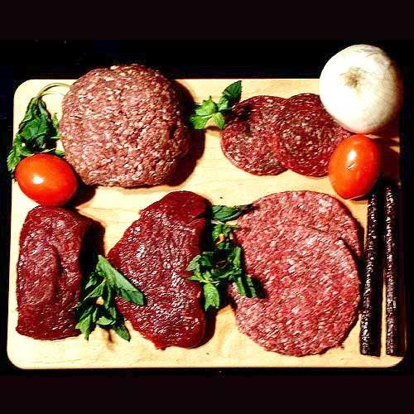
The Problem : Where
We consume %70 more protein than we need to function, and eat 50% more meat than other developed nations (such as France, Japan)

Slide 6
The Problem : Why
PROFITS!
Economic reasons
Cheaper foods are less expensive, organic and dietarily balanced foods more expensive
Convenience > health problems
Harsh pace of American lives

Slide 7
Lies You’ve Been Fed
Hereditary heart disease/cancer: only %2-3 of cancer is hereditary, the rest is LIFESTYLE inflicted
“Milk: does the body good” – dairy is the second most unhealthy food group (after meat)
Artificial sugar (aspartame): chemical that bonds within your body the same way sugar does, will for a fact kill you
High-fructose corn syrup: genetically modified corn, chemical shit storm
Obesity is genetic: NO (attraction to fats/sugars is genetic, obesity is not)

Slide 8
Lies You’ve Been Fed: Protein
Carl Voit: man only needs 52.5 g of protein per day, but recommended 119 g because “you can’t have too much of a good thing.”
Necessity for grazing land for cattle is the primary cause of water pollution in the U.S, and the main reason for the current destruction of the rainforest.
*Protein: Americans mostly gain through meat consumption, although nuts, grains, vegetables and most non-animal product foods contain protein

Slide 9
Ideal State
Individuals consume less processed foods and more fresh produce, legumes, and whole grain products from local farmers
Fewer counts of diet-related health concerns and deaths
Less reliance on meat, dairy, processed foods & fast food industry by the public
Increased public awareness concerning nutrition and daily intakes

Slide 10
General Treatment Strategy
Part 1 of 3: implementation of nutrition program in elementary schools.
Require all public schools to have a certified nutritionist on staff to work with school nurses.
School nutritionist formulated meals requiring daily recommendations of fruits, vegetables etc.
Restrict sales of soda, candy etc. in schools.
Include mandatory nutrition courses in curriculum.
Require physical education within basic curriculum.

Slide 11
General Treatment Strategy
Part 2 of 3: changes in legislation
Government revision of subsidy programs for farmers to encourage small-scale organic farming.
Limit advertising of unhealthy food & beverage to children.
Reformulation of foods directly linked to obesity rates.
Zoning of produce & junk food placement within stores.
Zoning of fast food restaurants within cities.

Slide 12
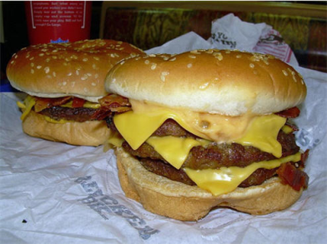
General Treatment Strategy
Part 3 of 3: create “sin tax” for foods high in sugar and fat, erase taxes on produce and organic products.
Increased taxes on high fat/sugar foods, resulting tax funds delegated towards farmer subsidies and school nutrition programs.
Lowered prices of produce bridge socioeconomic gap causing low-income individuals to lean towards cheap, unhealthy foods.
Imposing age restrictions on less healthful foods to children (such as done with alcohol/tobacco)

Slide 13
Support: Education
“The difference between the expected & actual fitness of students suggest that there may be a significant school effect.” – Procter
“It has been shown…that a school’s food policy to promote healthy eating can impact the nutrient intake of children.” – Procter
“Use of local produce in school meals provides a new direct market for farmers and mitigates environmental impacts of transporting food.” – Kalb, Farm to School treatment strategy

Slide 14
Support: Legislation
“Agricultural subsidies are heavily tilted towards large farms/producers (since subsidies are yield-based)” – CATO.org
Federal HeLP America Act: “restructuring health care systems towards prevention, wellness, and self care.”
“Studies find a tendency for lower levels of obesity in areas with more swimming pools and supermarkets.” – Stafford

Slide 15
Support: Sin Tax
“Increasing price of unhealthy food by %1 decreases the probability of being overweight by %2.3 and obese by %3.1” - Milijkovic
“Studies show that children with lower socio-economic status/from more deprived home environments have an increased risk of obesity.” – Procter
“Residual differences in BMI suggest characteristics of community facilitate in obesity, with a high concentration in the lower socieconomic stratosphere.” – O’Malley

Slide 16
Unintended Consequences
Part 1 (nutritional program in schools):
lack of public education funds
Tax increases for public = ☹
“No Food Left Behind”
Apathy in children/rebellion
Unexpected cuts in other areas of academics

Slide 17
Unintended consequences
Part 2 (change in legislation):
Possibility of immediate economic backlash
Reinvigoration of farm lands: grace period req.
Possibility of food prices increasing during grace period
Natural disasters, climate changes = food shortages
Outcry from large farm corporations

Slide 18
Unintended Consequences
Part 3 (sin tax, relieved taxes on organic & produce)
Loss of jobs through fast food, factory industries
Loss of revenue from advertising
Individuals addicted to food additives
Anger from public

Slide 19
Success and Failure
Success: decrease in health-related problems over a ten-year span, increased in sales for produce/sin food ratio
Failure: no change in rates of health-related problems or ratio of produce/sin food sales, or declines in either

Slide 20
Sources
1) Dr. Schmidt, MSUM professor
2) Patrick Stieg, Dakota County Public Health
3) Skinny Bitch, book by Rory Freedman
4) “King Corn,” documentary film
5) “Super Size Me,” documentary film
6) “Farm to School,” treatment strategy by Marion Kalb

Slide 21
Peer-Reviewed Sources
Dragan Milijkovic: “Economic factors affecting the increase in obesity in the United States: Differential response to price” (2007)
Myles Faith: “Toward the Reduction of Population Obesity: Macrolevel Enviromental Approaches to the Problems of Food, Eating and Obesity.” (2007)
Kimberly Procter: “Measuring the school impact on child obesity” (2008)
Judity Goldfinger: “Project HEAL: Peer education leads to weight loss in Harlem.” (2008)

Slide 22
Peer-Reviewed Sources
Mai Stafford: “Identifying local, modifiable determinants of physical activity and diet” (2007)
Patrick O’Malley: “Variation in Obesity Among American Secondary School Students by School and School Characteristics.” (2007)

